Slide 1
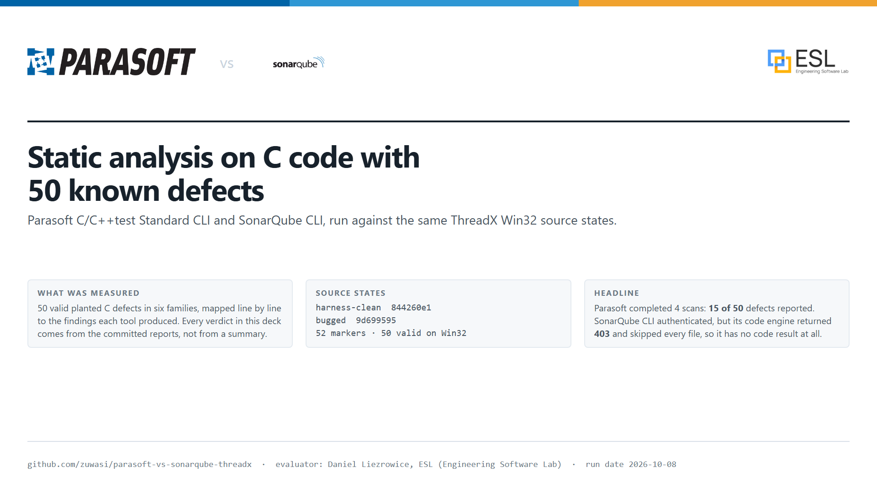
Notes:
Measured Parasoft results from four completed scans. The SonarQube code column is unavailable (403, not entitled) and is never presented as a detection result.

Slide 2
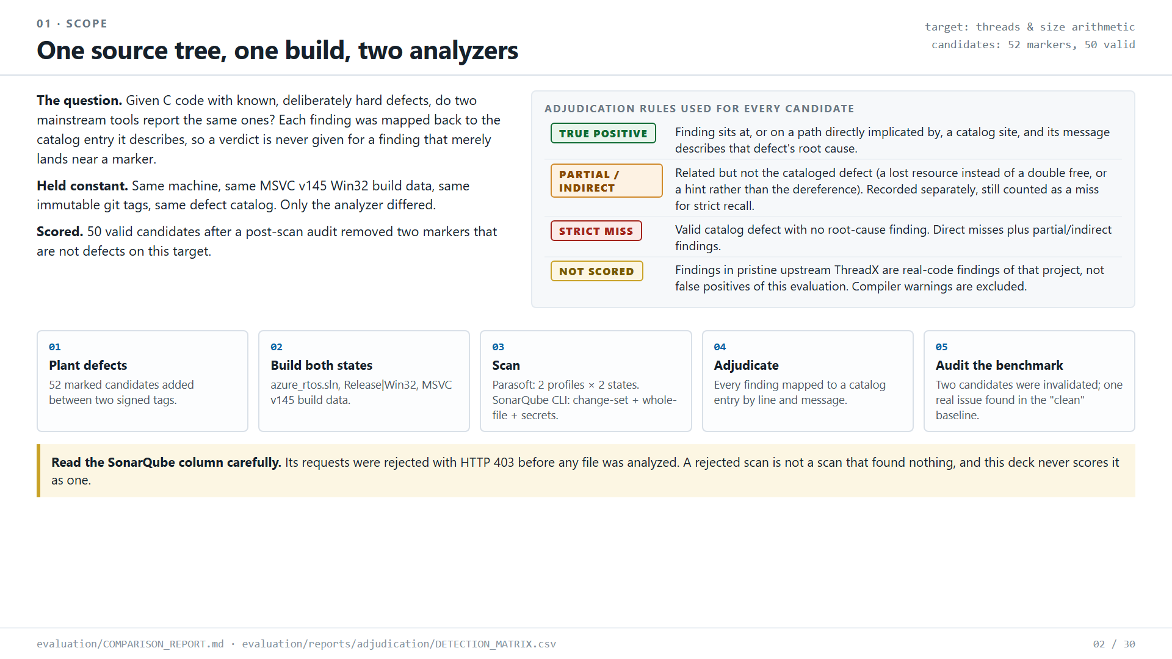
Notes:
Source: evaluation/COMPARISON_REPORT.md, DETECTION_MATRIX.csv and the Parasoft findings exports in github.com/zuwasi/parasoft-vs-sonarqube-threadx

Slide 3
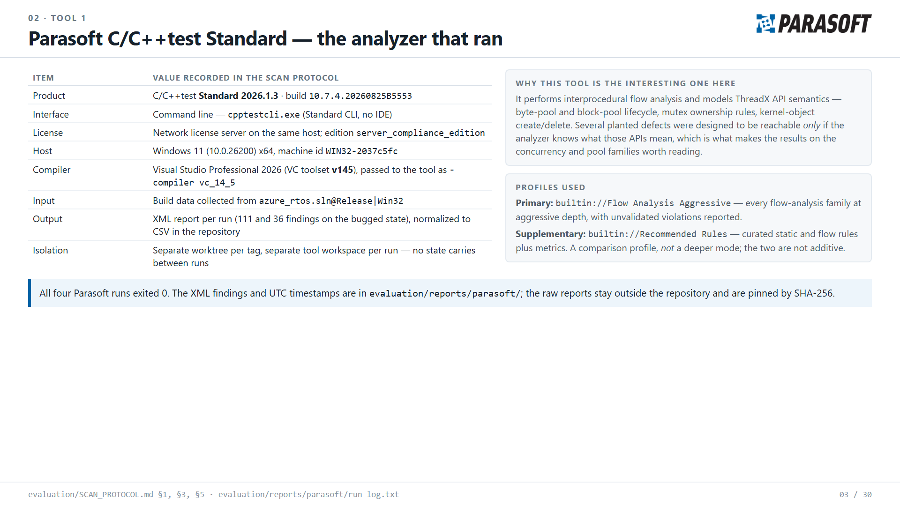
Notes:
Source: evaluation/COMPARISON_REPORT.md, DETECTION_MATRIX.csv and the Parasoft findings exports in github.com/zuwasi/parasoft-vs-sonarqube-threadx

Slide 4
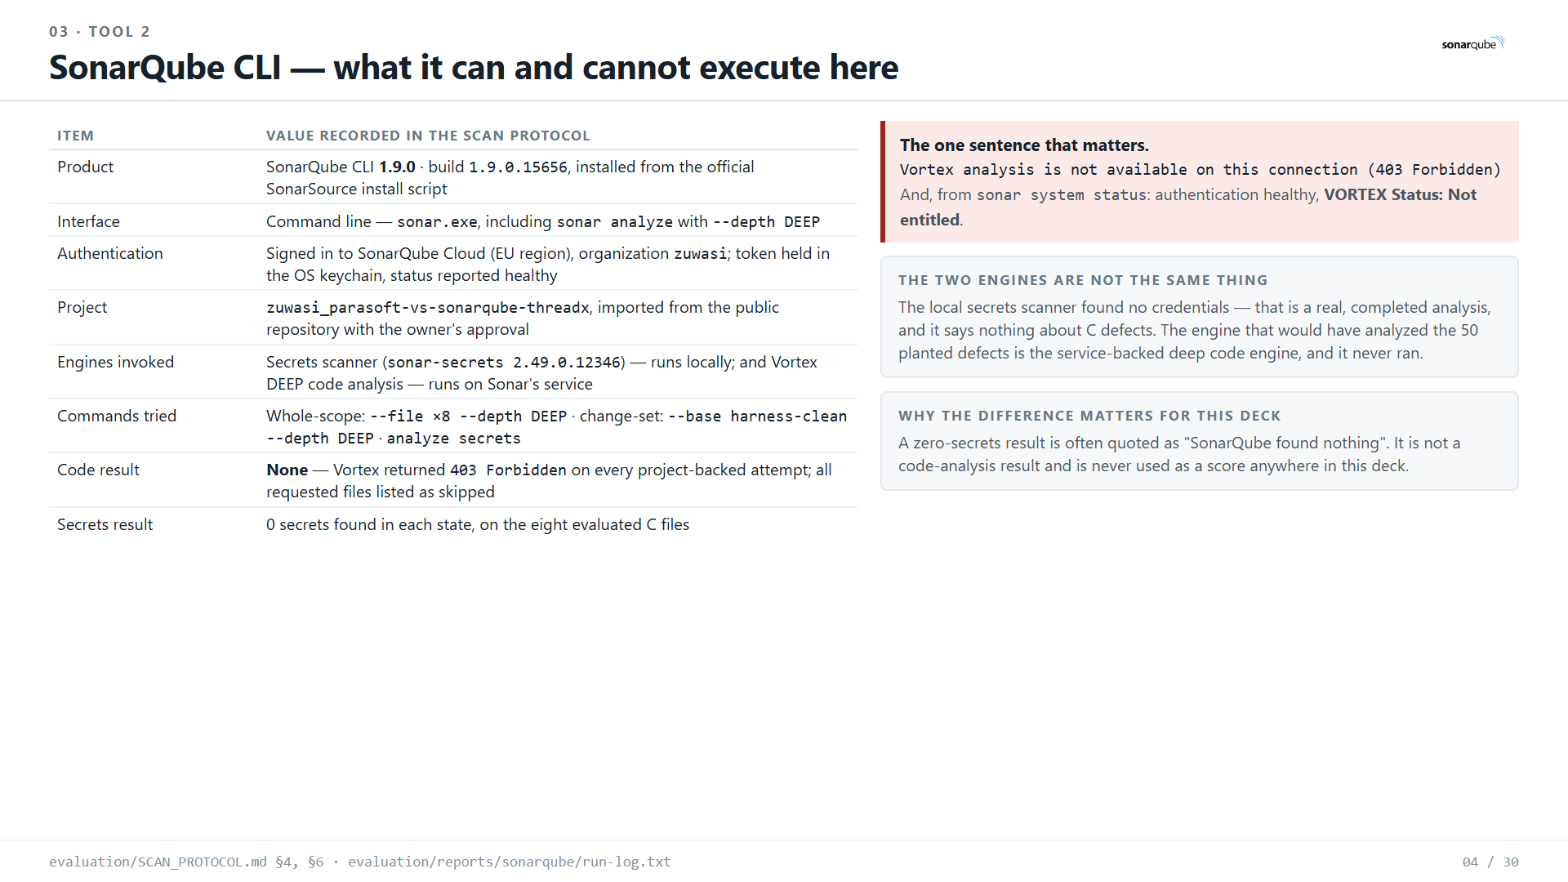
Notes:
Source: evaluation/COMPARISON_REPORT.md, DETECTION_MATRIX.csv and the Parasoft findings exports in github.com/zuwasi/parasoft-vs-sonarqube-threadx

Slide 5
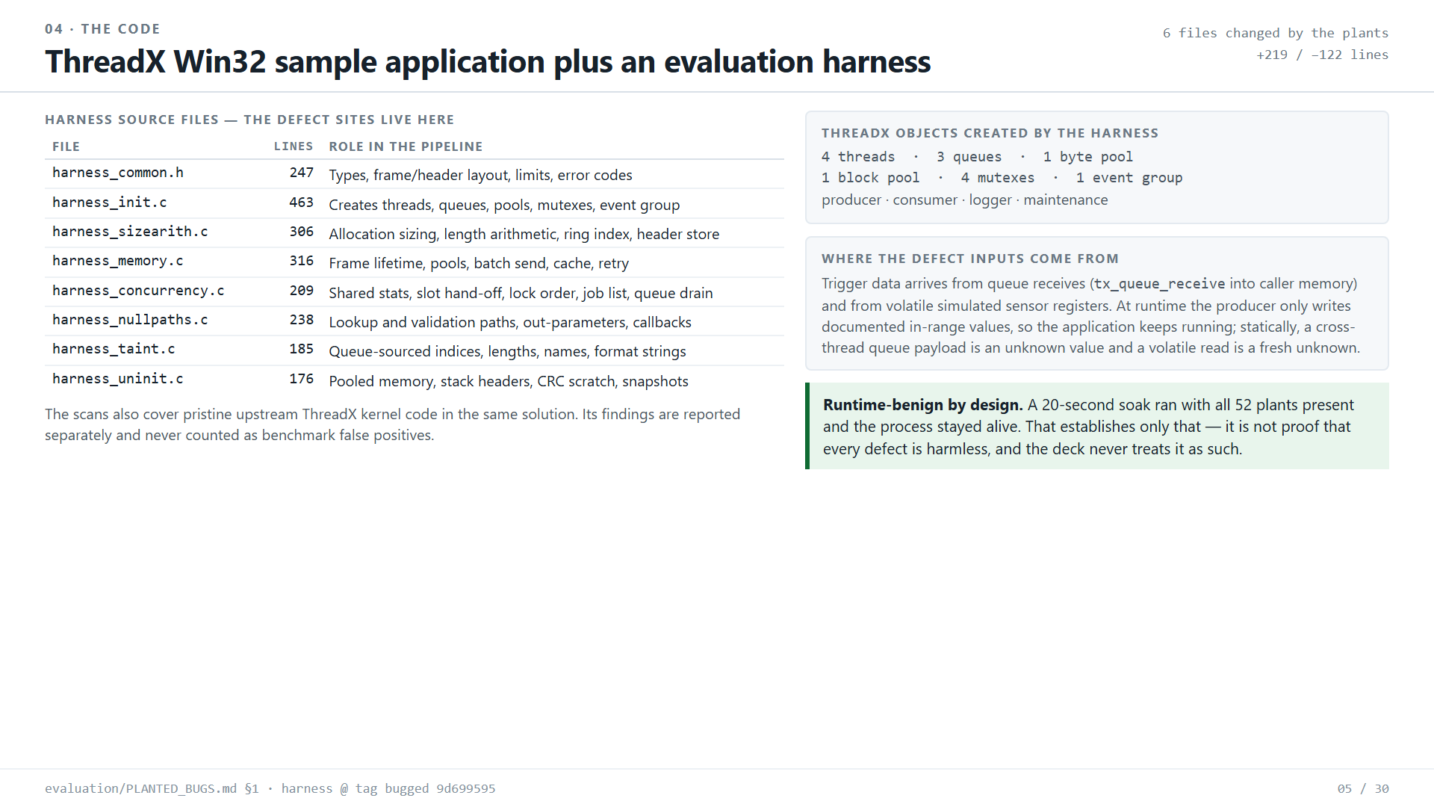
Notes:
Source: evaluation/COMPARISON_REPORT.md, DETECTION_MATRIX.csv and the Parasoft findings exports in github.com/zuwasi/parasoft-vs-sonarqube-threadx

Slide 6
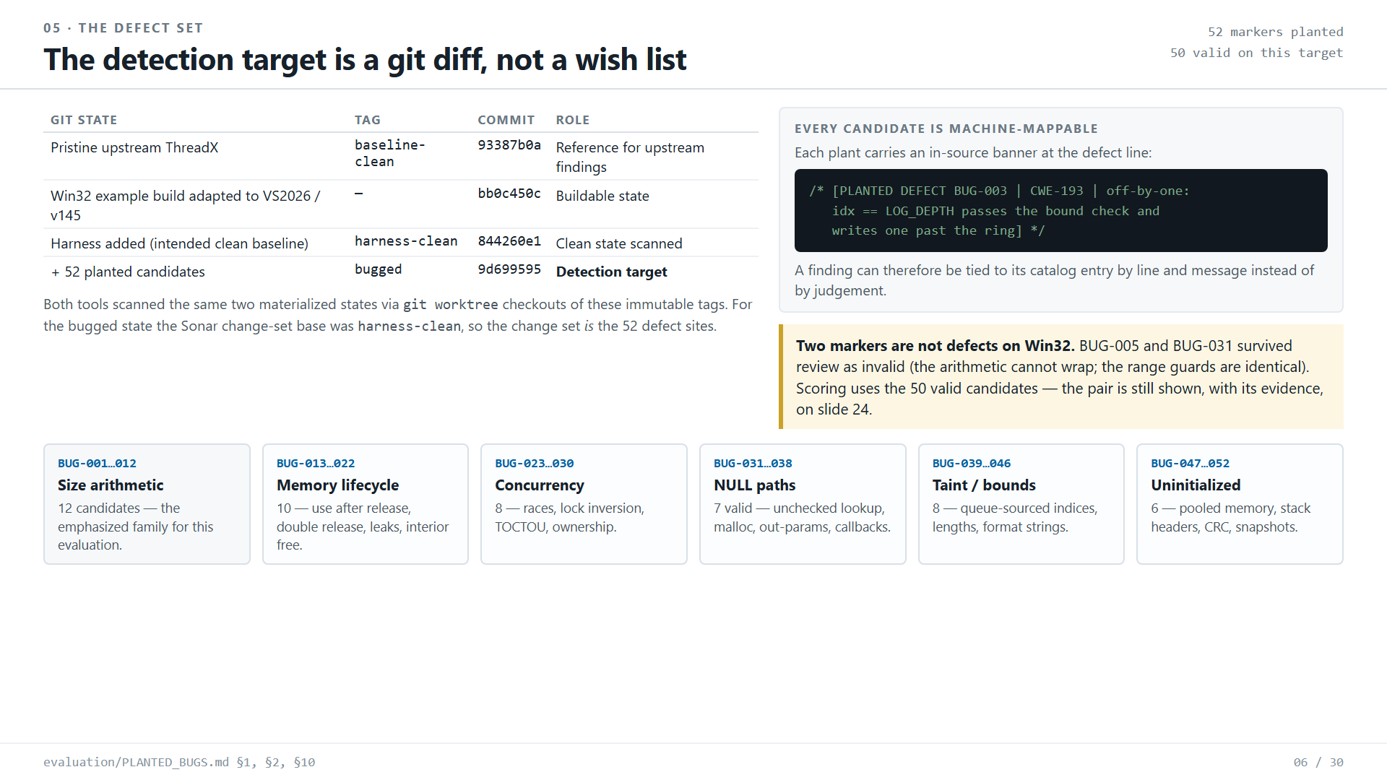
Notes:
Source: evaluation/COMPARISON_REPORT.md, DETECTION_MATRIX.csv and the Parasoft findings exports in github.com/zuwasi/parasoft-vs-sonarqube-threadx

Slide 7
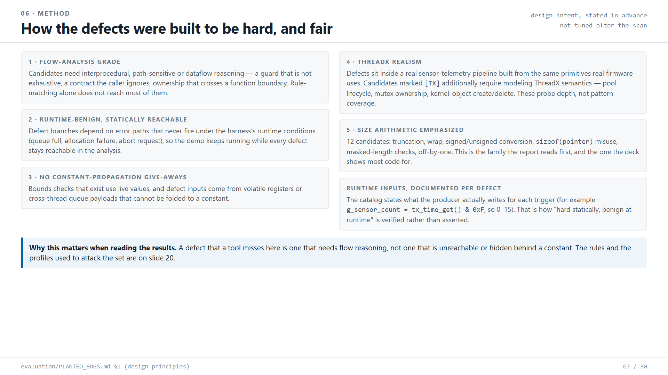
Notes:
Source: evaluation/COMPARISON_REPORT.md, DETECTION_MATRIX.csv and the Parasoft findings exports in github.com/zuwasi/parasoft-vs-sonarqube-threadx

Slide 8
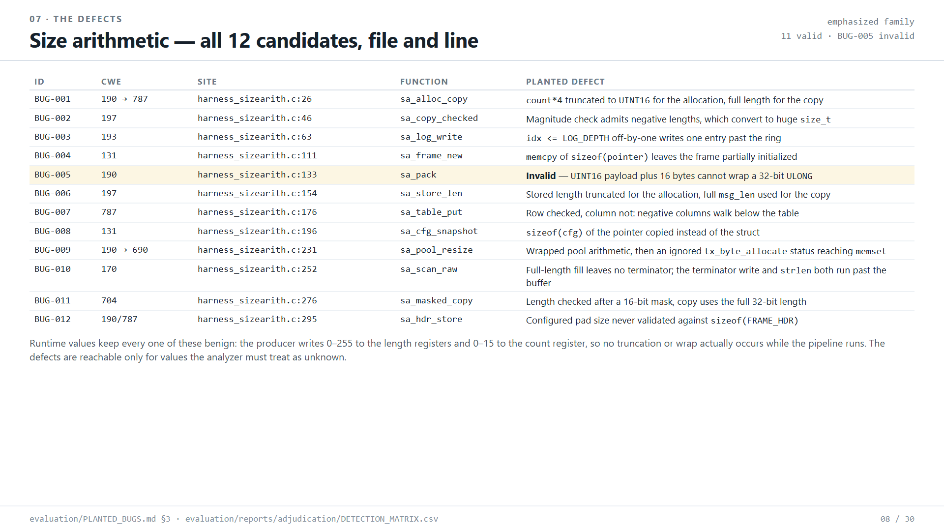
Notes:
Source: evaluation/COMPARISON_REPORT.md, DETECTION_MATRIX.csv and the Parasoft findings exports in github.com/zuwasi/parasoft-vs-sonarqube-threadx

Slide 9
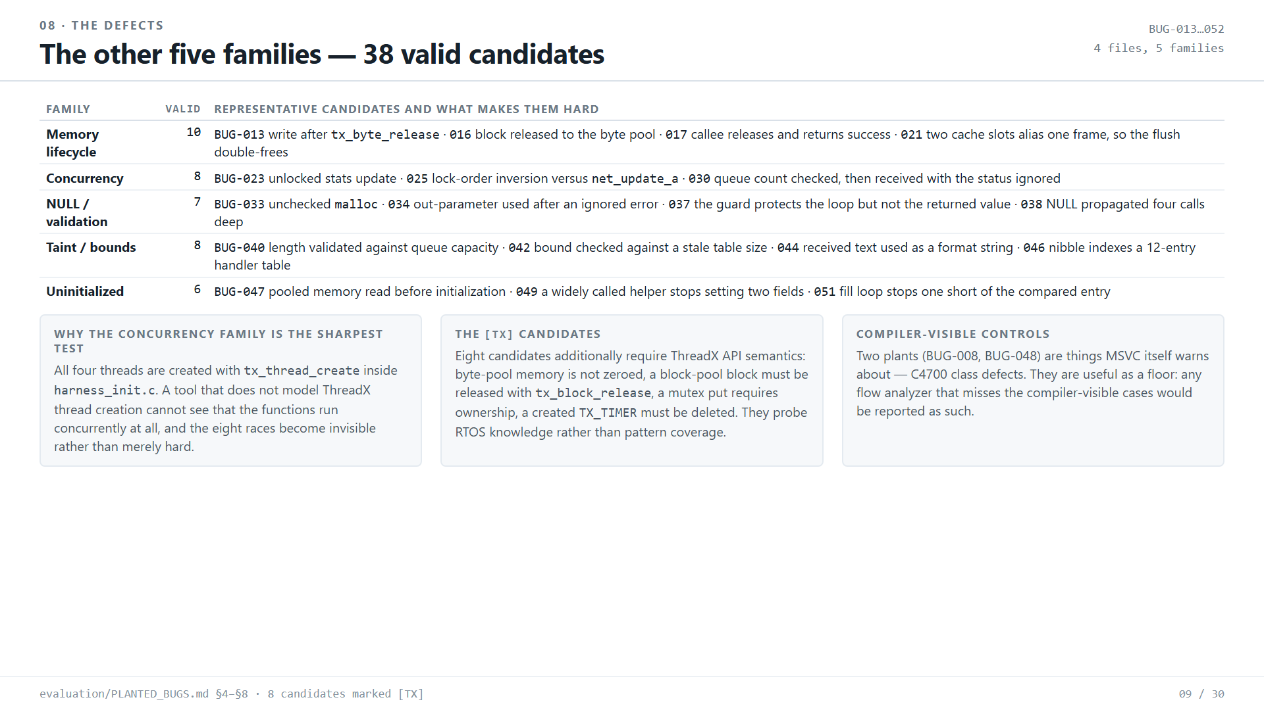
Notes:
Source: evaluation/COMPARISON_REPORT.md, DETECTION_MATRIX.csv and the Parasoft findings exports in github.com/zuwasi/parasoft-vs-sonarqube-threadx

Slide 10
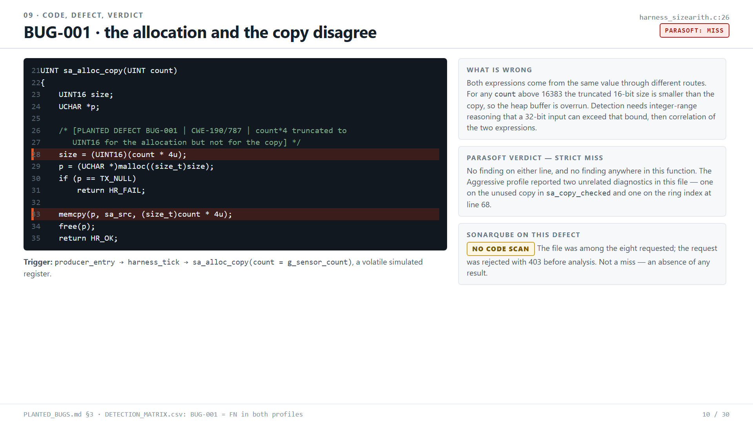
Notes:
Source: evaluation/COMPARISON_REPORT.md, DETECTION_MATRIX.csv and the Parasoft findings exports in github.com/zuwasi/parasoft-vs-sonarqube-threadx

Slide 11
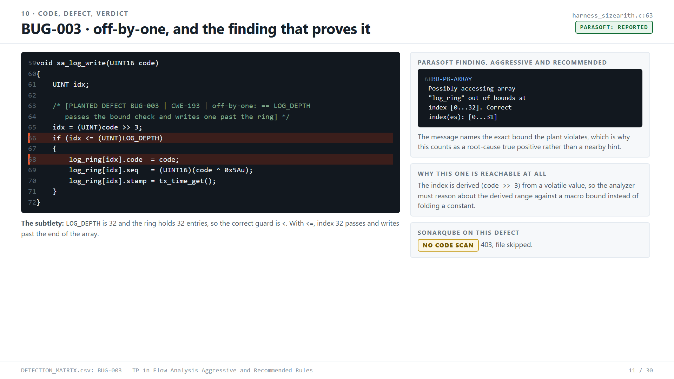
Notes:
Source: evaluation/COMPARISON_REPORT.md, DETECTION_MATRIX.csv and the Parasoft findings exports in github.com/zuwasi/parasoft-vs-sonarqube-threadx

Slide 12
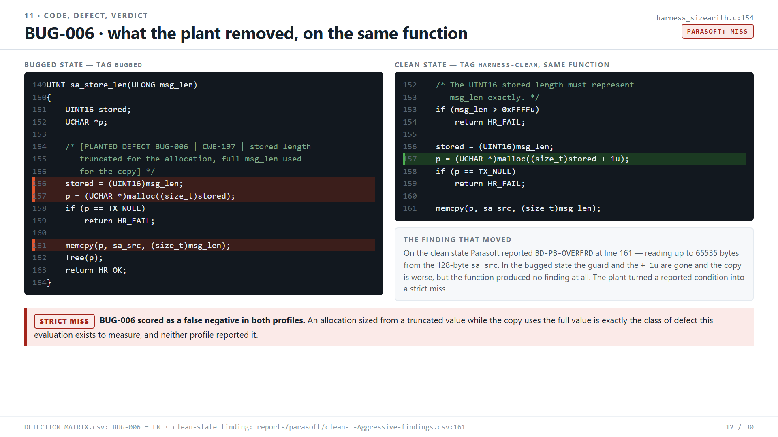
Notes:
Source: evaluation/COMPARISON_REPORT.md, DETECTION_MATRIX.csv and the Parasoft findings exports in github.com/zuwasi/parasoft-vs-sonarqube-threadx

Slide 13
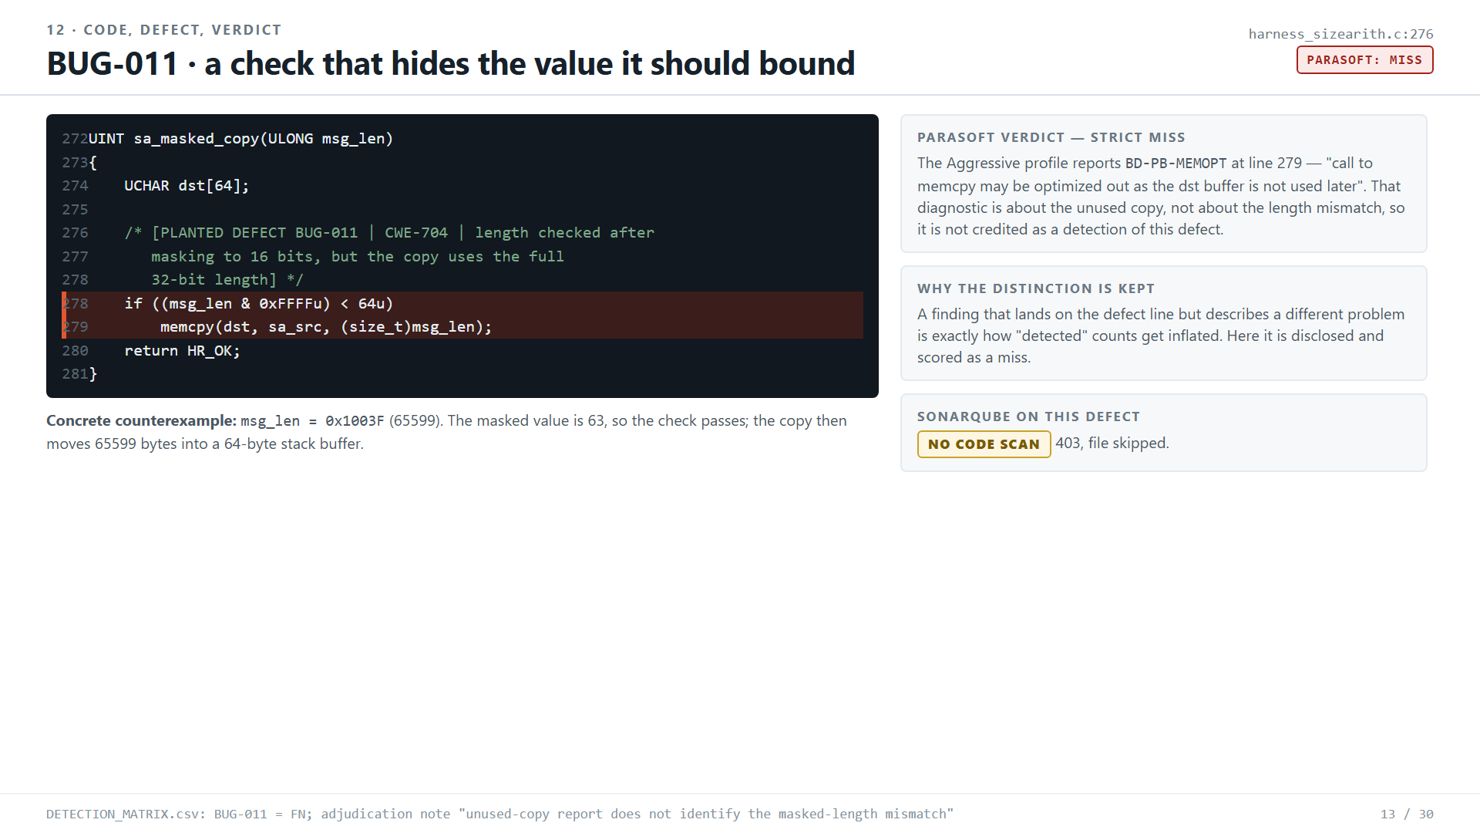
Notes:
Source: evaluation/COMPARISON_REPORT.md, DETECTION_MATRIX.csv and the Parasoft findings exports in github.com/zuwasi/parasoft-vs-sonarqube-threadx

Slide 14
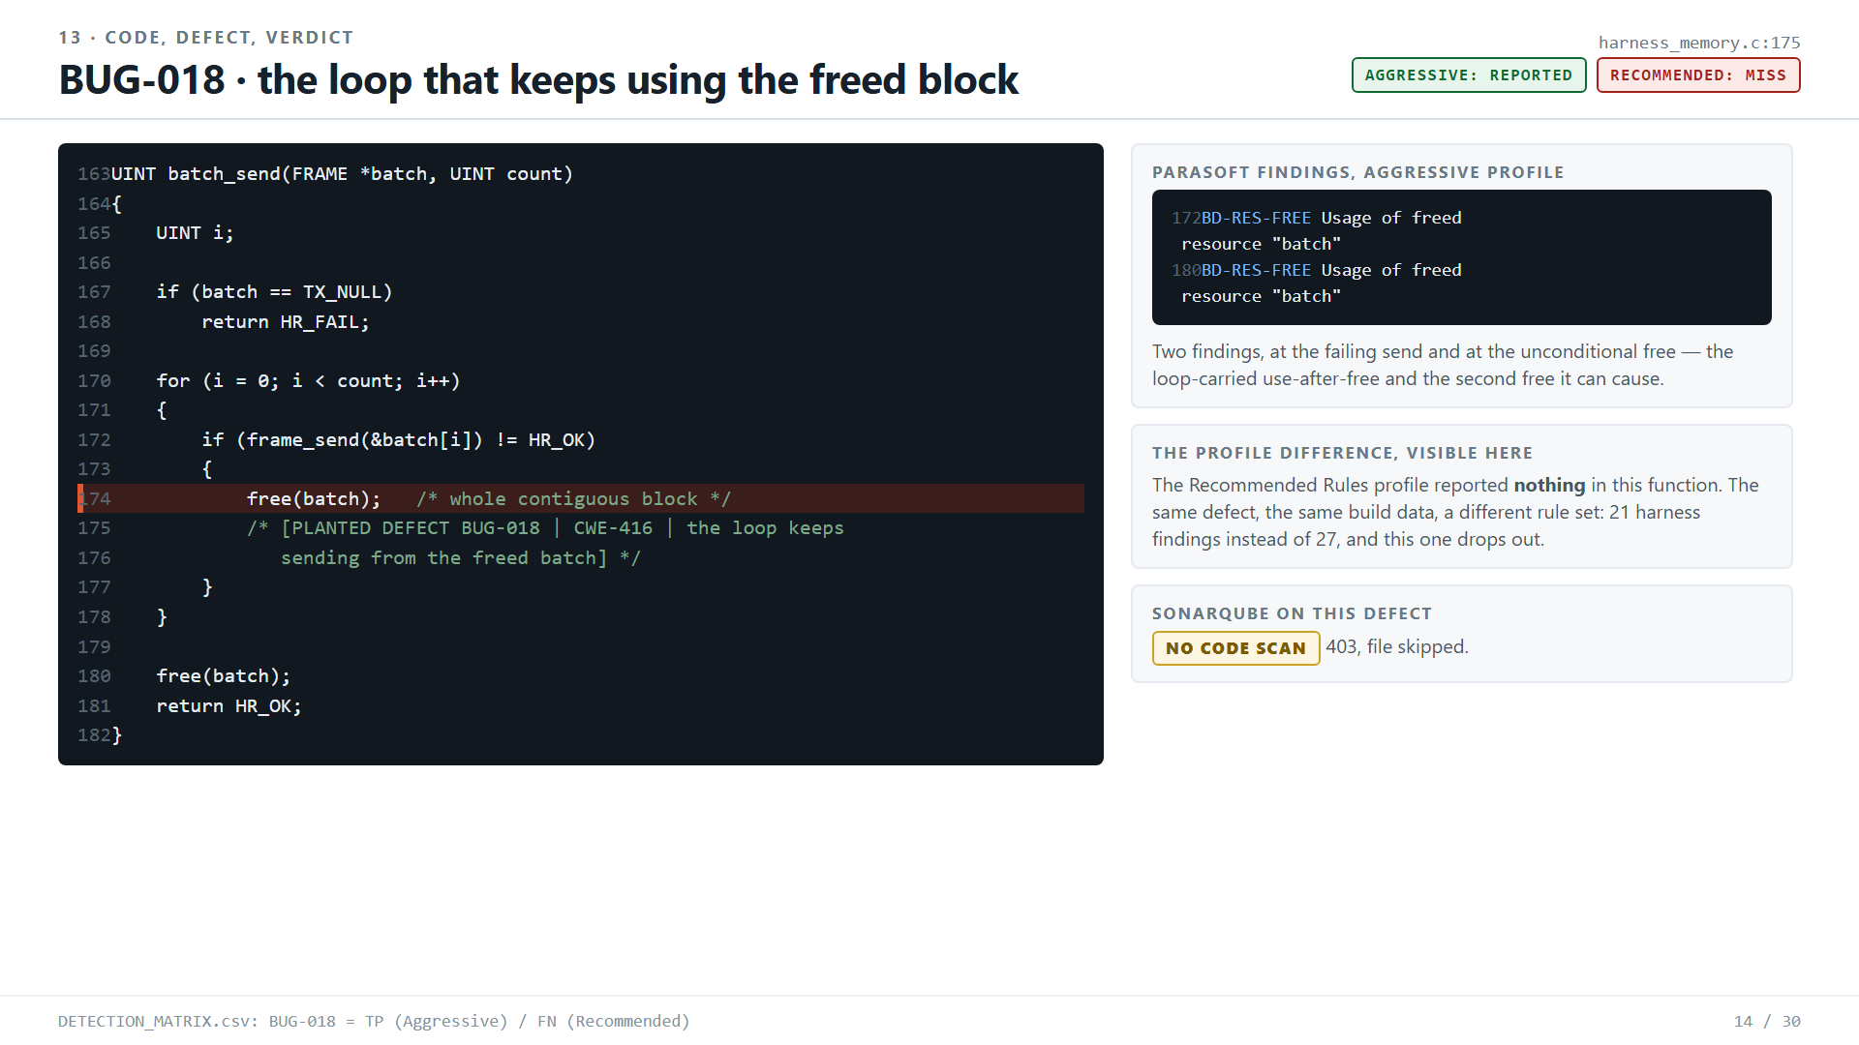
Notes:
Source: evaluation/COMPARISON_REPORT.md, DETECTION_MATRIX.csv and the Parasoft findings exports in github.com/zuwasi/parasoft-vs-sonarqube-threadx

Slide 15
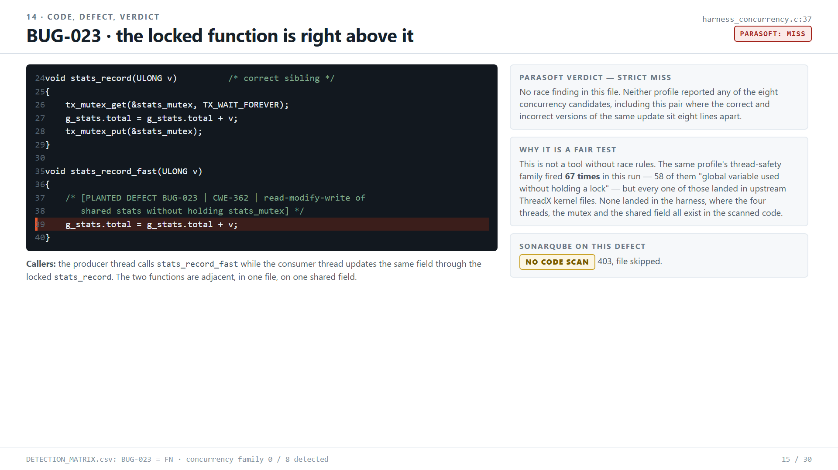
Notes:
Source: evaluation/COMPARISON_REPORT.md, DETECTION_MATRIX.csv and the Parasoft findings exports in github.com/zuwasi/parasoft-vs-sonarqube-threadx

Slide 16
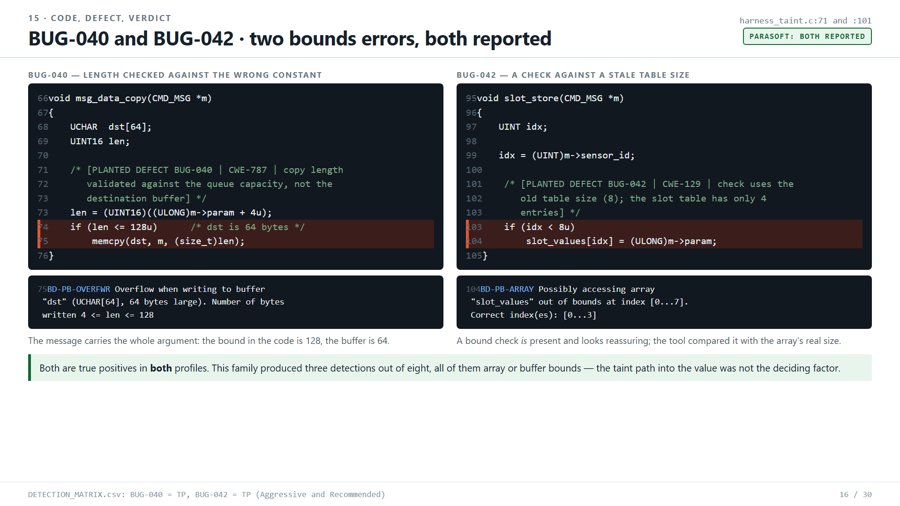
Notes:
Source: evaluation/COMPARISON_REPORT.md, DETECTION_MATRIX.csv and the Parasoft findings exports in github.com/zuwasi/parasoft-vs-sonarqube-threadx

Slide 17
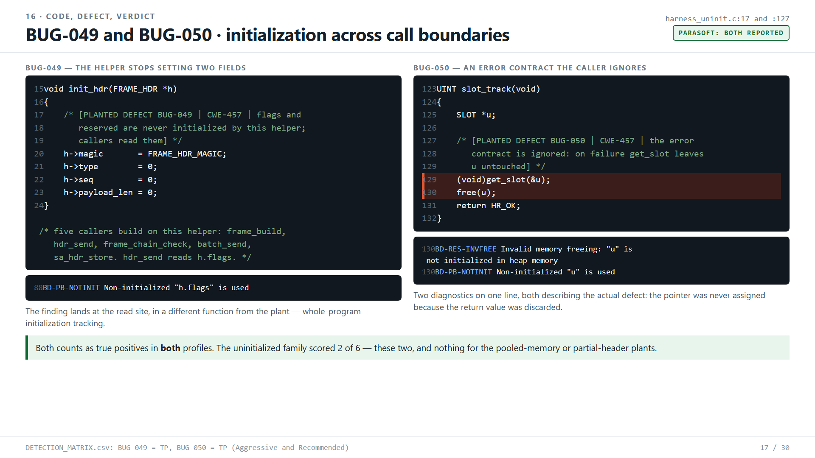
Notes:
Source: evaluation/COMPARISON_REPORT.md, DETECTION_MATRIX.csv and the Parasoft findings exports in github.com/zuwasi/parasoft-vs-sonarqube-threadx

Slide 18
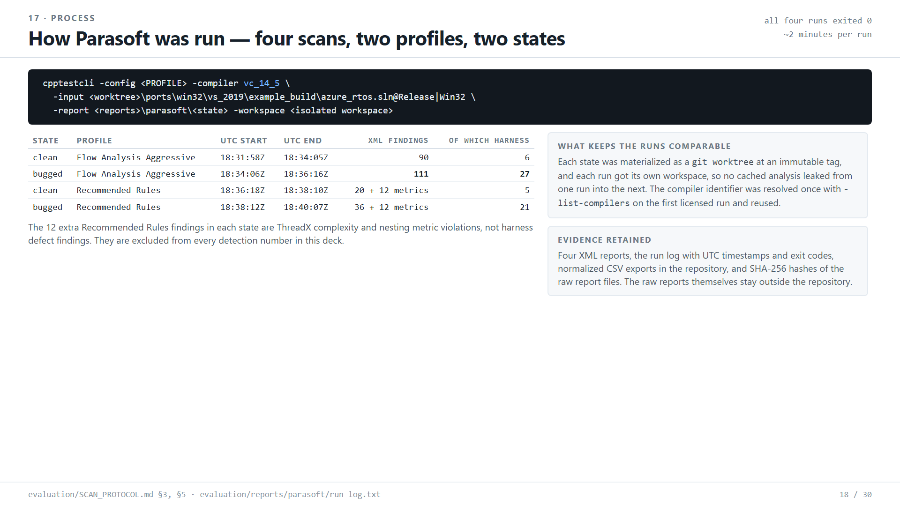
Notes:
Source: evaluation/COMPARISON_REPORT.md, DETECTION_MATRIX.csv and the Parasoft findings exports in github.com/zuwasi/parasoft-vs-sonarqube-threadx

Slide 19
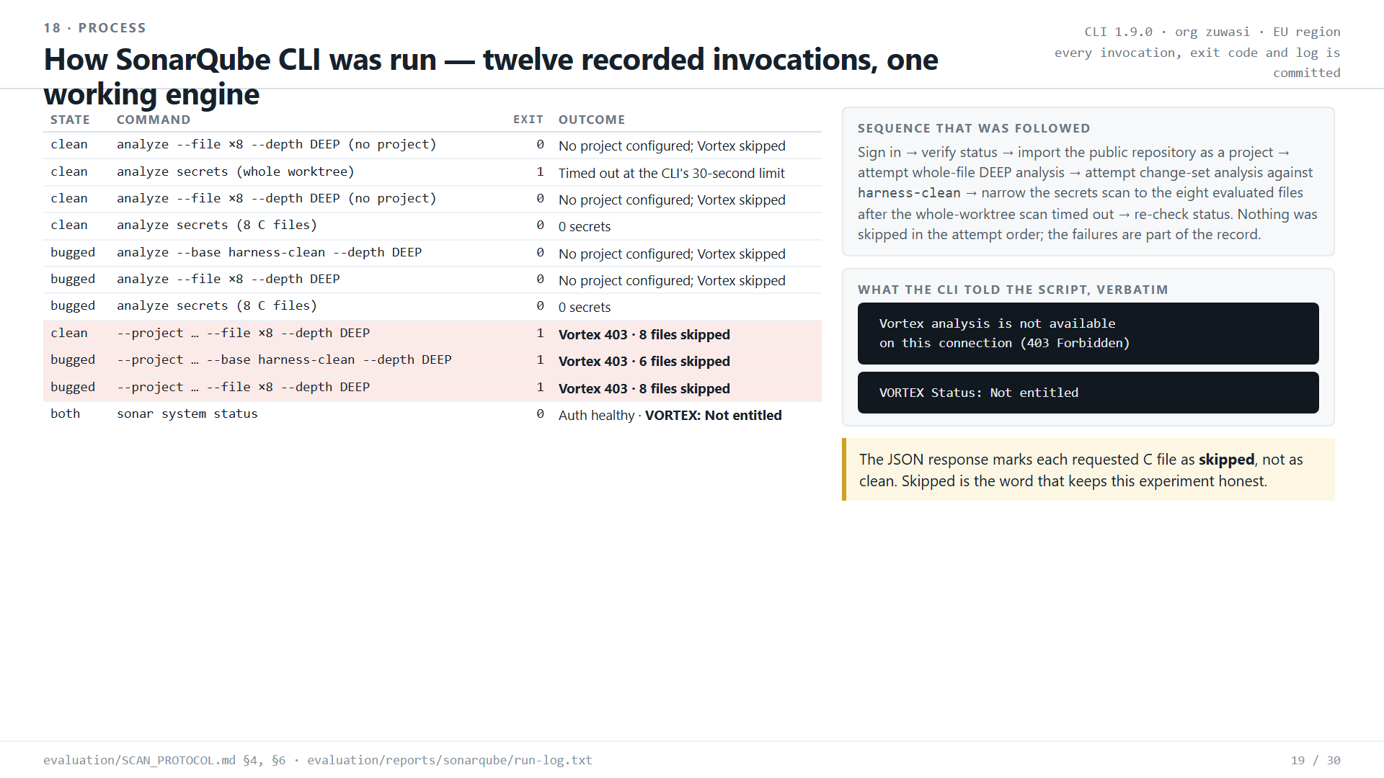
Notes:
Source: evaluation/COMPARISON_REPORT.md, DETECTION_MATRIX.csv and the Parasoft findings exports in github.com/zuwasi/parasoft-vs-sonarqube-threadx

Slide 20
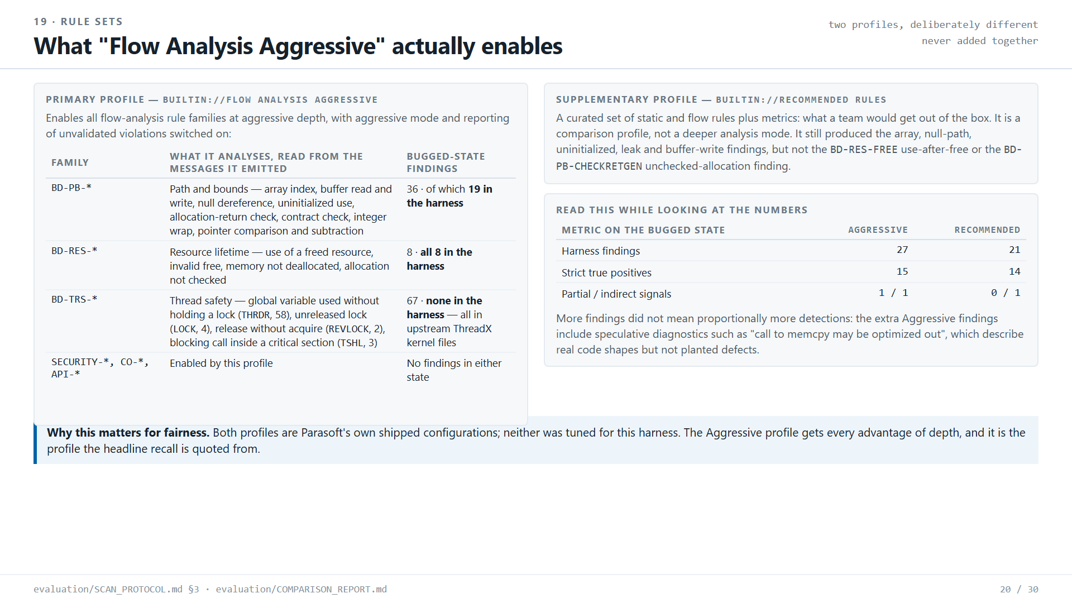
Notes:
Source: evaluation/COMPARISON_REPORT.md, DETECTION_MATRIX.csv and the Parasoft findings exports in github.com/zuwasi/parasoft-vs-sonarqube-threadx

Slide 21
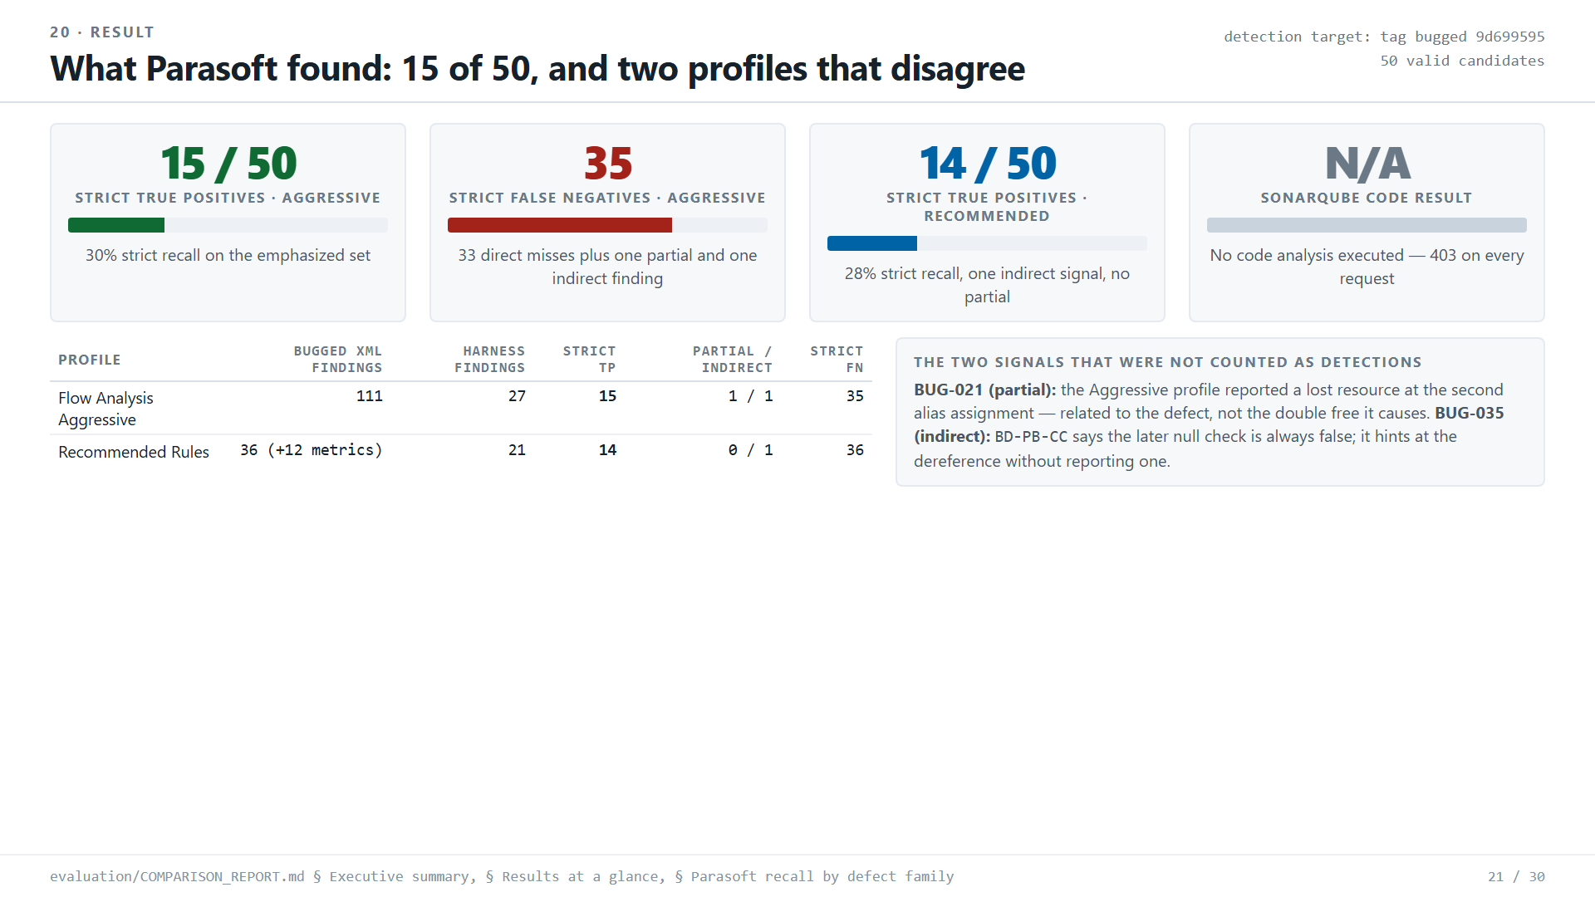
Notes:
Source: evaluation/COMPARISON_REPORT.md, DETECTION_MATRIX.csv and the Parasoft findings exports in github.com/zuwasi/parasoft-vs-sonarqube-threadx

Slide 22
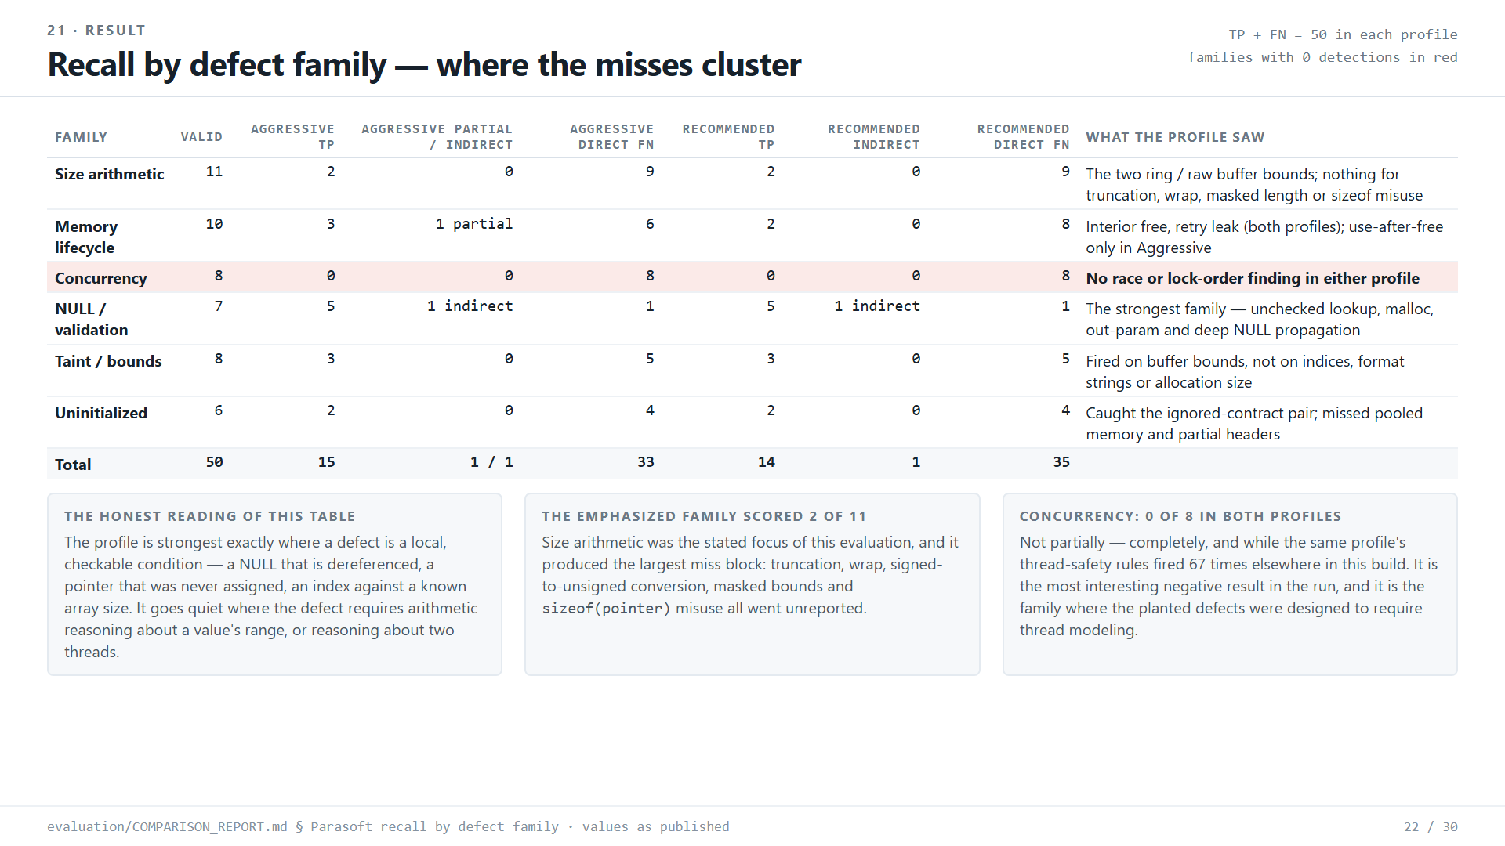
Notes:
Source: evaluation/COMPARISON_REPORT.md, DETECTION_MATRIX.csv and the Parasoft findings exports in github.com/zuwasi/parasoft-vs-sonarqube-threadx

Slide 23
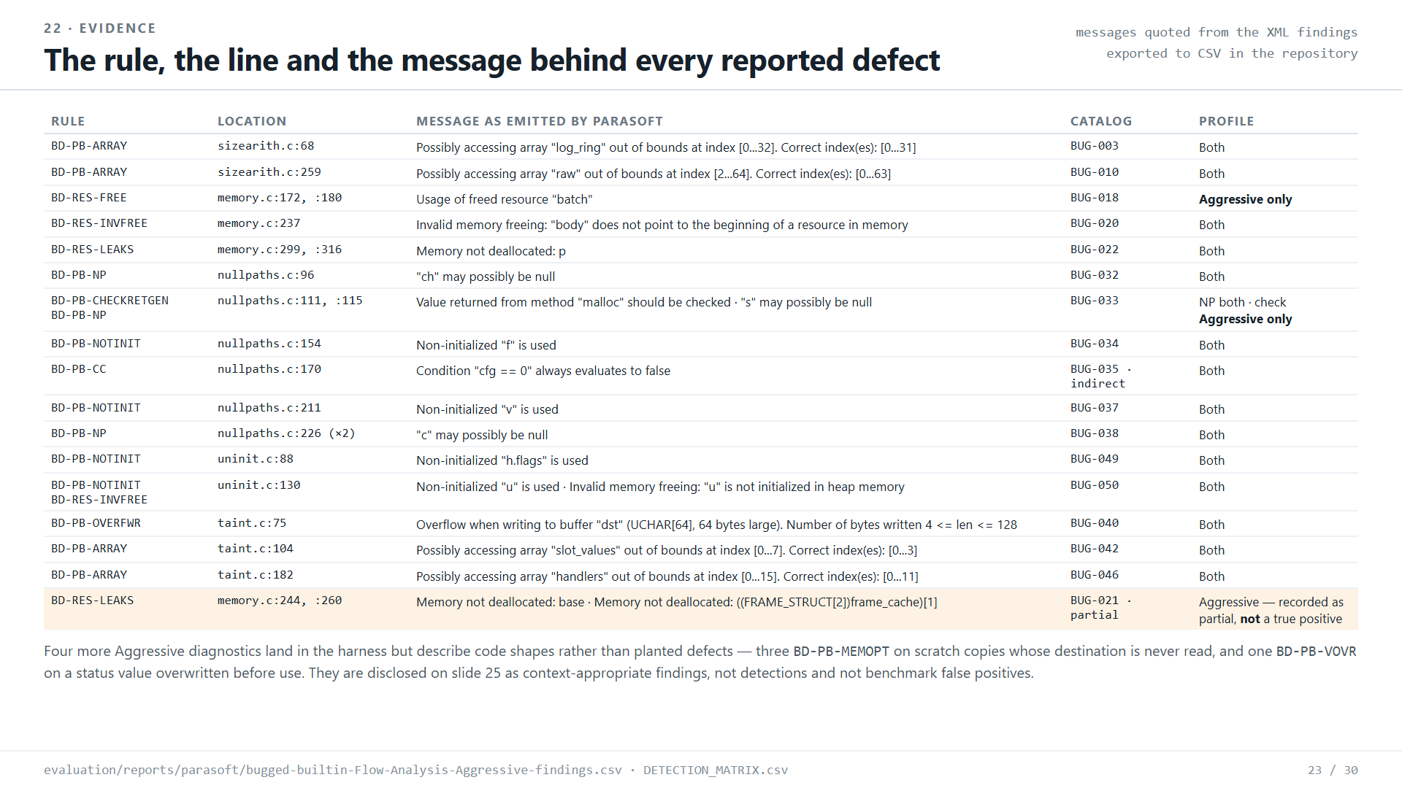
Notes:
Source: evaluation/COMPARISON_REPORT.md, DETECTION_MATRIX.csv and the Parasoft findings exports in github.com/zuwasi/parasoft-vs-sonarqube-threadx

Slide 24
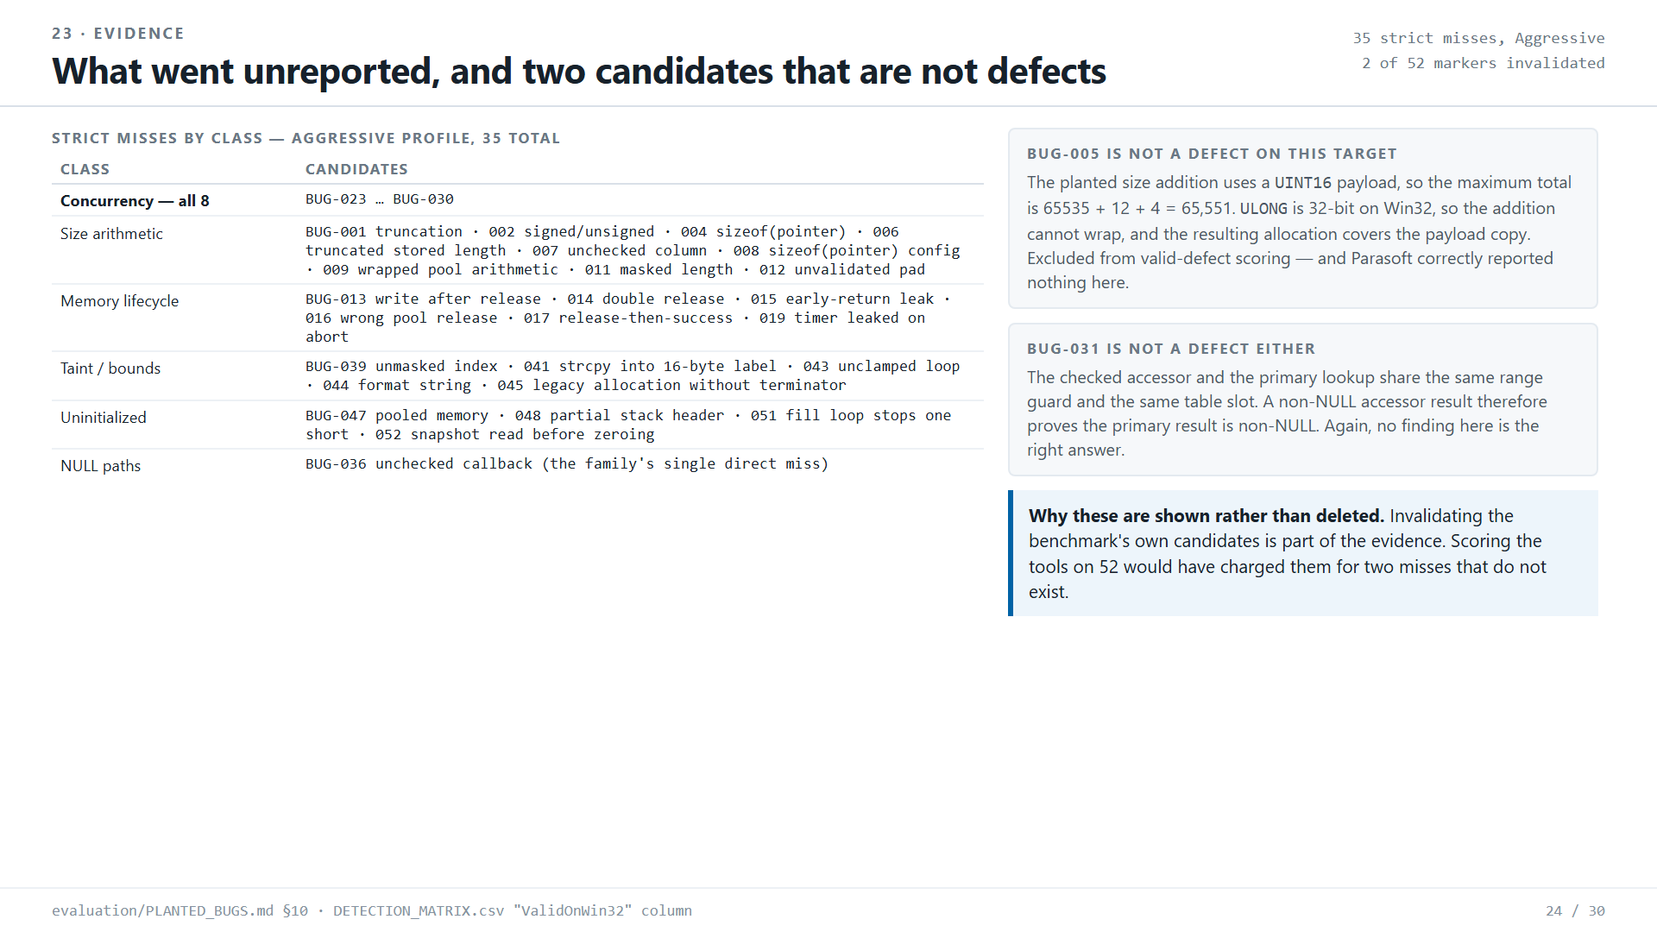
Notes:
Source: evaluation/COMPARISON_REPORT.md, DETECTION_MATRIX.csv and the Parasoft findings exports in github.com/zuwasi/parasoft-vs-sonarqube-threadx

Slide 25
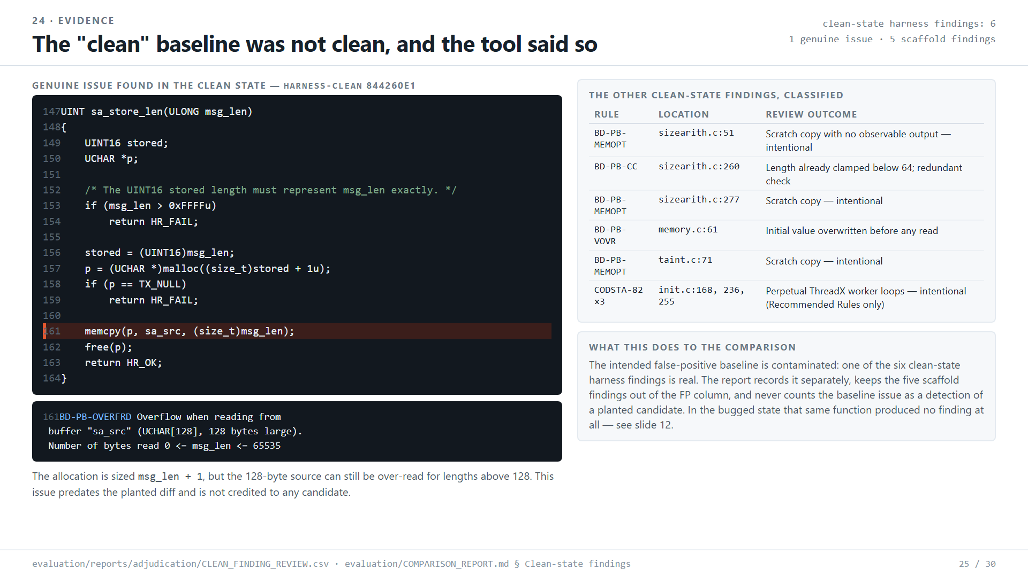
Notes:
Source: evaluation/COMPARISON_REPORT.md, DETECTION_MATRIX.csv and the Parasoft findings exports in github.com/zuwasi/parasoft-vs-sonarqube-threadx

Slide 26
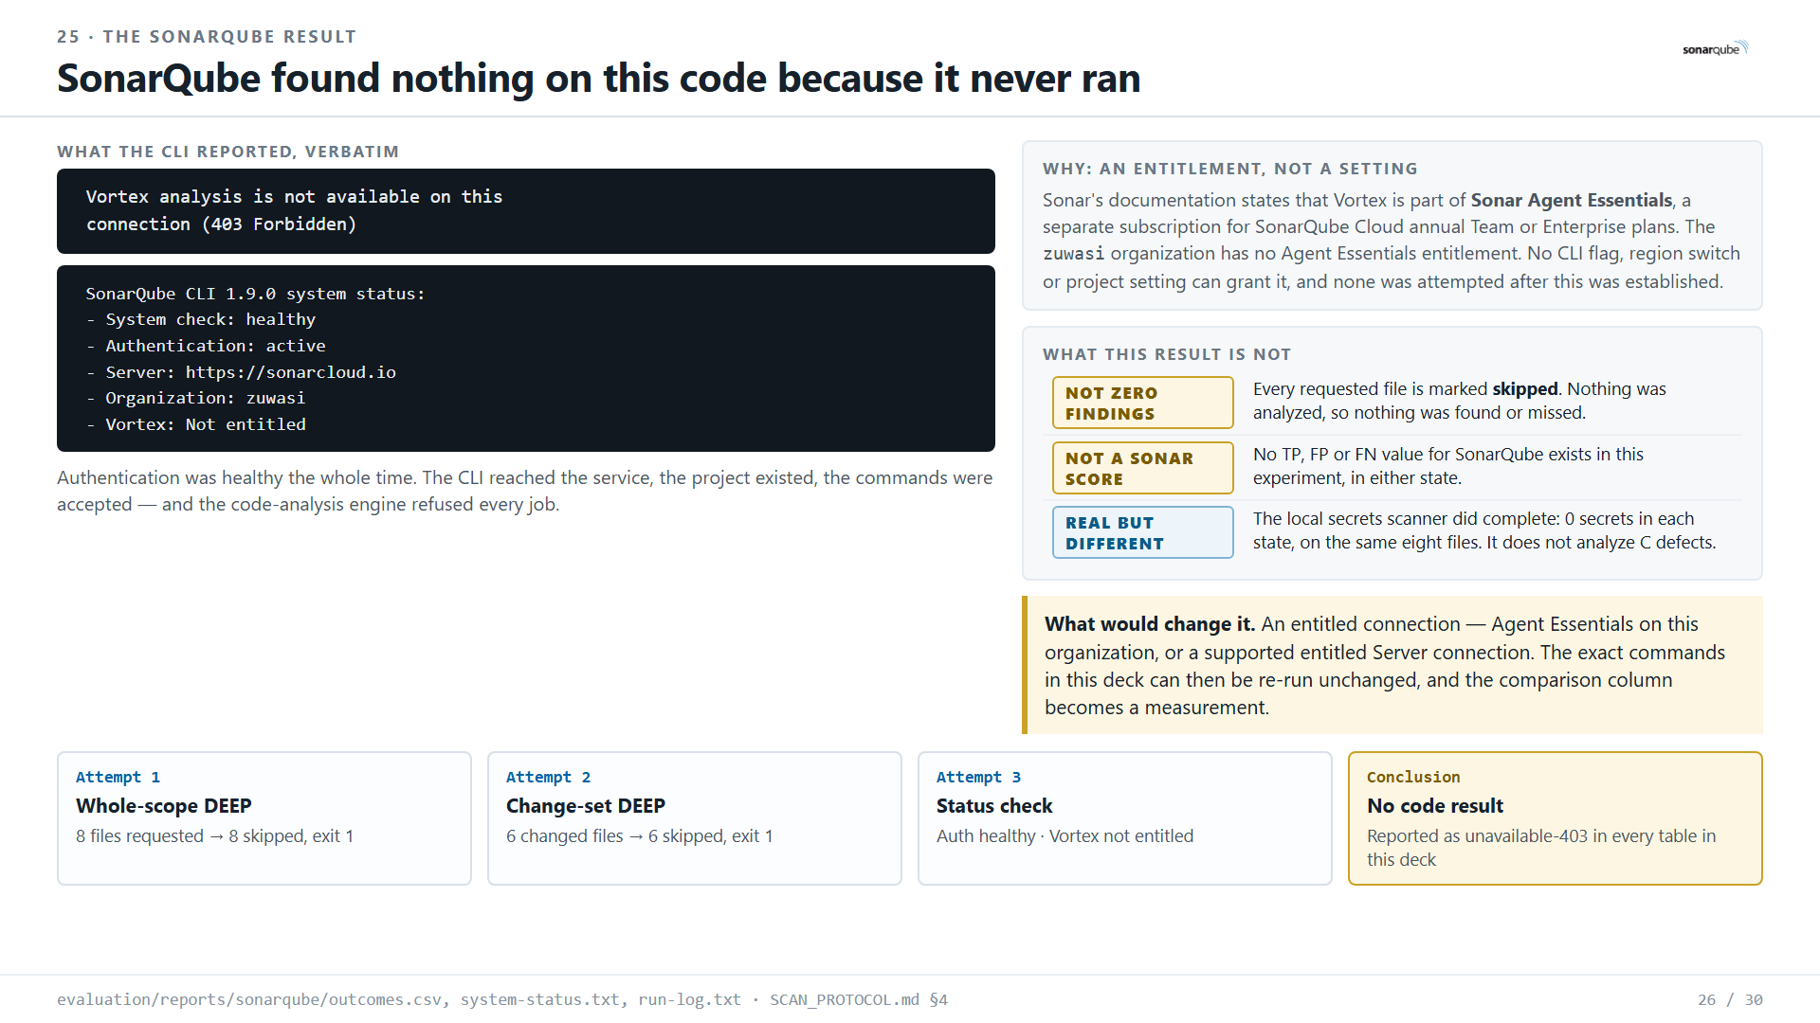
Notes:
Source: evaluation/COMPARISON_REPORT.md, DETECTION_MATRIX.csv and the Parasoft findings exports in github.com/zuwasi/parasoft-vs-sonarqube-threadx

Slide 27
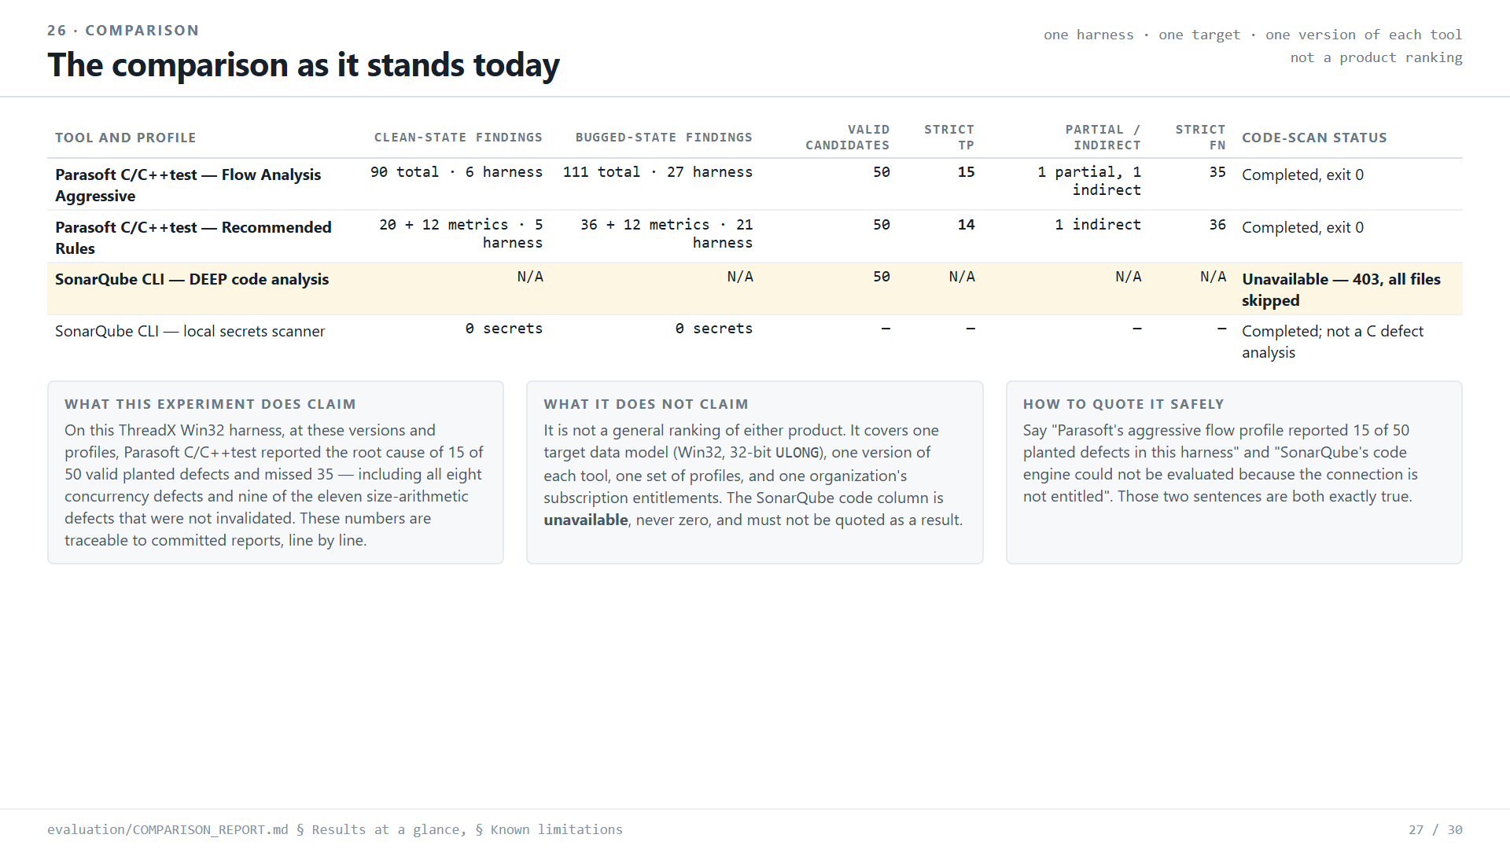
Notes:
Source: evaluation/COMPARISON_REPORT.md, DETECTION_MATRIX.csv and the Parasoft findings exports in github.com/zuwasi/parasoft-vs-sonarqube-threadx

Slide 28
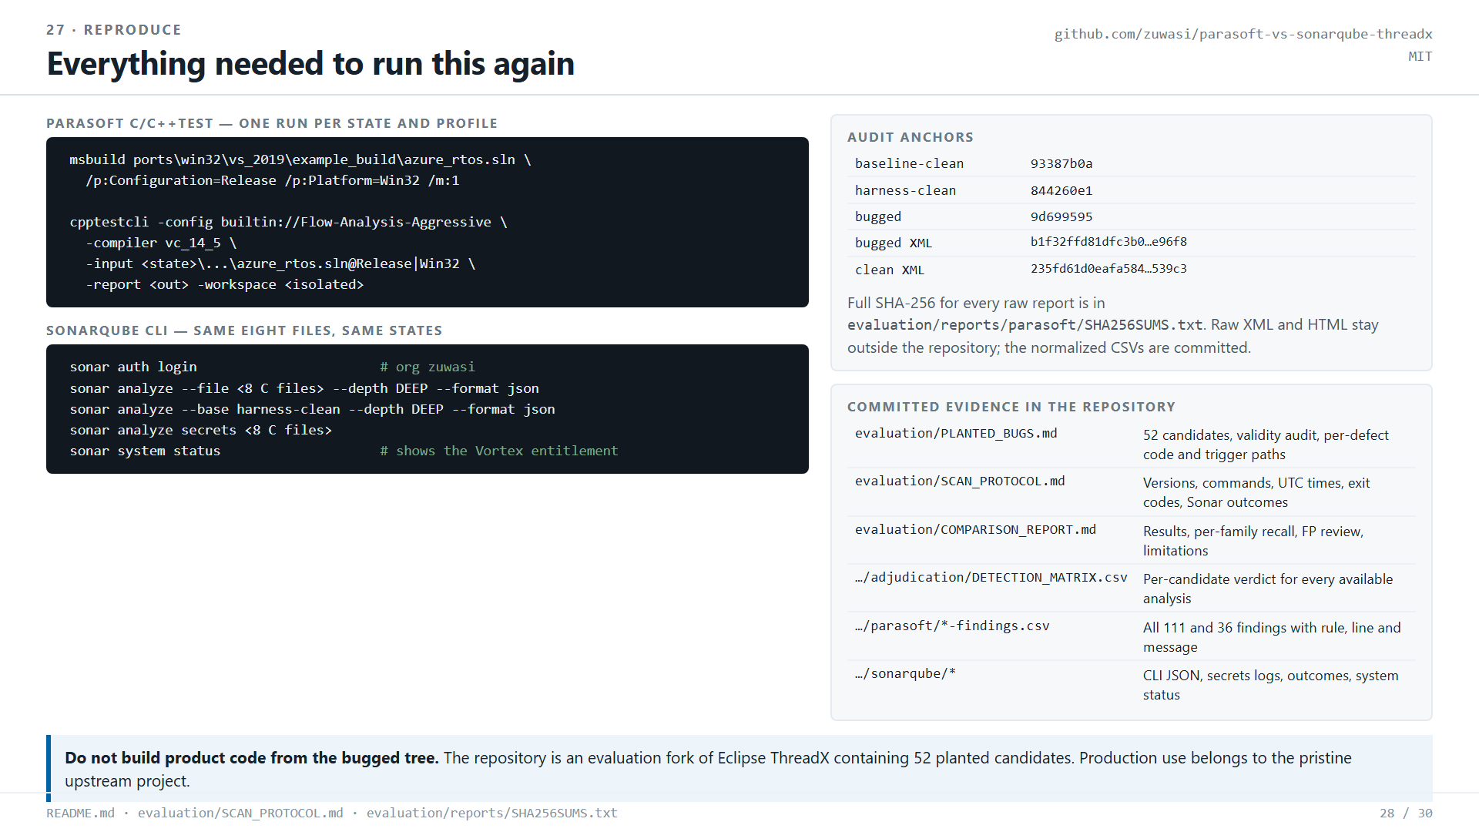
Notes:
Source: evaluation/COMPARISON_REPORT.md, DETECTION_MATRIX.csv and the Parasoft findings exports in github.com/zuwasi/parasoft-vs-sonarqube-threadx

Slide 29
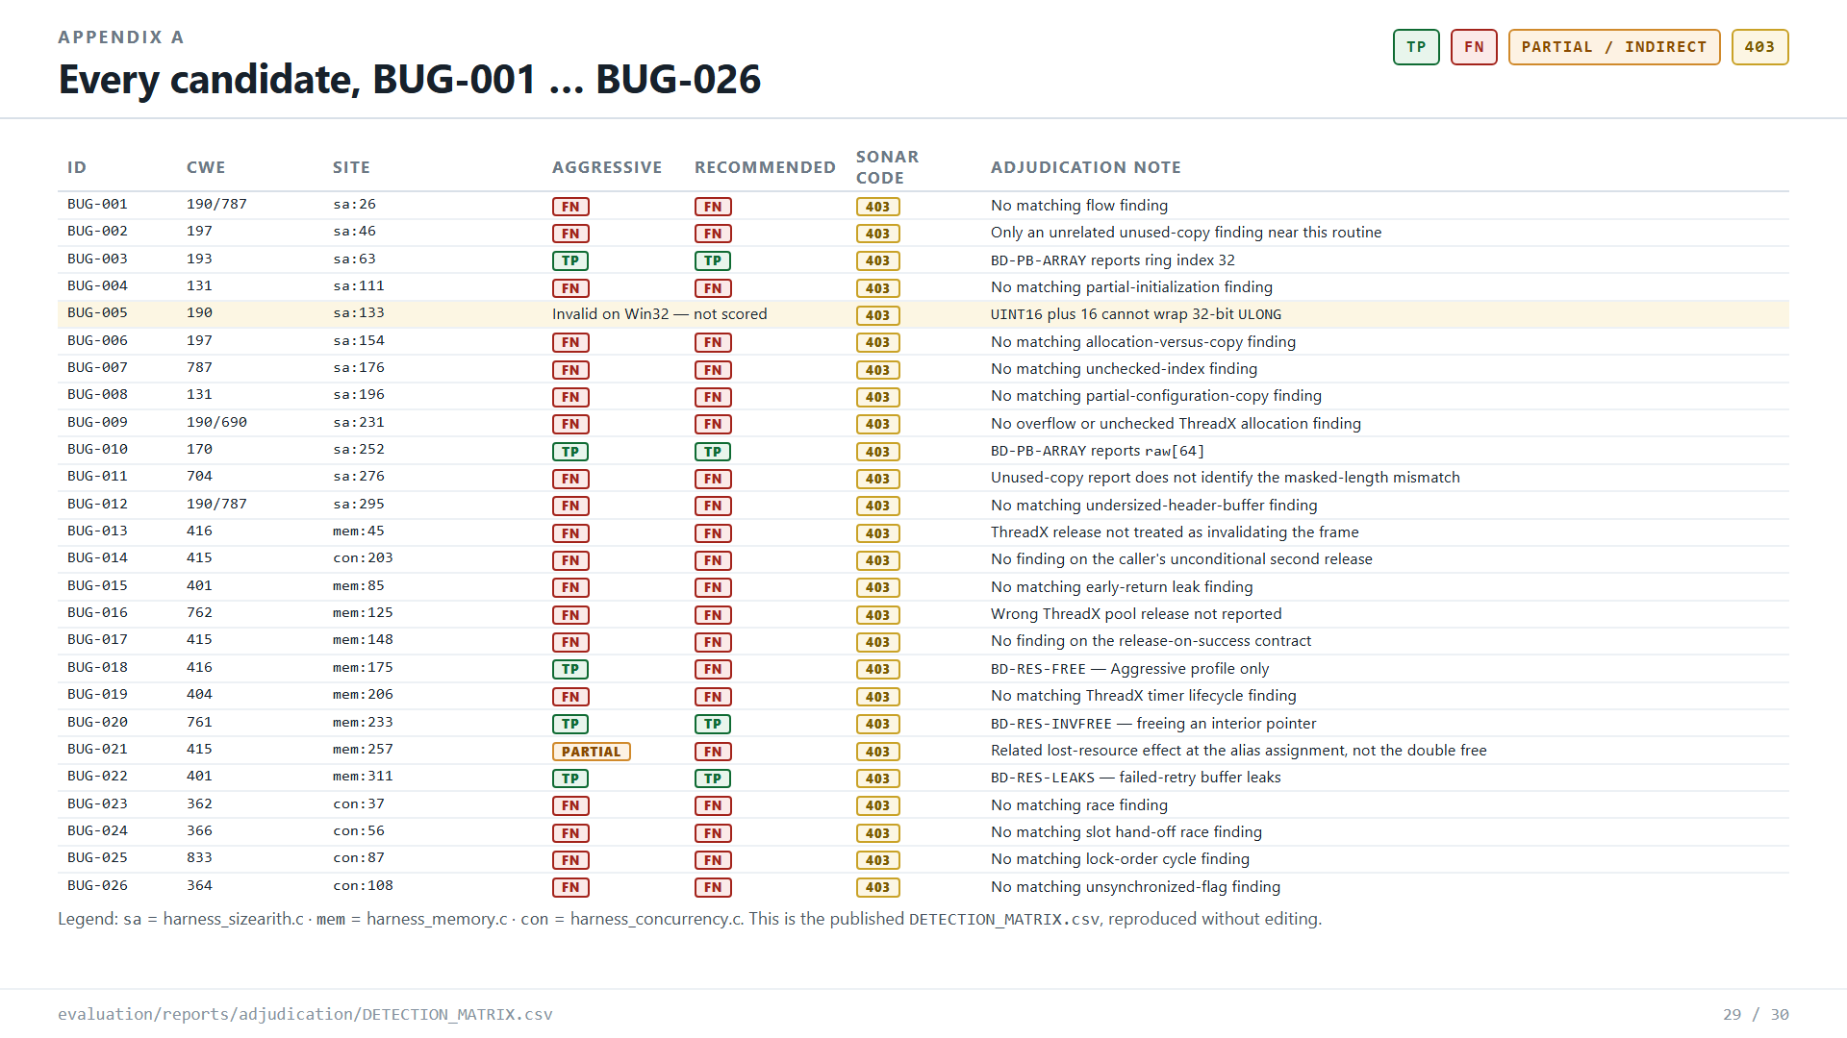
Notes:
Source: evaluation/COMPARISON_REPORT.md, DETECTION_MATRIX.csv and the Parasoft findings exports in github.com/zuwasi/parasoft-vs-sonarqube-threadx

Slide 30
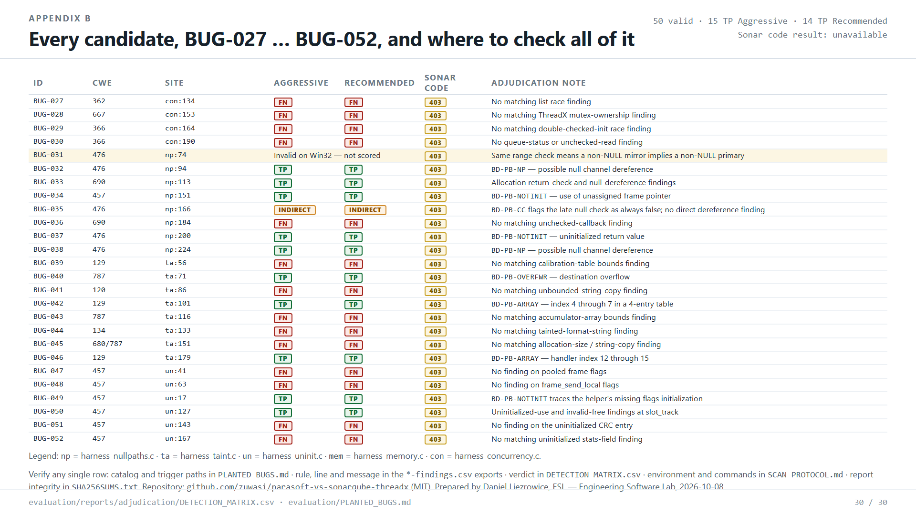
Notes:
Source: evaluation/COMPARISON_REPORT.md, DETECTION_MATRIX.csv and the Parasoft findings exports in github.com/zuwasi/parasoft-vs-sonarqube-threadx

