Slide 1
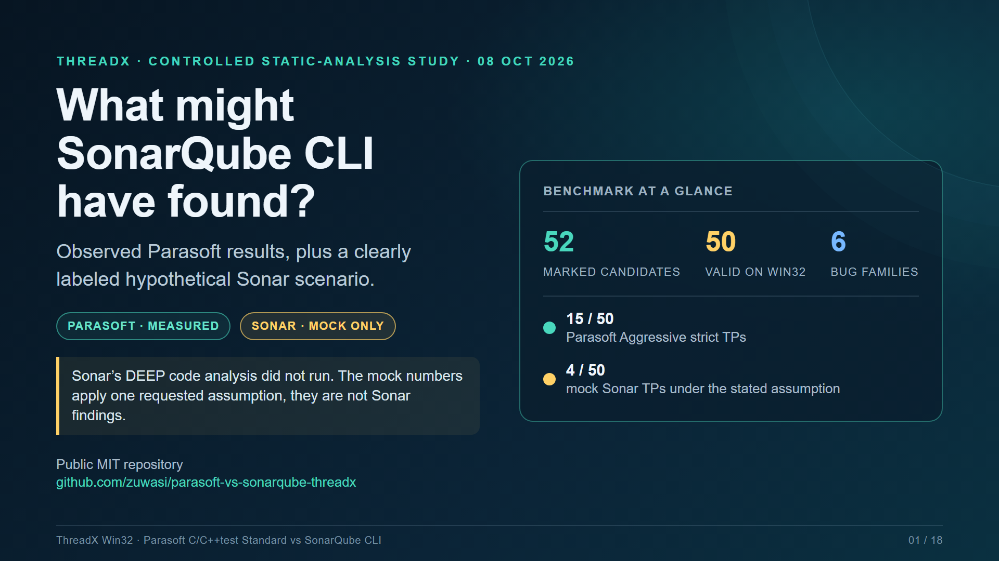

Slide 2
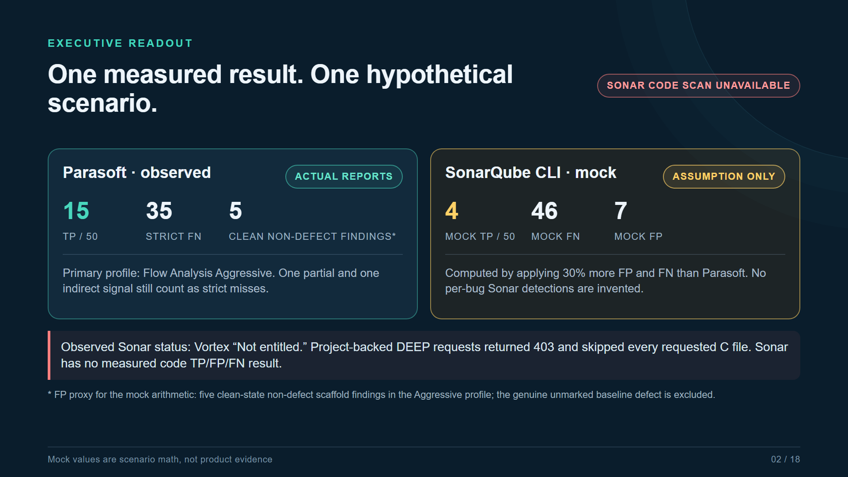

Slide 3
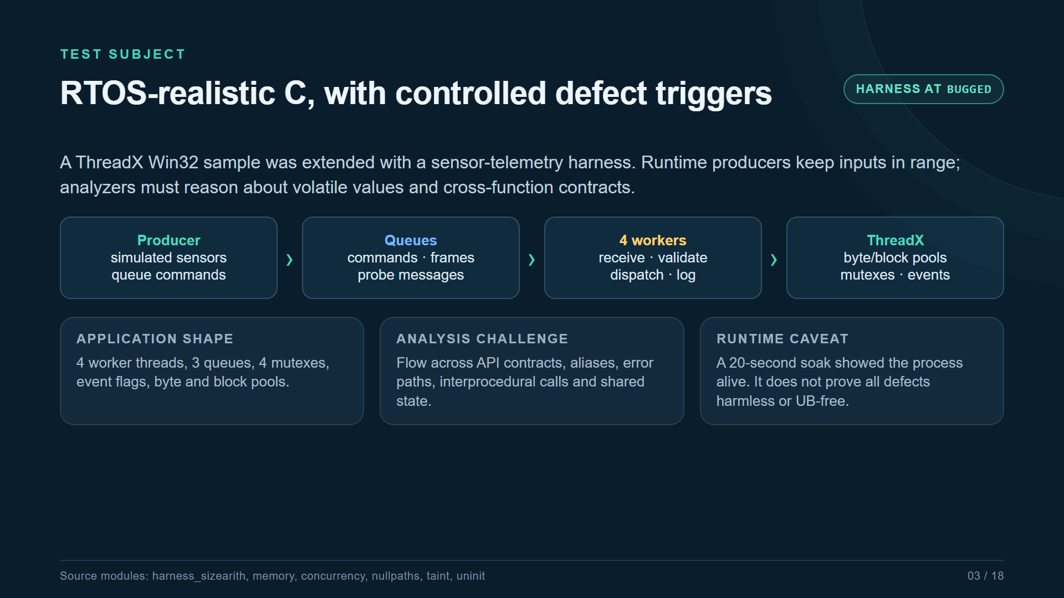

Slide 4
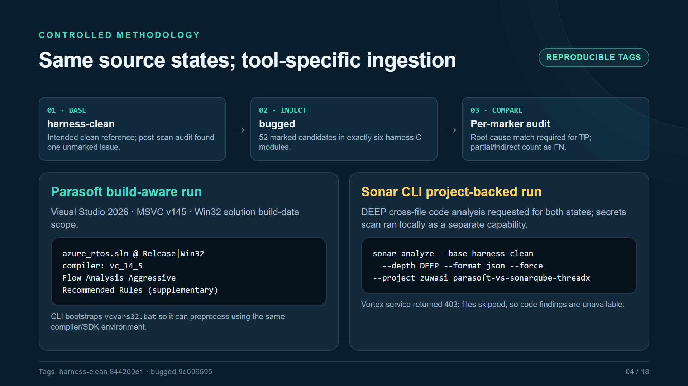

Slide 5
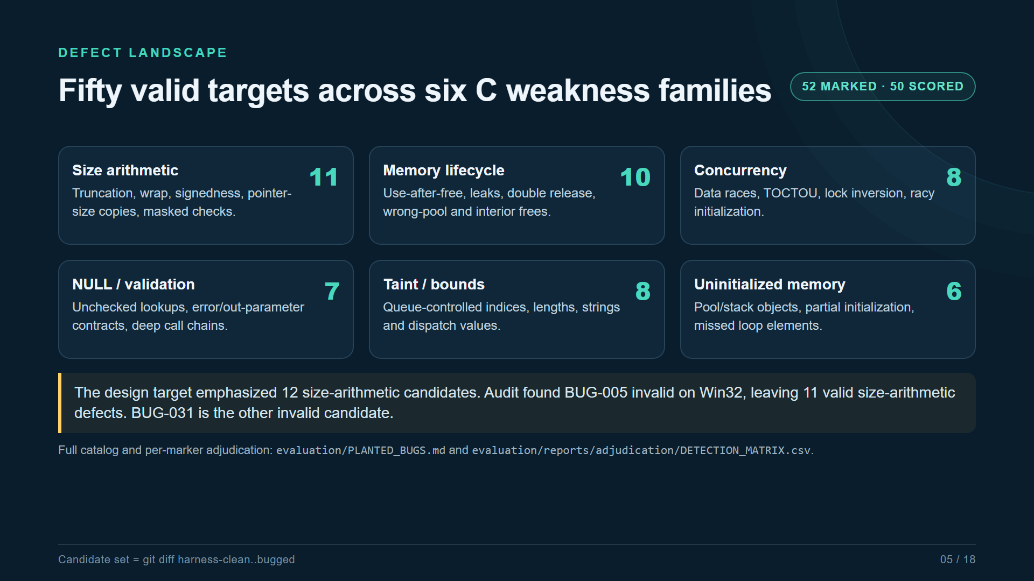

Slide 6
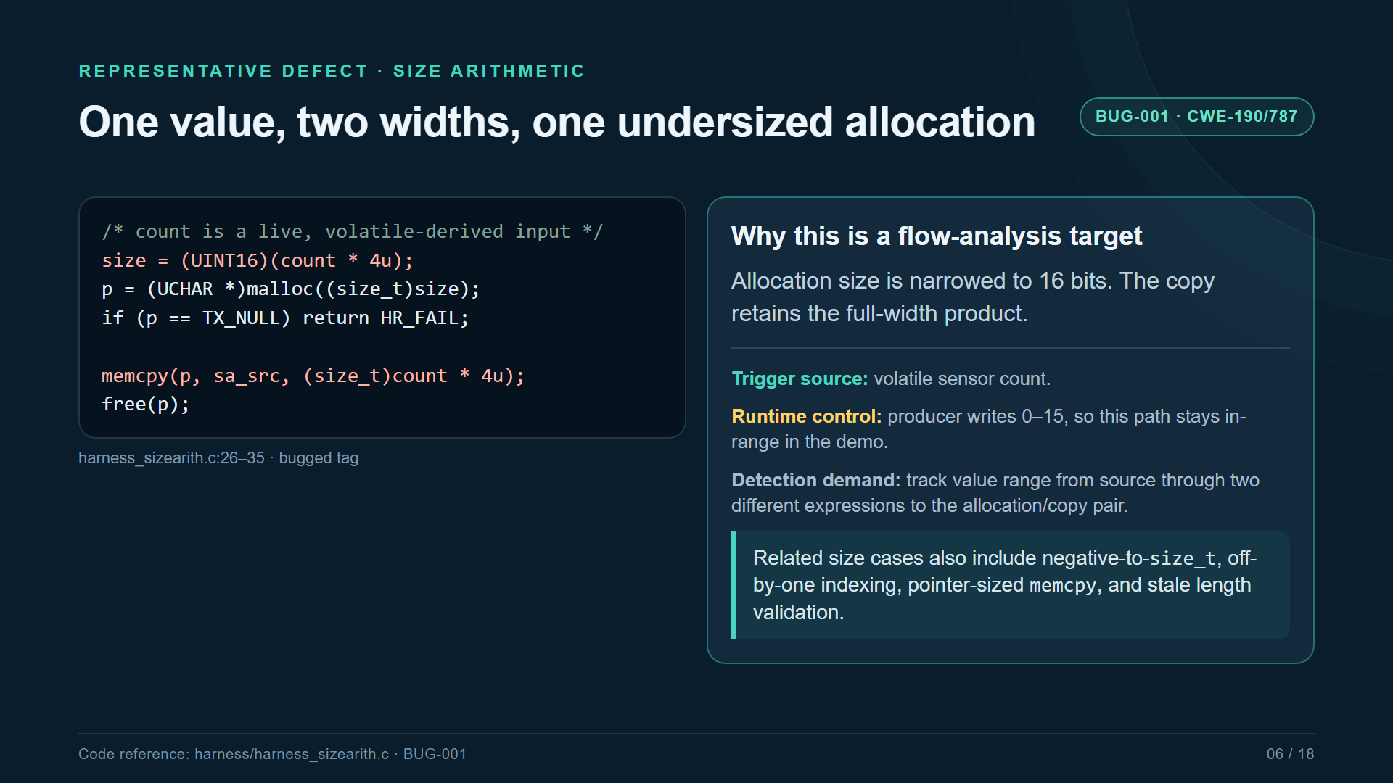

Slide 7
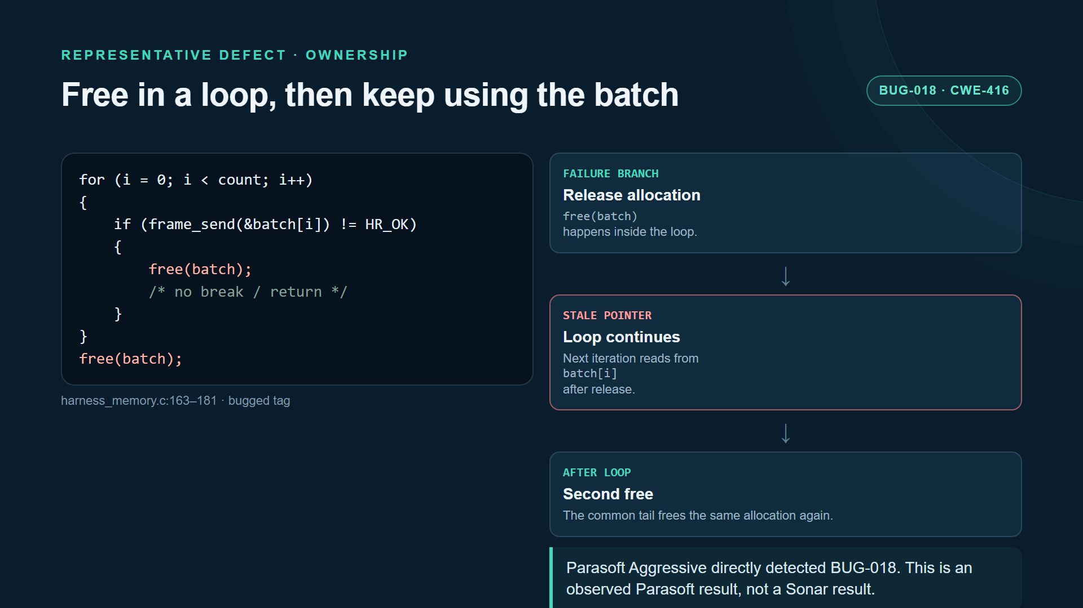

Slide 8
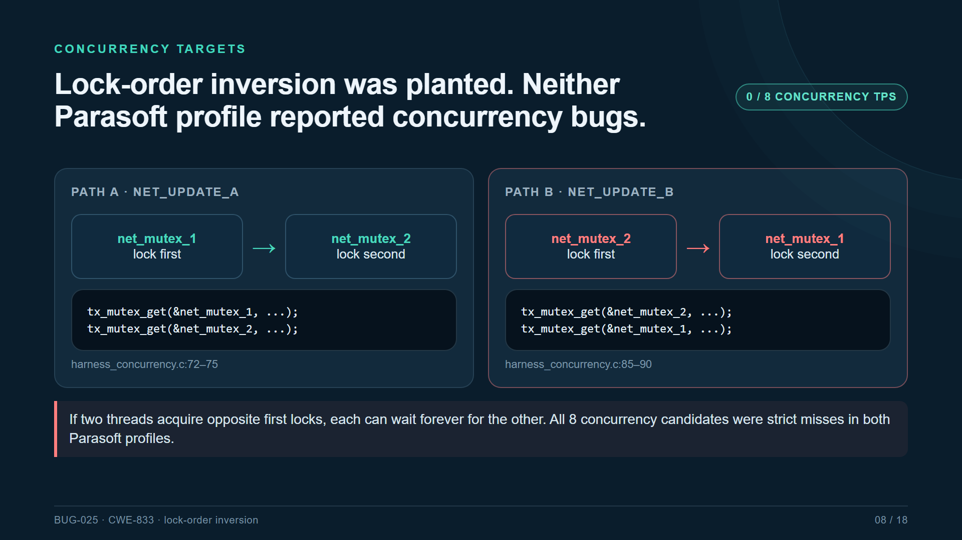

Slide 9
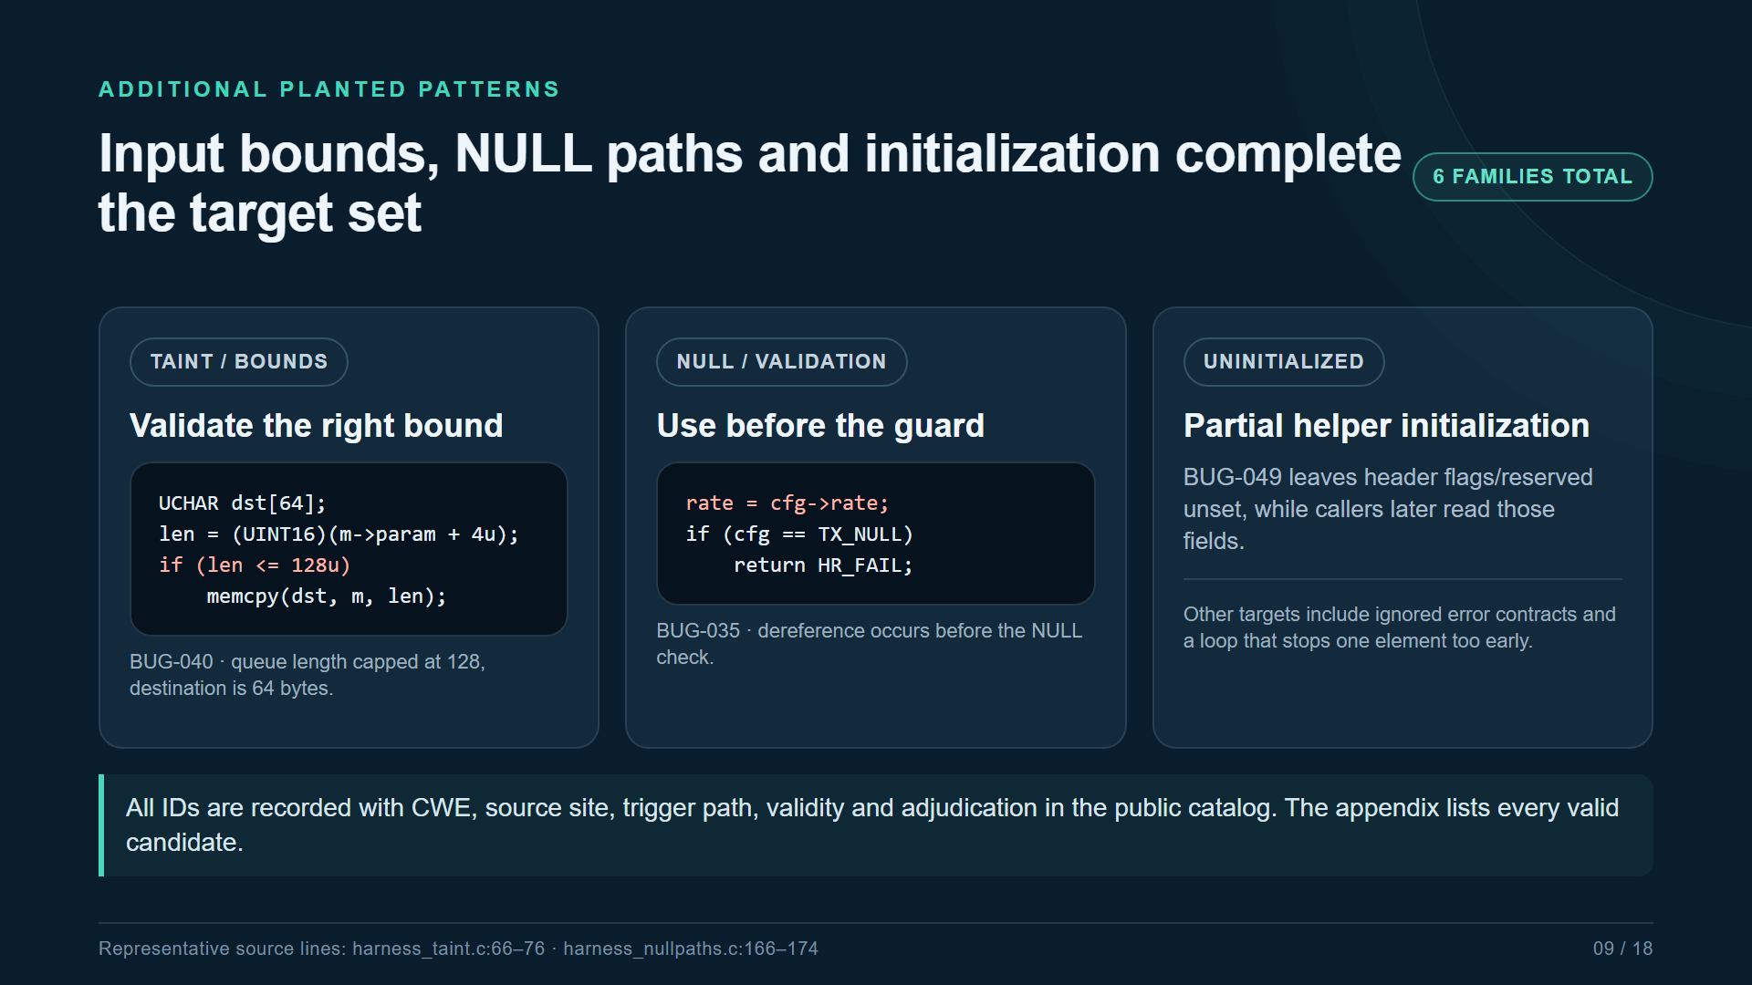

Slide 10
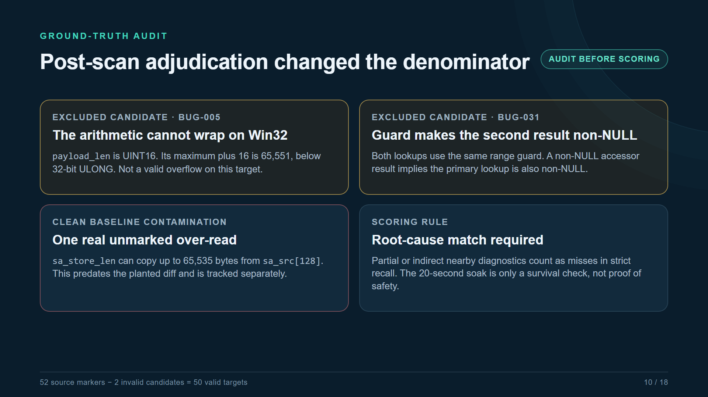

Slide 11
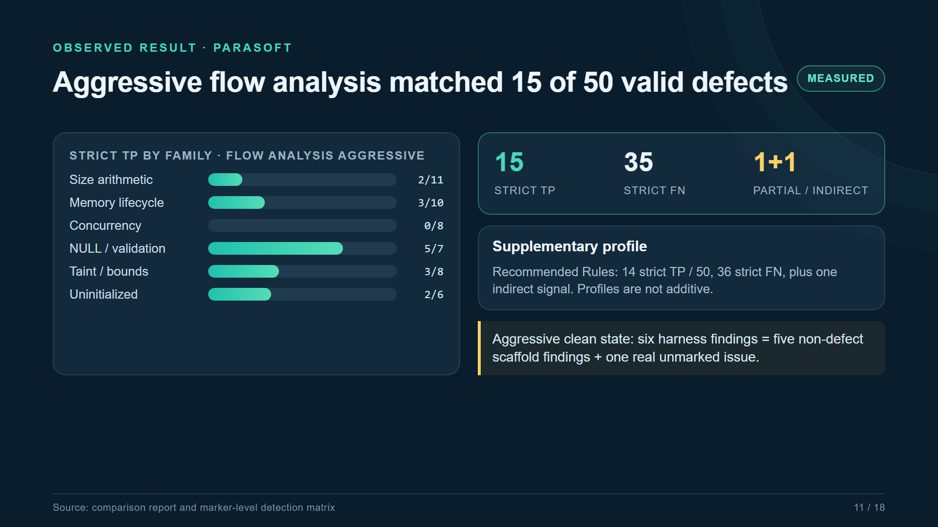

Slide 12
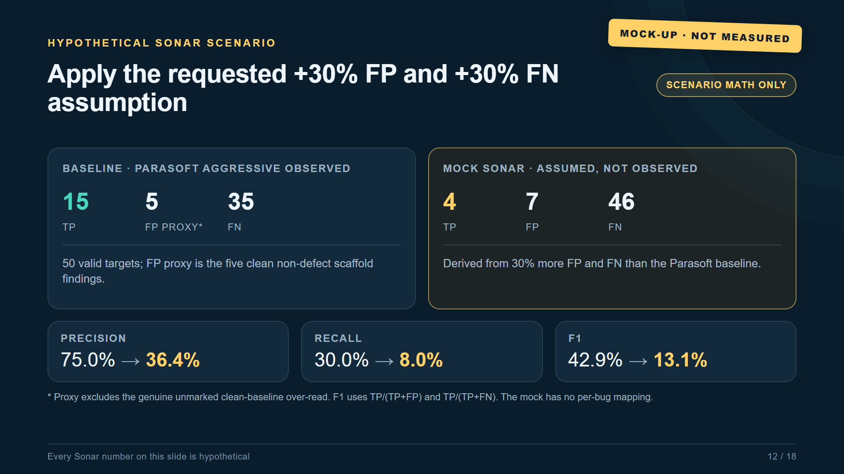
Notes:
MOCK-UP ONLY. SonarQube CLI code analysis did not run. These aggregate numbers are hypothetical and are computed only by applying the stated 30% FP/FN assumption to the observed Parasoft baseline.

Slide 13
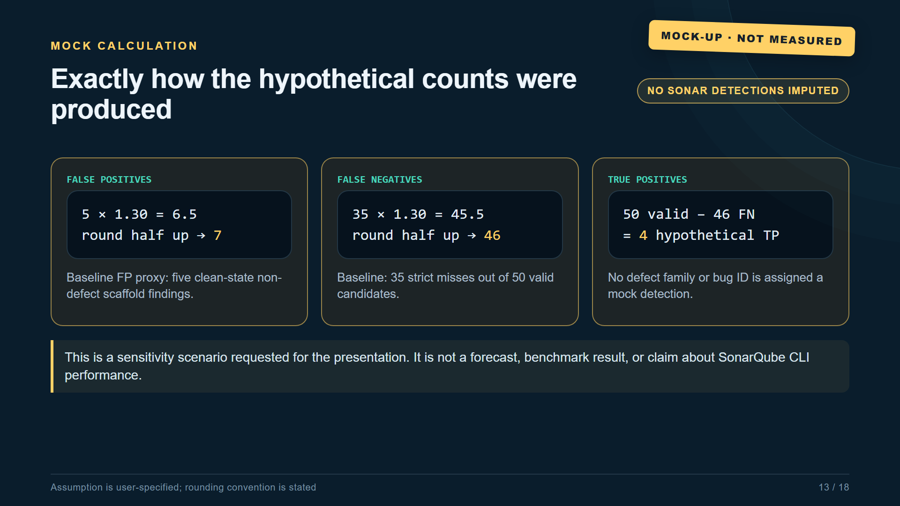
Notes:
MOCK-UP ONLY. SonarQube CLI code analysis did not run. These aggregate numbers are hypothetical and are computed only by applying the stated 30% FP/FN assumption to the observed Parasoft baseline.

Slide 14
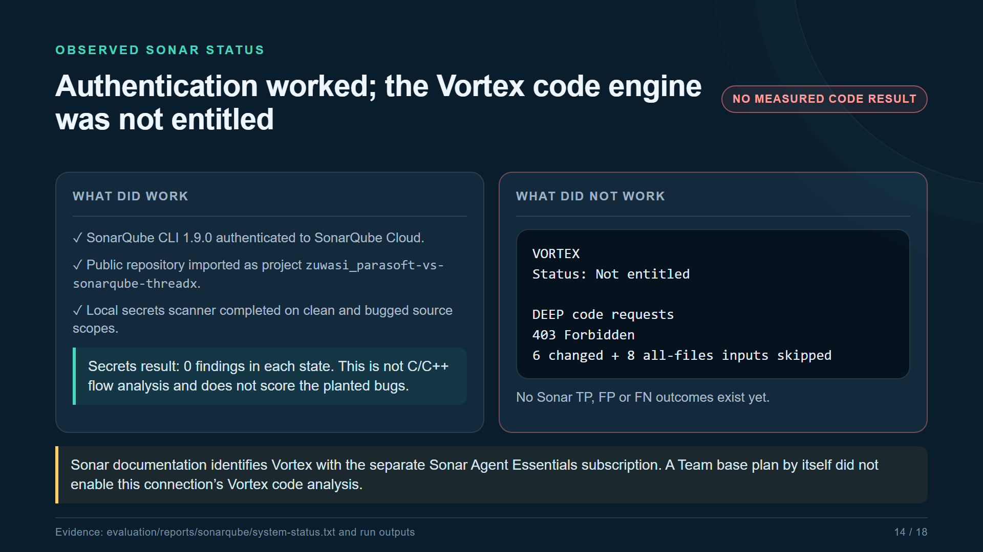

Slide 15
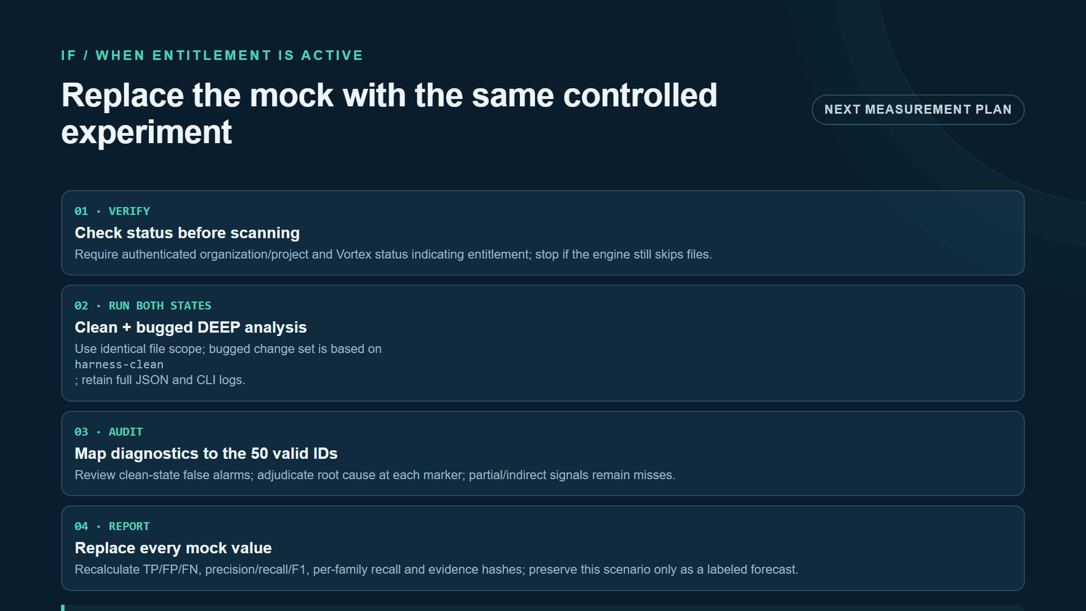

Slide 16
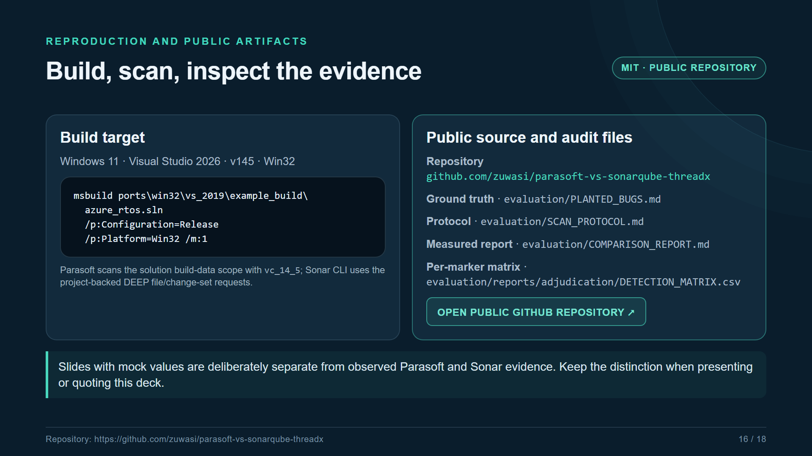

Slide 17
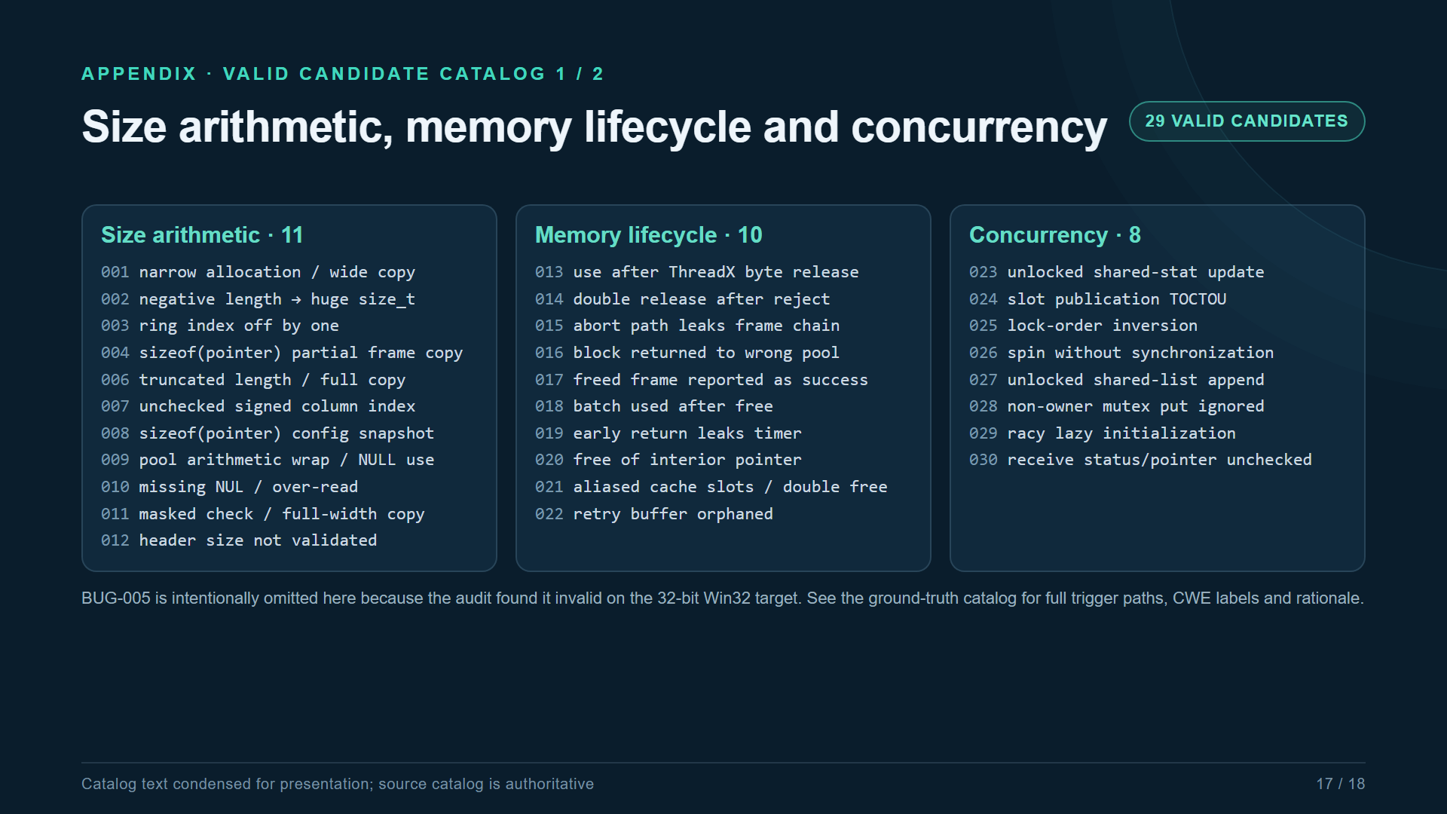

Slide 18
