Slide 1


Project code: SGP_04
Project team name: Shooting Stars
Project title: Kick it!
Project implementation period:
03.03.2021 – 06.05.2021
SUBSOCCER®
Serious Games Project – Spring 2021

Slide 2

Division of Work
UI/ UX and AI
Sensors

Slide 3
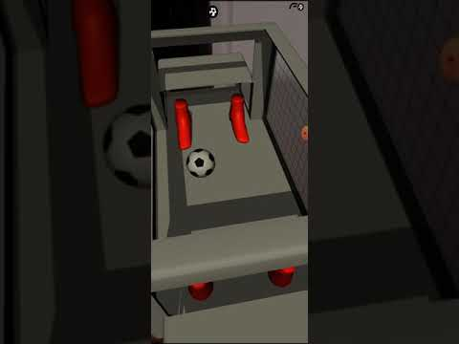
Demo

Slide 4
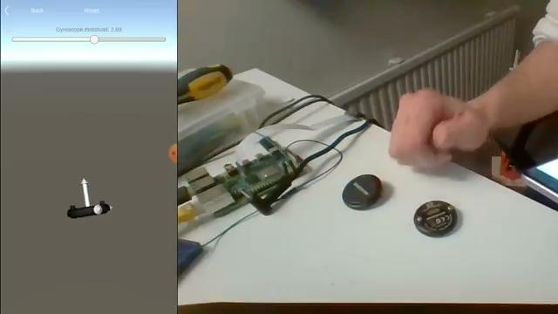
Sensors progress

Slide 5

Sensors progress

Slide 6
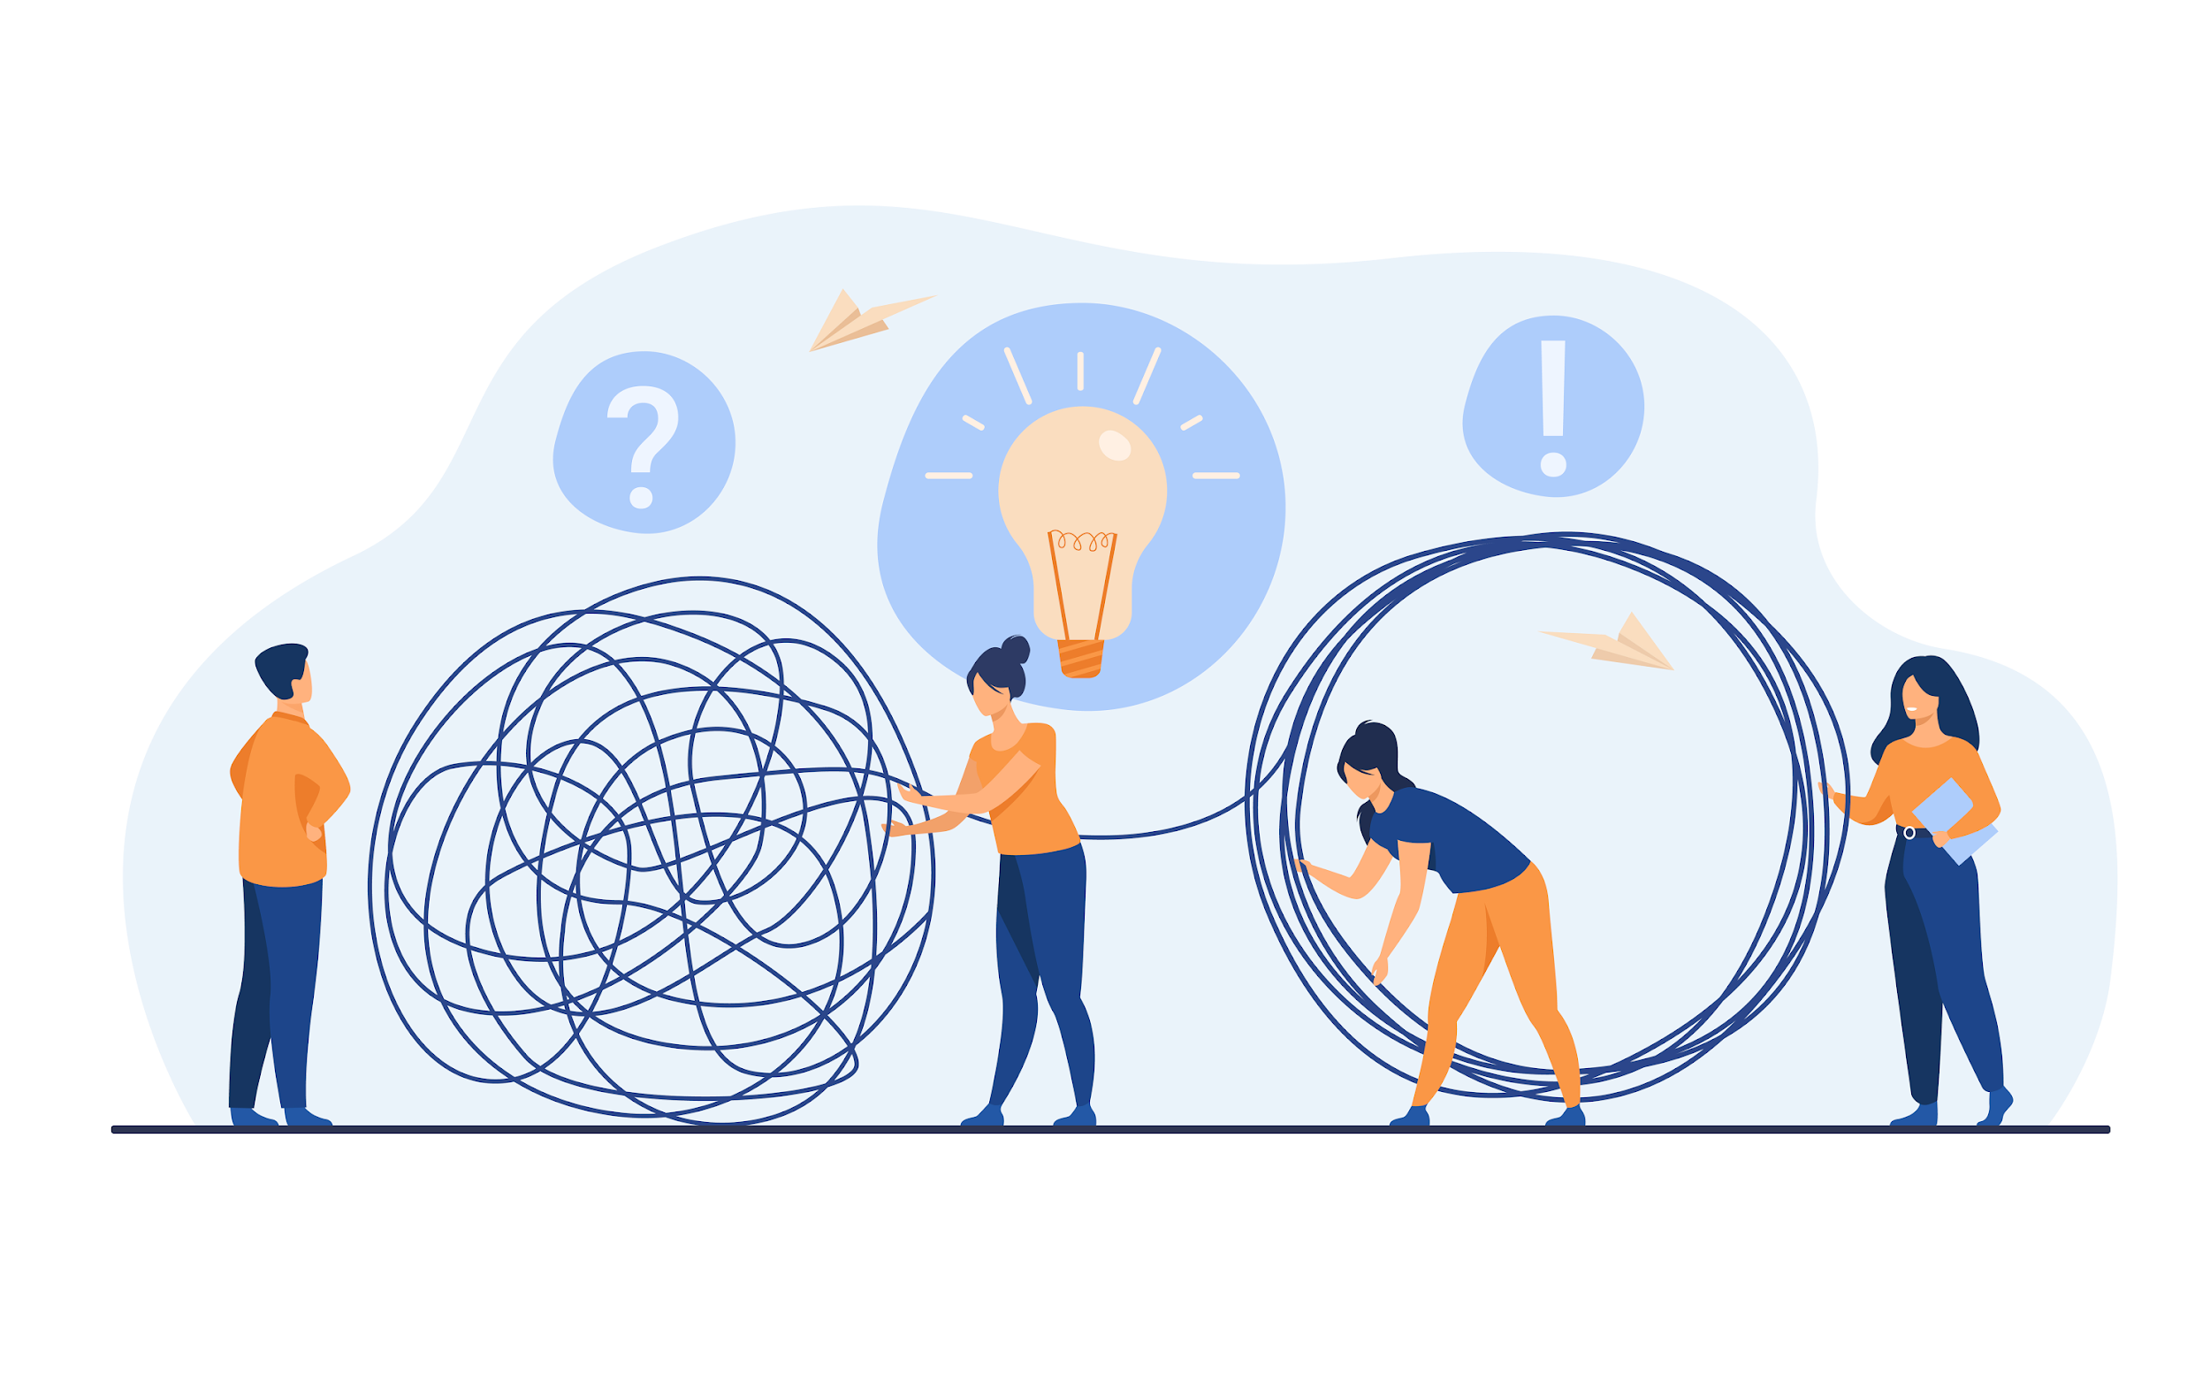
Problems we encountered

Slide 7

Major problems we encountered during the course
Multiplayer was impossible in this timeframe
Sensor technology turned out to be insufficient for the purpose

Slide 8
Multiplayer development Problems
Not enough time to research the right framework to use: We are using mobile, our team had experience on PC and Steam multiplayer
Matchmaking system requires a lot of time because you need complex understanding of the framework
Multiplayer development in general is slower / less time efficient than single player

Slide 9
Sensor development 1. A TIMELINE
Trying to fix scanning
Email to Suunto experts
Scanning and connecting not working
17.03.2021
25.03.2021
1
2
3
4
5
March
20.03.2021
30.03.2021
Getting sensors
Testing on different mobile phones
Fixed connection, integrating with AR Foundation

Slide 10
Sensor development 1. A TIMELINE
PO Presentation
Artem code
Fixing rotation correction
8.04.2021
20.04.2021
1
2
3
4
5
april
12.04.2021
25.04.2021
Change from ARFoundation to Vuforia
Full integration with Vuforia
Removing gravity, still working on position

Slide 11
Sensor development 2. Problems
Scanning – doesn’t work on most versions of Android
Connecting – only works with manual connection and with specific version of the plugin, sometimes it's random
Precision of the sensor mostly based on sample time and noise
Removal of gravity which depends on rotation, any amount of noise screws it up
Mathematical errors accumulate over time

Slide 12
“Position tracking with inertial sensors is challenging due to sensor errors/noise and gravity that hides the dynamic acceleration in accelerometer signal.”
—Suunto experts

Slide 13
Thank You
Aleksis- Artist 3d​
Julius- Artist 3d
Filipe- A.I Programmer / Project manager
Jaakko- A.R Programmer
Ere- Artist 2d
Zuzanna- Electronics
( Sensor )

Slide 14
THANKS!
Do you have any questions?
Please keep this slide for attribution

