Slide 1
2
0
1
9
学生问卷知识测试
|卢姗|夏小雪|宋雨|王鹏|

Slide 2
首页；登录、注册；查看问卷类别 ；查看成绩；导出成绩表到Excel；管理员更改密码
卢姗
王鹏
学生考试；修改密码；修改信息
项目分工
问卷类别方面的增删改查；
问卷试题方面的增删改查；
夏小雪
查看考试申请；批准拒绝学生考试；
学生成绩的各种查询操作；
宋雨

Slide 3

学生问卷知识测试
简介
随着Internet 的迅速发展和广泛普及，网络化教育代表了教育改革的一个发展方向，已经成为现代教育的一个特征，并对教育的发展形成新的推动力，远程教育成为现代教育技术发展的重要方向之一，考试测试作为远程教育的一个子系统也成为一个重要的研究领域。

Slide 4
01
Part One
页面设计，登录与注册，查看课程，查看成绩，导出成绩，管理员更改密码
Part One

Slide 5
登录与注册
Login and register
public String findStudent() {
StudentDao dao = new StudentDao();
student =
dao.findStudentBystidspwd(stId, spwd);
if (student != null) {
return "index_2";
} else {
return "fail";
}
}
登录
public void registerStudent() {
StudentDao dao = new StudentDao();
int rows = dao.insert(student);
if (rows != 0) {
message =
“注册成功，请跳转到登录页面登录！";
color = "green";
} else {
message =
"注册失败，请检查信息！";
color = "red";
}
}
注册

Slide 6
查看问卷类别
Select type
public List<StudentCourse> findCourseBySid(int sid){
Session session=null;
try{session=HibernateUtil.getSession();
Query query=session.createQuery("from StudentCourse where studentId=:studentId ");
query.setInteger("studentId", sid);
List<StudentCourse> list=(List<StudentCourse>)query.list();
if(list.size()!=0)
return list;
}catch(Exception e)
e.printStackTrace();
}finally{
if(session!=null)
session.close();
}return null;
}
public String queryCourse(){
StudentCourseDao dao=new StudentCourseDao();
scourselist=dao.findCourseBySid(student.getStudentId());
return "queryCourse";
}

Slide 7

查询成绩
Query grade
public List<Grade> findGradeBySid(int sid) {
Session session=null;
try{
session=HibernateUtil.getSession();
Query query=session.createQuery("from Grade where studentId=:studentId ");
query.setInteger("studentId", sid);
List<Grade> list=(List<Grade>)query.list();
if(list.size()!=0)
return list;
}catch(Exception e){
e.printStackTrace();
}finally{
if(session!=null)
session.close();
}
return null;
}
}
public String queryGrades(){
GradeDao dao=new GradeDao();
gradelist=dao.findGradeBySid(student.getStudentId());
return "queryGrade";
}

Slide 8
public static void fillExcel(List<Object[]> list,Workbook wb,String[] hearders){
int rowIndex=0;
Sheet sheet=wb.createSheet();
Row row=sheet.createRow(rowIndex++);
for(int i=0;i<hearders.length;i++){
row.createCell(i).setCellValue(hearders[i]);
}
for(Object[] obj:list){
row=sheet.createRow(rowIndex++);
for(int i=0;i<hearders.length;i++){
row.createCell(i).setCellValue(obj[i].toString()); }
}
}
成绩导出
export grade
public String exportAllCpy() throws Exception{
Workbook wb=new HSSFWorkbook();
String headers[]={"学生id","课程id","成绩","提交时间"};
Session session=HibernateUtil.getSession();
Query query=session.createQuery("select gradeId.studentId,gradeId.courseId,studentGrade,finishDate from Grade where gradeId.studentId=:studentId ");
query.setParameter("studentId", stId);
List<Object[]> list=query.list();
HibernateUtil.close(session);
ExcelUtil.fillExcel(list, wb, headers);
ExcelUtil.export(wb,"成绩单");
return null;
}

Slide 9

管理员更改密码
public void updateMpwd(int mno,String mpwd){
Session session=null;
session=HibernateUtil.getSession();
Transaction tran=session.beginTransaction();
Manager manager=(Manager)session.load(Manager.class,mno);
manager.setManagerPassword(mpwd);
session.update(manager);
tran.commit();
if(session!=null)
session.close();
}
public String updateMpwd()
{
ManagerDao dao = new ManagerDao();
dao.updateMpwd(stId,spwd);
return "index";
}

Slide 10
02
Part Two
修改个人信息、密码和进行考试
Part Two

Slide 11
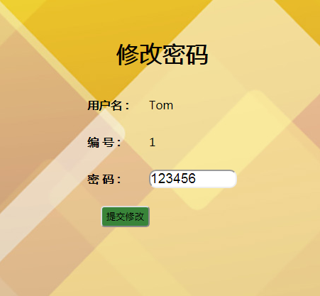
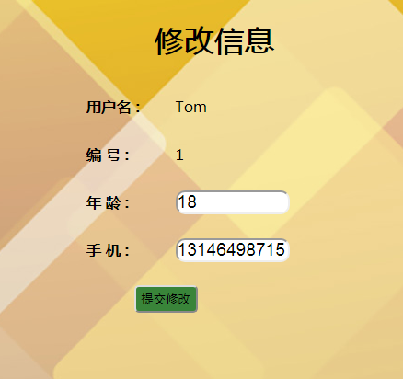
修改个人信息与密码

Slide 12
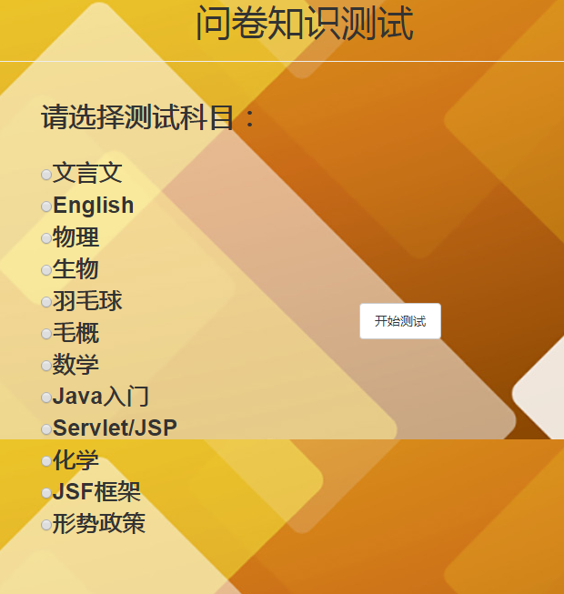
问卷测试
public String startExam() {
QuestionDao dao = new QuestionDao();
questionMap = dao.getQuestionsByCourseId(selectedCourseId);
currentQuestionId = 1；
currentQuestion = questionMap.get(1);
choiceMap = new HashMap<>();
marks = 0;
currentChoice = null;
return "exam";
}

Slide 13
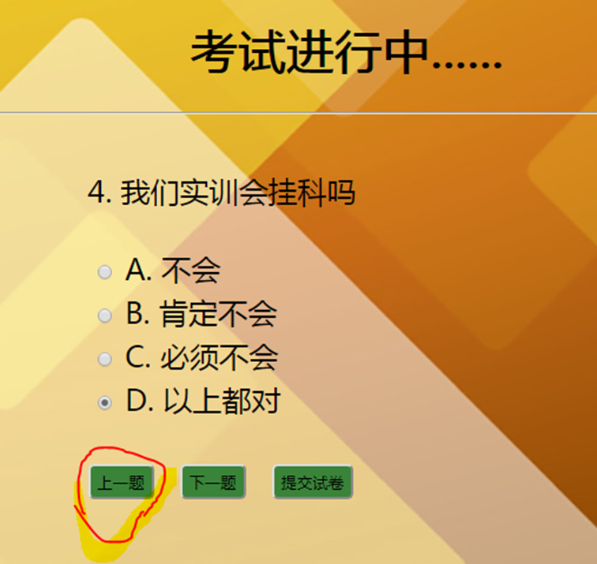
问卷测试
上一题按钮
public void previous() {
if (currentQuestionId > 1) {
choiceMap.put(currentQuestionId, currentChoice);
currentQuestionId--;
currentQuestion = questionMap.get(currentQuestionId);
currentChoice = choiceMap.get(currentQuestionId);
}
}
上一题

Slide 14
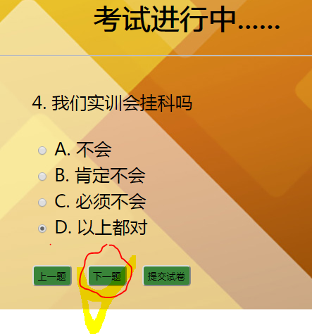
问卷测试
下一题按钮
public void next() {
if (currentQuestionId < questionMap.size()) {
choiceMap.put(currentQuestionId, currentChoice);
currentQuestionId++;
currentQuestion = questionMap.get(currentQuestionId);
currentChoice = choiceMap.get(currentQuestionId);
}
}
下一题

Slide 15
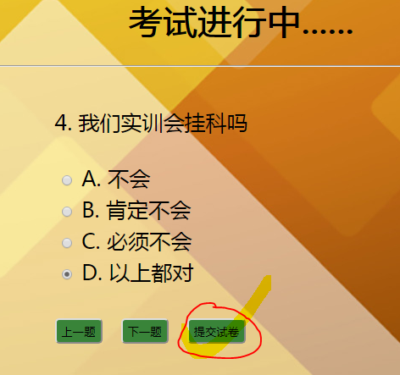
问卷测试
提交试卷
public String submit() {
choiceMap.put(currentQuestionId, currentChoice);
for (int i = 1; i <= choiceMap.size(); i++) {
String choice = choiceMap.get(i);
String answerKey = questionMap.get(i).getAnswerKey();
if (choice.equals(answerKey)) {
marks += questionMap.get(i).getCredit();
}
提交试卷

Slide 16
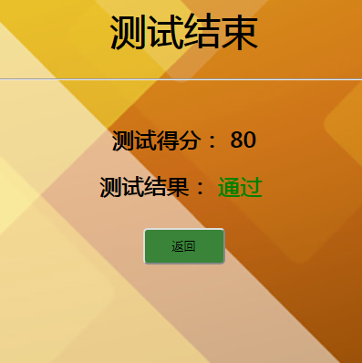
问卷测试
显示成绩
Date date = new Date();
DateFormat format = new SimpleDateFormat("yyyy-MM-dd");
String time = format.format(date);
GradeDao gdao = new GradeDao();
gdao.submitGrade(stId, selectedCourseId, marks, time);
result = marks >= 60 ？"通过" : "挂科";
color = marks >= 60 ？"green" : "red";
return "result";
显示成绩

Slide 17
03
Part Three
问卷类别和试题方面的增删改查
Part Three

Slide 18
问卷类别
查询
按照问卷模块排序课程
按照问卷模块查询课程
public void queryCourseModule(){
Session session=HibernateUtil.getSession();
Query query=session.createQuery(
"from Course order by cmodule");
courselist=query.list();
HibernateUtil.close(session);
public void findCourseByCmodule(){
Session session
=HibernateUtil.getSession();
Query query=session.createQuery(
"from Course wherecmodule=:cmodule");
query.setParameter("cmodule",coursemodule);
courselist=query.list();
HibernateUtil.close(session);
}

Slide 19
问卷类别
查询
按照问卷类别编号查询课程
按照问卷类别名称查询课程
public void findCourseByCnm(){
Sessionsession
=HibernateUtil.getSession();
Query query=
session.createQuery("from Course where courseName=:courseName");
query.setParameter("courseName", coursename);
courselist=query.list();
HibernateUtil.close(session);
}
public void findCourseByCid(){
Session session
=HibernateUtil.getSession();
Query query
=session.createQuery(
"from Course wherecourseId=:courseId");
query.setParameter("courseId", courseid);
courselist=query.list();
HibernateUtil.close(session);
}

Slide 20
增删问卷类别
添加问卷类别
删除问卷类别
public int insert(Course course) {
Session session = null;
try {
session = HibernateUtil.getSession();
Transaction tran = session.beginTransaction();
session.save(course);
tran.commit();
return 1;
} catch (Exception e) {
e.printStackTrace();
return 0;
} finally {
if (session != null) {
session.close();
}
}
}
public void deleteCourseById(String cid) {
Session session = null;
try {
session = HibernateUtil.getSession();
Transaction tran=
session.beginTransaction();
Coursecourse=
(Course)session.load(Course.class,cid);
session.delete(course);
tran.commit();
} catch (Exception e) {
e.printStackTrace();
} finally {
if (session != null) {
session.close();
}
}
}

Slide 21
更改问卷类别
public void updateCourse(String cid,String cname,int credit,String cmodule) {
Session session = null;
try {
session = HibernateUtil.getSession();
Transaction tran=session.beginTransaction();
Course course=(Course)session.load(Course.class, cid);
course.setCourseName(cname);
course.setCredit(credit);
course.setCmodule(cmodule);
session.update(course);
tran.commit();
} catch (Exception e) {
e.printStackTrace();
} finally {
if (session != null) {
session.close();
}
}
}
更改

Slide 22
删除/查询已注册问卷类别
public void deleteStudentCourseById(int sid,String cid) {
StudentCourseId studentId = new StudentCourseId(sid, cid);
Session session = null;
try {
session = HibernateUtil.getSession();
Transaction tran=session.beginTransaction();
StudentCourse scourse=
(StudentCourse)session.load(StudentCourse.class,studentId);
session.delete(scourse);
tran.commit();
} catch (Exception e) {
e.printStackTrace();
} finally {
if (session != null) {
session.close();
}
}
}
public void findStudentCourseByCid(){
Session session=HibernateUtil.getSession();
Query query=session.createQuery("
from StudentCourse where courseId=:courseId");
query.setParameter("courseId", courseid);
scourselist=query.list();
HibernateUtil.close(session);
}
删除
查询

Slide 23

查询/更改问卷试题
public void deleteQuestionById(int qid, String cid) {
QuestionId questionId = new QuestionId(qid, cid);
Session session = null;
try {
session = HibernateUtil.getSession();
Transaction tran = session.beginTransaction();
Question question = (Question) session.load(Question.class, questionId);
session.delete(question);
tran.commit();
} catch (Exception e) {
e.printStackTrace();
} finally {
if (session != null) {
session.close();
}
}
}
public void findQuestionByCid(){
Session session=HibernateUtil.getSession();
Query query=session.createQuery(
"from Question where courseId=:courseId");
query.setParameter("courseId", courseid);
questionlist=query.list();
HibernateUtil.close(session);
删除
查询

Slide 24
删除问卷试题
public void updateQuestion(int qid, String cid, String desc, String A, String B, String C, String D, String key, int credit) {
Session session = null;
QuestionId questionId = new QuestionId(qid, cid);
session = HibernateUtil.getSession();
Transaction tran = session.beginTransaction();
Question question = (Question) session.load(Question.class, questionId);
question.setQuestionDesc(desc);
question.setAnswerA(A);
question.setAnswerB(B);
question.setAnswerC(C);
question.setAnswerD(D);
question.setAnswerKey(key);
question.setCredit(credit);
session.update(question);
tran.commit();
if (session != null) {
session.close();
}
}
删除

Slide 25
04
Part Four
查看考试申请 批准拒绝学生考试
管理员对学生成绩的各种查询操作
Part Four

Slide 26
管理员对于申请考试的处理
查看考试申请
更改考试申请信息
public void searchApplicationList(){
Session session=HibernateUtil.getSession();
Query query=session.createQuery(
"from TestApplication where application=:application");
query.setParameter("application", application);
applicationlist=query.list();
HibernateUtil.close(session);
}
public void updateTestApplication(int sid,String cid,String application) {
TestApplicationDao dao = new TestApplicationDao();
dao.updateTestApplication(sid,cid,application);
applicationlist = dao.getAllTestApplication(application);
}

Slide 27
管理员对于申请考试的处理
更改考试申请信息
public void updateTestApplication(int sid,String cid,String application){
TestApplicationId testapplicationId=new TestApplicationId(sid,cid);
Session session=null;
try{
session=HibernateUtil.getSession();
Transaction tran=session.beginTransaction();
TestApplication testapplication=(TestApplication)session.load(TestApplication.class,testapplicationId);
testapplication.setApplication(application);
session.update(testapplication);
tran.commit();
}catch(Exception e){
e.printStackTrace();
}finally{
if(session!=null){
session.close();
}
}
}

Slide 28
管理员对学生成绩的各种查询操作
按照问卷类别编号查询成绩
public void findGradeByCid(){
Session session=HibernateUtil.getSession();
Query query=session.createQuery("from Grade where courseId=:courseId");
query.setParameter("courseId", courseid);
gradelist=query.list();
HibernateUtil.close(session);
}
public void findGradeByCidOrder(){
Session session=HibernateUtil.getSession();
Query query=session.createQuery(
"from Grade where courseId=:courseId
order bystudentGrade desc");
query.setParameter("courseId", courseid);
gradelist=query.list();
HibernateUtil.close(session);
}
按照问卷类别编号查询成绩排名

Slide 29
管理员对学生成绩的各种查询操作
按照学号查询成绩
public void findGradeBySid(){
Session session=HibernateUtil.getSession();
Query query=session.createQuery("from Grade where studentId=:studentId");
query.setParameter("studentId", stId);
gradelist=query.list();
HibernateUtil.close(session);
}
public void findGradeByDateCourse(){
Session session=HibernateUtil.getSession();
Query query=session.createQuery
("from Grade where finishDate=:finishDate
and courseId=:courseId");
query.setParameter("finishDate", gradeTime);
query.setParameter("courseId",courseid);
gradelist=query.list();
HibernateUtil.close(session);
}
按照指定日期和问卷类别编号查询成绩

Slide 30
感谢观看

