Slide 1
Individual Project Proposal
Terry Meacham of Team 8
ttm0011@uah.edu
20 January, 2012
Customer (if approved):
Christopher Meacham

Slide 2
COBRA Project Overview
Collaborative Broad(Pod)cast Application
Collaborative environment for co-located netcasts.
Provides file management components for maintaining a clip library.
Allows users to cue and play audio on the host machine.
Allows users to keep track of netcast events for later editing.
Works alongside common streaming software
Skype, Ventrilo, Google Talk, etc.

Slide 3
COBRA Project Overview
Collaborative Broad(Pod)cast Application
Client/Server architecture utilizing SSL for security.
8+ client connections for netcasts with multiple hosts.
Simple file transfer using STFTP (SSL based TFTP).
Sqlite Database for audio clip information storage.
File system used for file storage.
MD5 or SHA-256 used for file content attestation
(Stored in DB).

Slide 4
COBRA Project Overview
Collaborative Broad(Pod)cast Application
Other potential features include:
RSA Public Key authentication support.
File list export capability using XML/M3U encodings.
JACK (Jack Audio Connection Kit) Support for direct input to recording software.
http://www.jackaudio.org
Inject inaudible markers into audio stream.
The goal would be for them to be visible when viewed in a standard audio application, such as Audacity.

Slide 5
Market Research
No available applications for this exact purpose exist!
Many contain some subset of desired capabilities.
Netcast Create and Control Suite
“Features” Include:
Manage multiple video calls on one computer.
Produce a live netcast with one computer.
Unfortunately, source repository’s current revision is 0!

Slide 6
Market Research
Cuberok
Features Include:
Manage local Audio DB, which uses SQLite 3.
Update IDvX Tag Information in Audio Clips.
Appears to have a functional feature set, but is intended for typical media files.
OneClickFTP
Features Include:
Manage local Audio DB, which uses SQLite 3.
Update IDvX Tag Information in Audio Clips.
Appears to have a functional feature set, but is intended for file management.

Slide 7
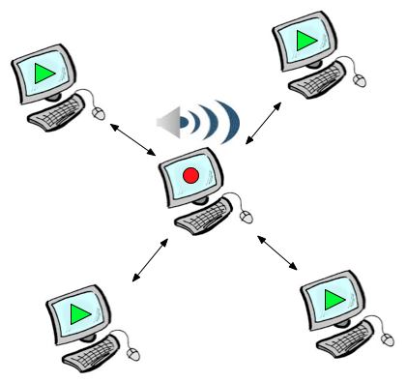
Use Case Model
UC01 – Configure Client
Specify server IP, port, and user credentials.
UC02 – Upload an Audio File
Allows authenticated users to upload audio files,
including information about the files, such as titles and descriptions,
to the server.
UC03 – Play an Audio File
Allows for authenticated users to play Audio Clips on the host
machine once a netcast has been started.
UC04 – Mark for Edit
Allows participants of a netcast to easily mark time offsets, optionally with
comments, for post production editing.

Slide 8
Complexity Estimate
Complexity Estimation Spreadsheet version 1.1 |  |  | Total Weight | 32
Qt Elements | Covered in Prerequisite Course | Weight | Included? Insert 1 here if yes
Networking
QSSL Sockets | No | 3 | 1 | 3
Q Tcp Server/Sockets | Yes | 3 | 1 | 3
Data Storage
SQLite Database | Yes | 2 | 1 | 2
Qt Containers (Q Queue, Q Stack, etc.) | Partially | 3 | 1 | 3
Multithreading
Qt Thread Synchronization | Yes | 3 | 1 | 3
Q Thread and Derivatives | Yes | 2 | 1 | 2
Layout
Item-View Classes | Yes | 3 | 1 | 3
Pull-Down Menus | Yes | 2 | 1 | 2
Toolbars | Yes | 2 | 1 | 2
Status Bar | Yes | 1 | 1 | 1
Keyboard Shortcuts | Yes | 1 | 1 | 1
Q MainWindow and Derivatives | Yes | 2 | 1 | 2
Q Widget, Q Dialog, or Derivatives | Yes | 2 | 1 | 2
Internationalization (English plus at least one other language)
Qt Linguist | No | 3 | 1 | 3
*These numbers exclude items listed as “Potential Features” (Page 4).

