Slide 1


Creating the Optimal NFL Team
By: Zach Vance

Slide 2

Background / Introduction
The NFL is a business
Business’s goal is to make money
The more games a team wins the more money they team makes
Ticket sales, merchandise, concessions,…
Goal: Win as many games as possible... What’s the best way to do that?
Project: see if we can predict a team’s success based on the way it allocated money per position within the salary cap.

Slide 3

The Data
Salary cap is a limit of how much money a team can pay its players in total.
Dead money is when a team is forced to pay a player no longer on the roster
Retrieved positional spending data for 2013-2018 for all 32 NFL teams along with their number of wins (192 rows)
Positional categories: QB, RB, WR, TE, OL, DL, LB, S, CB, Special Teams
I generate a ‘PercentUsed’ feature to be:
Total spent on players on roster / Salary cap limit

Slide 4

Proposed Approach
Attempt to predict the number of wins a team will earn using linear regression.
Attempt to classify a team as good, bad, or mediocre using a decision tree.
Good: 10+ Wins
Bad: 0-6 Wins
Mediocre: 7-9 Wins

Slide 5
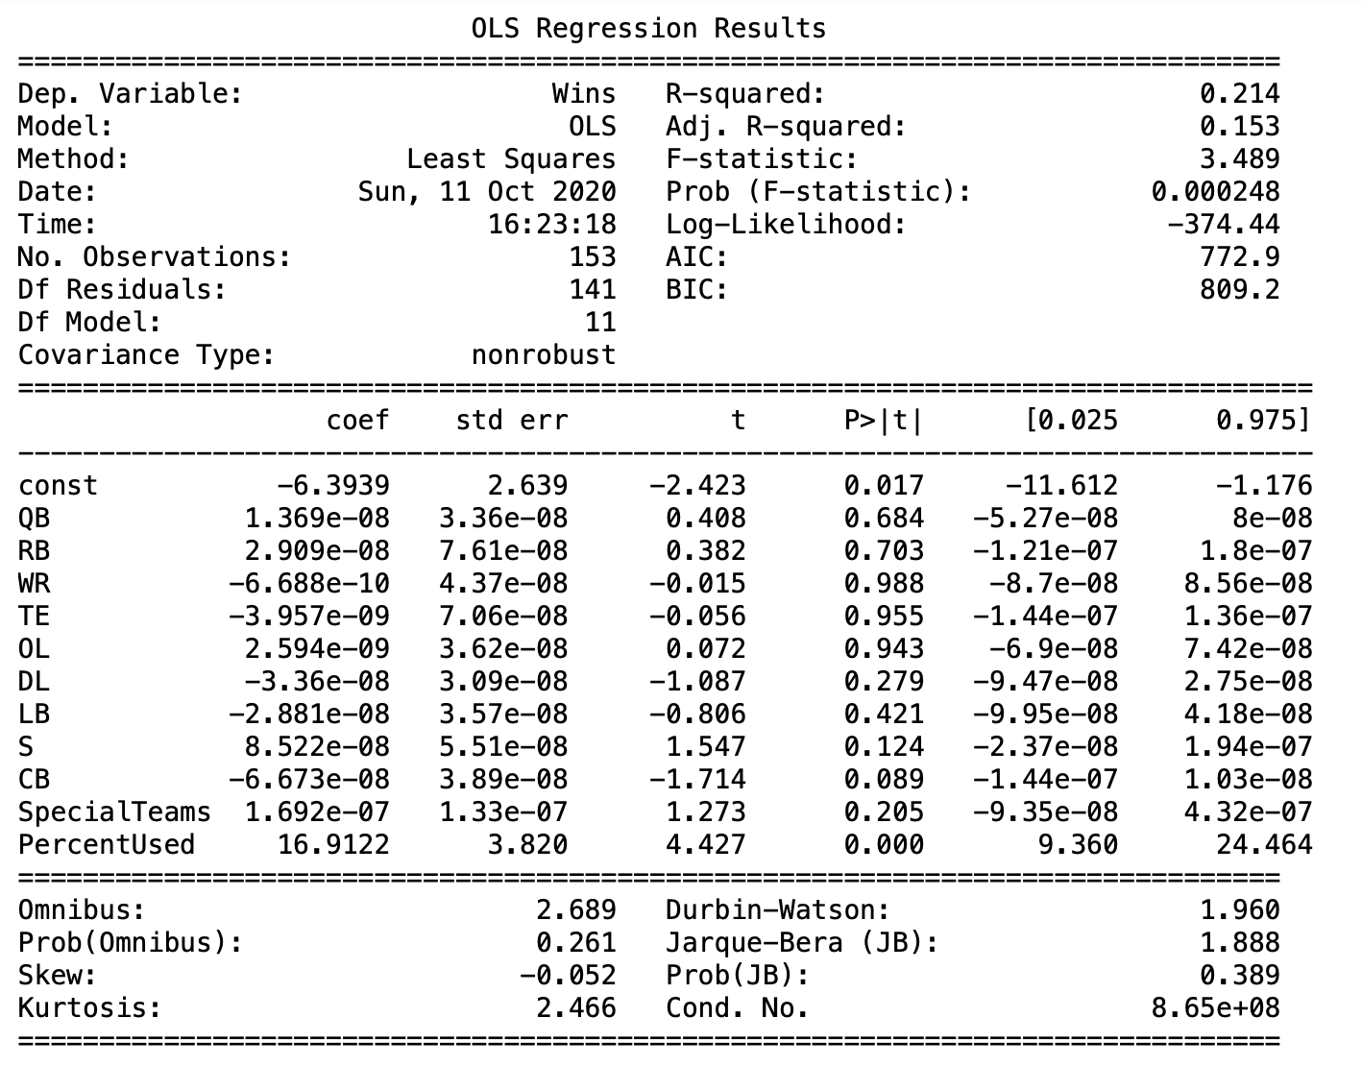
Linear Regression (OLS)
Only ~21.4% of the variation in wins is explained by the features in our model.
Only significant variable is the ‘PercentUsed’ that I generated.
Notes:
Mention the residuals plot. And how there were no patterns in it.

Slide 6
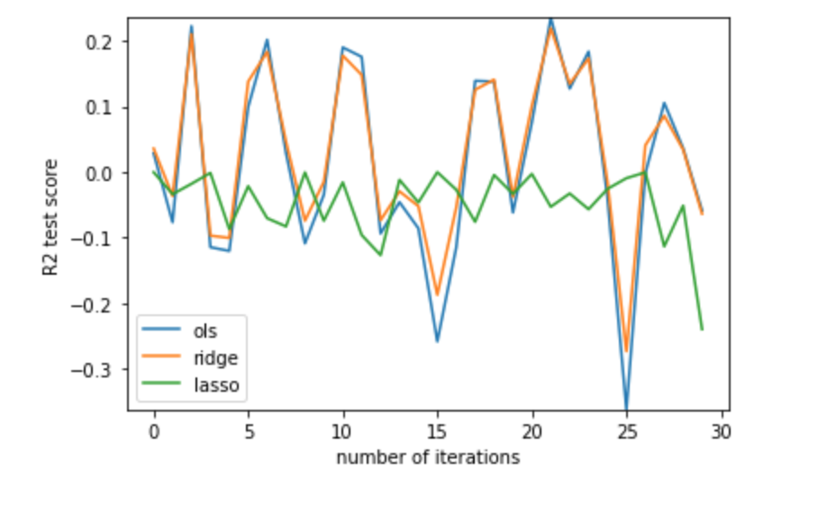
Ridge / Lasso Regression
Ridge/lasso to help with the high variation and collinearity.
Reduce overfitting by penalizing complexity.
Lasso feature selection property.

Slide 7
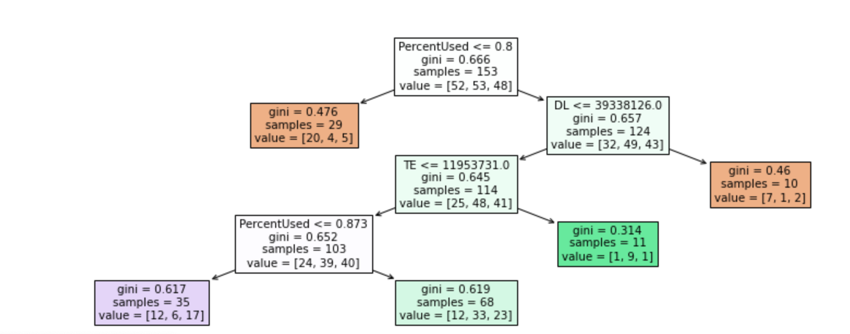
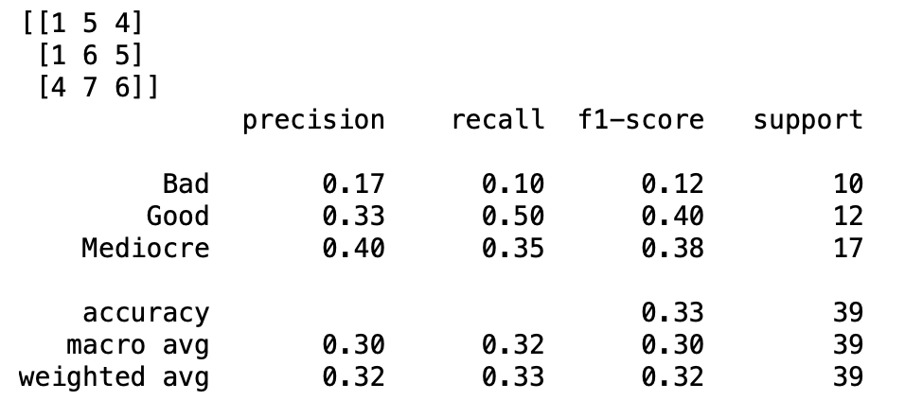
Decision Tree
Built on information gain.
Results show not any better than guessing.
Note: ‘PercentUsed’ seen again as most impactful.

Slide 8
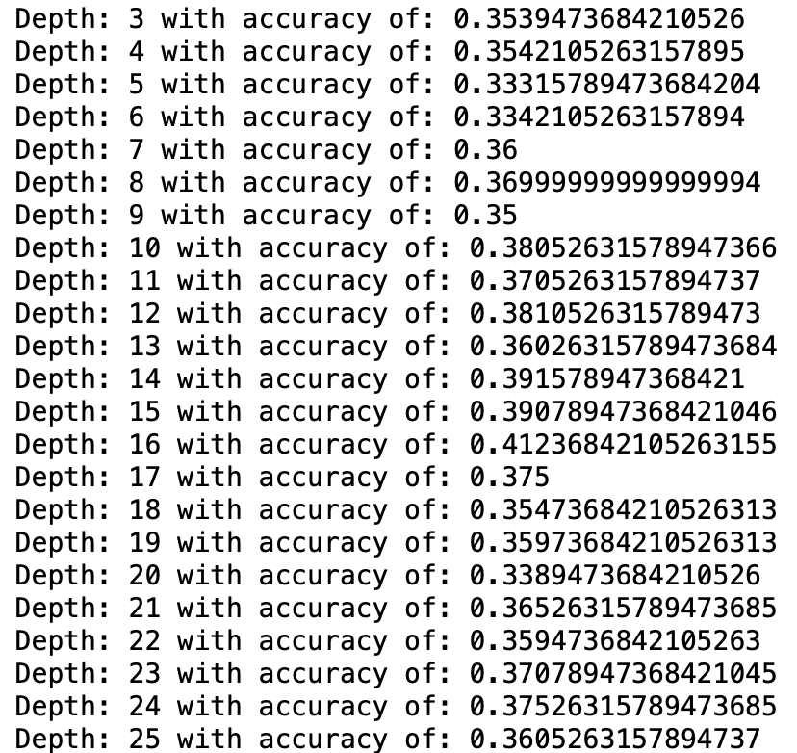
Decision Tree with Cross Validation
Technique: 10-fold cross validation
Slightly better results: Accuracy tends to be in 36-38% range, better than 33% the random guessing would be.

Slide 9

Conclusion / Summary
Not really a correct way to allocate money to each position within the reigns of the salary cap.
Many other factors involved than just the salary allocation.
The most seen characteristic of a successful team is that they utilize the full potential of the salary cap, minimize dead money.

Slide 10
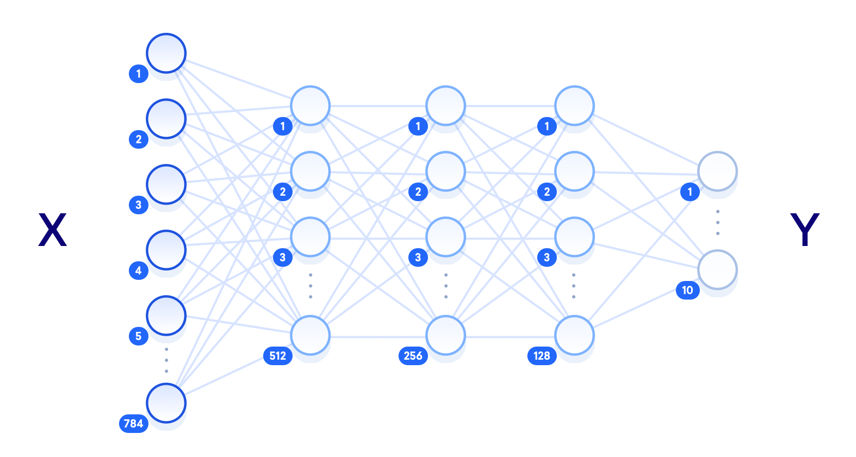
Limitations / Future Work
Relatively small dataset – could only get data back to 2013.
Could continue to collect data over the coming years to add to the set.
With the collinearity in the features, linear regression may not be the best
Potential deep learning algorithm such as neural networks that we will learn later in the course might work better.

