Slide 1
ANALYST WARS
CS 4996 Senior Project Team
Wayne state university
Detroit, mi

Slide 2
OVERVIEW
COMPANY NAME – TACTICAL CAPITAL INVESTMENT LLC
DESCRIPTION - CAPITAL ASSET MANAGEMENT FUND
FOUNDERS – TIMOTHY HOOKER (WSU) & BRIAN SMITH (MSU)
SERVICES PROVIDED
FINANCIAL ADVICE – INVESTMENT, INSURANCE & MANAGEMENT
FINANCIAL SOLUTION – SMALL BUSINESSES & START-UP VENTURES

Slide 3
BORN FREE FINANCIAL
PURPOSE:
CREATE A LAUNCHPAD FOR SERVICES OFFERED BY OUR CLIENT
SCOPE:
EXPOSE BUSINESS MODEL
IMPROVE PUBLIC INVESTMENT OPTIONS
OBJECTIVES:
PROVIDE USERS WITH HIGH-QUALITY STOCK ANALYSIS TOOLS
ALLOW USERS TO JOIN SOCIAL STOCK RATING NETWORKS/DISCUSSIONS
PROVIDE USERS WITH BEST FINANCIAL ADVICE AS FAST AS POSSIBLE

Slide 4
TEAM Pulkit Monga, Nick Crooker, zach vanoast & Jian deng
GOAL: CREATE AN EFFECTIVE AND EFFICIENT SOLUTION
ROLES & RESPONSIBILITIES:
FRONT END
Pulkit(POC) & Jian
BACK END + DATABASE (NICK & ZACH)
Nick & Zach

Slide 5
TEAM POLICY
RESOLUTION PLAN:
2+2 TEAM STRATEGY
ACKNOWLEDGE THE MISTAKE
ANALYZE THE IMPACT
IMPLEMENT A SOLUTION
INCREASE DAILY COMMUNICATION
Notes:
1.4 Problem Resolution Policies
IDEAS ABOUT THE PROBLEM RESOLUTION PLAN

Slide 6
Project plan
PROTOTYPE 1:
WEBSITE
1. CLIENT PROFILE
2. CLIENT ASSESSMENT – RISK TOLERANCE & TIME HORIZON
DATABASE & HOSTING
INTEGRATE WEBSITE WITH HOSTGATOR
USER DATA
FUTURE PLAN:
STOCK ANALYSIS TOOLS
STOCK RATING SOCIAL NETWORK
LIVE CHAT SYSTEM
Notes:
1.5 Project Plan
# Iterations
# Project Schedule

Slide 7
technologies
PRESENTATION TIER
HTML/CSS – RESPONSIVE GRID DESIGN
JAVASCRIPT
YAHOO API – STOCK TRENDS
LOGIC TIER
PHP
DATA TIER
HOSTGATOR – HOSTING
MYSQL – DATABASE

Slide 8
USERS
The users of the website could be anyone
Potential appeal to an “untapped” demographic – the young investor 18-25
Currently most young people do not do much investing for a number of reasons (time, motivation, knowledge, financial stability, etc.)
Notes:
2.2 Users/perspectives

Slide 9
Functional requirements
Allows a user to register and log in
Profile and account settings
Creates a client profile based on multiple key attributes determined during a survey at time of registration (or optionally later)
Provide stock suggestions based on the client profile
Allows the user to rate stocks based on their experience/opinion
Rate stock price targets for each month
Avoid, Sell Short, Neutral/Hold, or Buy
Show comparison to Wall Street Analysis
Allows the user to follow stocks (currently investing or just following)
Notes:
2.3 Functional Requirements
# Required
# Desired

Slide 10
Non-functional requirements
Website layout and services must be clear and easy for the user
Must be compatible on multiple browsers and browser versions, as well as on mobile
User credentials must be secure
Allow for backup of data
Notes:
2.4 Non Functional Requirements

Slide 11
BUSINESS CONSTRAINTS
Time limitations on our group due to project switch
Limited budget determined by client
Some functionality/requirements are unclear
Lack of SME working directly on the project
Notes:
2. 6 Business Constraints

Slide 12
Technical constraints
HostGator functionality
Dependency on financial website API’s (accessing Wall Street ratings or market stock prices)
Notes:
2.7 Technical Constraints

Slide 13
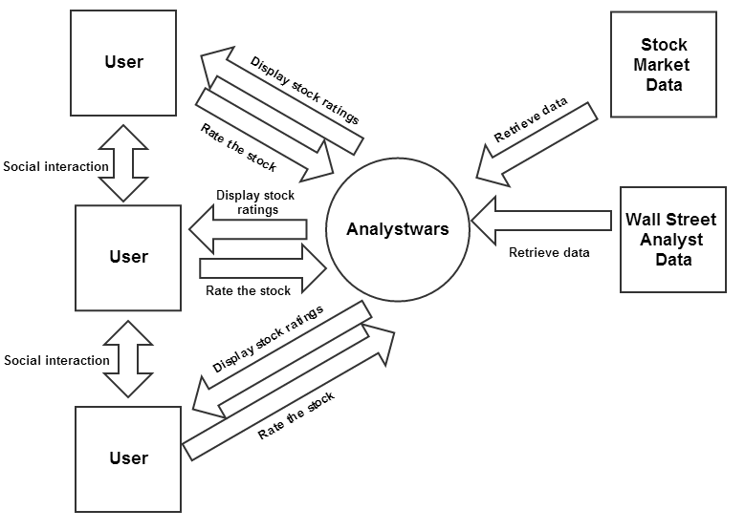
System Context (Updated)
Circle: Actual Process
Rectangle: External Entities

Slide 14
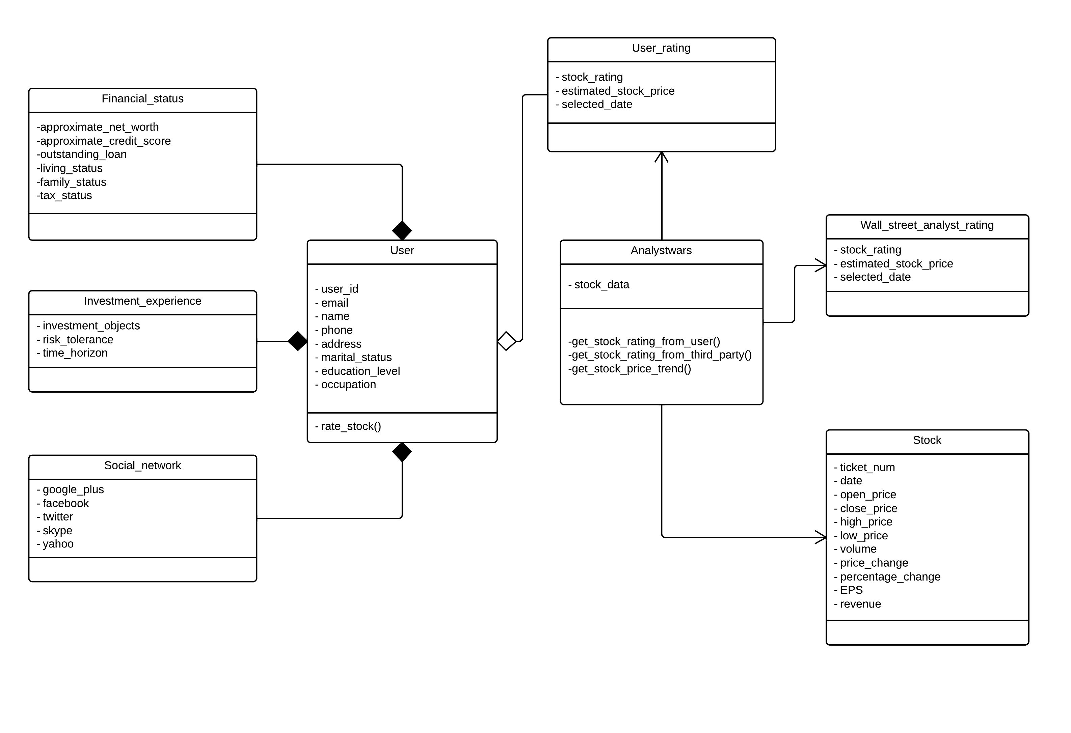
Domain model (Updated)

Slide 15
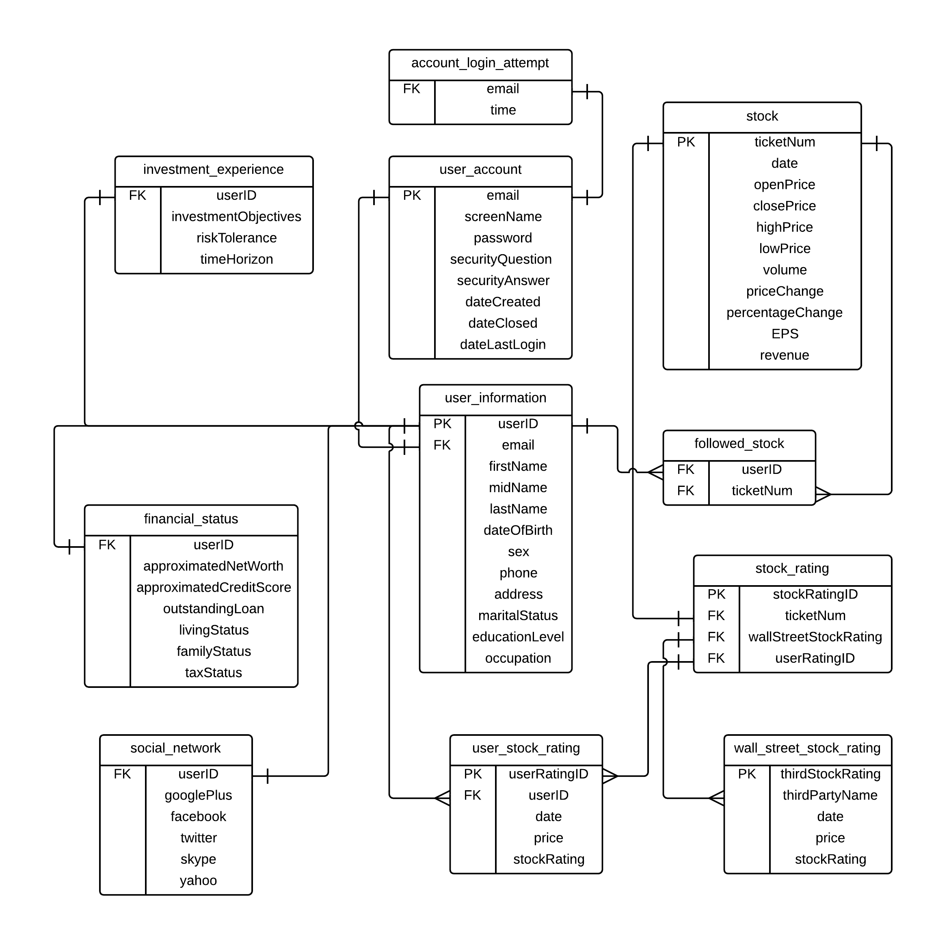
DATABASE DESIGN (Updated)

Slide 16
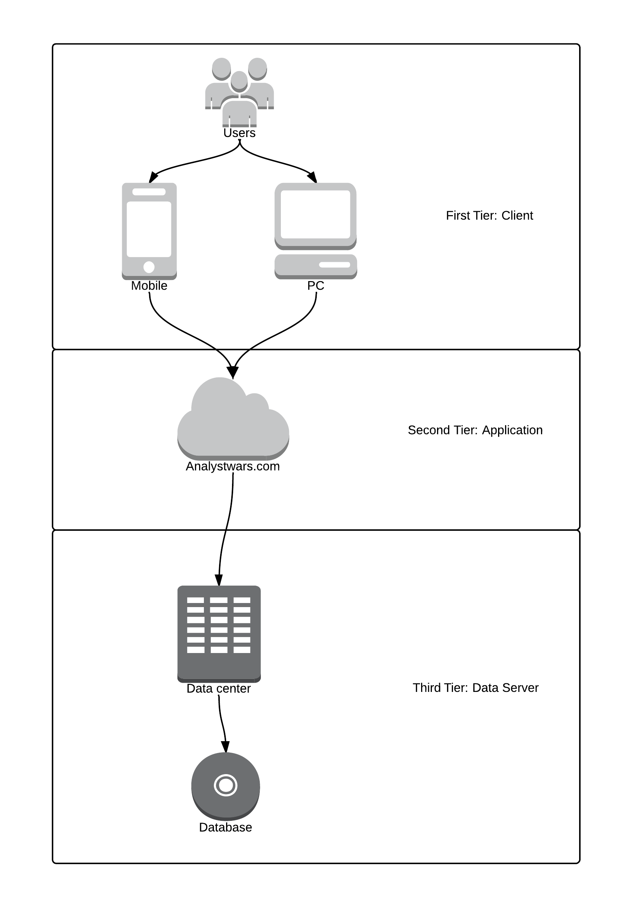
architecture DESIGN (Updated)

Slide 17
Updates (March 18, 2014)
MAIN FUNCTIONALITY:
Allow User to:
Sign Up
Log In
Create Profile
Add/Modify Profile Content & Settings
WORK ASSIGNED:
Pulkit - framework, UI elements, Log in, Sign up, Profile and Settings
Jian – Stock Page, Front End Design Research
NIck - YQL, Testing Plan, Registration System
Zach - Database Tables, Registration System, Secure Log In, Secure Session
ACOMPLISHMENTS:
Finished:
Registration Form
Log In
Stock Information System
In Progress:
Profile
Profile Settings
Stock Rating Tool

Slide 18
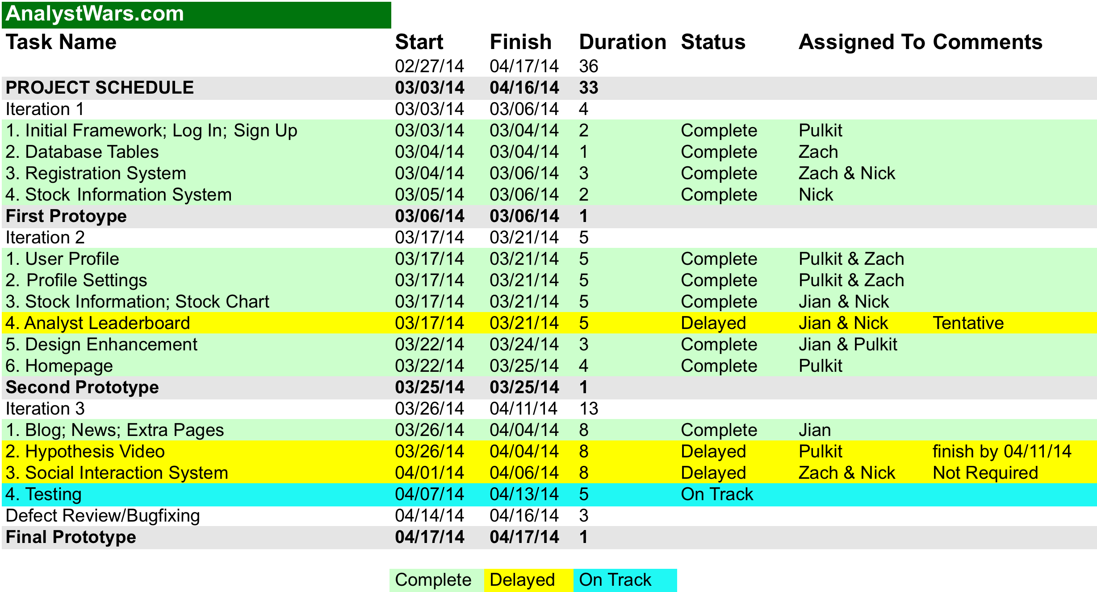
PROJECT SCHEDULE (Updated)

Slide 19
TESTING PLAN
FUNCTIONAL TESTING
Python Selenium II library
Registration
User Profile
Stock Rating
NON-FUNCTIONAL TESTING
Manual
Layout & Services
Compatibility
Secure

Slide 20
TESTING PLAN
INTEGRATION TESTING
Register an account and fill out user profile. Profile will be displayed on user account
Accurately estimate stock. User rating increases and reward points given
Inaccurately estimate stock. User rating decreases and no points are given
USER ACCEPTANCE TESTING
Starts after main features are functional
To show that the system can support day to day use

