Slide 1
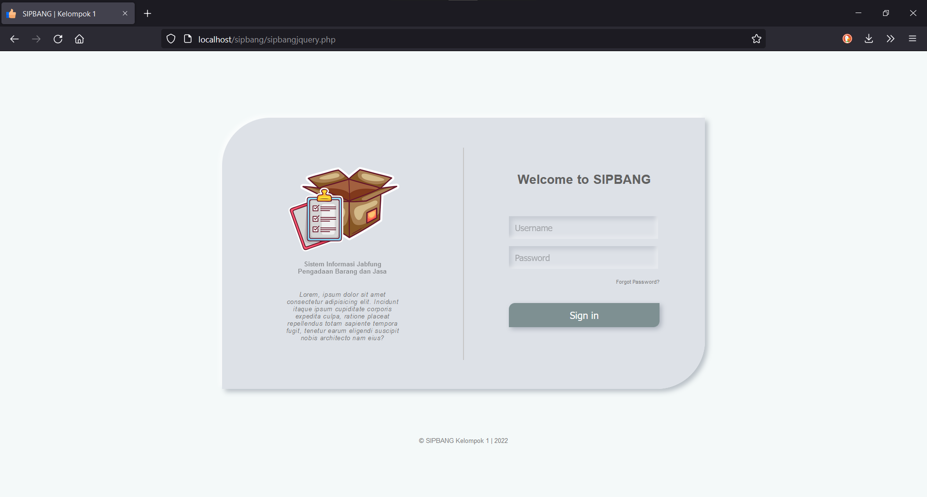
Notes:
Login page

Slide 2
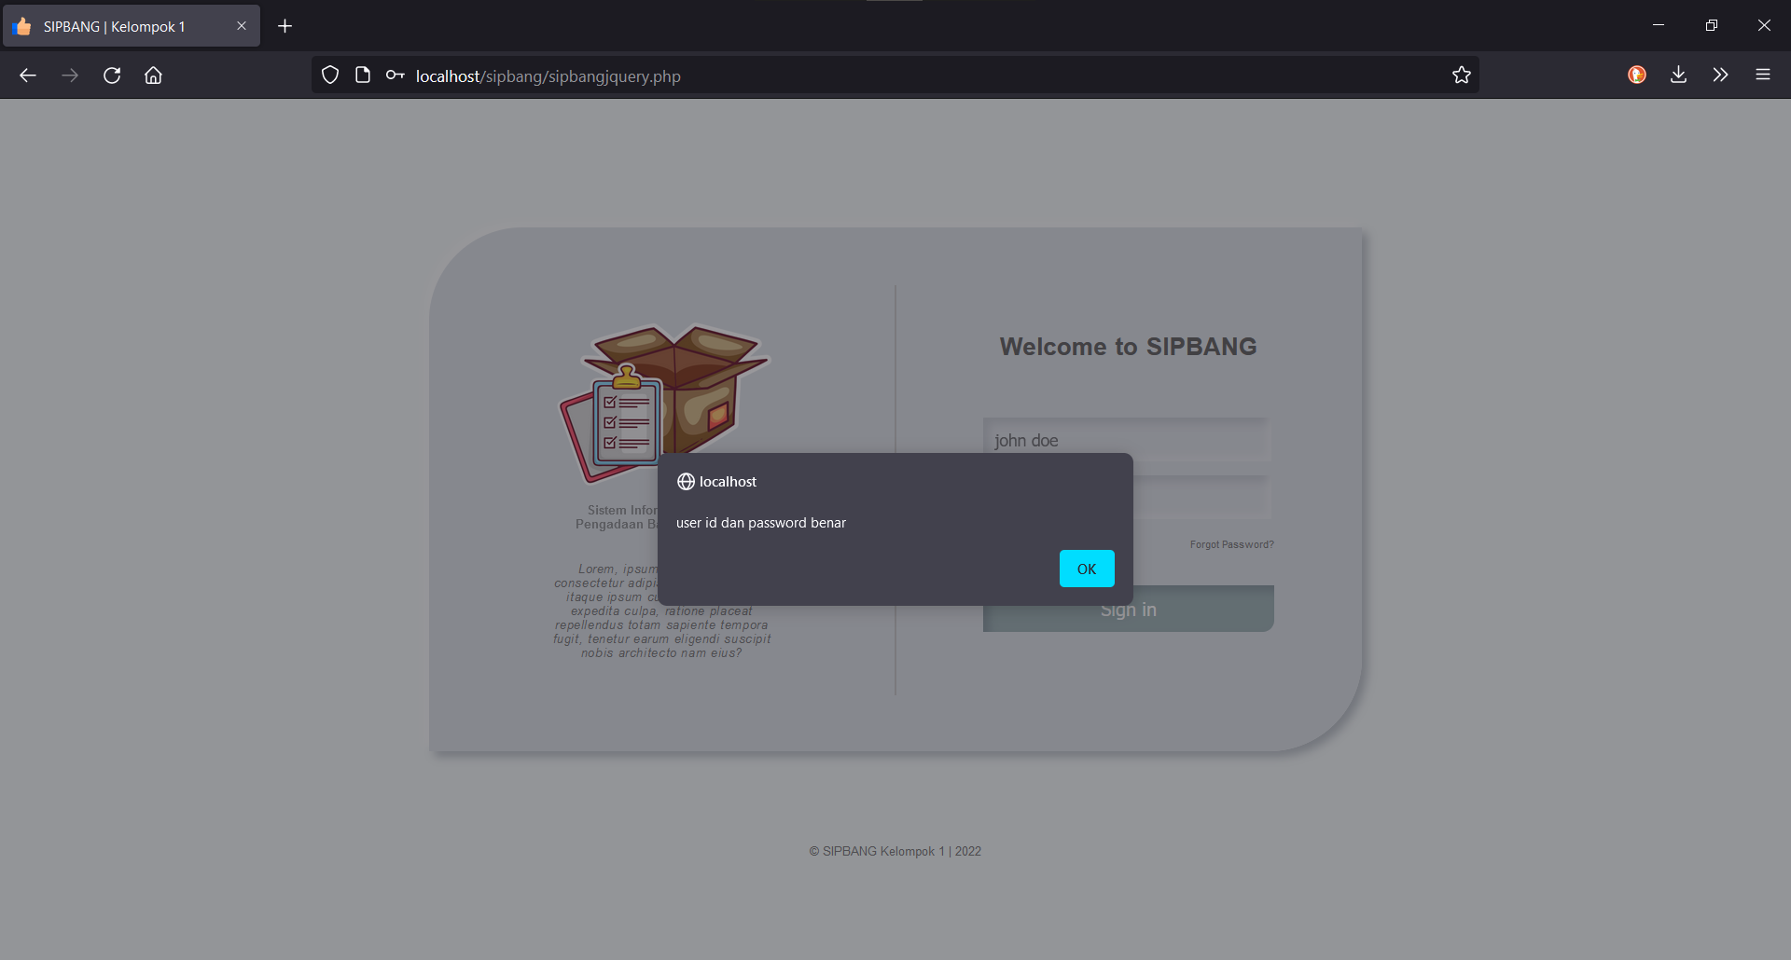
Notes:
Login credential benar

Slide 3
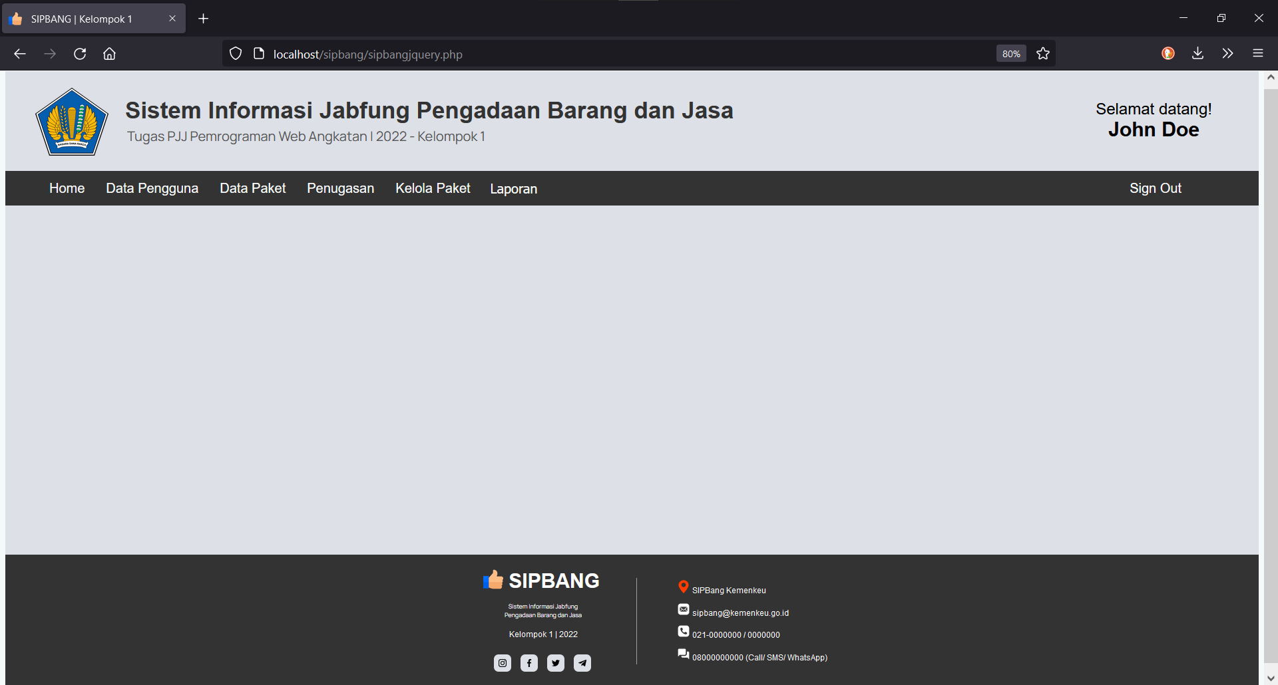
Notes:
Tampilan awal (homepage)

Slide 4
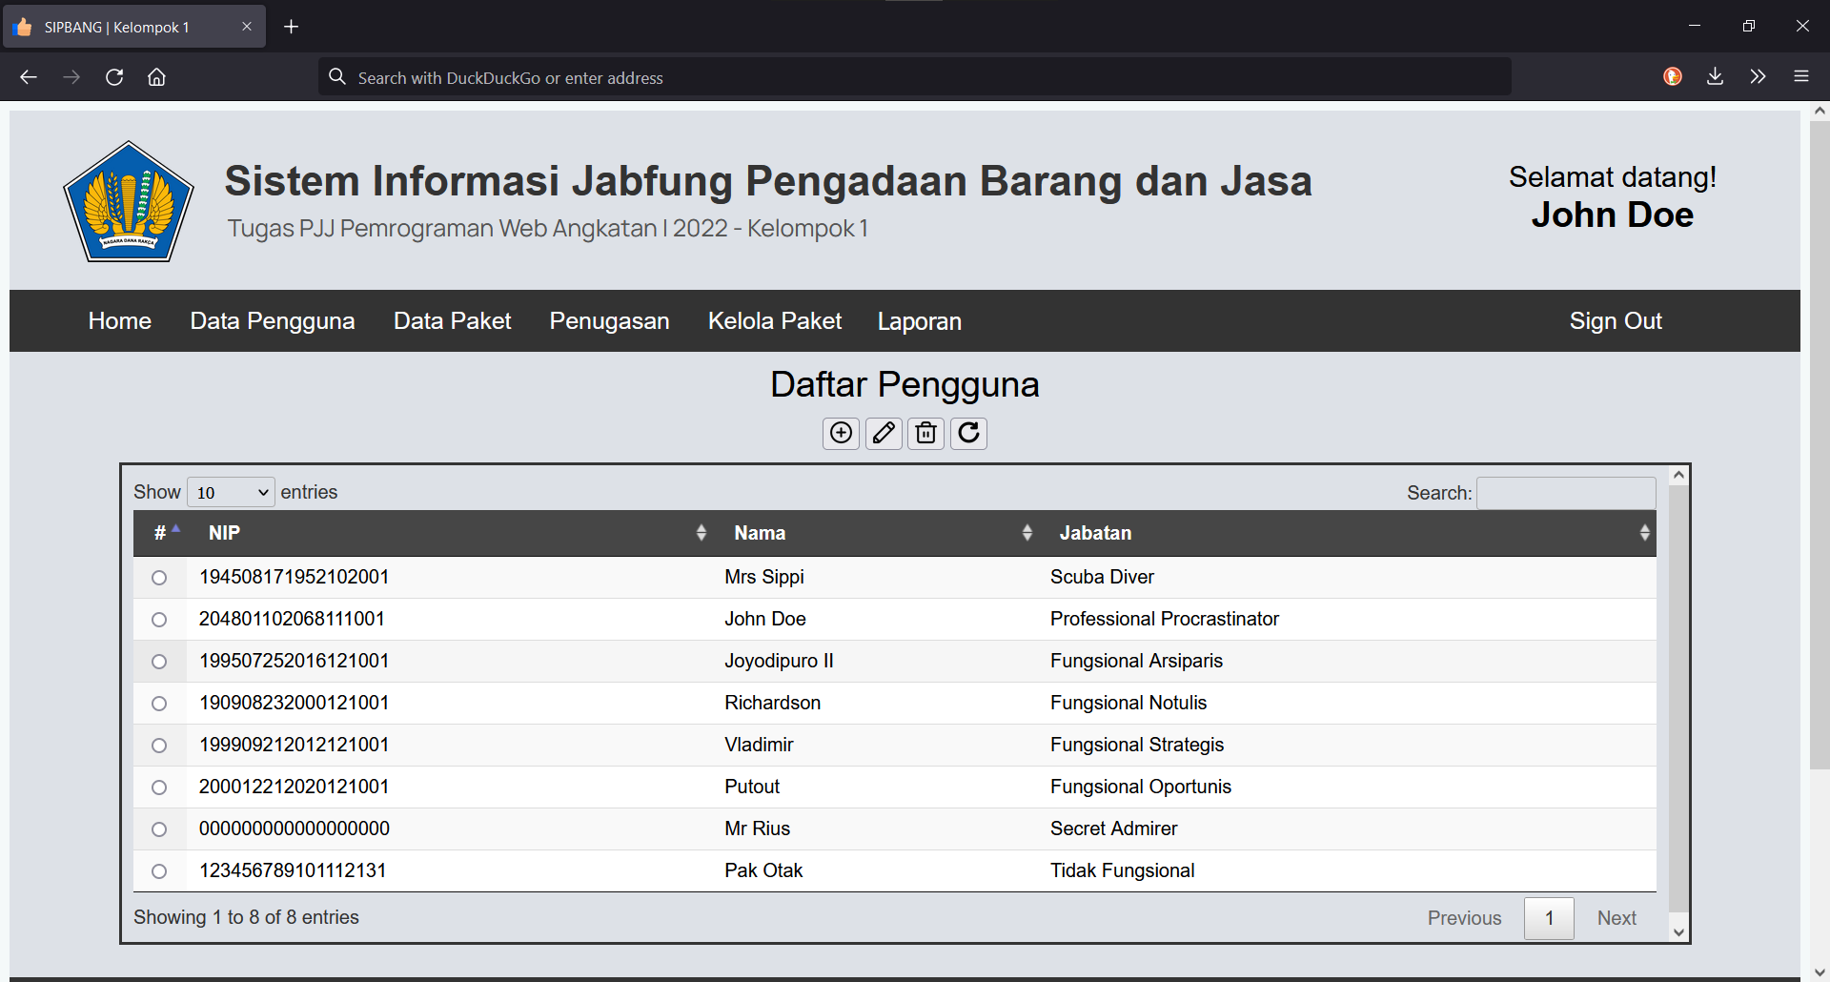
Notes:
Menu data pengguna

Slide 5
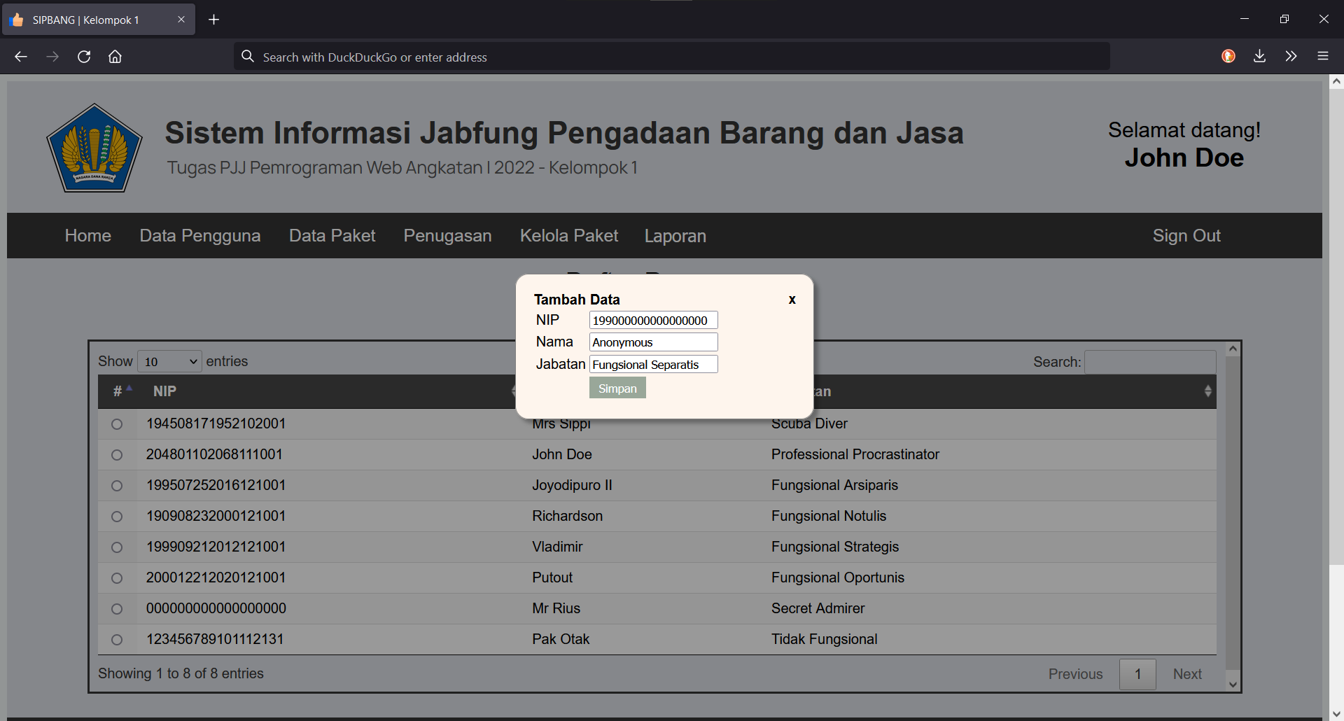
Notes:
Tambah data

Slide 6
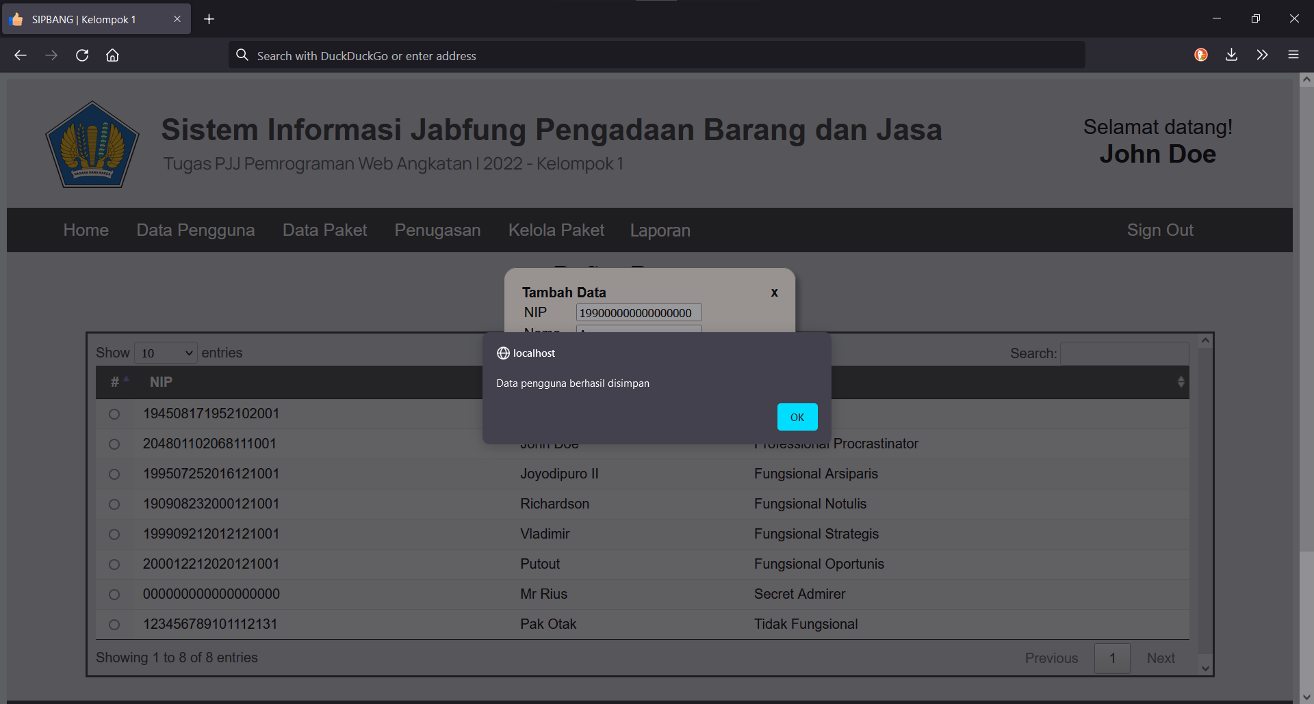
Notes:
Tambah data berhasil

Slide 7
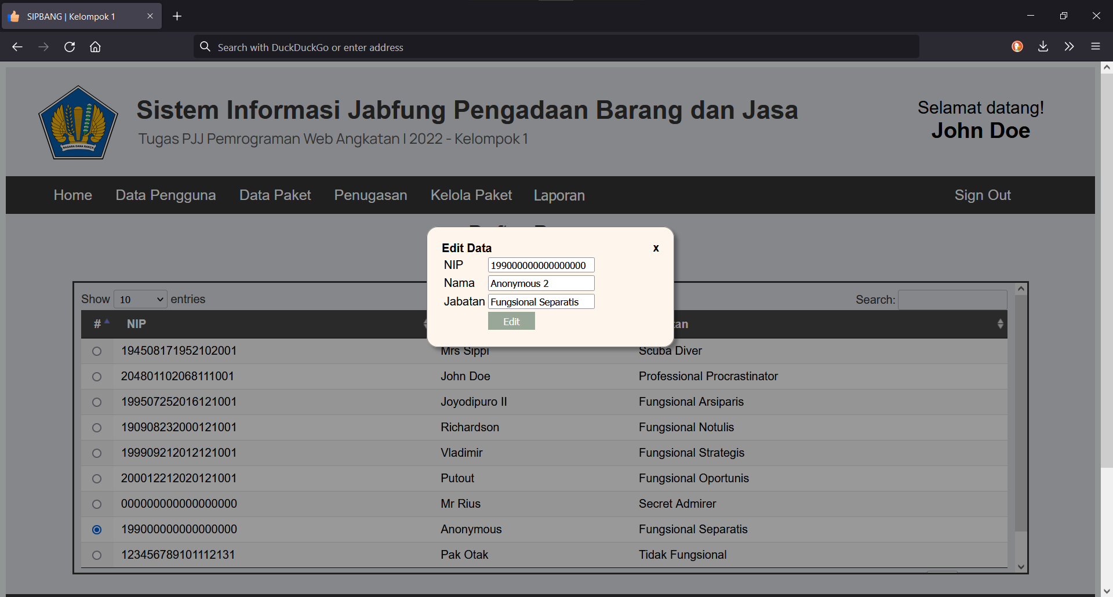
Notes:
Edit data

Slide 8
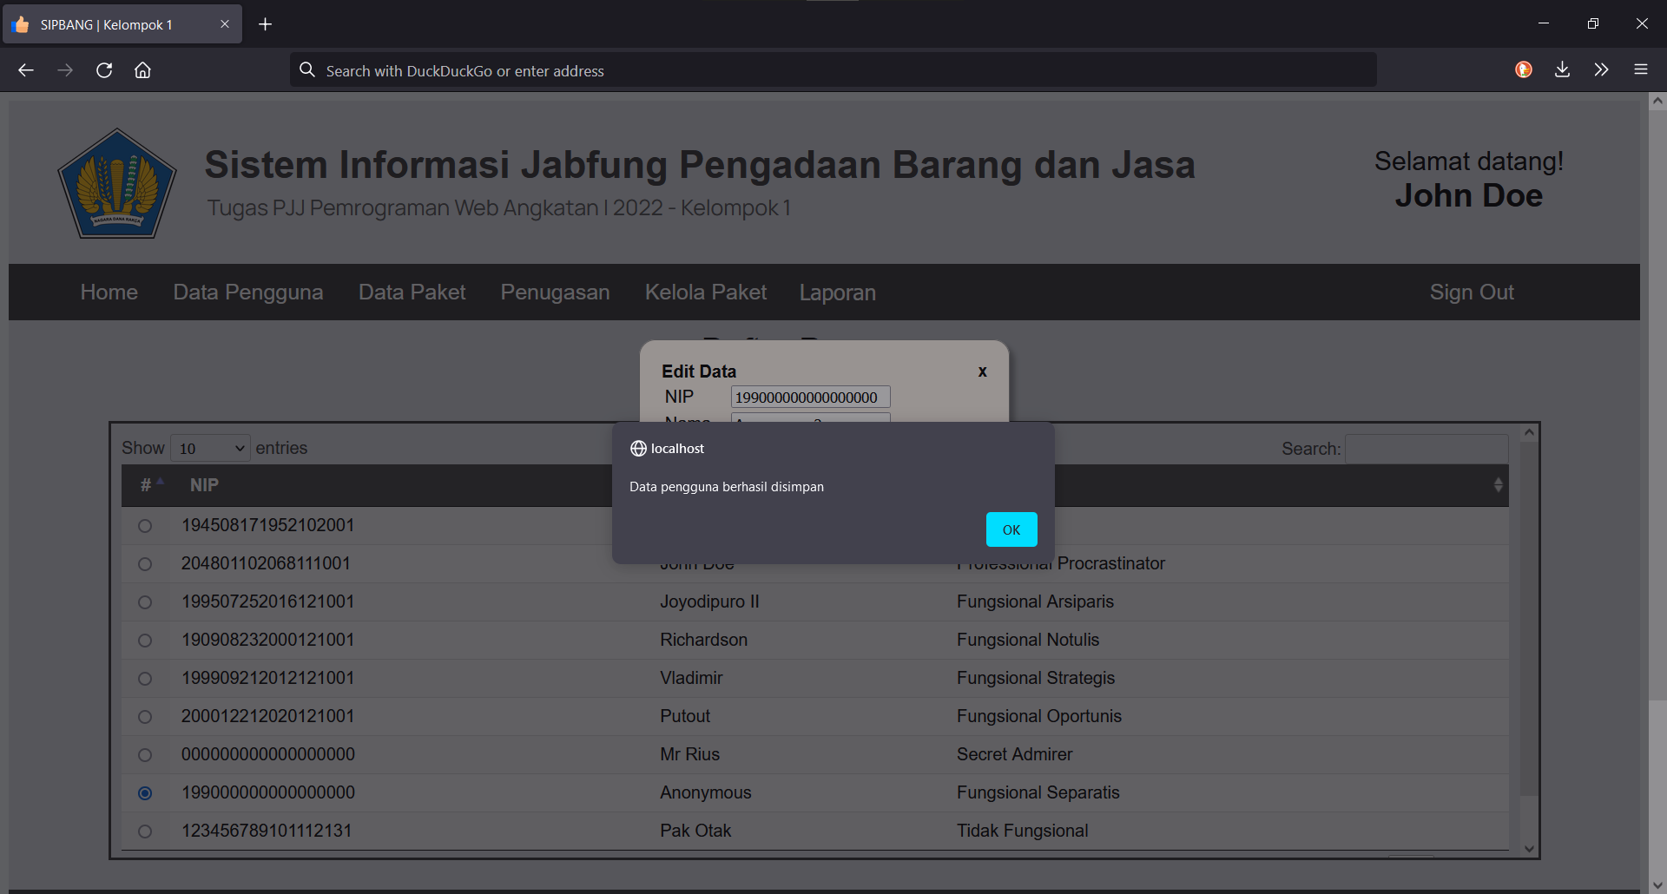
Notes:
Edit data berhasil

Slide 9

Notes:
Delete data

Slide 10

Notes:
Delete data berhasil

Slide 11
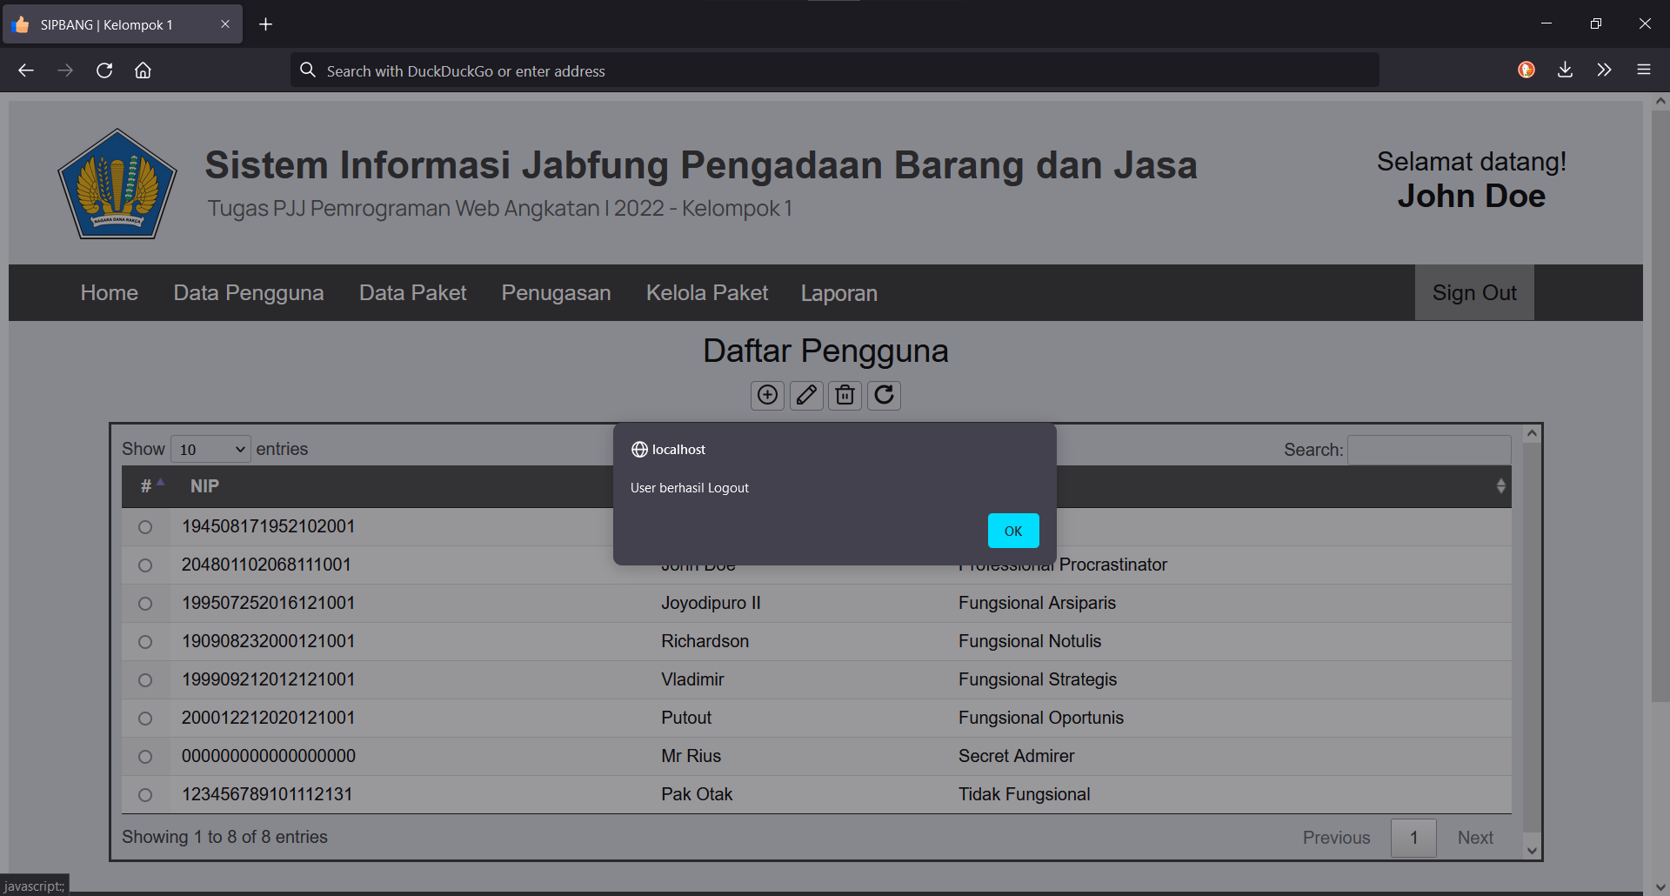
Notes:
Sign out

