Slide 1


Mobile Test Automation
Zveda Hayrapetyan

Slide 2
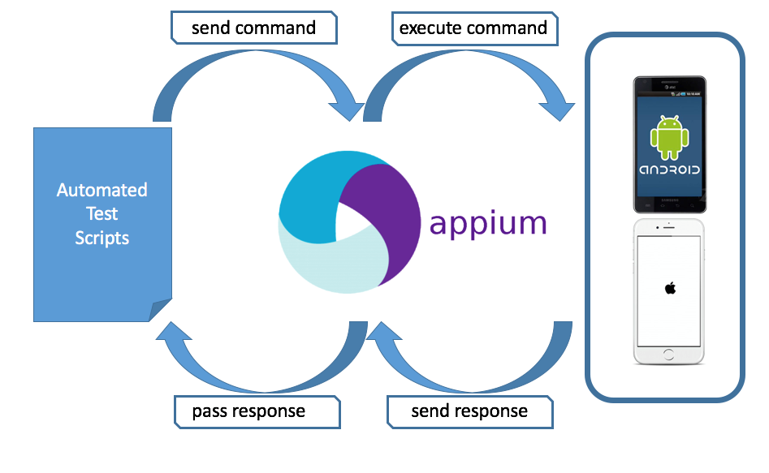
What is Mobile Test Automation?
Link - https://www.todaysoftmag.com/article/2290/appium-amp-opium-alternative-solutions-for-automated-testing

Slide 3
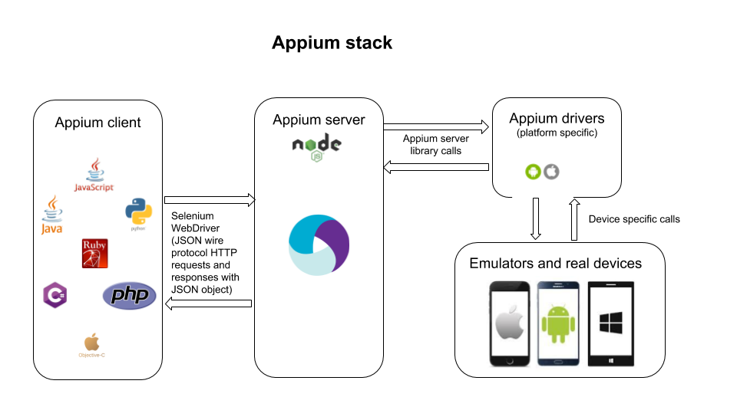
What is Mobile Test Automation?
Link - https://digital.ai/catalyst-blog/comparing-and-combining-web-and-mobile-test-automation-drivers/

Slide 4
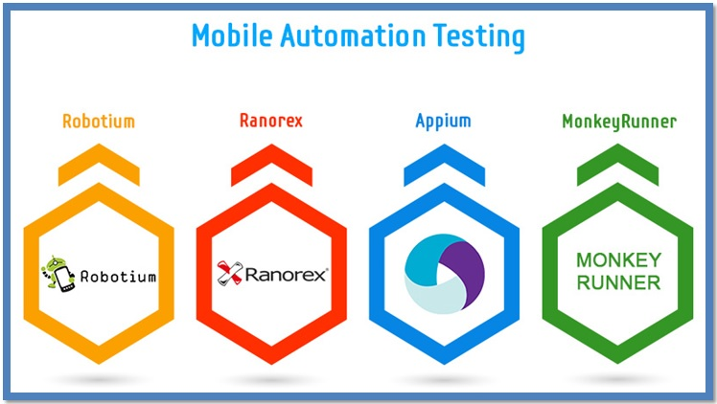
Mobile Automation Testing Managing the Mobile Invasion
Link - https://www.spec-qa.com/blog/mobile-automation-testing-managing-the-mobile-invasion/

Slide 5
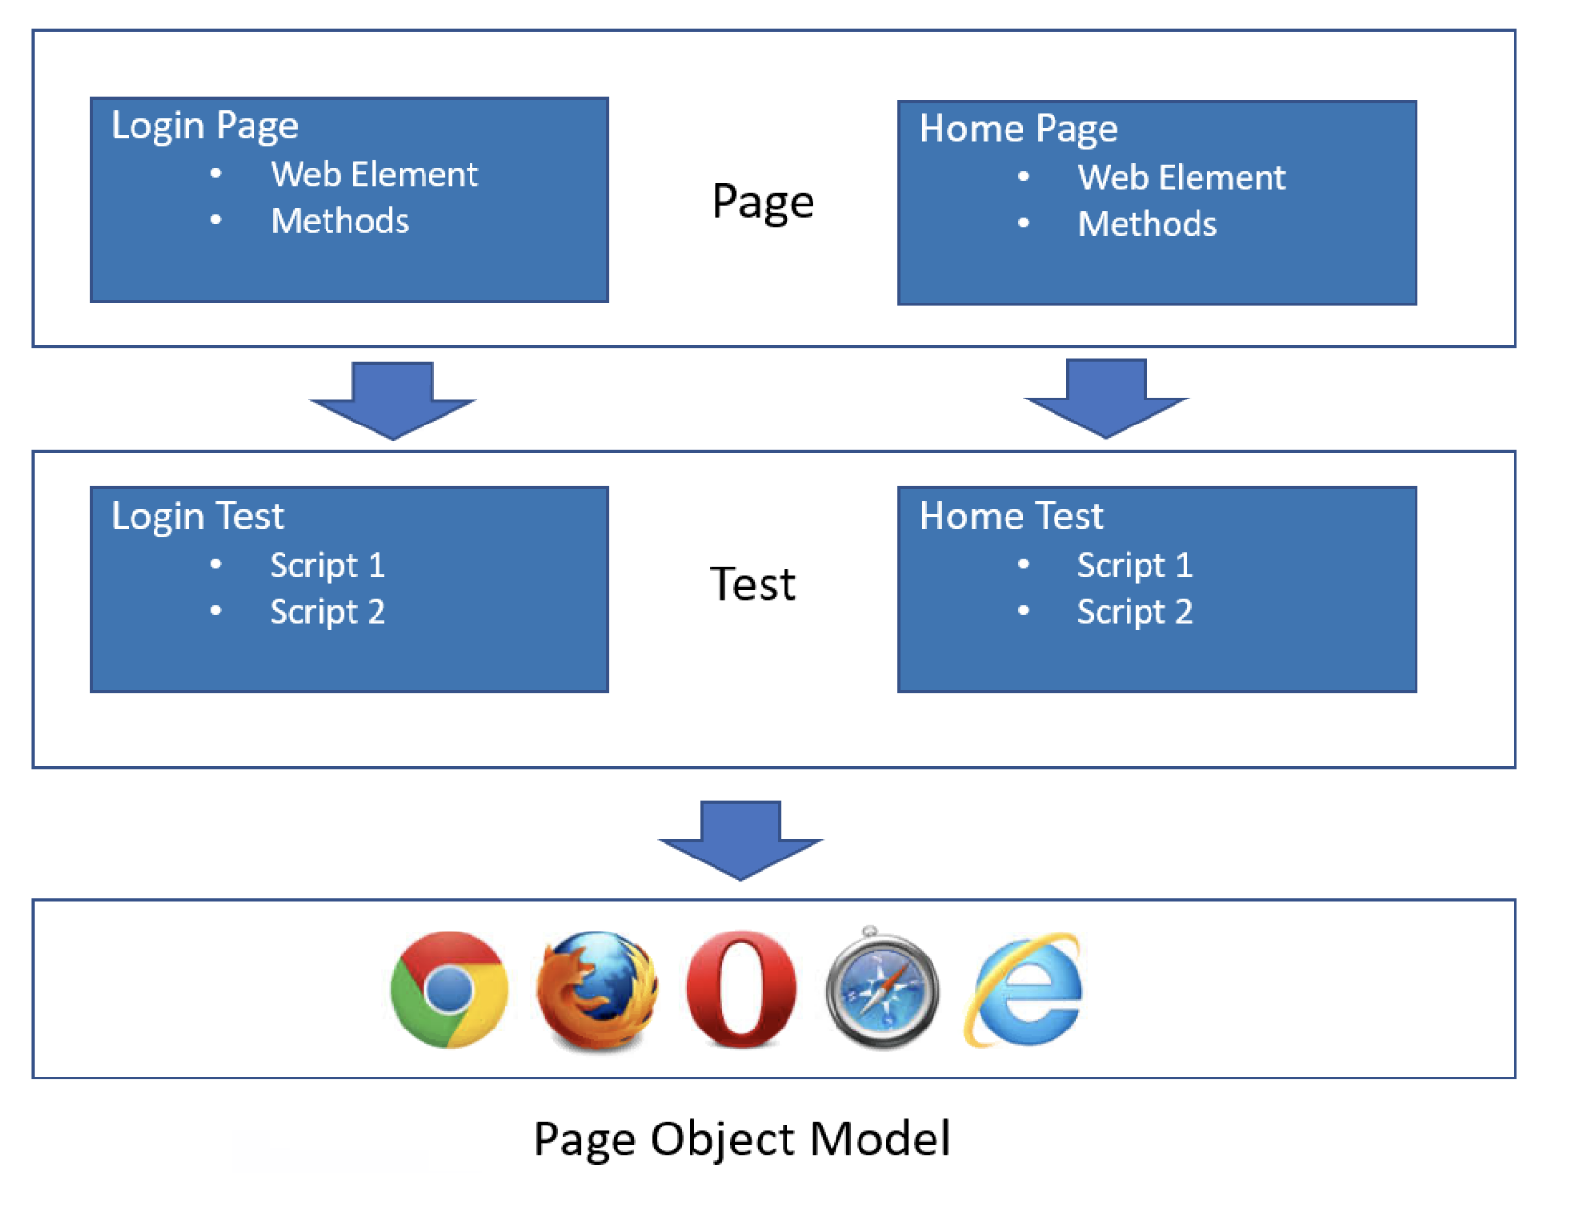
What is Page Object Model ?
The Page Object Model (POM) is a design pattern in Selenium that helps in the creation of more maintainable and reusable automated test scripts.
Link - https://www.browserstack.com/guide/page-object-model-in-cucumber

Slide 6


