Slide 1
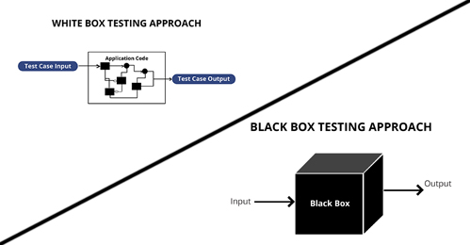
Methods of Testing

Slide 2

Testing
Testing is an essential part of software development.
It ensures that the program:
Works correctly without error
Meets the needs of the user
Testing needs to be planned ahead of actually writing the code.
It also needs to be approached in a disciplined way.

Slide 3
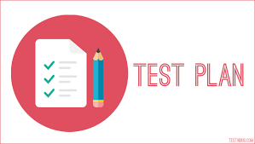
Testing
For personal projects, coders tend to just have an idea in their head of what the program needs to do when they start to write it.
During development, they test small segments of code to make sure they're working correctly.
This is fine for small, personal programs that have a specific purpose.
But for larger, professional-level projects there needs to be a test plan in place that is based on what the end-user needs.

Slide 4
Test Plan
First of all, there needs to be an understanding of what the user wants from the system.
This is initially defined in the project specification and agreed with the user.
Once the project outcomes have been clearly defined, the test plan can be written.
A test plan is a formal document which details the tests to be performed on the software.

Slide 5
Test Plan
A test plan describes:
The scope of the testing
The tests to be performed
The reason for each test
The data to be used in tests
The expected outcome of each test
Once the test has been conducted, the actual result from the test, along with evidence (e.g. screenshots) is added to the plan.

Slide 6
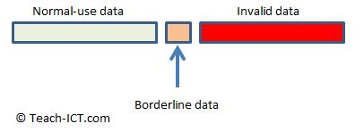
Test Data
Whilst writing the test plan, the 'test data' that is going to be used for each test, must be identified.
There are three types of test data :

Slide 7
Normal Data
This is the data that is expected to be entered into the application.
E.g. An input form asking for a username.
It is expected that the user will type in some letters and numbers for this, so normal use data will consist of usernames made of different combinations of letters and numbers.
The program needs to run without any errors when presented with this kind of data.

Slide 8
Borderline / Extreme data
This is testing the very boundary of acceptable data.
Borderline data is still acceptable and it will be processed in the same way as normal data.
E.g. The user is asked to enter a username with between 1 and 10 characters.
The borderline test data would be a username with 1 character and a username with 10 characters.
Borderline data is excellent for testing the hard limits written into the software and that the application still runs properly when handling it.

Slide 9
Invalid Data
This is data that the program rejects as invalid.
That might be because it is the wrong data type, because it contains characters that are not allowed, or it may be that the value falls outside the accepted parameters of the program.
E.g. If the user is asked to enter a username with between 1 and 10 characters, invalid test data would be a blank username, or one with 13 characters, or one that doesn't use standard letters and numbers.
If invalid data is presented, then the application needs to handle it properly i.e. not crash. Usually the user is told that the data provided has been rejected.

Slide 10
White Box Testing
White box testing is when the internal structure/ design is known (to the tester) and requires programming knowledge.
A 'white box' approach looks into the details of every algorithm in the software, rather than overall functionality
It tries to test every possible path through each bit of code and ensures that it works correctly every time.
One way this can be done is by first setting up the test input data and then "single-step" through the code by hand.
The results of this are recorded in a "trace table".

Slide 11
White Box Testing
The advantage of white box testing is that if a test fails, you can quickly pinpoint exactly where the problem is and fix it.
The disadvantage of white box testing is that it can take a long time to run through all of the test data.
You would have to make trace tables for all of the normal test data, borderline test data, and invalid test data.

Slide 12
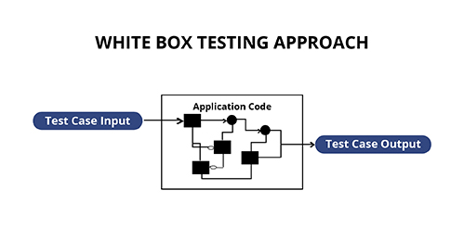
White Box Testing
Understands the structure and logic of the program
Each line and every possible path though the code is tested
Planned using the source code
Quality of algorithm is checked
Includes Dry Runs and Trace Tables
Manually execute using defined inputs
Creating a trace table

Slide 13
Black Box Testing
Black box testing is performed by people who don’t understand the internal structure/logic of the program and requires limited/no programming knowledge
The testers ignore how the program itself works, they simply enter inputs and check if the outputs match their expectations.
Because the person carrying out the test doesn't need to know anything about the software – it makes finding testers a lot easier to find, as they can be non-experts.
When you have a lot of test data to go through, black box testing allows you to check whether the program works very quickly and easily.
The disadvantage of black box testing is that if the test fails, the tester doesn't know why it failed.

Slide 14
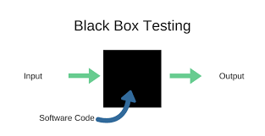
Black Box Testing
Checks that the correct output is produced for any input (valid or invalid)
Tests are based on the requirements documentation and not on the code itself.
No understanding of the code (not looking at the code).
Not concerned with quality of algorithms

Slide 15
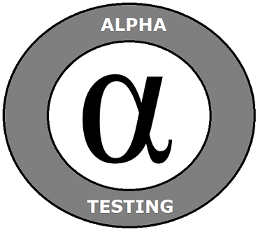
Alpha Testing
Testing is performed with a restricted audience of testers, within the software company, who provide feedback to the developers
Carried out as the program is developed
Aim is to find bugs
The software version maybe incomplete or have (known) faults

Slide 16
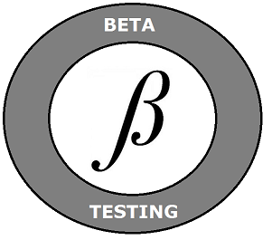
Beta Testing
Beta testing is the second stage of acceptance testing when external user-testers are used to spot flaws or issues with the software.
Beta testing is carried out when the code is nearly ready by an invited group of external testers who provide feedback.
Beta testing is intended to represent the experience of a normal user and expose any faults or issues with the application.
A Beta tester would use the software in every way they can think, to see if any bugs crop up.

Slide 17
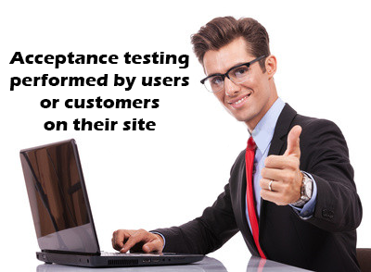
Acceptance Testing
The application is complete
The company demonstrates it to the users to see it working
The aim is to show that all the requirements have been met.

