Slide 1
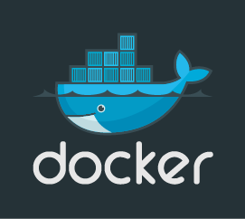

intro to docker
boise code camp 2016

Slide 2
presenter
Zach Vickery <zvickery@gmail.com>
DevOps Engineer at Cradlepoint, Inc.
Presentation Materials
https://github.com/zvickery/bcc-2016.git

Slide 3
agenda
Why Docker?
Docker - How it works
Docker Compose
Docker Machine and Docker Swarm

Slide 4
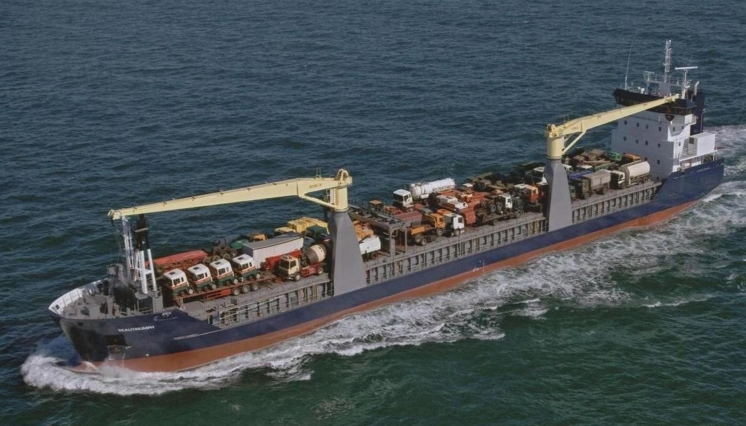
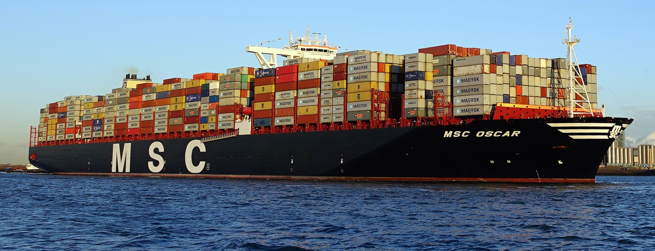
historical note

Slide 5
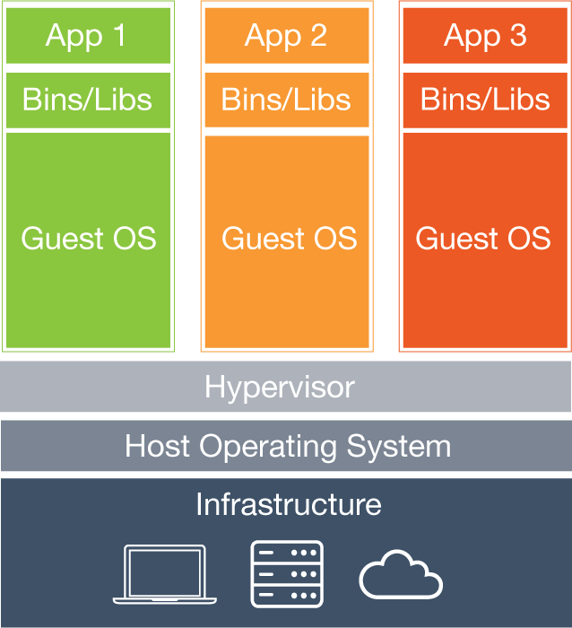
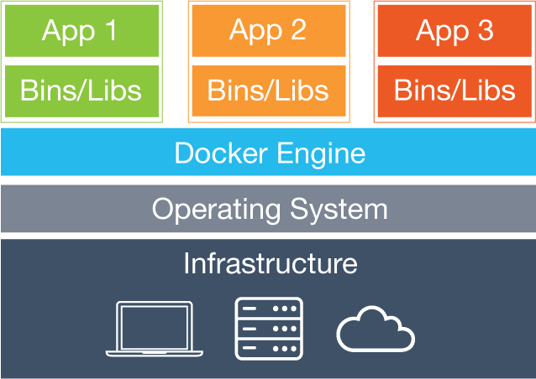
what is docker?

Slide 6
Containers - A rationale
Virtualization solutions should be less common then they have been
Are VMs even necessary? Why can’t the kernel do what a hypervisor does?
The Linux kernel (and other OS’) can do so much to support how code is shipped
Development of Linux cgroups started in 2006
FreeBSD jails and Solaris zones go back to the early 2000s

Slide 7
OS Support for containerization
cgroups features: resource limiting, prioritization, accounting, control
Namespacing: pids, networks, users, mounts, IPC, hostname
Union filesystem (e.g. aufs, OverlayFS, btrfs)

Slide 8
Linux container implementations
lxc - user-space Linux containers
CoreOS / rkt - minimal Linux kernel based OS for running containers
libcontainer (Go layer over linux containers)
Docker!

Slide 9
finally… docker
Docker is a collection of tools which makes Linux containers user-friendly
Tools allow building images, launching containers, managing them, versioning, storage, community..
Vision: Docker containers run any software, anywhere
Demo

Slide 10
docker machine
A tool to build VMs whose Docker engines can communicate
Useful to run Docker on non-Linux platforms
A building block of clusters (useful for Swarm)
Lots of VM backends supported (VirtualBox, AWS, Digital Ocean, etc)
Demo

Slide 11
docker best practices
Containers are ephemeral
One process per container
Minimize layers (to reduce image size)
Use volumes for persistence
Design for fault-tolerance and scale

Slide 12
volumes
Disk within a container is ephemeral
If your container stops, the data in it is gone
Volumes allowing mapping from the host FS to the container FS
Can be annoying with incomplete user mapping support in Docker

Slide 13
resource allocation
Controlled via ‘docker run’ options
CPU (dynamic and reserved)
—cpu-shares, —cpuset-cpus
Memory limit
—memory

Slide 14
docker cleanup
Docker doesn’t clean up resources automatically
Must manage stray containers, images, and volumes manually
CLI is the standard way to do this
docker ps -aq | xargs docker rm
docker images –qf “dangling=true” | xargs docker rmi
docker volume ls -qf dangling=true | xargs docker volume rm

Slide 15
docker hub
Community site for sharing Docker images
Integrated into ‘docker pull’, ‘docker search’, ‘docker build’, etc.
Private repositories cost money
https://hub.docker.com/
Demo

Slide 16
Docker registry
Sort of like a private Docker Hub
An alternative to Docker Hub for hosting private images
It’s just a Docker container, so hosting is straightforward
Demo

Slide 17
docker compose
Containers are great, but what if you want more than one process?
Compose uses a YAML format to allow describing multiple containers, how they should be run, and how they talk to each other
Compose is a separate download from Docker engine
Demo

Slide 18
batch jobs
Compose is a great tool for running batch jobs via the ‘run’ sub-command
‘docker run’ commands can get super-long when there are many environment variables or volumes
Compose can be used sort of like a Makefile with targets

Slide 19
docker swarm
What about running containers on more than one VM?
Swarm allows building a cluster with docker-machine
Requires either static discovery (token) or a service like consul
Eventually it will ‘just work’ with docker-compose
Demo

Slide 20
the future
Better autoscaling support
Cloud provider integration - AZ distribution
Rebalancing upon failure / network partitioning
Unikernels - library operating systems

Slide 21
limitations
Containers are new and many existing tools don’t support them directly
Debugging tools
Monitoring tools
Load balancers
Auto-scaling services

Slide 22
Thank you
Materials
https://github.com/zvickery/bcc-2016.git

