Slide 1
Ramsey Theory
Presented by Lariza Ramsammy

Slide 2

Recall:
Graph – a set of vertices and edges denoted by single digit elements and coordinates, respectively
Colourings – a characteristic of an edge; gives us a way to vary a connection between two vertices
Monochromatic – a graph with one colouring
Complete Graph – We call a complete graph, $K_{m}$ , a graph on m vertices whose edges are all connected
Subgraph – a subset of a graph
Clique - a complete subgraph
[n] = {1,2,…,n}
Alphabet - an alphabet is a set of elements, called letters which are used to create words
Words – a combination of letters from an alphabet

Slide 3
What is Ramsey’s Number?
R ( n , k ) = m
m - the minimum required number of vertices s.t. I can find a complete monochromatic subgraph on n vertices or a complete subgraph on k vertices in another colouring
Examples
What is Ramsey’s number for R(2,2)?
What is R(3,3) ?
R(4,4) = ?
R(4,5) =?
R (5,5) =?

Slide 4
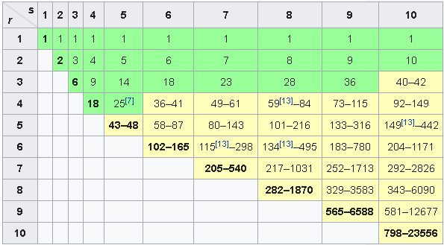
Known Values/Ranges of Ramsey’s Numbers

Slide 5


Ramsey’s Theorem
For all n , k $∈$ N , R(n , k ) = m will be finite.
Proof: Base Case: Let n + k = 4. Then R(2,2) = 2.
Suppose then R( n – 1 , k ) and R( n , k - 1) are finite
Claim: R( n , k ) $≤$ R( n – 1 , k ) + R( n , k - 1)
Let $m=R\left(n−1 , k\right)+R(n, k−1)$
Consider, in terms of one vertex, v, you have the remaining m – 1 vertices.
We can look at those as two different subsets: vertices connected to v by a red edge and those connect to v by a blue edge.
We’ll label these sets A and B respectively.
So we can say then that m - 1 = |A|+|B|= R ( n – 1 , k ) + R ( n , k – 1 ) - 1
Then we have two possibilities. Either:
|A| ≥ R ( n – 1 , k ) or |B| ≥ R ( n , k – 1 )

Slide 6

Proof continued…
Suppose then, WLOG |A| ≥ R ( n – 1 , k )
Then A contains either a red $K_{n−1}$ or a blue $K_{k}$
If the former, then when we consider our point of focus, v, we get exactly $K_{n}$
If the latter, we’re already done
Hence, we have that if a graph has at least m = $R\left(n−1 , k\right)+R(n, k−1)$ vertices, then there is a red $K_{n}$ or a blue $K_{k}$ .
Therefore R( n , k ) $≤$ $R\left(n−1 , k\right)+R(n, k−1)$ and is thus finite.
□

Slide 7

Generalization of Ramsey’s Theorem
In general, Ramsey’s Theorem claimed that R($n_{1}, …., n_{k}$) = m is finite.
Proof by induction again: This time on the number of colours.
Base case is k = 2 (Proven in last slides)
Claim: $R\left(n_{1}, …., n_{k}\right)≤R\left(n_{1}, …. n_{k−2},R\left(n_{k−1}, n_{k}\right)\right)$
Suppose we have a k-coloured graph of size $R\left(n_{1}, …. n_{k−2},R\left(n_{k−1}, n_{k}\right)\right)$. Let k-1 and k represent colours red and blue, respectively. Then we either have an i-coloured $K_{n_{1}}$ subgraph, or red/blue subgraph of size $R\left(n_{k−1}, n_{k}\right)$.
If the former, done.
If the latter, then again, we have two cases. Either there is a red - $K_{n_{n−1}}$ or a blue $K_{n_{k}}$ subgraph.
Hence, we can conclude that $R\left(n_{1}, …., n_{k}\right)≤R\left(n_{1}, …. n_{k−2},R\left(n_{k−1}, n_{k}\right)\right)$ and since $R\left(n_{1}, …. n_{k−2},R\left(n_{k−1}, n_{k}\right)\right)$ is finite, so too must $R\left(n_{1}, …., n_{k}\right)$ be finite.
□

Slide 8

Bounds for Ramsey Numbers
$2^{\frac{n}{2}}≤R(n,n)$
R(n,k) ≤ $(\begin{matrix}n+k −2 \\ n−1\end{matrix})$
$R\left(n_{1}, …., n_{k}\right)≤R\left(n_{1}−1, …., n_{k}\right)+R\left(n_{1}, n_{2}−1,…., n_{k}\right)+…+R(n_{1}, …., n_{k}−1)$
$R\left(n_{1},+1, n_{2}+1,…., n_{k}+1\right)≤(\frac{\left(n_{1}+n_{2}+…+n_{k}\right)!}{n_{1}!n_{2}!{…n}_{k}!})$

Slide 9
Other Theorems and Applications of Ramsey’s Theory

Slide 10
Schur’s Theorem
Given a positive integer r, there exists a positive integer S(r) s.t. if [S(r)] is coloured with r colours, then a monochromatic x, y, and z exists satisfying x + y = z. Note that x and y are not necessarily distinct.
Applications of Schurr’s Theorem
Triangularization Theorem
Schur’s Theorem for a Block Hadamard Product
Schur Decomposition Theorem
Schur’s Lemma as a result of Representation Theory (Alternate Algebraic Interpretation)

Slide 11
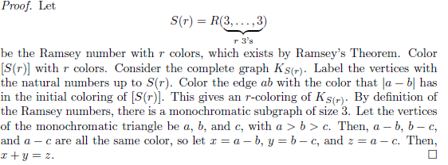
Proof of Schur’s Theorem

Slide 12
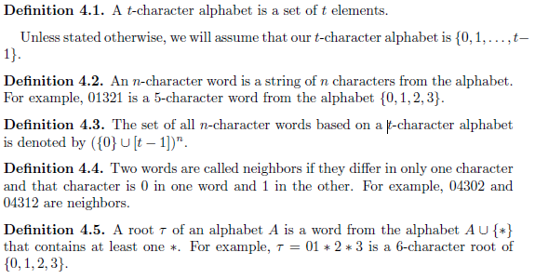
Vocab Re-established with notation in keeping with proof to follow:

Slide 13

Hales – Jewett Theorem
Given an alphabet of length t and r colours, there exists an integer HJ(r , t) s.t. for N ≥ HJ(r , t) and any r-colouring of words of length N, there exists a monochromatic combinatorial line.

Slide 14
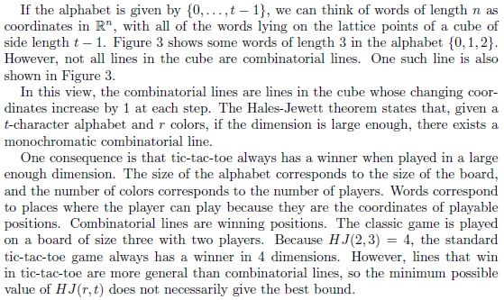
Added for Clarification:
Click here for video representation of Tic-Tac-Toe ApplicatioNs as Mentioned

Slide 15

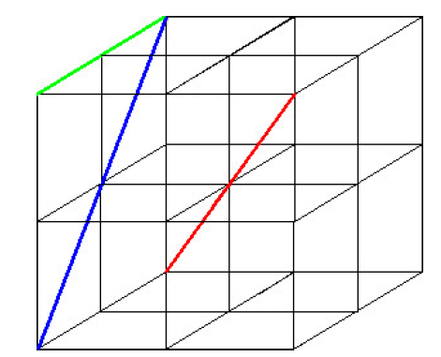
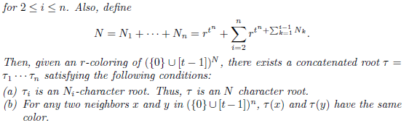

Before the proof, we’ll establish this crucial Lemma…

Slide 16
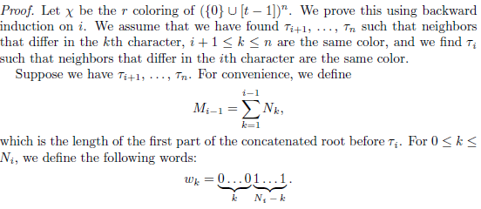
Proof of Lemma

Slide 17
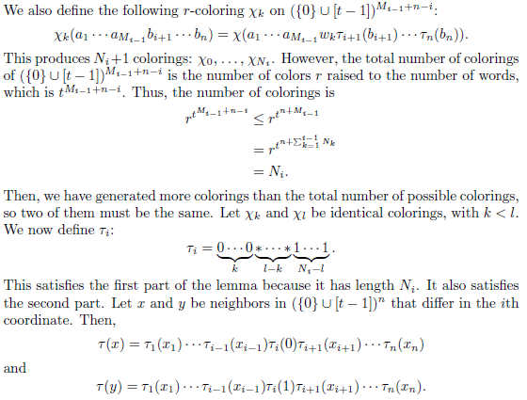
Proof of Lemma Continued…

Slide 18
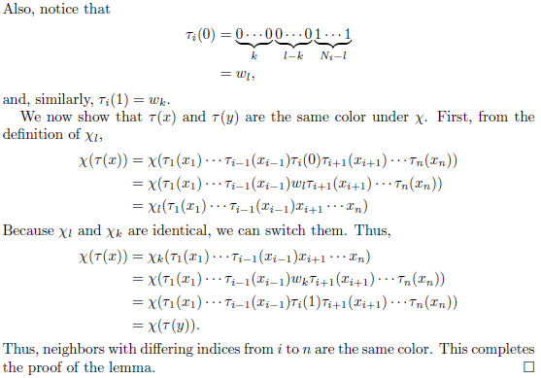
Proof of Lemma Continued…

Slide 19

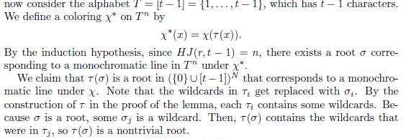
Proof of HaleS-JeweTt Theorem

Slide 20
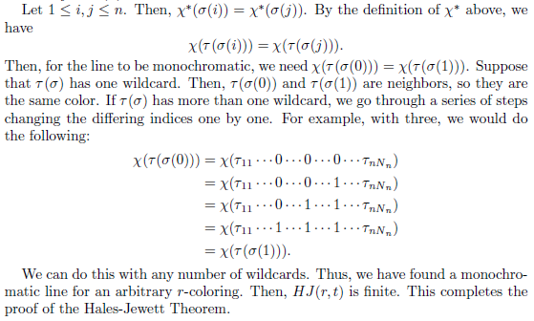
Proof of HaleS-JeweTt Theorem Continued…

Slide 21
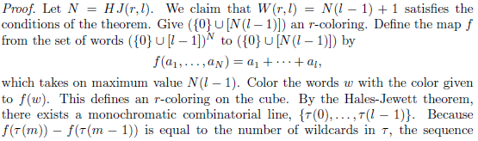
Van der Waerden’s Theorem
Given any two natural numbers r and l, there exists a natural number W(r,l) s.t. if set {1,2,…,W(r,l)} is coloured with r colours, there exists a monochromatic arithmetic progression of length l.

Slide 22

Proof of Van Der Waerden’s Theorem Continued…

Slide 23

Gallai – Witt’s Theorem
Basically states that if we extend Van Der Waerden’s Theorem to multiple Dimensions, it still holds. Colour some ${\text{Z}}^{m}$ with r colours. Then for any finite subset of vectors V, there exists a monochromatic homothetic copy of V a.k.a. a translation and dilation of V. (A homothetic copy of V can formally be defined as a set $u+aV=\{u+av_{i}|v_{i}∈V\}$ where $u$ is a vector and $a$ is a scalar).
Graph Theory Interpretation

Slide 24
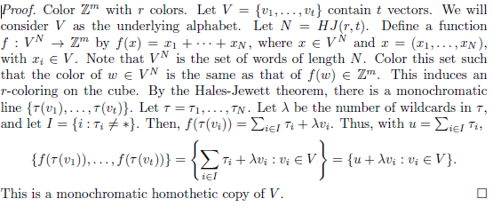
Proof of Gallai – Witt’s Theorem

Slide 25
Resources
Known Values/Ranges of Ramsey’s numbers Chart
Arithmetic Ramsey Theory by Zdenek Dvorak, Charles University in Prague, September 14, 2015.
Combinatorics 3 - Combinatorial Number Theory by Henry Liu, University of Cambridge, February 6, 2012.
Combinatorial Relations and Chromatic Graphs by R.E. Greenwood and A.M. Gleason Havard University in collaboration with the University of Texas, June 8, 1954.
Purely Combinatorial Proofs of Van Der Waerden-Type Theorems by William Gasarch and Andy Parrish, Penn State University, January 14, 2008.
Ramsey Theory by Lane Barton IV, Whitman College, May 13, 2016.
Some Theorems and Applications of Ramsey Theory by Matthew Steed, University of Chicago.
Kaj Hansen’s Youtube Series on Ramsey Theory Parts 1-6, Georgia University, January 2014.
PBS Infinite Series’s “Higher Dimensional Tic-Tac-Toe” September 21, 2017.
Sir Timothy Gowers’s Numberphile interview on Van der Waerden’s Theorem “Colouring Numbers”, January 21, 2020.

