Slide 1
The Cramér-Rao Bound for Sparse Estimation
Zvika Ben-Haim and Yonina C. Eldar
Technion – Israel Institute of Technology
IEEE Workshop on Statistical Signal Processing
Sept. 2009

Slide 2
Overview
Sparse estimation setting
Background: Constrained CRB
Unbiasedness in constrained setting
CRB for sparse estimation
Conclusions

Slide 3
Sparse Estimation Settings
.
  General case: arXiv:0905.4378 (submitted to TSP)

Slide 4
Background
Many applications:
  Denoising
  Deblurring
  Interpolation
  In-painting
  Model selection
Many estimators:
  Basis pursuit/Lasso
  Dantzig selector
  Matching pursuit
  (and variants)
  Thresholding
How well can these algorithms perform?
Our goal: Cramér-Rao bound for estimation with sparsity constraints

Slide 5


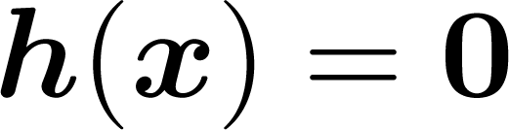
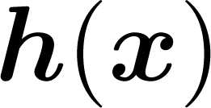


Background
Cramér-Rao bound (CRB) with constraints:
What is the lowest possible MSE of an unbiased estimator of when it is known that
Gorman and Hero (1990), Marzetta (1993),
Stoica and Ng (1998), Ben-Haim and Eldar (2009)
  Constrained CRB lower than unconstrained bound
None of these approaches is applicable to our setting:
  Sparsity constraint cannot be written as
  for continuously differentiable
  underdetermined singular Fisher information

Slide 6
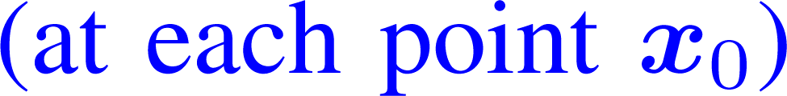



The Need for Unbiasedness
CRB: A pointwise lower bound on MSE
MSE
CRB

Slide 7


The Need for Unbiasedness
CRB: A pointwise lower bound on MSE
To get such a bound, we must exclude
some estimators
  Example:
MSE
CRB

Slide 8
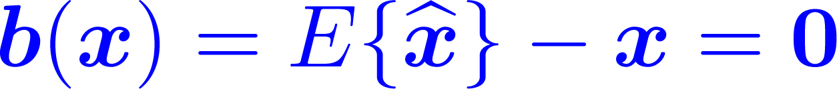

The Need for Unbiasedness
CRB: A pointwise lower bound on MSE
To get such a bound, we must exclude
some estimators
  Example:
Solution: Unbiasedness
(or more generally, specify any desired bias)
  Implies sensitivity to changes in

Slide 9



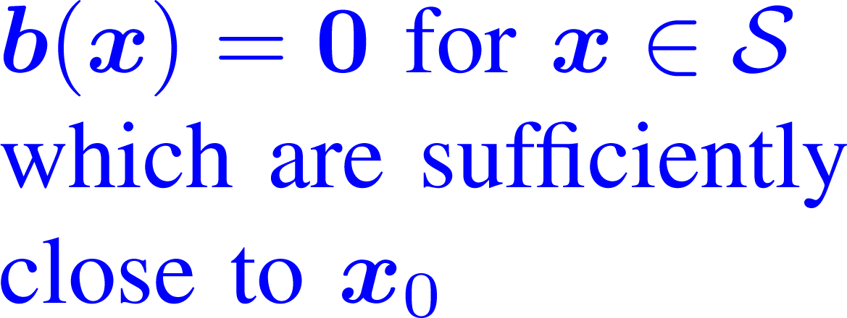
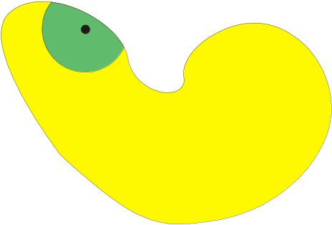

What Kind of Unbiasedness?
Unbiased for all
  We will show that no such estimators exist
  in the sparse underdetermined setting
Unbiased at our specific
  Not good enough:
.
Unbiased at specific and its local neighborhood

Slide 10

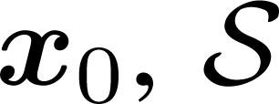

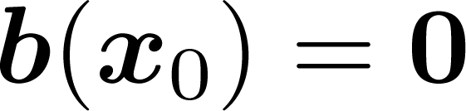
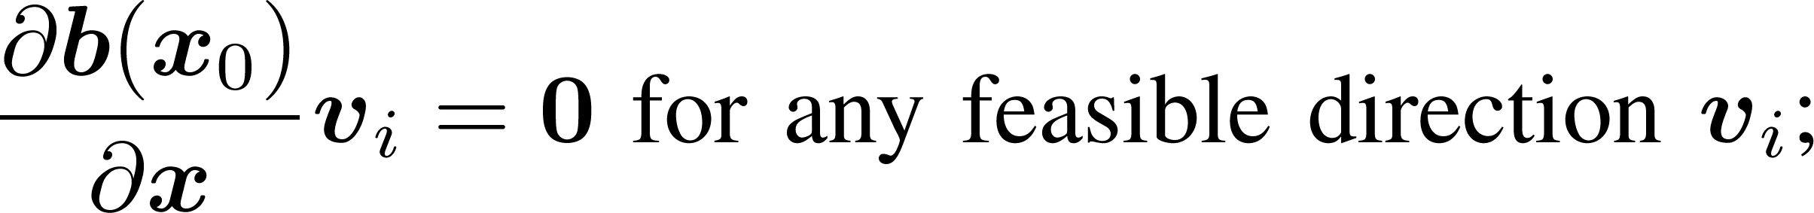
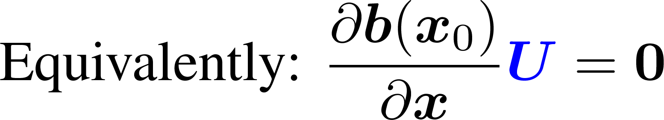
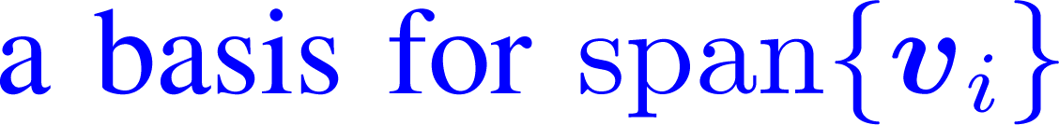
Formalizing -Unbiasedness
is a union of subspaces
At any point is
characterized by a set of
feasible directions
  The constraint set is completely defined
  by the matrix U at each point
  This characterization does not require
  to be continuously differentiable

Slide 11

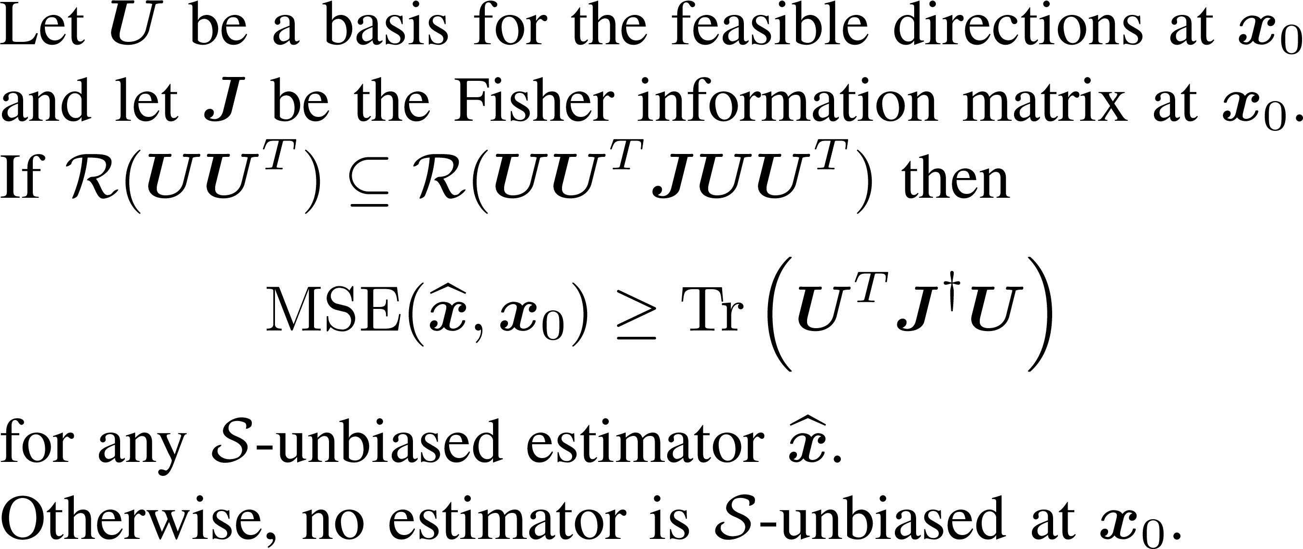
Constrained CRB
CRB for constraint sets characterized by feasible directions:
Coincides with previous versions
of constrained CRB
(when they are characterizable
using feasible directions)
Theorem:

Slide 12
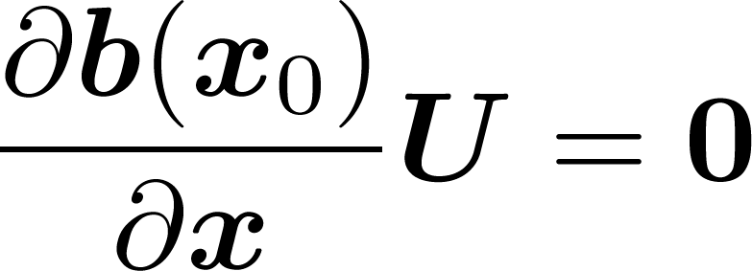

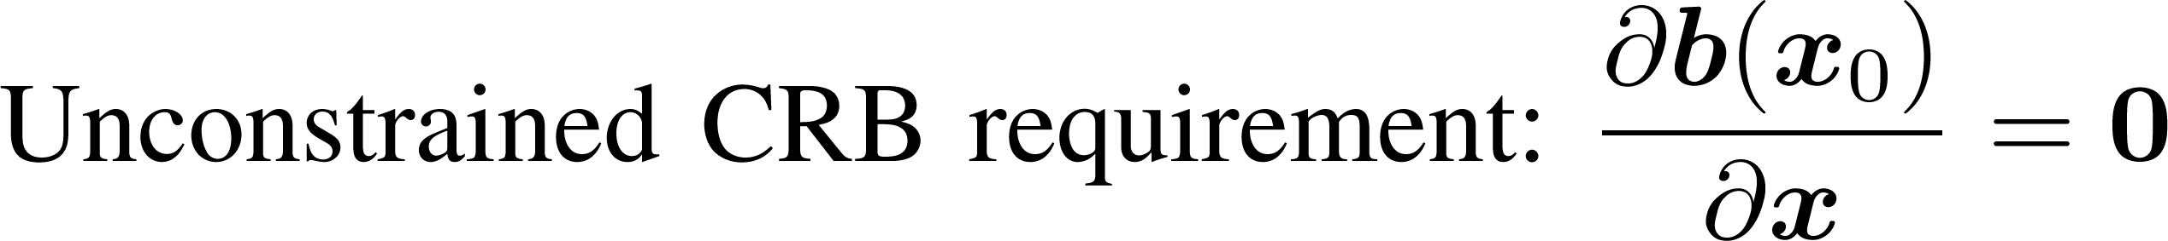
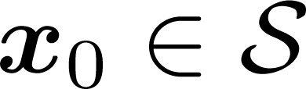
Constrained and Unconstrained CRB
.
  More estimators are included in constrained CRB
  Constrained CRB is lower
  … but not because it “knows” that

Slide 13

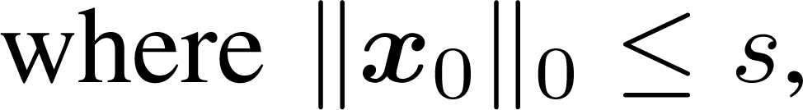
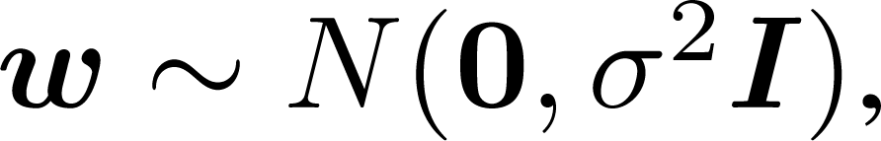
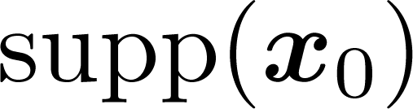
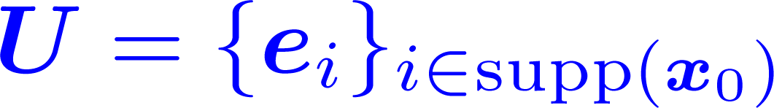


Constrained CRB in Sparse Setting
Back to the sparse setting:
What are the feasible directions?
  At points for which
  changes are allowed within
  At sub-maximal support points,
  changes are allowed to any entry in

Slide 14
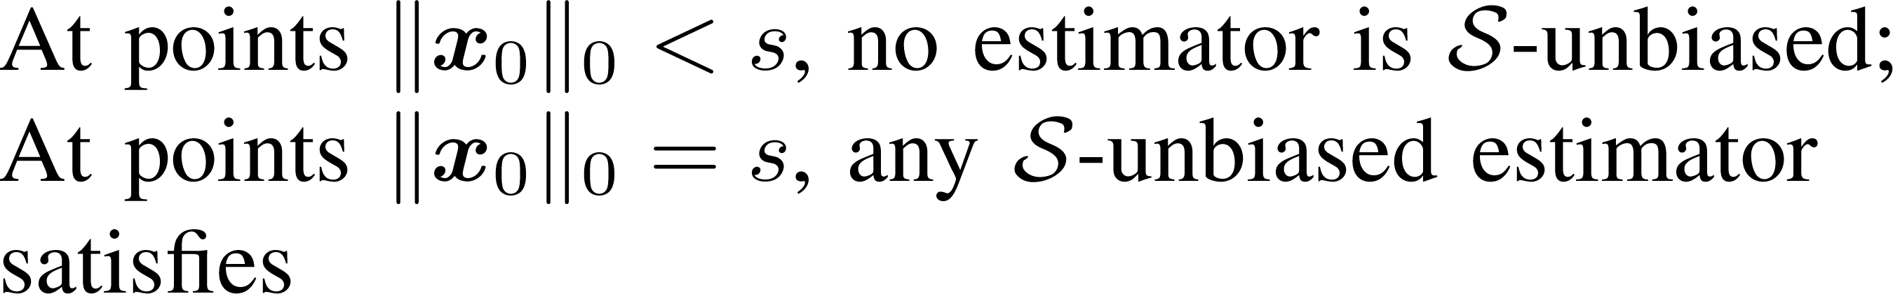
Constrained CRB in Sparse Setting
Back to the sparse setting:
MSE of “oracle estimator”
which has knowledge of
true support set
Theorem:

Slide 15
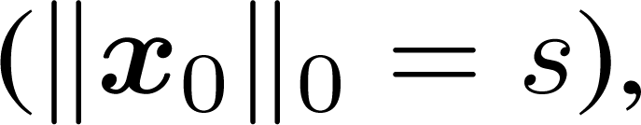
Conclusions
For points with maximal support
the oracle is a lower bound on -unbiased estimators
Maximum likelihood estimator achieves CRB
at high SNR
  alternative motivation for using oracle as
  “gold standard” comparison

Slide 16
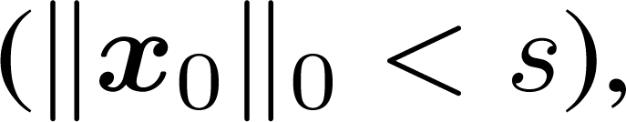
Conclusions
For points with sub-maximal support
there exist no -unbiased estimators
  No estimator is unbiased everywhere
  This happens because:
    When support is not maximal, any direction is feasible
    We require sensitivity to changes in any direction
    But measurement matrix is underdetermined

Slide 17
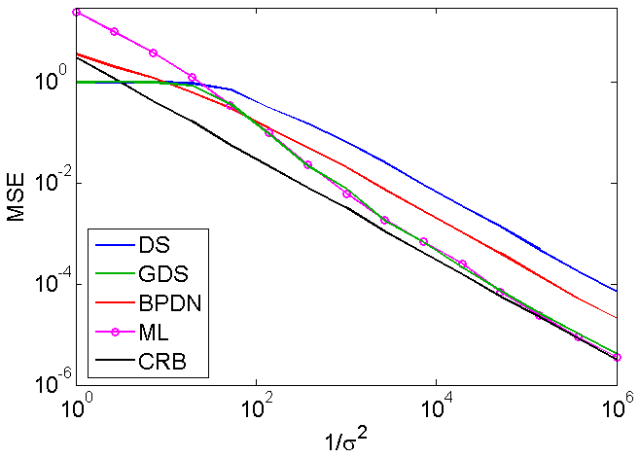
Comparison with Practical Estimators
?
Some estimators are better than the oracle
at low SNR
!
Oracle = unbiased CRB, which is suboptimal at
low SNR
SNR

Slide 18
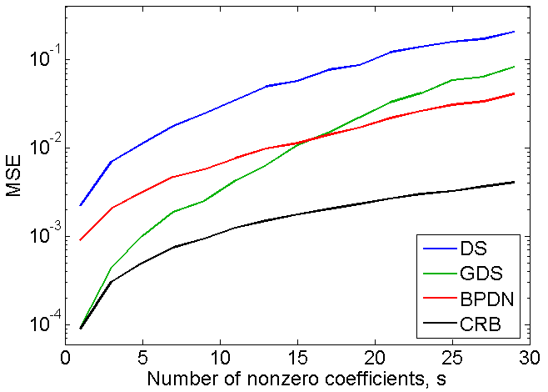
Comparison with Practical Estimators

Slide 19
Thank you for your attention!

Slide 20
References
Gorman and Hero (1990), “Lower bounds for parametric estimation with constraints,” IEEE Trans. Inf. Th., 26(6):1285-1301.
Marzetta (1993), “A simple derivation of the constrained multiple parameter Cramér-Rao bound,” IEEE Trans. Sig. Proc., 41(6):2247-2249.
Stoica and Ng (1998), “On the Cramér-Rao bound under parametric constraints,” IEEE Sig. Proc. Lett., 5(7):177-179.
Ben-Haim and Eldar (2009), “The Cramér-Rao bound for sparse estimation,” submitted to IEEE Tr. Sig. Proc.; arXiv:0905.4378.
Ben-Haim and Eldar (2009), “On the constrained Cramér-Rao bound with a singular Fisher information matrix,” IEEE Sig. Proc. Lett., 16(6):453-456.
Jung, Ben-Haim, Hlawatsch, and Eldar (2010), “On unbiased estimation of sparse vectors,” submitted to ICASSP 2010.

