Slide 1
Minimax Estimators Dominating the Least-Squares Estimator
Zvika Ben-Haim and Yonina C. Eldar
Technion - Israel Institute of Technology

Slide 2
Overview
Problem: Estimation of deterministic parameter with Gaussian noise
Common solution: Least Squares (LS)
Our solution: Blind minimax
Theorem: Blind minimax outperforms LS
Comparison with other estimators

Slide 3


Problem Setting
  x unknown, deterministic parameter vector w Gaussian noise
  zero mean, known covariance C_{w}
  H known system model
  y observation vector
Goal: Construct an estimator x
to estimate x from observations y
Objective: Minimize MSE,
Bayesian approach (Wiener) not relevant here

Slide 4


Previous Work
Least-Squares Estimator
(Gauss, 1821)
  Unbiased
  Achieves Cramér-Rao lower bound
  Does not minimize the MSE
We construct provably better estimators!

Slide 5

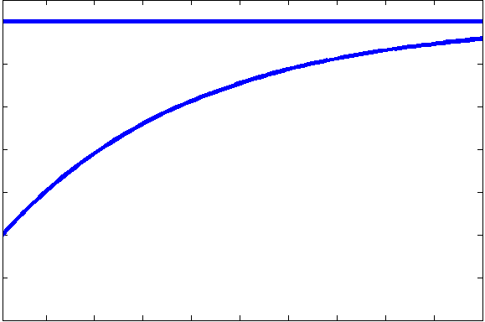
Previous Work
For iid case
some estimators dominate LS estimator:
achieve lower MSE for all x
(James and Stein, 1961)
There exists an extension to the general
(non-iid) case
(Bock, 1975)
LS
Dominating
MSE
x

Slide 6

Minimax Estimation
Minimax estimators minimize
the worst-case MSE, among x within
a bounded parameter set
(Pinsker, 1980; Eldar et al., 2005)
Theorem
For all ,
minimax achieves lower MSE than LS
(Ben-Haim and Eldar, IEEE Trans. Sig. Proc., 2005)

Slide 7
Blind Minimax Estimation
Based on minimax estimation,
but does not require prior knowledge of
Two-stage estimation process:
    Estimate parameter set
    from measurements
    Apply minimax estimator
    using estimated parameter set
Blind minimax can be proved to outperform LS

Slide 8






Estimator Definition
Use the parameter set
Estimate L² to approximate
  Method 1: Direct Estimate
  Method 2: Unbiased Estimate
  since
  where

Slide 9
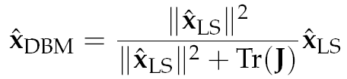
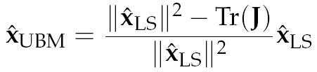

Estimator Definition
Resulting blind minimax estimators:
  Direct Blind Minimax Estimator
  Unbiased Blind Minimax Estimator
The UBME reduces to the James-Stein estimator in the iid case

Slide 10


Dominance Theorem
Theorem
Both DBME and UBME
dominate the LS estimator if
where
and
Blind minimax estimators are better than LS
(in terms of MSE)

Slide 11
Estimator Comparison
We propose two novel estimators,
the DBME and the UBME.
These estimators and Bock’s estimator
all dominate the standard LS solution.
Which estimator should be used?

Slide 12
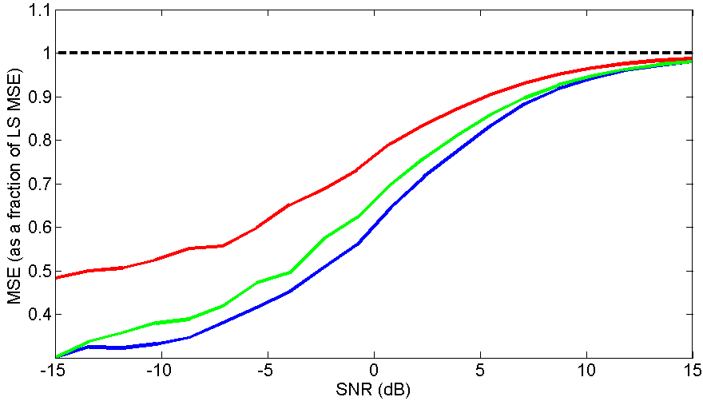
Simulation
LS
At 5 dB…
Bock saves 9%
UBME saves 17%
DBME saves 20%
…off LS MSE
Bock
UBME
DBME

Slide 13

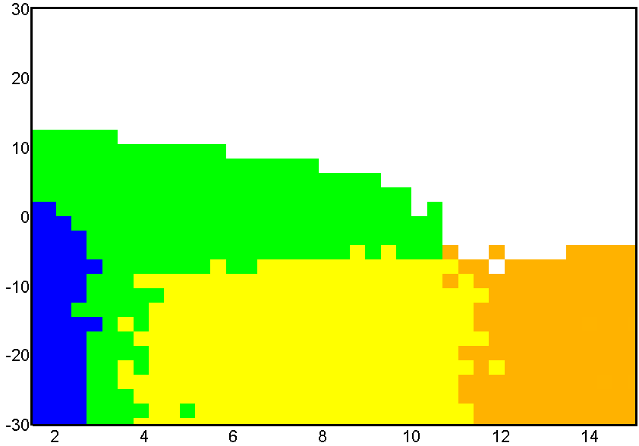
Simulation
DBME
Bock
UBME
SNR
Effective Dimension

Slide 14
Future Work
When noise is highly colored, non-spherical parameter sets make more sense
This results in non-shrinkage estimators
These estimators tend to perform better
than spherical estimators, but have a more complex form

Slide 15
Summary
The blind minimax approach is a new technique for constructing estimators
Resulting estimators always outperform LS
The proposed estimators also outperform
Bock’s estimator
If goal is MSE minimization,
LS is far from optimal!

Slide 16
Thank you
for your attention!

Slide 17
Summary
Minimax
Minimax
Extension
Blind Minimax
Blind Minimax
Lower MSE than
Bock
DBME
UBME
iid
iid
James-Stein
Minimax
iid case
All estimators in this chart
achieve lower MSE than the LS estimator

Slide 18
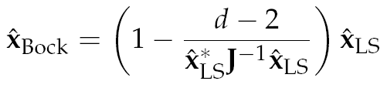
Comparison

