Slide 1



Music Database Query by Audio Input
Zvika Ben-Haim
Advisor: Gal Ashour

Slide 2

Purpose of the Project
Recorded melody
Software
Song name

Slide 3
Presentation Overview
Demonstration
Internals
Results
Conclusions

Slide 4
Program Demonstration

Slide 5
Inside the Program
Vocal Input
Pitch Detection
Volume Detection
Segmentation
Database Search
List of Best Matches

Slide 6
ועכשיו בעברית
קלט קולי
זיהוי pitch
זיהוי ווליום
סגמנטציה
חיפוש במאגר המידע
רשימת התאמות טובות ביותר

Slide 7

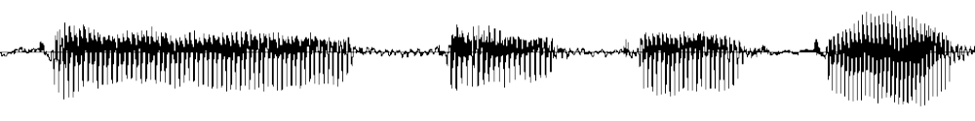
Definition of Input
Input
Pitch Detection
Segmentation
Search
The input is sung by a human, who does not need to have any knowledge of music.
The program was optimized for singing using the syllables “da-da-da” or “ti-ti-ti”. All testing was performed on this type of input.

Slide 8
Pitch Detection
Input
Pitch Detection
Segmentation
Search
The super-resolution pitch detection algorithm achieves accurate detection values without increasing CPU time, by performing linear interpolation on a
low sampling rate recording.
Detection is performed in a pitch-synchronous fashion (one pitch value for each cycle).

Slide 9
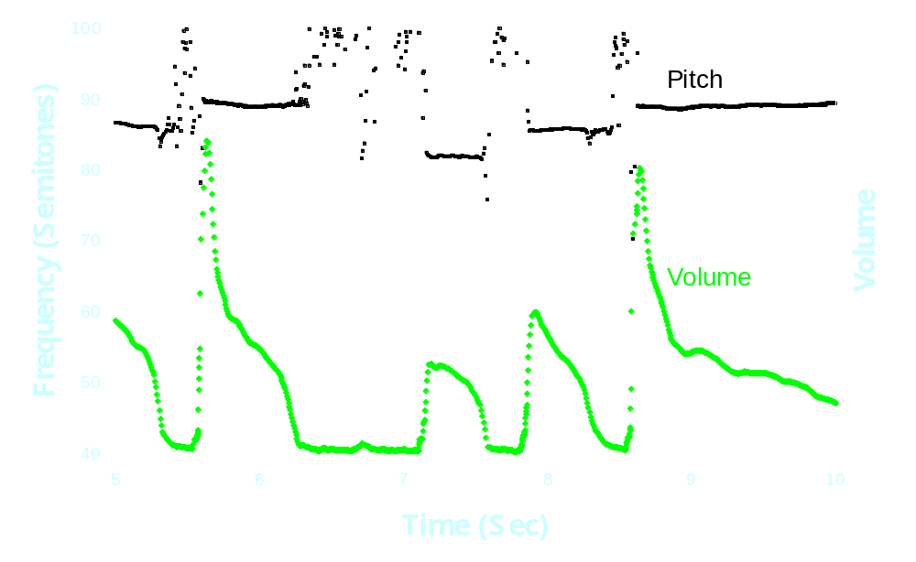
Pitch/Volume Detection
Input
Pitch Detection
Segmentation
Search

Slide 10
Segmentation (1/3)
Input
Pitch Detection
Segmentation
Search
Sequence of Pitches and Volumes
Volume-Based Segmentation
Pitch-Based Segmentation
Noise
Voice
Decision
Ignore
Note Identification
Sequence of Notes

Slide 11
עכשיו בעברית
רצף ערכי pitch ו-volume
סגמנטציה ראשונית - מבוססת volume
סגמנטציה שניונית - מבוססת pitch
רעש
צליל
החלטה
ביטול הסגמנט
זיהוי גובה ומשך זמן
רצף של תווים - גובה ומשך זמן

Slide 12
Segmentation (2/3)
Input
Pitch Detection
Segmentation
Search
Volume Segmentation: Possible notes are identified as a region in which the volume is higher than a trigger value.
Thus, it’s important to separate each note by a short quiet period, e.g. by pronouncing “ta-ta-ta” rather than
“la-la-la”.

Slide 13
Segmentation (3/3)
Input
Pitch Detection
Segmentation
Search
Pitch Segmentation: Within each segment, find the longest region in which the pitch is relatively constant.
Noise Removal: If this region is very short, then the segment is assumed to be noise, and it is ignored.
Conversion to Notes: The frequency of the note is identified by an iterative averaging technique.

Slide 14
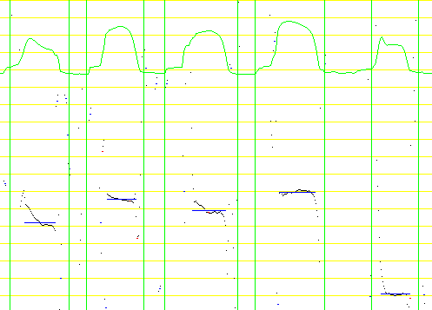
Segmentation Example
Input
Pitch Detection
Segmentation
Search

Slide 15
Database Search
Input
Pitch Detection
Segmentation
Search
Sequence of Notes
Convert to relative frequencies and durations
Find edit distance for each database entry
Sort by increasing edit cost
List of Best Matches

Slide 16
Edit Distance (1/3)
Input
Pitch Detection
Segmentation
Search
Purpose: Correction of errors in singing and in previous identification steps.
Mechanism: The edit distance is the minimum cost required to transform one string into another. The following changes can be applied at given costs:
  Change one character into another
  Insert one character
  Delete one character

Slide 17
Edit Distance (2/3)
Input
Pitch Detection
Segmentation
Search
Example:
How to make an elephant become elegant:
elephant
Replace
eleghant
Delete
elegant
Total edit distance is the cost of replacing
‘p’ with ‘g’, plus the cost of deleting ‘h’.

Slide 18
Edit Distance (3/3)
Input
Pitch Detection
Segmentation
Search
Algorithms differ by the content of the strings being compared. Three algorithms were checked:
  Parsons code: Only the direction of pitch change is compared (up, down, or repeat).
  Frequency similarity: The direction and size of pitch change (e.g., up 3 semitones).
  Frequency/Duration similarity: Both pitch change and relative duration of notes (e.g., up 3 semitones, and a longer note).

Slide 19
Results

Slide 20
Simulation
Simulations of the search engine were performed in order to have a larger ensemble, from which a detection probability was calculated.
Random noise was added to the first few notes of a tune. The tune was then applied to the search engine.

Slide 21
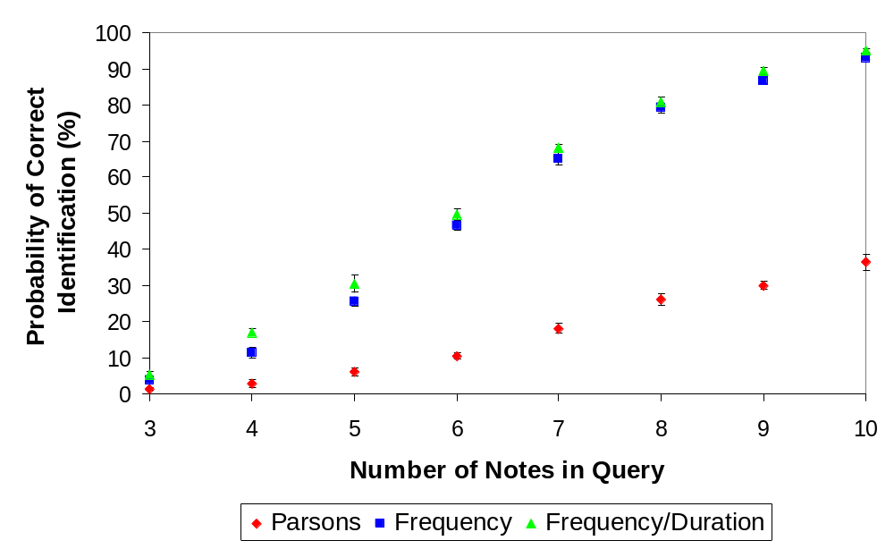
Comparison of
Search Algorithms

Slide 22
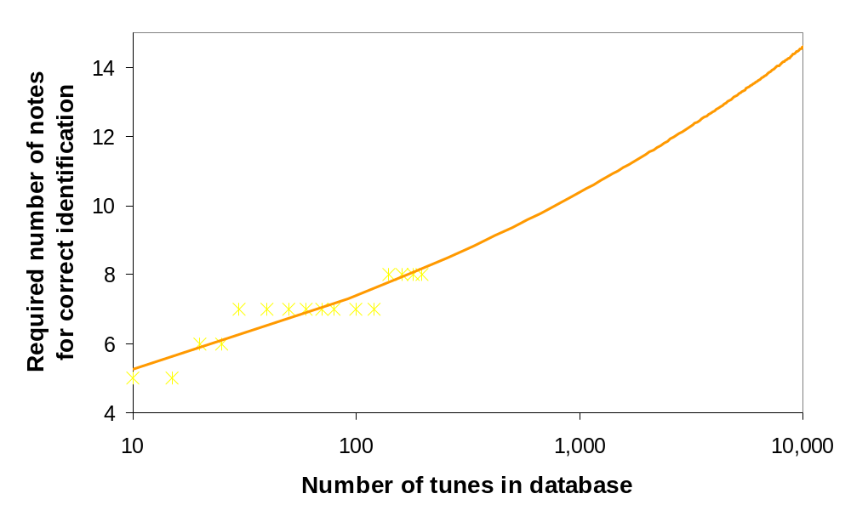
Effect of
Database Size

Slide 23
Empirical Test
Subjects listened to a sample query.
Then, they chose a song from the database, and were told to sing it in a similar manner.
Number of test subjects: 14
Number of recorded songs: 64
Number of songs in database: 197

Slide 24
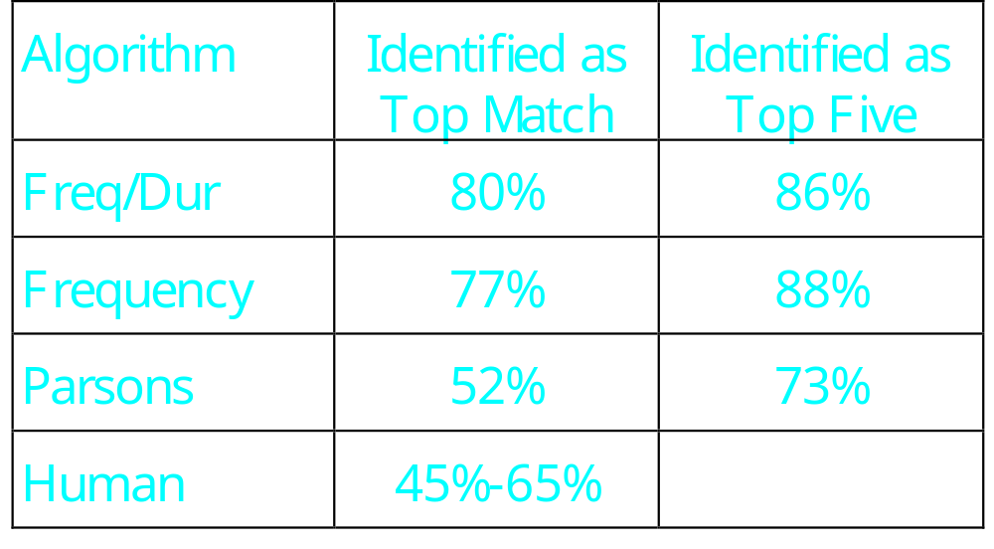
Empirical Results

Slide 25
Conclusions
Combined frequency/duration search is the most robust search algorithm tested, and outperforms the Parsons code search by a wide margin.
The program performs better than an average human under the tested conditions.

Slide 26
Summary
A successful melody search engine has been created.
Real-time software implementation is possible.
The new frequency/duration search algorithm was found more effective than the existing Parsons code search.

Slide 27
The End

