Slide 1

PARK the System
TOGETHER we can accomplish SAFE & FAIR PARKING
Notes:
FREEING citizens from UNFAIR PARKING tickets, and CONFUSION

Slide 2
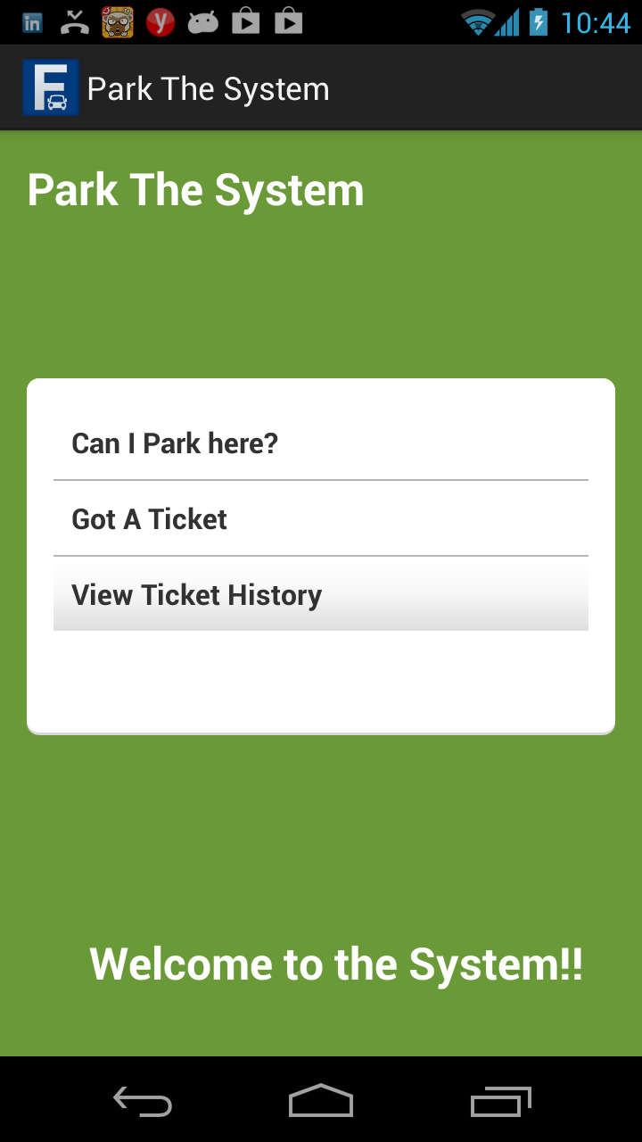
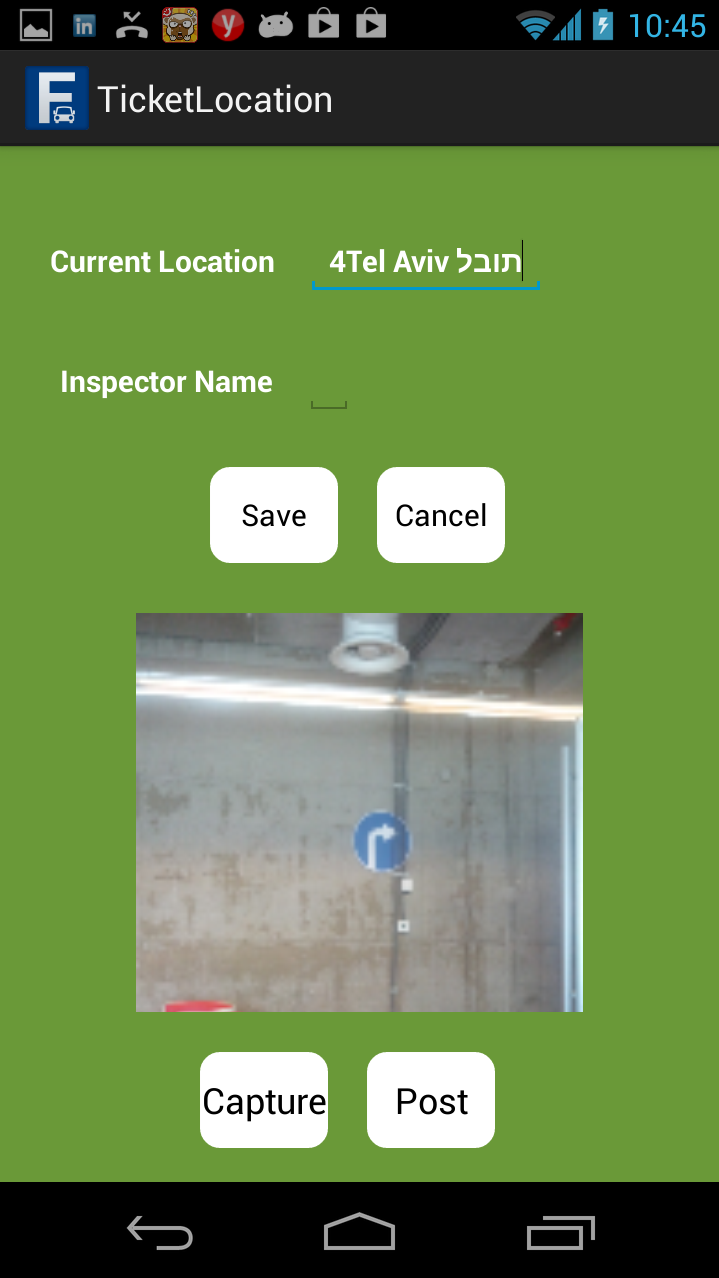
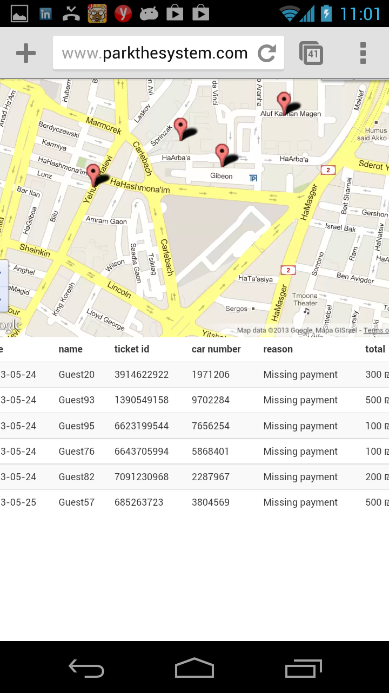
Can I park here? I UNFAIR ticket I city parking API

Slide 3
Features
Crowd Alerts
FAX the system
Connect \ Class suit
Can I park here? city parking API

Slide 4
Win Win biz model
70% are illegal\ invalid
People
Class suit
Pressure
safe parking (city parking API)
Cities
Efficiency
Relationship
Rating\election
Success fee from class suit\ refunds
Premium
Parking service providers
LBS

Slide 5
http://www.parkthesystem.com/

Slide 6
Market
Tel Aviv
900,000 per year
2,400 per day
55% appeals
UK
781 million per year
70% are illegal\ invalid
1% appeal

Slide 7
Benchmarks
Noparking fine
Not crowd sourcing
No class suit
No “safe parking”
50% commission!

Slide 8
PARK the System
TOGETHER we can accomplish SAFE & FAIR PARKING
Notes:
FREEING citizens from UNFAIR PARKING tickets, and CONFUSION

