Slide 1
E-Adhyapan Project Progress Report submitted to CHHATTISGARH SWAMI VIVEKANAND TECHNICAL UNIVERSITY BHILAI CHHATTISGARH (INDIA) for the partial fulfillment of degree MASTER OF COMPUTER APPLICATIONS (MCA) By Vikrant Sahu & Kumari Mausham Roll No.:500102121015 & 500102121022 Under the Guidance of Dr. Sanjeev Karmakar DEPARTMENT OF COMPUTER APPLICATIONS, BHILAI INSTITUTE OF TECHNOLOGY DURG, CHHATTISGARH (INDIA) Session: 2022-2023

Slide 2
List Of Contents
Introduction
Objective
Project’s Process Documentation
Inception Phase
Elaboration Phase
Construction Phase
Transition Phase
Screenshot Samples
Conclusion

Slide 3
INTRODUCTION
A “E-Adhyapan” portal project that acts as an online portal between students and the admin.
The system is designed for a Students who are in interested to study online.
It contains an admin who can enter details.
Student can register their id. Students can then login and ask Questions When students login they can see their Previous Asked Question and also a download page where students may download pdf format eBooks or Notes from the web system

Slide 4
Objective
The main objective behind construction of this portal is to provide a single place to students from where they can do all the study related activates without login to different websites.

Slide 5
Project’s Process Documentation

Slide 6
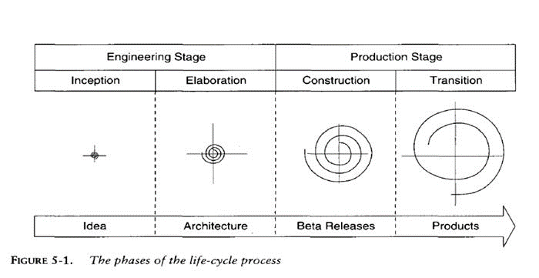
Project Development Process Model
We will use modern software development process model to create website record maintenance system, modern software development process model is an iterative process model in which all phases of software development like inception, elaboration, construction and transition will be used. We will not jump to the next phase until we complete the present phase.
Inception
Elaboration
Construction
Transition

Slide 7
Project’s Process Documentation
Inception Phase
Elaboration Phase(Detail Design)
Construction Phase
Transition Phase

Slide 8
Inception Phase
Initial Description of Problem
Software Requirement Specification-SRS
Security features
Reliability
Cost estimation using DFP

Slide 9
Initial Description of Problem
The objective is to develop an Online Portal System to promote and encourage students
Our project replaces the conventional and inconvenient method of clearing doubts in classes which involves the mentor and student to be physically present at the same time.
In this context arises the importance of our project. This project bridges the existing gap between mentor and students due to the time constraints.

Slide 10
Non- Functional Requirements Functional Requirements Performance Requirements
Software Requirement Specifications

Slide 11
Non Functional Requirements
Minimum Hardware Requirements :
Processor : Intel dual core
Memory(RAM) : 1 GB
Hard Disk : 80 GB
Monitor : Generic PNP Monitor
Keyboard : PS2 / USB
Mouse : PS2 / USB
Software Requirements :
Operating System : Windows 7 or higher
Browser : Any of Chrome, Opera etc.
IDE : Visual Studio Code
Front End : HTML , CSS
Back End : Django
Database : SQL Lite

Slide 12
Functional Requirements :
Administrator Page
User’s Page
Videos Page
Notes Page
Registration
Contact Page
Ask Question Page
Performance Requirements :
Static Performance : Multiple user make their profile and use this and changeable.
Dynamic Performance : Run time exception handling is used in this program.

Slide 13
Security Features:
Front-End Security
Security API’s
Cryptographic Security
Exception Handling
Back-End Security
Database Password
Strong Password Suggestion
Workgroup Security
Password Authentication

Slide 14
Reliability :
User Interface : Moderate
Output Interface : Moderate
Result : Moderate

Slide 15
Standard Table for function point
Cost Estimation using DFP
Measurement Parameter | Simple | Average | Complex
External input | 3 | 4 | 6
External Output | 4 | 5 | 7
Logical Internal File | 7 | 10 | 15
External Interface file | 5 | 7 | 10
External Enquiry | 3 | 4 | 6
Function Point of the project
Parameter | Quantity
Function Type | Simple | Average | Complex
External input type | 4 | 0 | 0
External Output type | 3 | 0 | 0
Logical Internal File type | 7 | 0 | 0
External Interface file type | 0 | 0 | 0
External Enquiry type | 0 | 0 | 0

Slide 16
Environment Complexity of the project
Data Communication | Average Influence | 3
Distributed Processing | Not Present | 0
Performance Objective | Significance Influence | 4
Operation Configuration Load | Insignificant Influence | 1
Transaction Rate | Not Present | 0
Online Data Entry | Insignificant Influence | 1
End-User Efficiency | Average Influence | 3
Online Update | Average Influence | 3
Complex Processing Logic | Insignificant Influence | 1
Re-usability | Significance Influence | 4
Installation case | Significance Influence | 4
Operational Case | Average Influence | 3
Desire to facilitate change | Insignificant Influence | 1
Multiple Sites | Moderate Influence | 2
Environment complexity (N)
N = 3+0+4+1+0+1+3+3+1+4+4+3+1+2 = 30

Slide 17
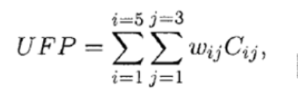
UFP :- Unadjusted Function Point
CAF :- Complexity Adjustment Factor
DFP :- Delivered Function Points
Calculating Unadjusted Function Point (UFP) by equation-
UFP = 3*3+ 4*0 + 6*0 +
4*4 + 5*0 + 7*0 +
7*3 + 10*0 + 15*0 +
7* 1 + 7*0 + 10*0 +
3*1 + 4*0 + 6* 0
= 9+0+0+16+0+0+21+0+0+7+0+0+3+0+0 = 56
CAF = 0.65 + 0.01*(N)
= 0.65 + 0.01*30 = 0.95
DFP = CAF * UFP
= 0.95* 56 = 53.2

Slide 18
Elaboration Phase

Slide 19
Object Class
Object Model
As per the requirement describe in the SRS we have following class object name and their description/purpose as given as following table-1
Sr. No | Name of Object/Classes | Description
1 | Login Page | Used to provide authentication and validation.
2 | Home | Used to provide all task to move from the homepage to the destination task page.
3 | Contact Page | Used to provide to fill the require record and save it into the database.
4 | Notes page | Page where all document provided by admin are available.
5 | Video page | Page where all the video contents are available.
6 | Admin Dashboard | Used to provide all task to move from the homepage to the destination task page.

Slide 20
Modules
Main modules of E-Adhypan are related to:
Administrator Module
User Module
Videos Module
Notes Module
Registration Module
Contact Module
Ask Question Module
Authentication module

Slide 21
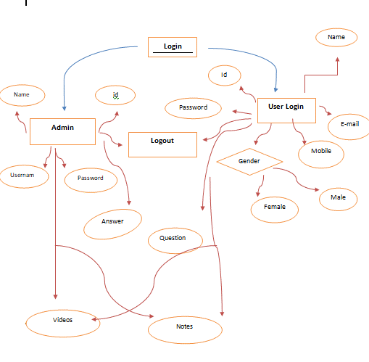
Data Flow Diagram

Slide 22
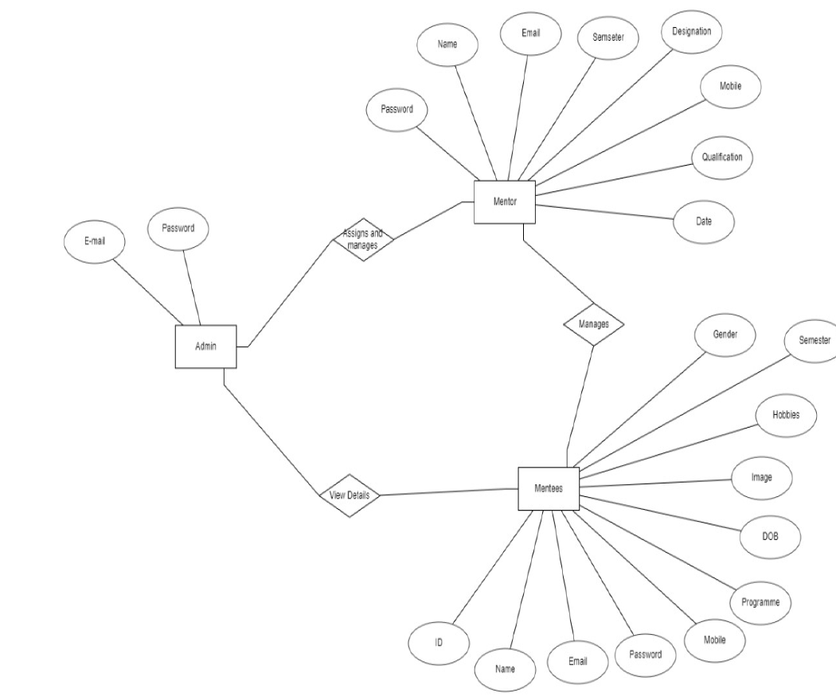
Database Design

Slide 23
Construction Phase

Slide 24
Case Tool : Visual Studio Code
Coding Language : Python ,Html, CSS
Operating System : Windows 11
Database Connectivity Procedure: SQL lite
Server : ASGI (Asynchronous Server Gateway Interface)
Framework : Django

Slide 25
Transition Phase

Slide 26
3.4.1. Report of Alpha testing
Two different testing during alpha testing has been used
Black Box unit testing
White box unit testing

Slide 27
Limitations
Distributed Processing
Online Data Entry
Online Update
Future Enhancement
Attach with Server
Deploy in Android

Slide 28
Screenshot Samples

Slide 29
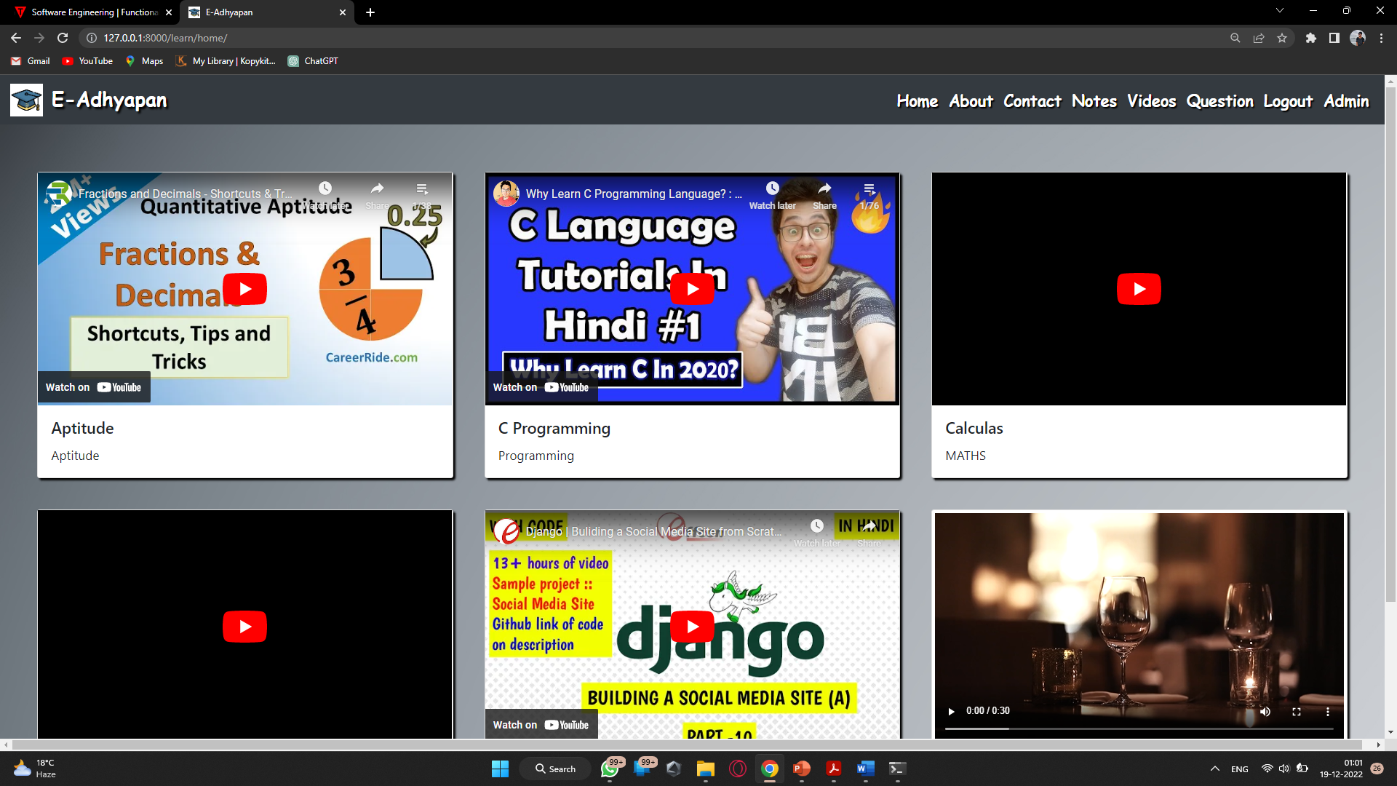
HOME PAGE

Slide 30
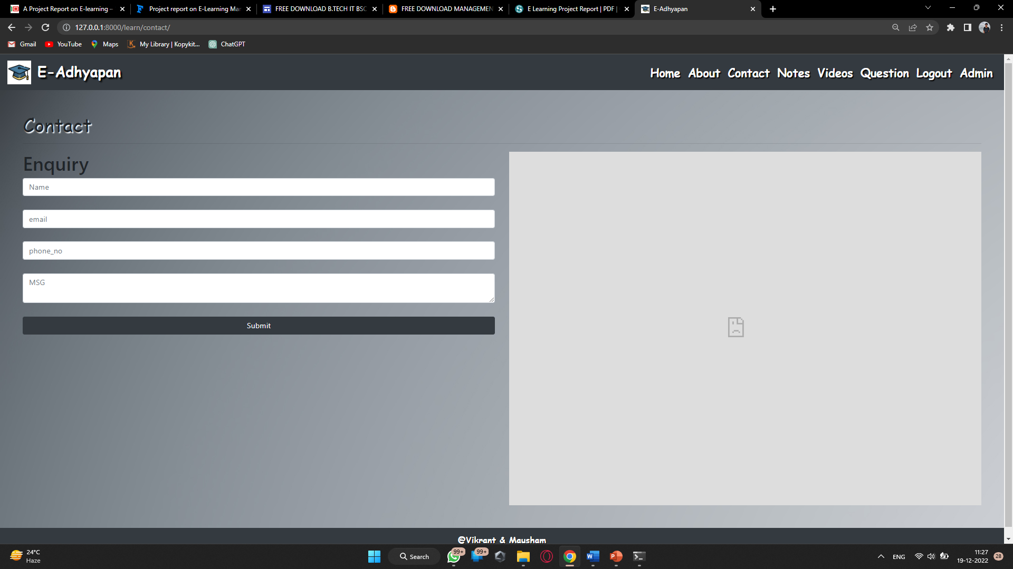
Contact

Slide 31
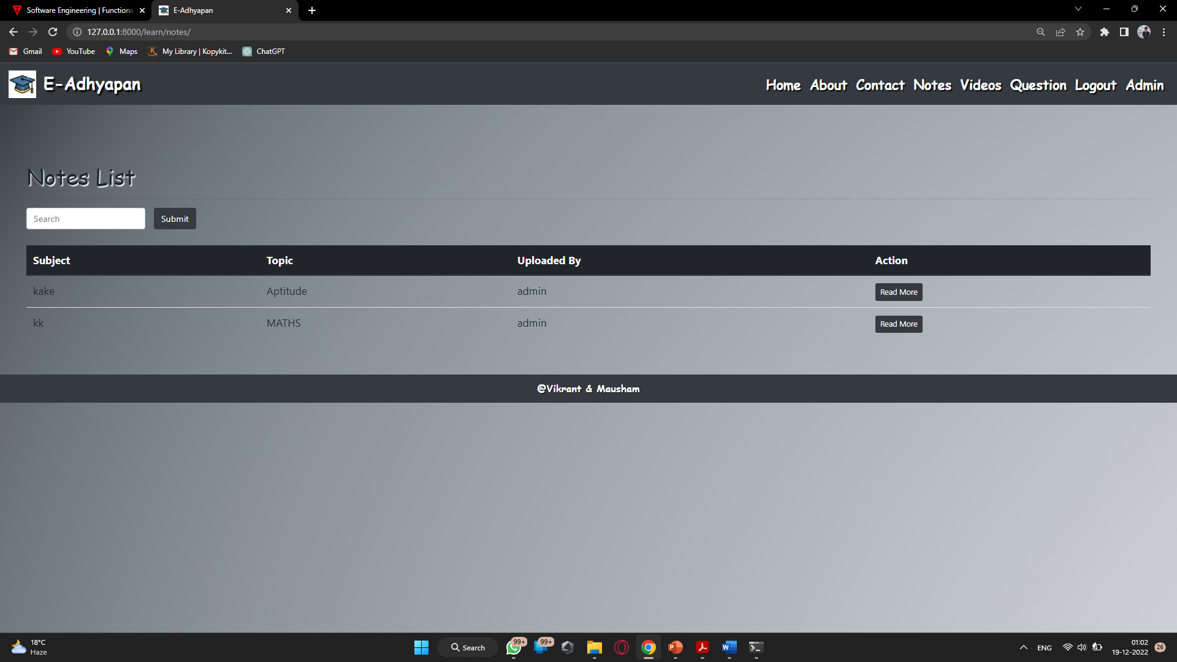
Notes

Slide 32
Videos

Slide 33
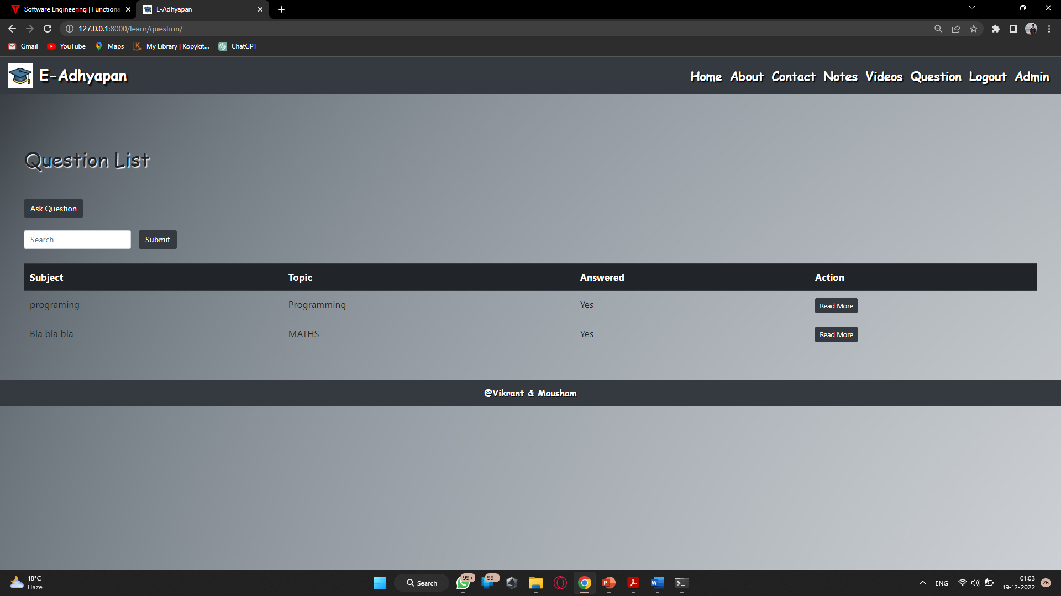
Question

Slide 34
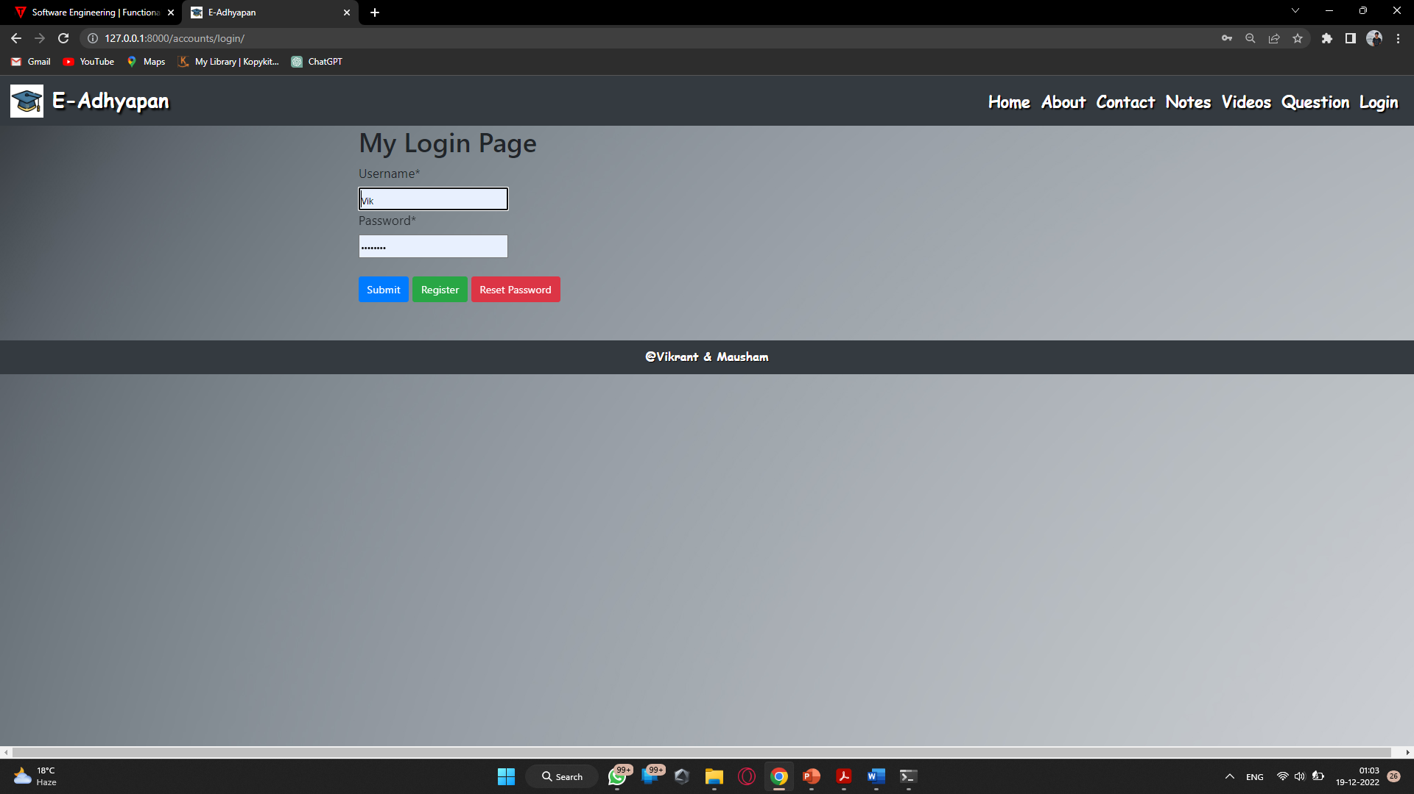
Login

Slide 35
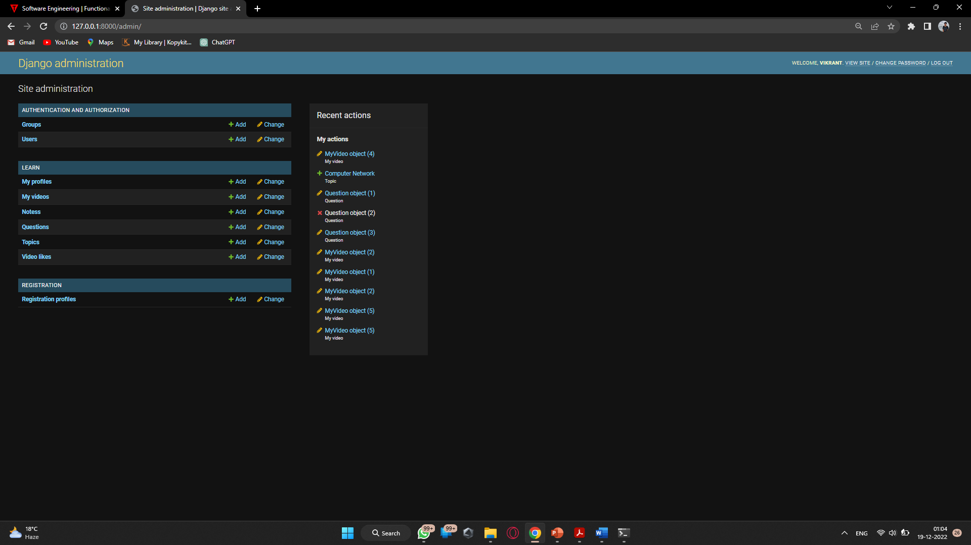
Admin Dashboard

Slide 36
CONCLUSION
The E-Adhyapan is mainly used to share the views between the users of the application which is very useful to upgrade the knowledge of everyone. The application is also serve as a useful site to know what is going on and can also know about the various opportunities of the outer world. The application can be further expanded by following the future Enhancements mentioned above.
The above features the detailing , description and facilities from E-Adhyapan.
The addition .deletion ,and modification of various details for various forms like user details , notes details, etc.
This project are very user friendly , simple and easy , it aimed at overcoming the shortcoming of manually operated system.

Slide 37
Thank you
BY :-
Vikrant Sahu & Kumari Mausham

