Slide 1
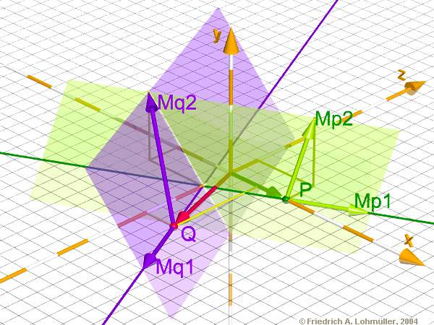
Raytracing on the
Cell Broadband Engine
  A quick overview

Slide 2
Agenda
Introduction
Objectives of the work
Cell Processor
Ray Tracing Application Architecture
Summary

Slide 3
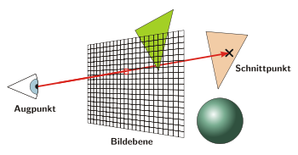
Introduction
What is Raytracing?
  Method to create photo-realistic images on a computer
  Rays are casted through an imaginary camera into a virtual world
  Raytracing mathematically models the light rays as they bounce in the virtual world
  Advanced optical effects
  Accurate simulations of reflection and refraction
  Rendering time differs from seconds to many days
  The waiting is worth while -> Impressive results

Slide 4
Introduction
Why Raytracing?
  Vector arithmetic
  Nearly only floating-point calculation
  Highly parallelizable
  Every one of the rays is independent from each other
  It's up to the developer how much work to distribute
  The smallest amount of work can be a
    Single ray
    Raypacket (2x2, 4x4 ... )
    Tile ...

Slide 5
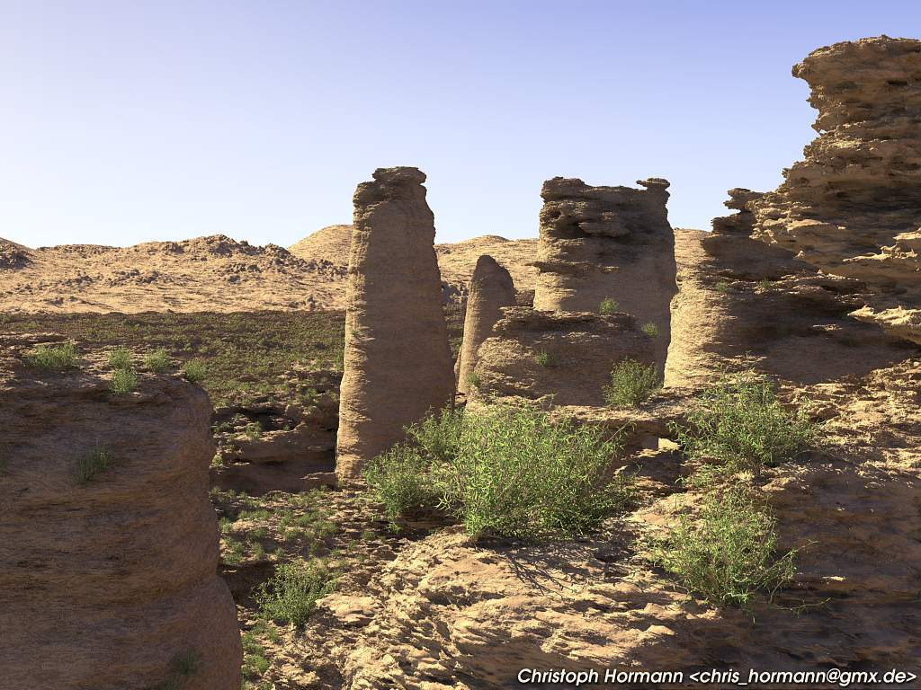

Slide 6
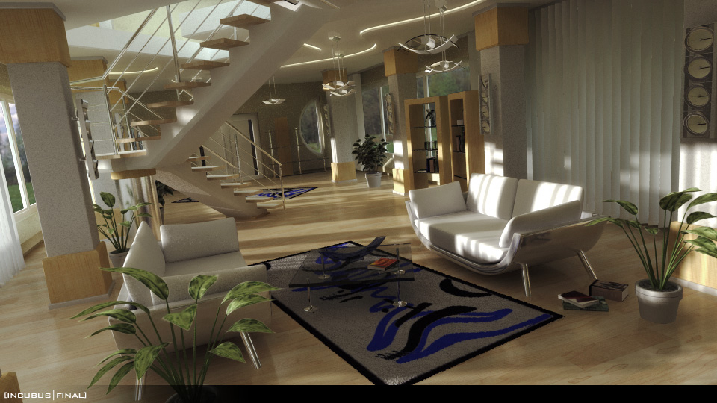

Slide 7
Objectives of the work
Solution to an increasing demand of computational power
  Manufactures take multi-core chip design into consideration
Consequences
  A paradigm shift is to take place
  To solve a specific task entirely new approaches have to be developed
  The tasks have to be adapted to the new architecture
  A variety of approaches have to be taken into account to solve a given problem
  With respect to its performance and adaptability each approach has to be tested to determine the best solution

Slide 8
Objectives of the work
Diploma thesis
  The problem that yields out of that situation will be examined for a Raytracer which will be adapted to the CBE architecture
  Different approaches are supposed to be introduced
  The single approaches are examined with its respect to performance and its capability for Raytracing
  Goal of the work is to develop an optimal architecture for Raytracing for the CBE with focus on performance
  Result of the work will be a Raytracer that can render medium sized scenes at acceptable rates

Slide 9
Cell Processor
Joint Venture of Sony Toshiba and IBM also known as STI, formally started 2001
Cell Processor first incarnation of a new family of microprocessors conforming the Cell Broadband Engine Architecture
Initially attended for applicatons in game consoles and media-rich consumer-electronic devices
  Sony Playstation 3, HDTV, Developer Boards, Cell Blades
A much broader use of the architecutre envisioned
  Cell designed to enable fundamental advances in processor performance

Slide 10
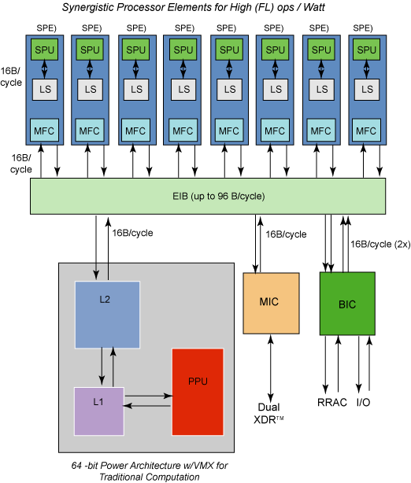
Cell Processor Highlights
9 Multi-Core microprocessor
  1 PowerPC Processing Element
  8 Synergetic Processing Elements
3.2 Ghz clock frequency
10x performance for many applications

Slide 11

Previous Work
Raytracer based upon the recursive ray tracing algorithm
  Featured reflection but no refraction
  Performance as a Pentium 4
Streaming programming model
  Data-Flow not optimal
Drawbacks
  Poor performance
  Shader, Illumination modell not easily extensible
  Poor use of the hardware architecture

Slide 12
Targeting the CBE
General work flow
  Porting to the PPE
  Application partitioning, Programming model
  Offloading parts to the SPE's
  Using SPU C/C++ Language Extensions to achieve maximum performance
  Tuning data access and flow with double-buffering and prefetching
  SIMD vectorization

Slide 13
Ray Tracing Application Architecture (CBE view)
Shared memory programming model
  Access to main memory reduced
  Communication overhead minimized
  PPE needed just for initialization
  4 -Way Set Associative Cache
  Load Balancing

Slide 14
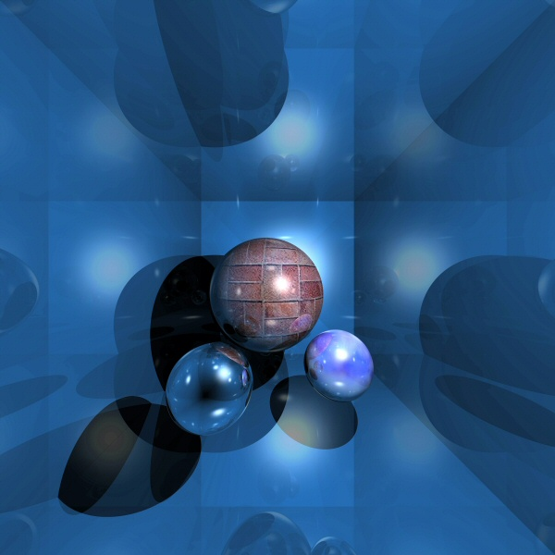
Ray Tracing Application Architecture (SPE view)
Every SPE a little Ray Tracer
  Raytracing acceleration techniques
  Input camera, objects
  Output rendered tile, access to main memory reduced
  PPE completely ignored
  Output is double-buffered into a SDL Surface
  Communication between the SPE's not needed

Slide 15
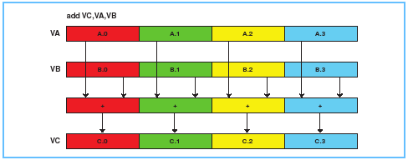
Ray Tracing Application Architecture (SPU view)
Data Flow and SIMD vectorization
  Double buffering and prefetching
  Loop vectorization
  Ray packets, simultainously perform calculation on 4 rays
  Caching of often used objects

Slide 16
Ray Tracing Application Architecture
Shared memory programming model
  Reducing the access to main memory
  Shader pluggable
Cache management
  4 – Way Set Associative Cache
Load Balancing
  Dimension Exchange method (Work Stealing)

Slide 17
Summary
Raytracing Application Architecture
  Outperformed the last implementation
  Shader easily pluggable
  Options for further improvements
CBE
  Fast , powerful
  Unleashing the power, needs knowledge about the hardware

