Slide 1
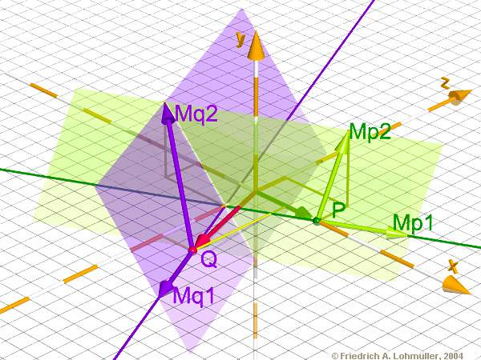
Raytracing on the CBE
  A quick overview

Slide 2
Agenda
Introduction
Objectives of the work
Targeting the CBE
Obstacles and drawbacks
Solving general Problems
Summary

Slide 3
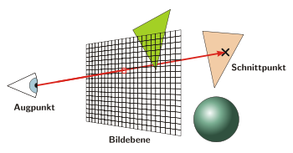
Introduction
What is Raytracing?
  Method to create photo-realistic images on a computer
  Rays are casted through an imaginary camera into a virtual world
  Raytracing mathematically models the light rays as they bounce in the virtual world
  Advanced optical effects
  Accurate simulations of reflection and refraction
  Rendering time differs from seconds to many days
  The waiting is worth while -> Impressive results

Slide 4
Introduction
Why Raytracing?
  Vector arithmetic
  Nearly only floating-point calculation
  Highly parallelizable
  Every one of the rays is independent from each other
  It's up to the developer how much work to distribute
  The smallest amount of work can be a
    Single ray
    Raypacket (2x2, 4x4 ... )
    Tile ...

Slide 5


Slide 6
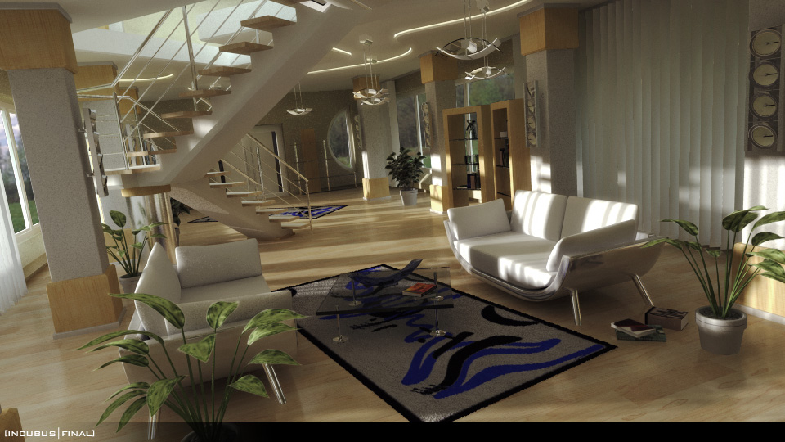

Slide 7
Objectives of the work
Solution to an increasing demand of computational power
  Manufactures take multi-core chip design into consideration
Consequences
  A paradigm shift is to take place
  To solve a specific task entirely new approaches have to be developed
  The tasks have to be adapted to the new architecture
  A variety of approaches have to be taken into account to solve a given problem
  With respect to its performance and adaptability each approach has to be tested to determine the best solution

Slide 8
Objectives of the work
Diploma thesis
  The problem that yields out of that situation will be examined for a Raytracer which will be adapted to the CBE architecture
  Different approaches are supposed to be introduced
  The single approaches are examined with its respect to performance and its capability for Raytracing
  Goal of the work is to develop an optimal architecture for Raytracing for the CBE with focus on performance
  Result of the work will be a Raytracer that can render medium sized scenes at acceptable rates

Slide 9
Targeting the CBE
General work flow
  Porting to the PPE
  SIMD vectorization
  Application partitioning
  Offloading parts to the SPE's
  Using SPU C/C++ Language Extensions to achieve maximum performance
  Tuning data access and flow with double-buffering and prefetching

Slide 10
Obstacles and drawbacks
Application partitioning and offloading
  Several considerations have to be taken into account
    Processing load distribution
    Program structure
    Program data flow and data access patterns
    Cost of data moving from one SPU to another
    Programming model
      PPE centric ...

Slide 11
Obstacles and drawbacks
SPU C/C++ Language Extensions
  Reduce scalar operations
    Too much overhead with rotating and shifting the scalar into the right place
  Watch out for casts between double and float
    SPU optimized for single-precision calculation
    Floating-point format not fully ISO-compliant
  Reduce branching (no branch prediction)
    Taken branch 1 cycle
    Non taken branch 18 cycles
  Local Store size is limited
    Respect Local Store size in the development process

Slide 12
Obstacles and drawbacks
Tuning data access
  Double buffering
    Fetch data in one buffer, perform calculations in the other buffer
  Prefetching
    If it's known which data is needed, prefetch them to avoid computational stalls

Slide 13
Solving general Problems
As an example: Load balancing
  Computational workload of a part/tile/packet is not known
  One SPU get its job done fast, the other needs more time
  How to achieve a balanced workload on each SPU?

Slide 14
Solving general Problems
Solution is a load balancer
  Static load balancing
    Naive tile assignment
    Scatter method
    Random assignment
    Problem: Algorithm may converge to the average workload
  Dynamic load balancing
    Diffusion algorithm (multi-port)
    Dimension exchange method (single-port)

Slide 15
Summary
Raytracing
  Optimal for the CBE, caching, load balancing, ...
  Different programming models, pipeline, shared memory
  Eye-Candy, results are impressive
CBE
  Fast , powerful
  Unleashing the power, needs knowledge about the hardware

