Slide 2
Main disagreements with the Duke – Cowan report
Use of weighted vs. simple averages
Separation of bay and coastal habitats for the purpose of effect estimation
Use of mean vs. maximum periods of exposure to larval entrainment

Slide 3
Use of weighted vs. simple averages
It’s a matter of the question asked:
What is the larval loss for fish?, or
Use weighted averages
What is the rate of loss for all organisms entrained, fish or otherwise, sampled or not? For example, invertebrate larvae, algal spores, sea grass seeds, zooplankton, phytoplankton.
Use simple averages

Slide 4
Main disagreements with the Duke – Cowan report
Use of weighted vs. simple averages
Separation of bay and coastal habitats for the purpose of effect estimation
Use of mean vs. maximum periods of exposure to larval entrainment

Slide 5
Estimates of Mortality Rates - Fish
Species | Total Entrainment | Mortality Rate (%) (avg. period at risk) | Mortality Rate (%) (max. period at risk)
Unidentified Gobies | 3.9 x 10⁸ | 11.5 | 42.8
Pacific Staghorn Sculpin | 1.7 x 10⁷ | 5.1
Northern Lampfish | 1.5 x 10⁷ | 2.4
Shadow Goby | 1.3 x 10⁷ | 1.4 | 3.3
Comptooth Blennies | 1.0 x 10⁷ | 49.1 | 72.4
KGB Rockfishes | 6.4 x 10⁶ | 2.4
Jacksmelt | 6.3 x 10⁶ | 21.9 | 44.2
White Croaker | 3.0 x 10⁶ | 2.1
Pacific Herring | 3.0 x 10⁶ | 1.2 | 1.7
Cabezon | 2.9 x 10⁶ | 3.7
Average Mortality Rates
Coastal species
Bay Species
3.1% 3.1%
17.2%
32.8%
Combined ~10% 32.8%

Slide 6
Estimation of larvae at risk
Location of entrainment sampling stations
Estimate for open ocean species
2
Estimate for Bay species
1
Estimate for open ocean and Bay species
3
Estimate for entrainment
4
5

Slide 7
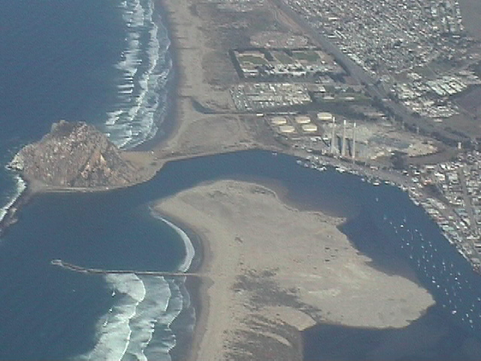
Habitat Equivalency – a way to interpret loss
Method allows for conversion of organismal loss to habitat
Entrainment causes loss of larval production
From 17 - 33% of Morro Bay =
380 - 759 acres
From 3% of coastal source population =
~2 - 4 miles

Slide 8
Main disagreements with the Duke – Cowan report
Use of weighted vs. simple averages
Separation of bay and coastal habitats for the purpose of effect estimation
Use of mean vs. maximum periods of exposure to larval entrainment

Slide 9
25
Mean
Entrainment Risk
20
Statistical Max
15
Percent
10
5
0
0
4
8
12
16
4
11
Mean
Maximum
Age of Fish at entrainment (days)

Slide 10
The argument:
differential susceptibilities as a function of age
Entrainment Risk
4
11
Mean
Maximum
Age of Fish at entrainment (days)
Potential solution: estimate susceptibilities as a function of age

Slide 11
Only able to do this for gobies
50
43 %
40
38 %
Estimate of Proportional Mortality %
30
20
11%
10
0
Mean
Recalculated
Maximum
Method of estimation of Proportional Mortality (PM)

Slide 12
Main disagreements with the Duke – Cowan report
Use of weighted vs. simple averages
Separation of bay and coastal habitats for the purpose of effect estimation
Use of mean vs. maximum periods of exposure to larval entrainment

