Slide 1
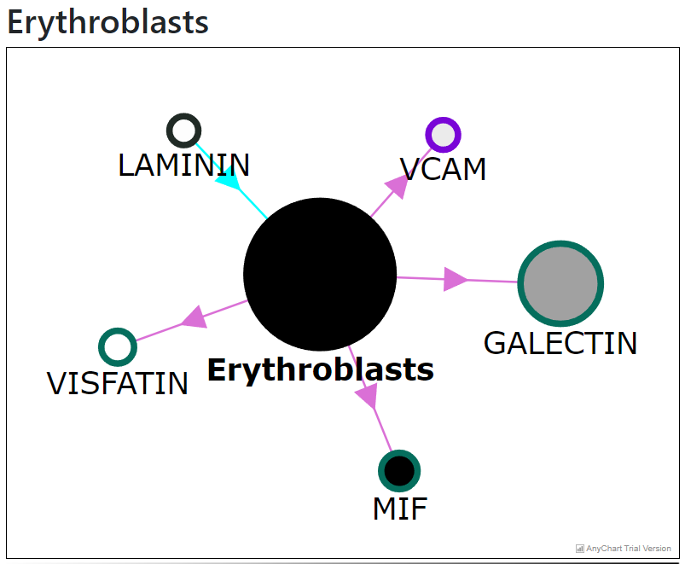
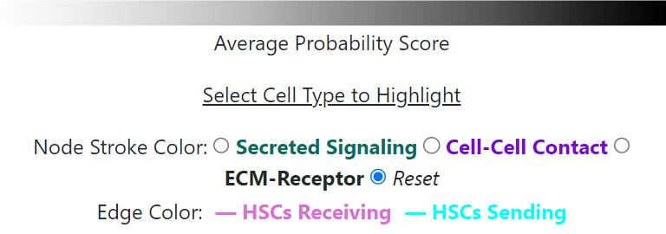
Pathway
Nodes. Double click takes you to pathway page
Probability score reflected in node color
Edge color relates to signaling direction
Select radio button to highlight signaling type

Slide 2
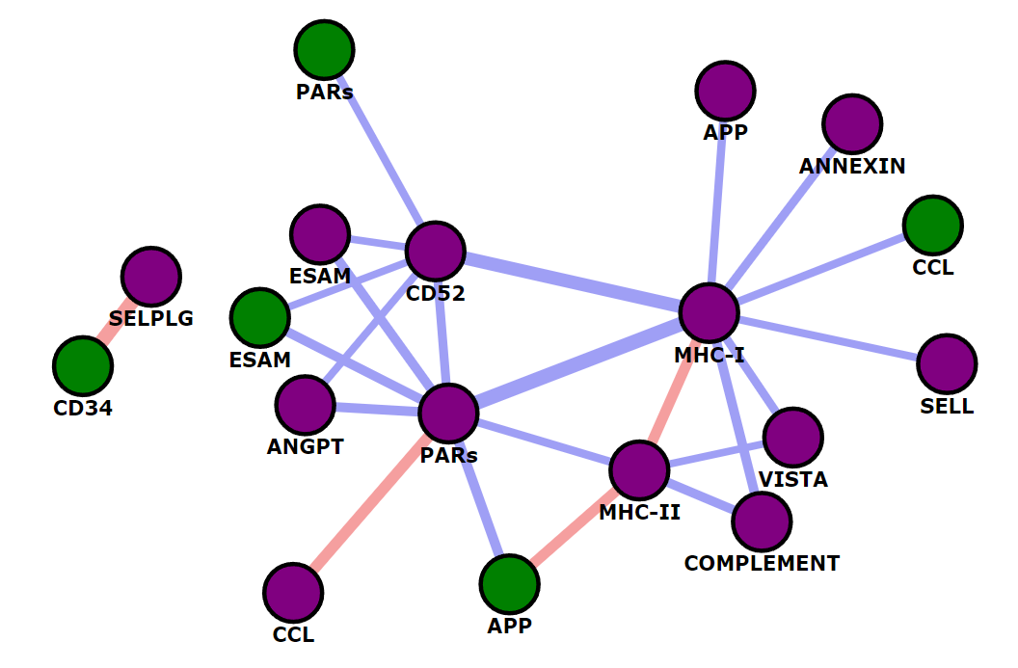
Pathway
Nodes colored by direction of signaling. Double click to go to pathway page
Edge colors tell you if the correlation is positive or negative
Edges connect significantly correlated pathways
Edge weights reflect how correlated the pathways are. Click to view gene network below

Slide 3
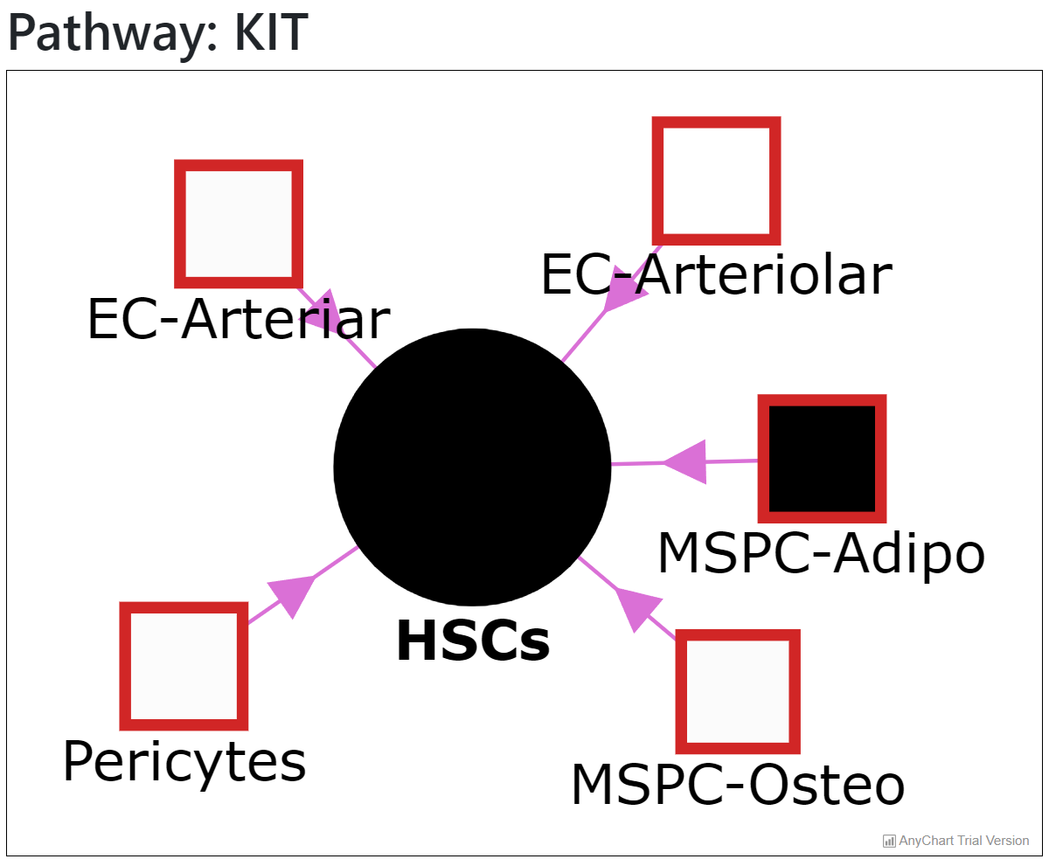
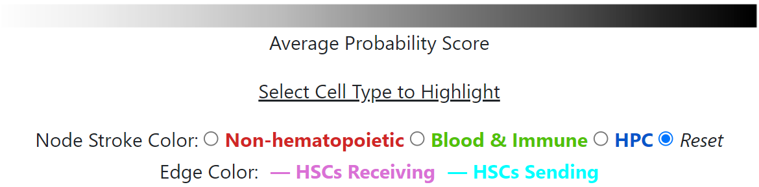
Cell type
Nodes. Double click takes you to cell type page
Edge color relates to signaling direction
Select radio button to highlight cell type

Slide 4
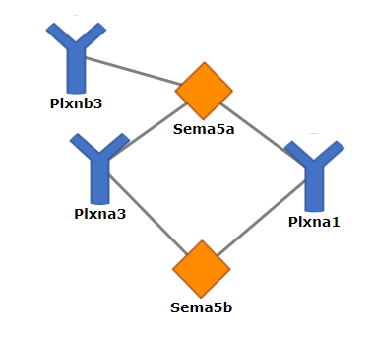
Ligand –Receptor Interaction
*On gene specific page, gene of interest will be highlighted
Receptor
Ligand

Slide 5
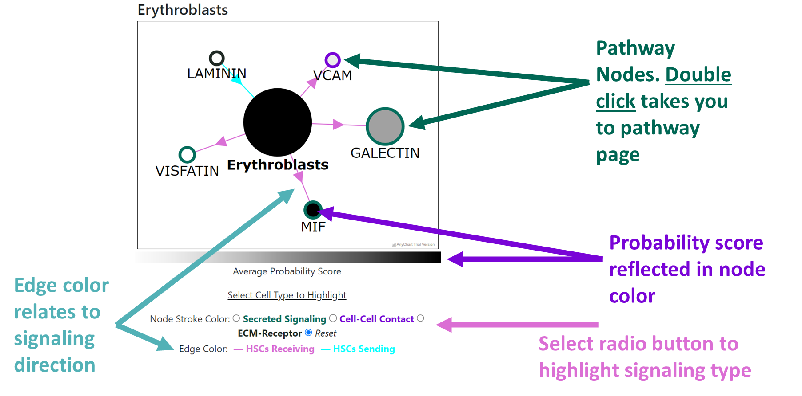

Slide 6
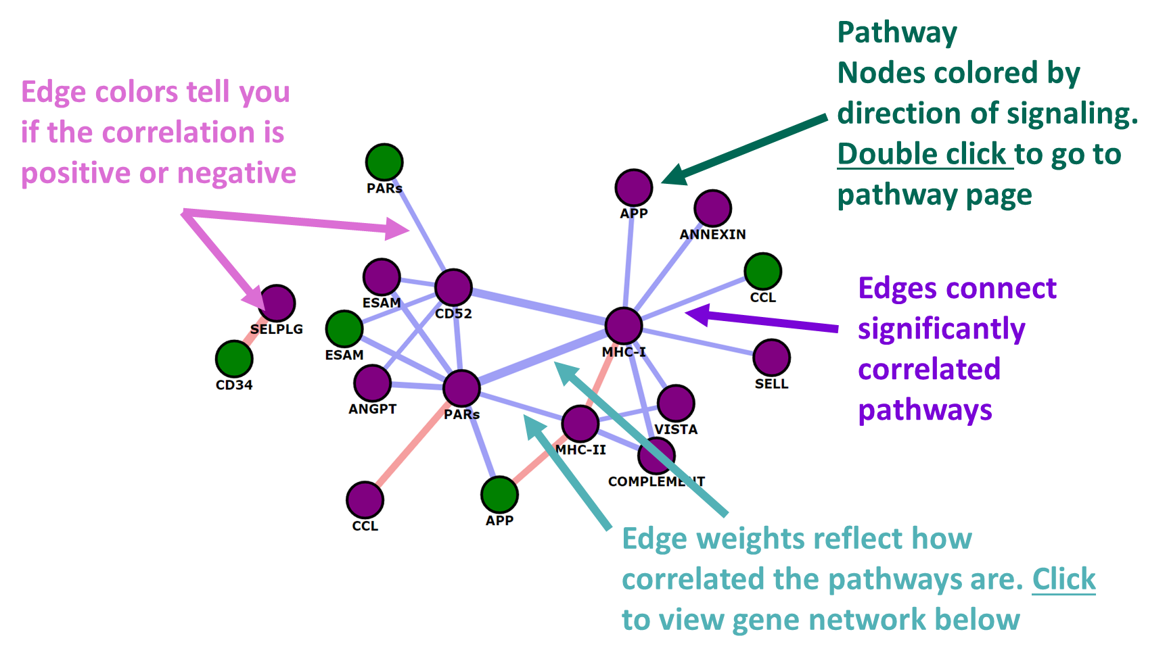

Slide 7
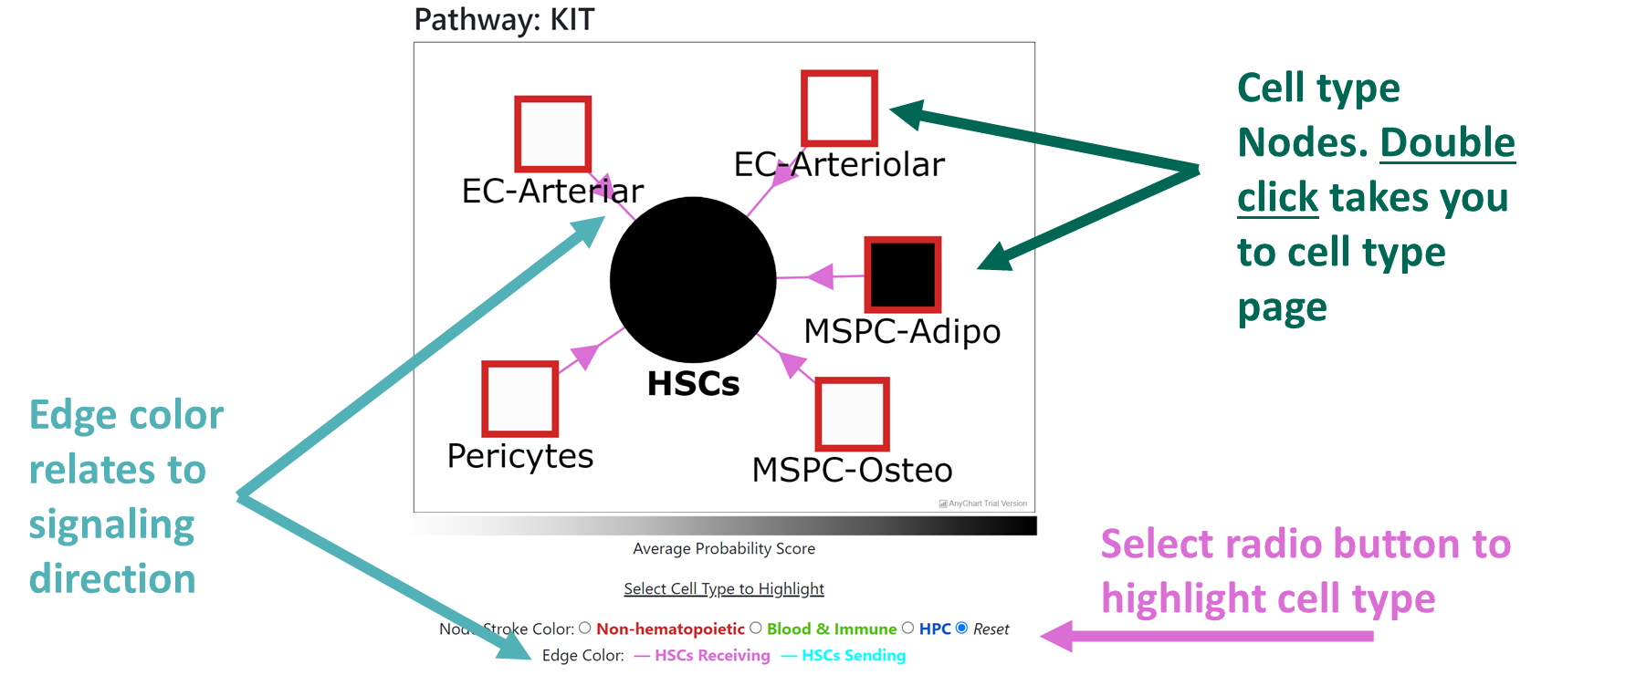

Slide 8
