Slide 2

MAJOR – II
Web Scraping And Prediction Of Selling Prices Using BeautifulSoup And Random Forest Regressor
SUBMITTED BY:
SANDEEP KUMAR MAYANK SHEKHAR
Sap Id: 500062372 Sap Id: 500063785
RISHANK GUPTA BEDABANDHU SAHOO
Sap Id: 500062486 Sap Id: 500063049
UNDER GUIDANCE OF :
Dr. Rohit Tanwar
Assistant Professor – Selection Grade,
Department of Systemics,
School of Computer Science

Slide 3
ABSTRACT
Data Analysis has been a great help in understanding data in several areas like stock market, commercial enterprises, weather, electricity demand, cost and usage of products such as fuel, electricity, etc. It provides organization with useful information that is necessary to make informed decisions.
In this project we work towards building our own data-set formed by scraping websites. Further, the data-set is to be cleaned, to remove the various anomalies that arise in the data-set and is to be visualized. After that further appropriate analysis is done on the data like prediction of MRP of cars.
*Keywords- Data Analysis, scraping, data-set, Machine Learning, WebApp.

Slide 4
Introduction
Whether you’re a scientist analysing earthquake data to predict the next “big one”, or are in health-care analysing patient wait times to better staff your ER, understanding data is crucial to making better, data informed decisions.
Data collection is gathering (from relevant sources), the various measures and information related to certain variables in question present in a system.
Web scraping is used to collect large information from websites. It is an automated method used to extract large amounts of data from websites.
Analysis done using random forest regressor

Slide 5
Problem Statement
To choose a car ,which is also a hefty investment, a lot of time is wasted by every individual to reduce that time we used random forest regressor to help make better and fast choices, the model makes use of multiple attributes of car like facilities, engine, transmission, safety etc to make a differentiated choice.

Slide 6
Objectives
Gathering data by web scraping in Python.
Cleaning the gathered data and converting it into a dataset.
Analysis on the basis of the gathered data.
Splitting the dataset for testing and training.
Predicting the MRP of cars and comparing them to testing data.
Creating a WebApp that will show Output.

Slide 7
Objective Achieved
Gathered data by web scraping in Python.
Cleaning the gathered data and converted it into a dataset.
Analysis on the basis of the gathered data.
Successfully predicted the MRP of cars after applying regression.
Created a WebApp GUI for Output.

Slide 8
Methodology
We will use a combination of iterative and incremental process models (Agile SDLC model) with focus on process adaptability. This will break the project into small incremental builds. These builds are provided in iterations. Each iteration will last from about one to three weeks.
●Requirement Analysis
●Gathering Data
●Building Data Set
●Cleaning Data Set
●Pre processing of data
●Visualizing results
●applying random forest regressor

Slide 9
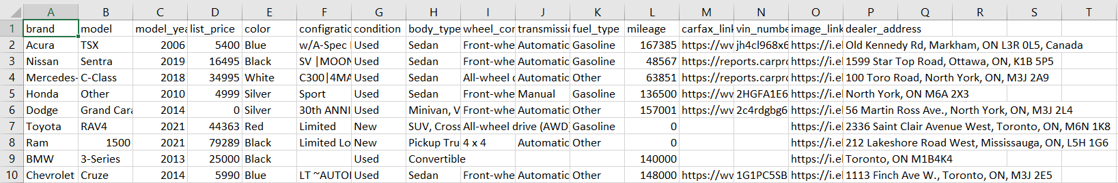
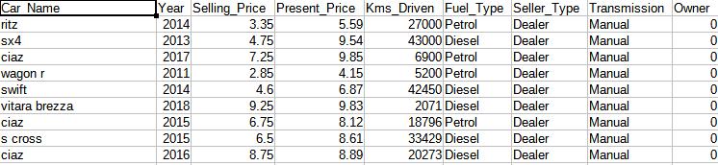
DATA GATHERING AND PREPROCESSING
Data set after Scrapping
Figure 1: Data set after cleaning
Data set after required modification to be used as input for algorithms
Figure 2: Data set after required modification

Slide 10
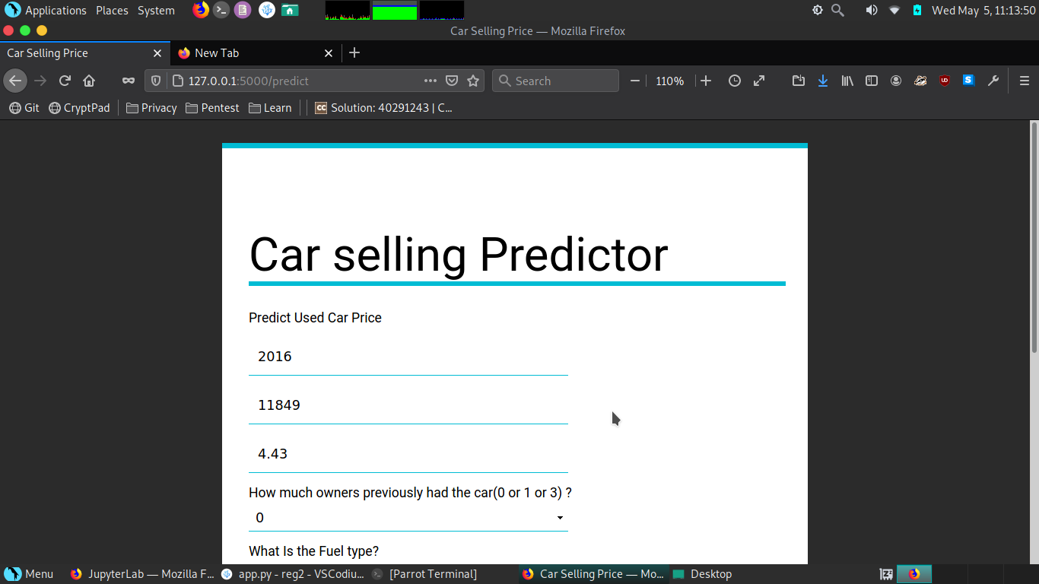
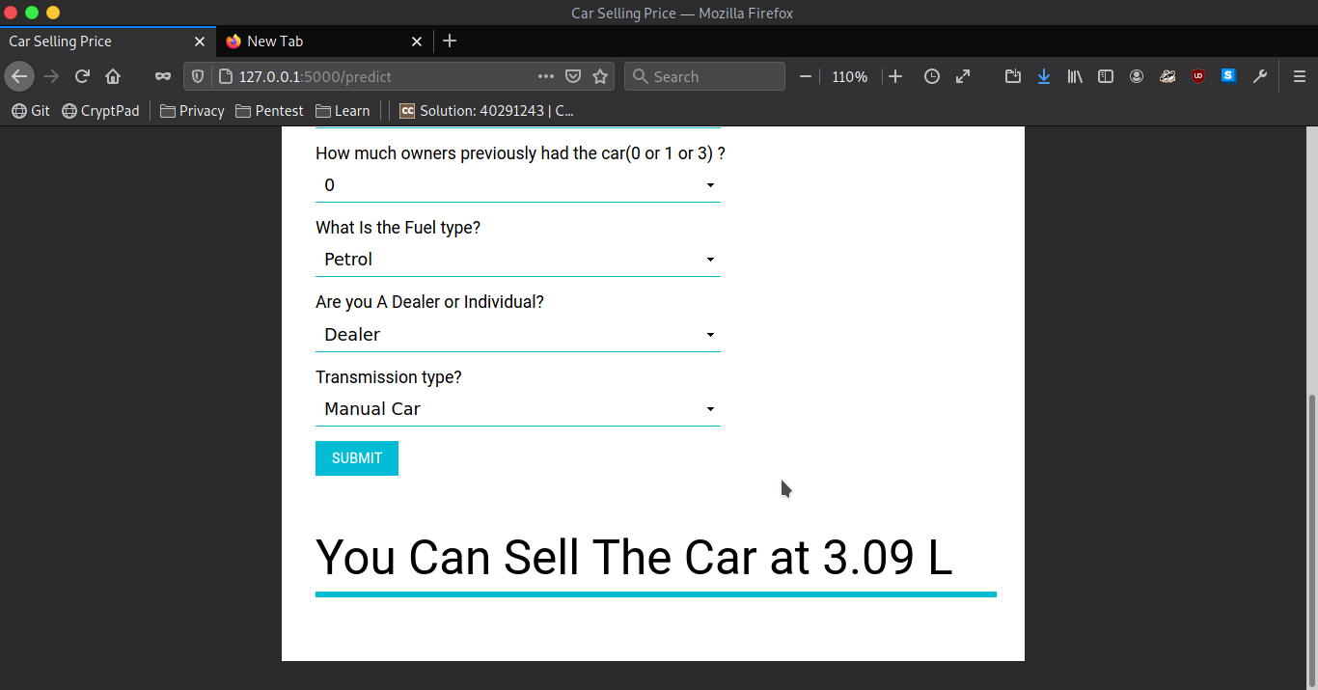
RESULTS
Figure 3: Prediction of Selling Price after applying regression.

Slide 11
TOOLS
● Python version 3.7 (current available)
● Packages : BeautifulSoup, requests, pandas, numpy, matplotlib
● Windows text editor or equivalent software
● Tableau Software
● Microsoft excel or equivalent spreadsheet software
● JupyterLab

Slide 12
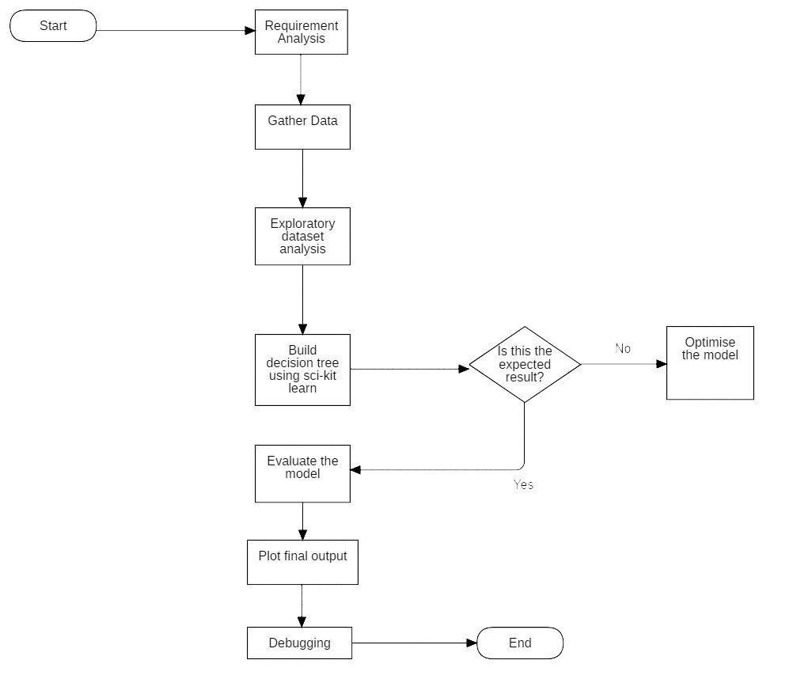
PROJECT FLOW

