Slide 1
British Airways Buying Behavior Prediction
Apr 7th, 2023
Zhe Wang

Slide 2
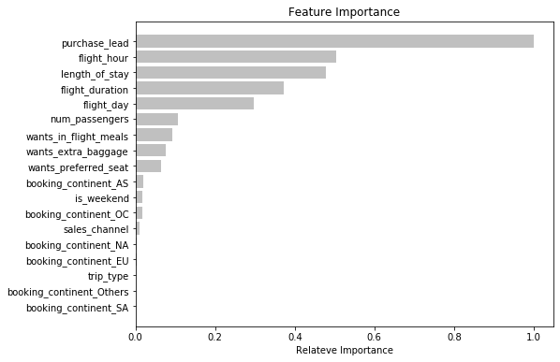
Predictive Model
Results:
The most important feature is purchase_lead, which is the number of days between purchase and departure.
Features that are related to the flight, such as flight_hour and flight_duration, are also important.
The booking_continent_XX, which is the continent from where the booking was made, is not very important.
The accuracy and the F1-score of the model were 0.81 and 0.23, respectively. Improvements are needed.
Recommendations:
Investigate the relationships between the most important features and customer bookings for potential strategies.
Remove the features with low predictive powers and add more customer-centric features to improve the performance of the model.

