Slide 1
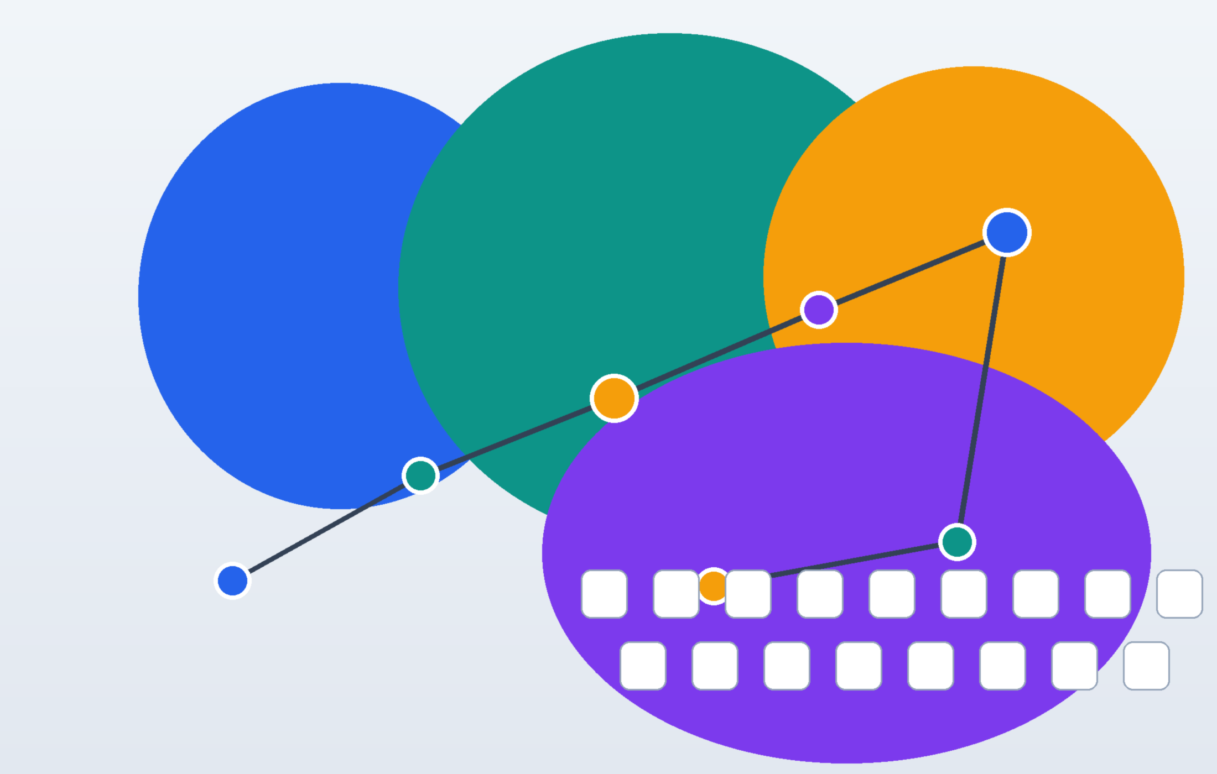




AI value capture is moving from foundation-model capex to workflow monetization
Capital still scales the supply stack, but durable profit pools shift toward workflow owners.
Executive View
The next AI winners will monetize workflows, not just model access.
Supply-side capex remains necessary, but durable profit pools accrue where inference, domain data, governance and distribution reinforce each other.
Where value is moving
Revenue CAGR (2023-2028E)
Downstream EBIT Share
41%
56%
Revenue scales from $155B to $890B.
Most profit lands in apps and services.
Inference Cost Decline
Budget Concentration
68%
61%
Cheaper inference unlocks more workflows.
Five workflows absorb most 2026 buying intent.
Generated locally inside the workspace to cover the image-hero route.
S01
Illustrative market view for skill demo only. Data is fabricated but internally consistent.

Slide 2
Revenue scales fast, while profit pools migrate downstream
The sector keeps growing, but the best economics migrate from model supply to application monetization.
Market Economics
Revenue by stack layer, $B
EBIT pool migration, % of industry EBIT
Revenue CAGR 41%
Apps/services EBIT share 56%
Cost curves unlock new demand
Revenue expands around 6x as pilots turn into funded programs.
Profit shifts toward recurring workflow software and services.
Cheaper inference lets more workflows clear ROI.
S02
Editable native charts are used intentionally here to preserve post-handoff data editing.

Slide 3
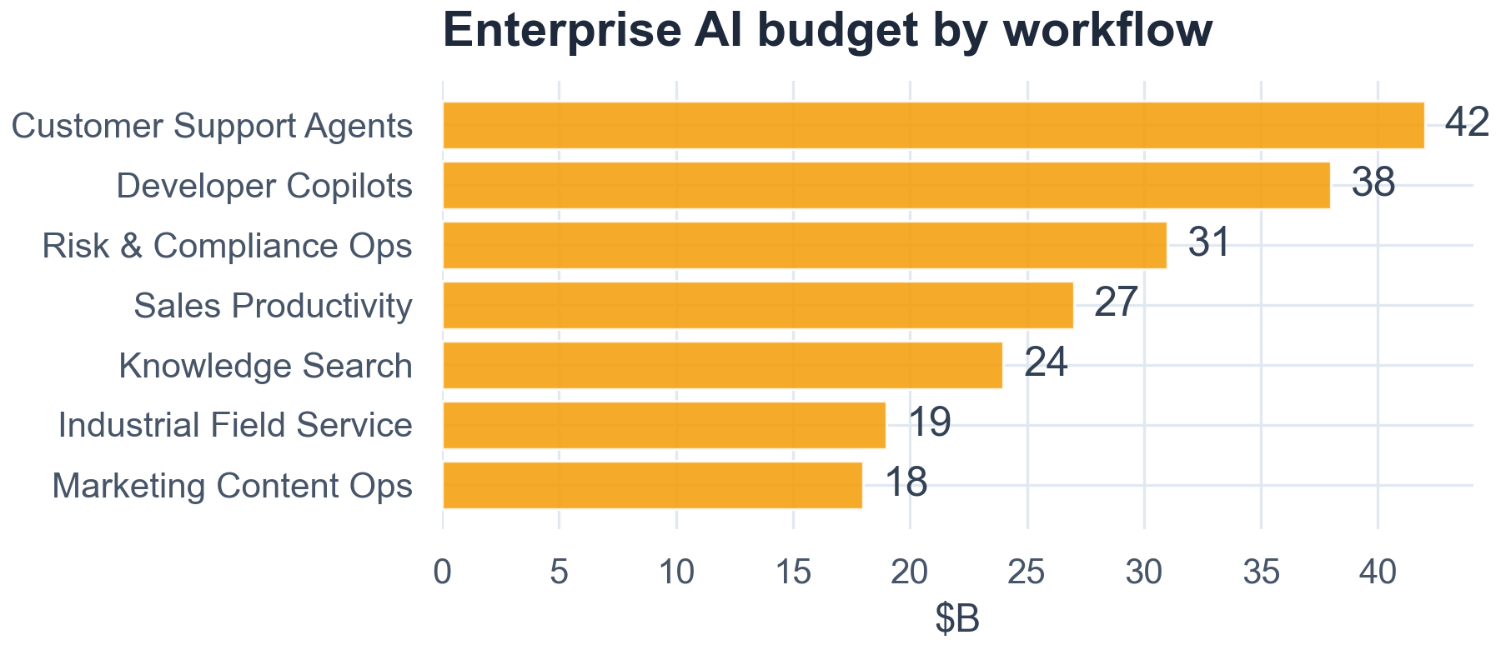
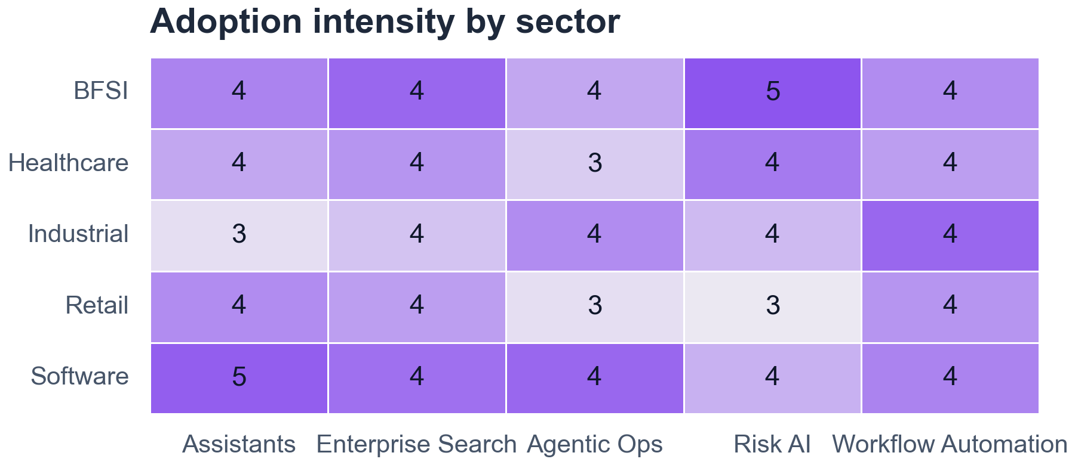
Enterprise demand is broad, but monetization concentrates in budget-rich workflows
The early revenue pool is driven by a narrow set of workflows with budget authority and clear ROI owners.
Demand Shape
2026 enterprise AI budget by workflow, $B
Adoption intensity by sector and use case
Budget authority is concentrated in workflows with labor substitution or risk ownership.
Adoption is broad, but the monetization path differs sharply by sector and workflow owner.
Why spending concentrates
1. Budget-rich functions buy first: support, software delivery, risk and sales productivity have clear owners and measurable ROI.
2. Cross-functional use cases adopt broadly, but broad adoption does not automatically create a monetization wedge.
3. This is why the winning product is usually a workflow package with integration, guardrails and change management baked in.
S03
This page uses Python figure assets to preserve information density that would be awkward in native Office charts.

Slide 4



Control points sit where model capability, proprietary data and distribution create feedback loops
The winning layer is the one that compounds model access with enterprise data, governance and user distribution.
Control Architecture
AI industry control map
Economic implications
1. Models stay essential, but control economics sit one layer downstream where products orchestrate tools, policies and data.
2. Proprietary data and governance make workflows sticky; distribution and user telemetry keep improving the product after sale.
3. Integrators monetize deployment, but the compounding moat usually belongs to the product layer that owns the feedback loop.
Compute
Fabric
Foundation
Models
Agent Control
Layer
Vertical Workflow
Apps
Enterprise
Distribution
Proprietary Data
Safety & Governance
Capital stays upstream
Implementation Services
User Feedback
Telemetry
Profit shifts downstream
Moat compounds in governance
S04
This page intentionally uses real glued connectors so the diagram remains maintainable after handoff.

Slide 5

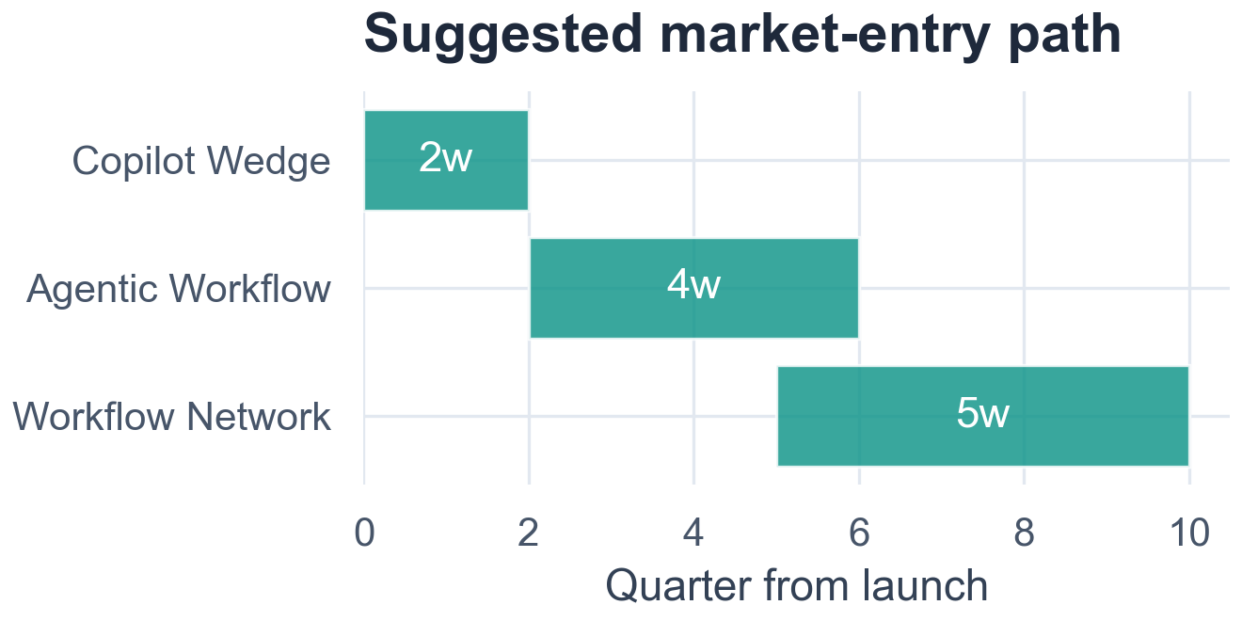
The best risk-adjusted play is a domain-focused agent stack, not another general model lab
Domain agent stacks win because they pair software economics with differentiated data and workflow embedment.
Recommendation
Archetype scorecard
Investment thesis
Archetype
Growth
Margin
Moat
Capital Efficiency
Time to Scale
The best play is a domain-focused agent stack with a narrow wedge, clear budget owner and expansion path into adjacent workflows.
That model captures software-like margin while still benefiting from falling model cost and rising enterprise adoption.
Compute Fabric
3
2
3
1
2
Model Labs
4
2
3
1
2
Suggested three-wave entry plan
Agent Control Layer
5
4
4
3
4
Domain Agent Stack
Pick
5
5
5
4
4
Services Integrator
3
4
2
5
5
Score meaning: 5 = strongest strategic position, 1 = structurally weak.
Capital Efficiency treats a lighter capital model as more attractive.
Start with a narrow copilot wedge, then expand into agentic workflow execution and workflow-network adjacencies.
S05
The matrix is intentionally native-shape based, while the rollout path uses a Python figure to preserve density and clarity.

Slide 6




One workflow auto-produces a board-ready deck with validation evidence
This demo itself is the proof that planning, asset build, PPT generation and validation can be one reproducible workflow.
Capability Proof
Reproducible deck workflow
Asset coverage in this demo
Brief
Lock audience and message.
Editable layout
Native charts
Text and shapes remain editable after handoff.
Revenue and EBIT pages stay editable.
Plan
Set archetype and validation.
Data
Keep inputs stable and traceable.
Connector diagram
Python figures
The industry map keeps real glued connectors.
Research figures keep density and clarity.
Build
Generate charts, icons and slides.
Validation bundle
Reusable workflow
Validate
Check connectors and previews.
Manifest, previews and connector checks stay together.
The workspace is built for iteration.
Deliver
Ship a board-ready workspace.
The value is not just automated slide drawing.
Planning, asset routing, editable build and validation stay preserved in one workspace.
Slides
6
Native charts
2
Python figs
3
Conns
11
Icons
1
S06
This final page turns the demo itself into proof that the skill can deliver both insight and production workflow.

