Slide 1

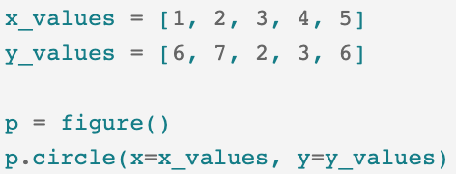
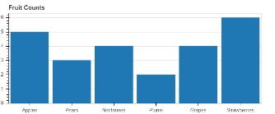
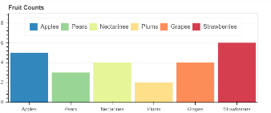

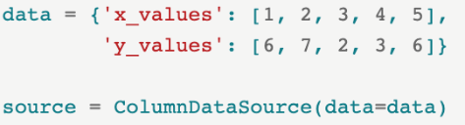
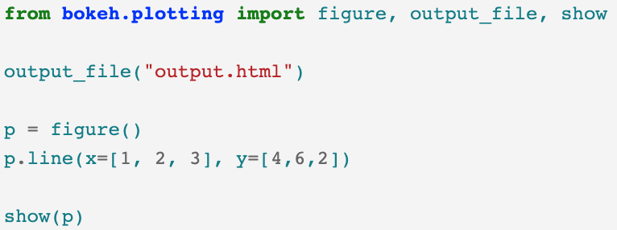
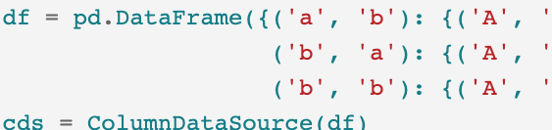
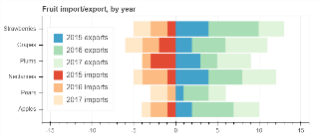
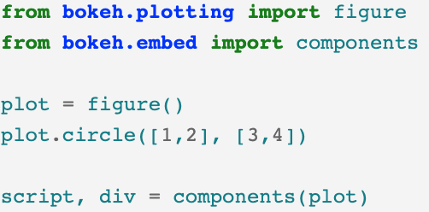
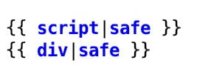
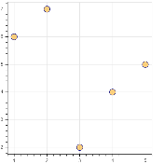
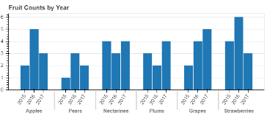
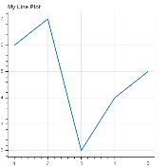
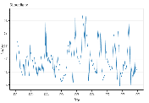
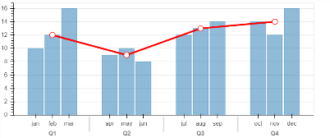

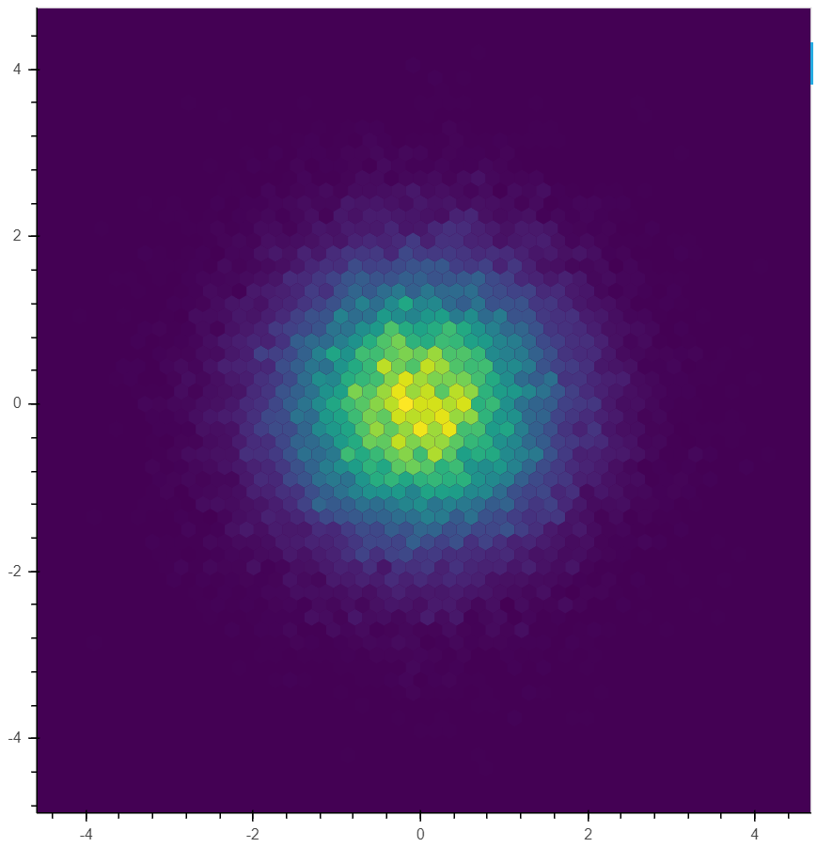
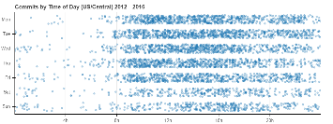
Interactive Data Visualization
Zihe Wang (zw2624), Yaotian Dai(yd2512)
Basics
Data Source
Bar and Categorical Data Plots
Bokeh is an interactive visualization library that targets modern web browsers for presentation. Bokeh provides elegant, concise construction of versatile graphics with interactivity over very large or streaming datasets in a quick and easy way from Python.
Providing data directly
Some of the ‘layers’ allow the direct pass of lists of values. Take circle plot as an example.
Basic Bar Charts
Use vbar for vertical bars and hbar for horizontal bars
Create a source and use that to drive the plot
source = ColumnDataSource(data=dict(fruits=…, counts=…, color=…))
p = figure(x_range=…, plot_height=…, title…)
p.vbar(x=…, top=…, width=…, legend…, source=…)
Output
User should define the type of outputs for Bokeh documents before create the plot.
output_file: generates simple standalone HTML documents. output_notebook: displays inline in Jupyter notebook.
There is also an embedding option, letting user generate the <script> and <div> parts for the plot.
ColumnDataSource
The core of most Bokeh plots.
import
Once the ColumnDataSource has been created, it can be passed into the source parameter of plotting methods which allows you to pass a column’s name as a stand in for the data values. In addition to dict, pandas and numpy are also acceptable.
Without source
With source
Stacked Bars
Use vbar_stack for vertical bars and hbar_stack for horizontal bars
Set output before use
source = ColumnDataSource(data=dict(fruits=…, counts=…, color=…))
p = figure(x_range=…, plot_height=…, title…)
p = hbar_stack(a series for each "row", y=…, height=…, color=…, source=ColumnDataSource(…),legend=[…])
output
Grouped Bar Charts
Automatically group output according to the outermost level
Columns of the data source should contain tuples, for example, x = [ ("Apples", "2015"), ("Apples", "2016"), ("Apples", "2017"), ("Pears", "2015), ... ]
Show contents and order the axis range, by explicitly passing a FactorRange to figure
Basic Plotting
source = ColumnDataSource(data=dict(x=…, counts=…, color=…))
p = figure(x_range=FactorRange(…), plot_height=…, title…)
p.vbar(x=…, top=…,width=…, source=…)
Scatter Plots
Usage when rendered to html
p = figure(plot_width=, plot_height=)
p.circle or p.square … (data,size = ,line_color = , fill_color= , fill_alpha= )
Figure and glyph method
bokeh.plotting is the mid-level general purpose interface for Bokeh and its figure() function, just like the ‘ggplot()’ in R, creates a figure object that we can later use glyph functions to draw (add layers) on.
Line Plots
p = figure(plot_width=, plot_height=)
p.line(data,size = ,line_width = )
Mixing Categorical Levels
Plot glyphs using only the "outer" categories
The plot also overlays a line representing average quarterly values
p.vbar(x=…, top=…,width=…, source=…)
p.line(x=.., y=.., color=..", line_width=..)
p.circle(x=…, y=…, line_color=…, fill_color=…, size=…)
Create figure object
Datetime axes
draw
p = figure(x_axis_type="datetime“, plot_width=, plot_height=)
p.xgrid.grid_line_color=… p.ygrid.grid_line_alpha=…
p.xaxis.axis_label =…p.yaxis.axis_label =…
For the parameters in figure(), you can set the width and height, xlabs and ylabs manually.
Hex Tiling
Categorical Scatterplots
To make the values more distinguishable, we can also add a jitter transform to the y-coordinate
p = figure(tools…, match_aspect=…, background_fill_color = …)
p.hex_tile(bins.q, bins.r, size=…, line_color=…, fill_color=...)
p.circle(x=…, y=jitter(…), line_color=…, fill_color=…, size=…)
Reference: https://docs.bokeh.org/en/latest/index.html• package version 1.3.4 • Updated: 2017-01

Slide 2
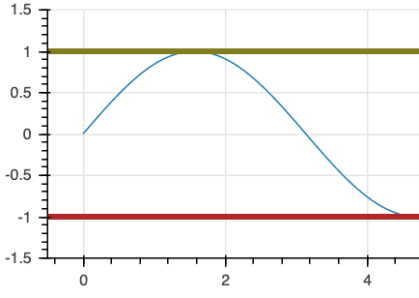


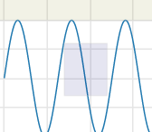
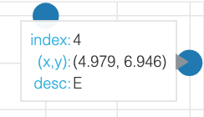
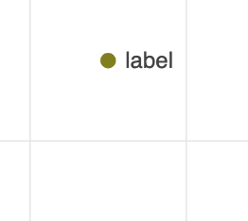
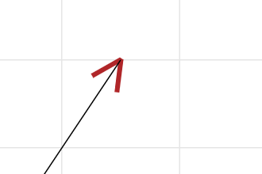
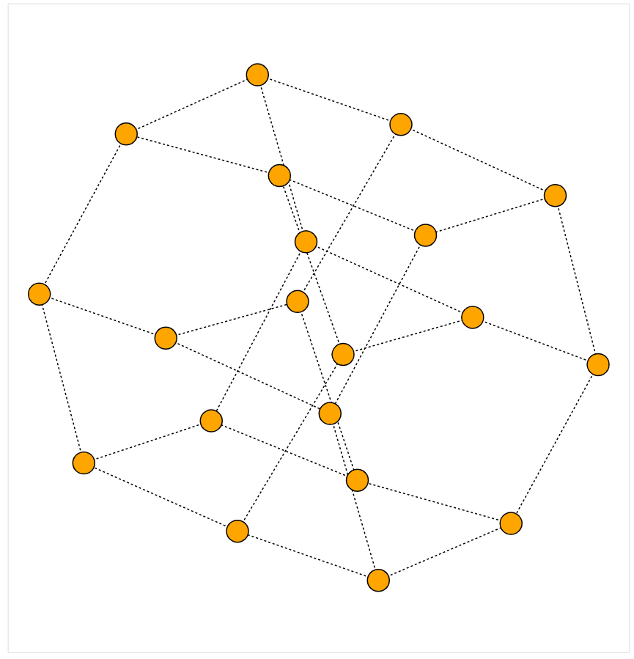

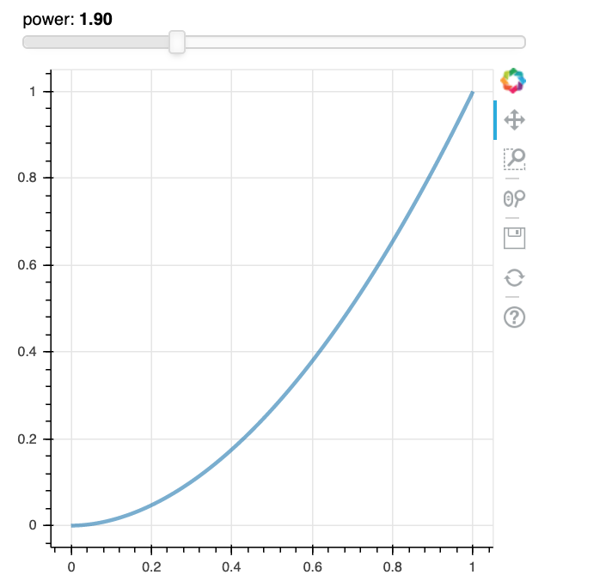
Graph and Network Plots
use the from_networkx function
node_renderer draws the nodes and edge_renderer draws the edges
Interactions
Annotations
Linked Interactions
link various interactions between different Bokeh plots
bokeh.models.annotations
Tools = ‘pan, wheel_zoo’
P = figure(tools = Tools)
Spans
Span(location, dimension, line_color, line_width)
Spans are "infinite" vertical or horizonal lines.
import networkx as nx
from bokeh.models import Range1d, Plot
from bokeh.models.graphs import from_network
G = nx.desargues_graph()
plot = Plot(x_range=Range1d(…), y_range=Range1d…))
# Create a Bokeh graph from the NetworkX input using nx.spring_layou
graph = from_networkx(G, nx.spring_layout, scale=…, center=…))
plot.renderers.append(graph)
# Set some of the default node glyph (Circle) properties
graph.node_renderer.glyph.update(size=…, fill_color=…)
# Set some edge properties too
graph.edge_renderer.glyph.line_dash = …
pan, wheel_zoo
Box_select, lasso_select, help
Box Annotation
BoxAnnotation(top, left, bottom, right, fill_alpha, fill_color)
Shaded box
Hover Tools
Hover Tool that allows additional information to be displayed in a popup whenever the user hovers over a specific glyph.
Hover = HoverTool(tooltips=[])
P = figure(tools = [Hover])
Where tooltips is a list of tuples (text, value) like (‘x’, ‘$x’)
Label
Label(x, y, text…)
Attach text label. can also set colors and front.
Widgets
Bokeh supports direct integration with a small basic widget set.
Arrows
Arrow(end, x_start, y_start, x_end, y_end)
The ‘end’ can be chosen from models.arrow_heads
Slider
Slider(start, end, value, step)
Button, Toggle, Dropdown….
Layout
Inspection and Selection Policies
inspection_policy and selection_policy can be used to control how hover inspections highlight the graph, or how selection tools make selections.
JS Callbacks
Hover Tool that allows additional information to be displayed in a popup whenever the user hovers over a specific glyph.
There are three ways to show multiple plots in one shot.
Row/Colums
show(row(p1, p2, p3))
Column() has similar effect.
callback = CustomJS(code)
Tap = TapTool(callback)
P = figure(tools=[Tap])
Where code is a snippet of JavaScript code. To make CustomJS for Property changes, use CustomJS(args, code). Use Slider widget for example:
graph.node_renderer.glyph = Circle(size=…,, fill_color=…)
graph.edge_renderer.glyph = MultiLine(line_color=…, line_alpha=…, line_width=…)
graph.node_renderer.hover_glyph = Circle(size=…, fill_color=…
graph.edge_renderer.hover_glyph = MultiLine(line_color='#abdda4', line_width=…)
# When we hover over nodes, highlight adjecent edges too
graph.inspection_policy = NodesAndLinkedEdges()
Grid
gridplot(l)
Where l is a matrix containing plots (like matrix in numpy, [[], []])
arg= dict(source=source, slider=slider) update=CustomJS(args=arg, code)
slider.js_on_change(‘value’, update)
Tab
Panel(child = plot)
Tab(tabs = [panel, ..])

