Slide 1
Windows Platform Hacking
Vincent Wang 17272381
Tony Shi 20016503

Slide 2
Overview
Vulnerability Discovery
Exploit Creation
Kali Linux Introduction
Live Demonstration for Windows Attack
Defence Strategies
Conclusion

Slide 3
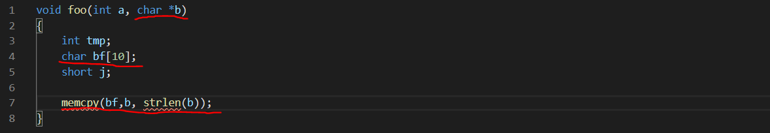
Vulnerability Discovery
Memory Bugs -> Cause Stack/Heap Overflow
Race Conditions
Logic Errors

Slide 4
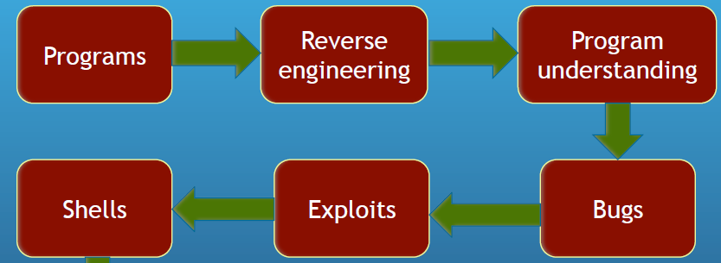
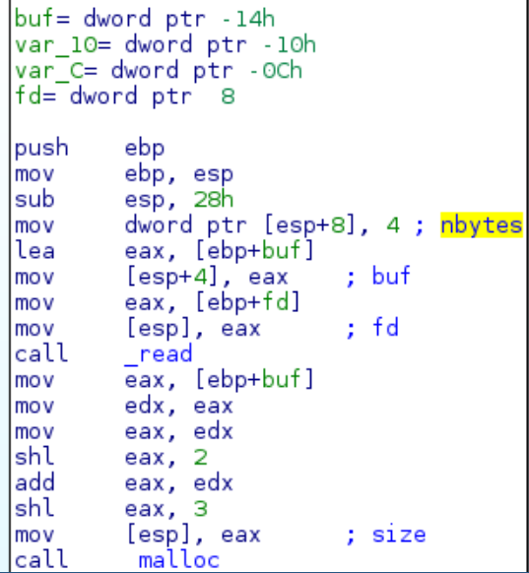
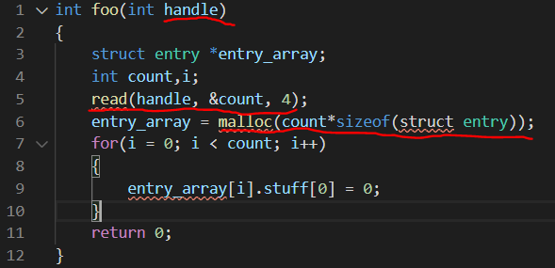
Vulnerability Discovery
1
2

Slide 5

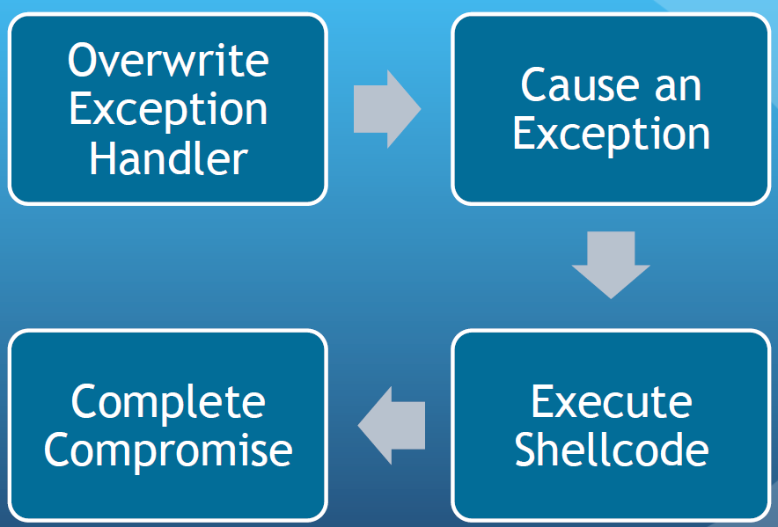
Exploit Creation – Stack Overflow
1
2

Slide 6
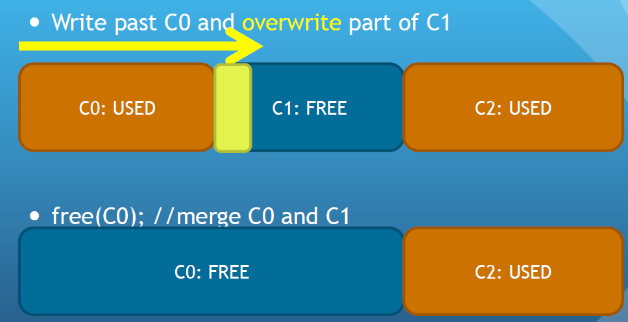
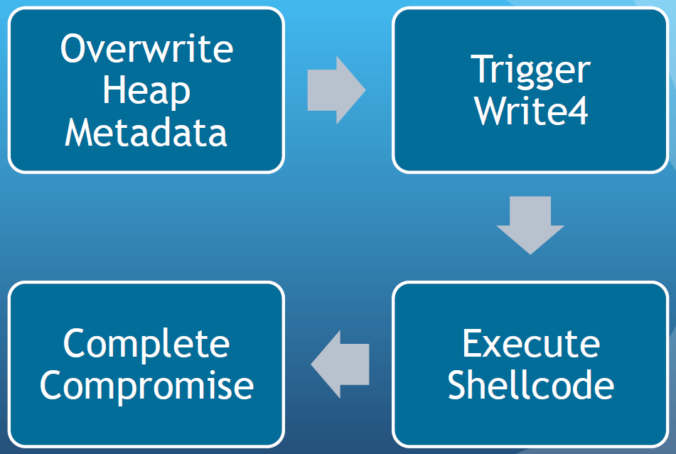
Exploit Creation – Heap Overflow
1
2

Slide 7
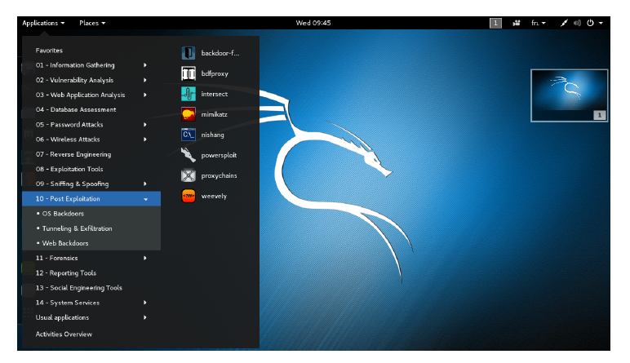
Kali Linux Introduction
Debian-derived Linux distribution designed for digital forensics and penetration testing. It is maintained and funded by Offensive Security, which has over 600 preinstalled penetration-testing programs, most of them involve exploiting a victim network or application, performing network discovery, or scanning a target IP address.
Metasploit Framework (Exploitation Tool)
Nmap (a port scanner),
Wireshark (a packet analyzer),
John the Ripper (a password cracker)
Aircrack-ng (a software suite for penetration-testing wireless LANs)
Burp suite (web application security scanners)

