Slide 1
Bike Sharing Demand Prediction in Seoul
-- Group 13
Zehua Wang, Yue Pan, Faye Fang, Ziman Jiang

Slide 2
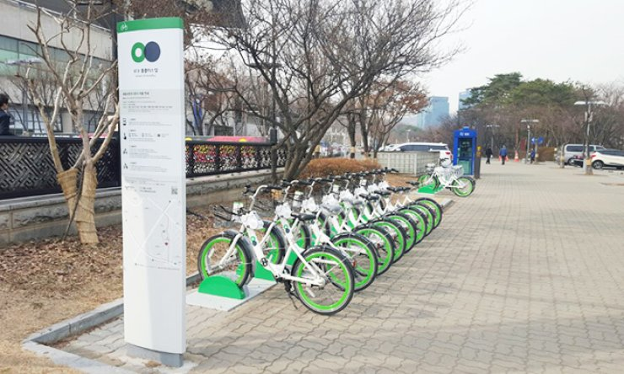
Introduction
Bike-Sharing systems are currently widely introduced in urban cities to solve the “last mile” problem, improving the link between other modes of transportation. Bike-sharing systems facilitate the use of public transportation, enhance traffic troubles, as well as minimize greenhouse gas emissions.
Notes:
We expect that the peak of usage at the hours of on and off duty, 8-10 am and 5-7 pm.
Introduce bike-sharing in Seoul, ie spot for rent and return

Slide 3
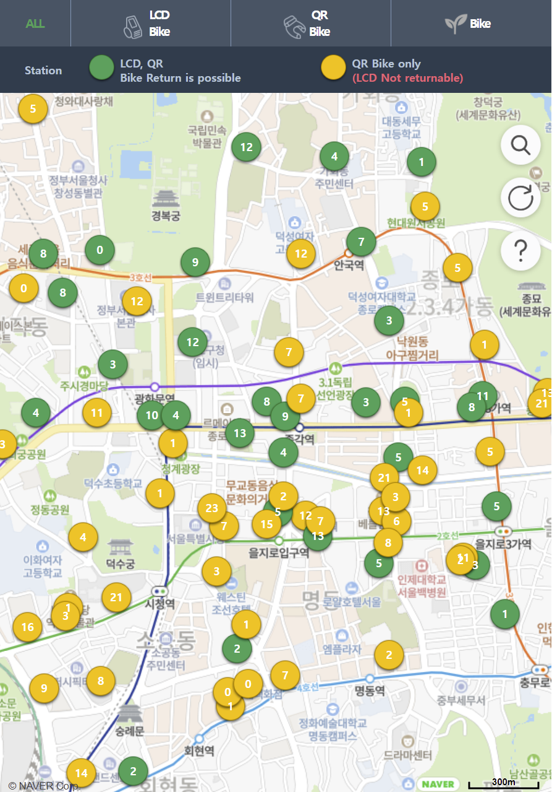
Introduction
However, the availability and accessibility of sharing bikes could be a problem since the demand and supply of bikes are not stable.
This project aims to use machine learning and data-mining-based algorithms to predict the demand for rental bikes in the Seoul City at each hour in order to provide a stable bike supply.
Notes:
We expect that the peak of usage at the hours of on and off duty, 8-10 am and 5-7 pm.
Introduce bike-sharing in Seoul, ie spot for rent and return

Slide 4
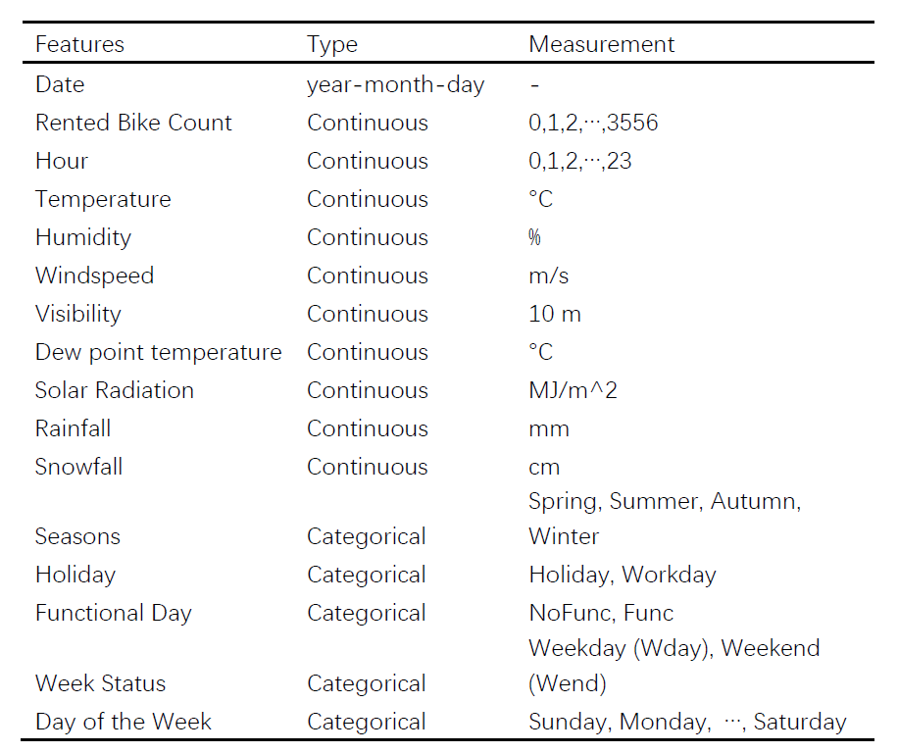
Data
Data Source
https://archive.ics.uci.edu/ml/datasets/Seoul+Bike+Sharing+Demand#
Data Description
The dataset contains weather information (Temperature, Humidity, Windspeed, Visibility, Dewpoint, Solar radiation, Snowfall, Rainfall), the number of bikes rented per hour and date information. There are 8,760 cases and 14 covariates.
Data Pre-Processing
No missing data
Date to Weekdays and Month

Slide 5
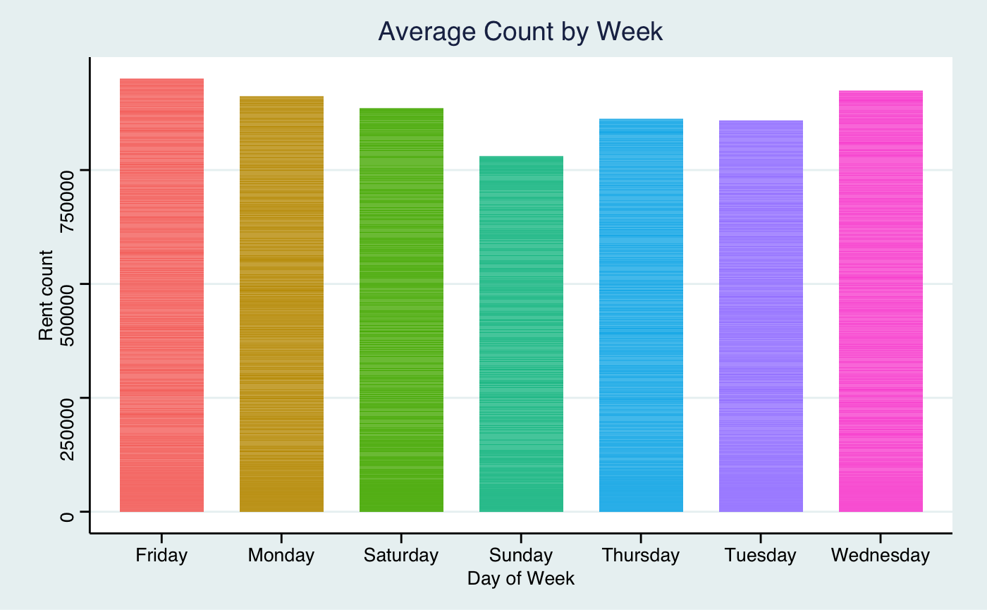
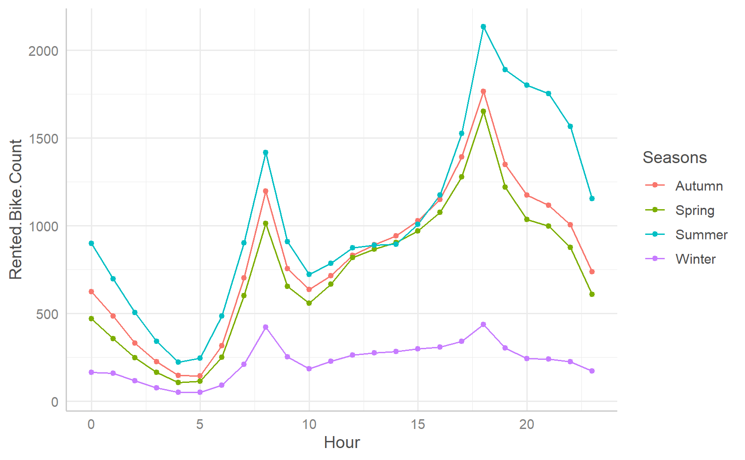
Data

Slide 6
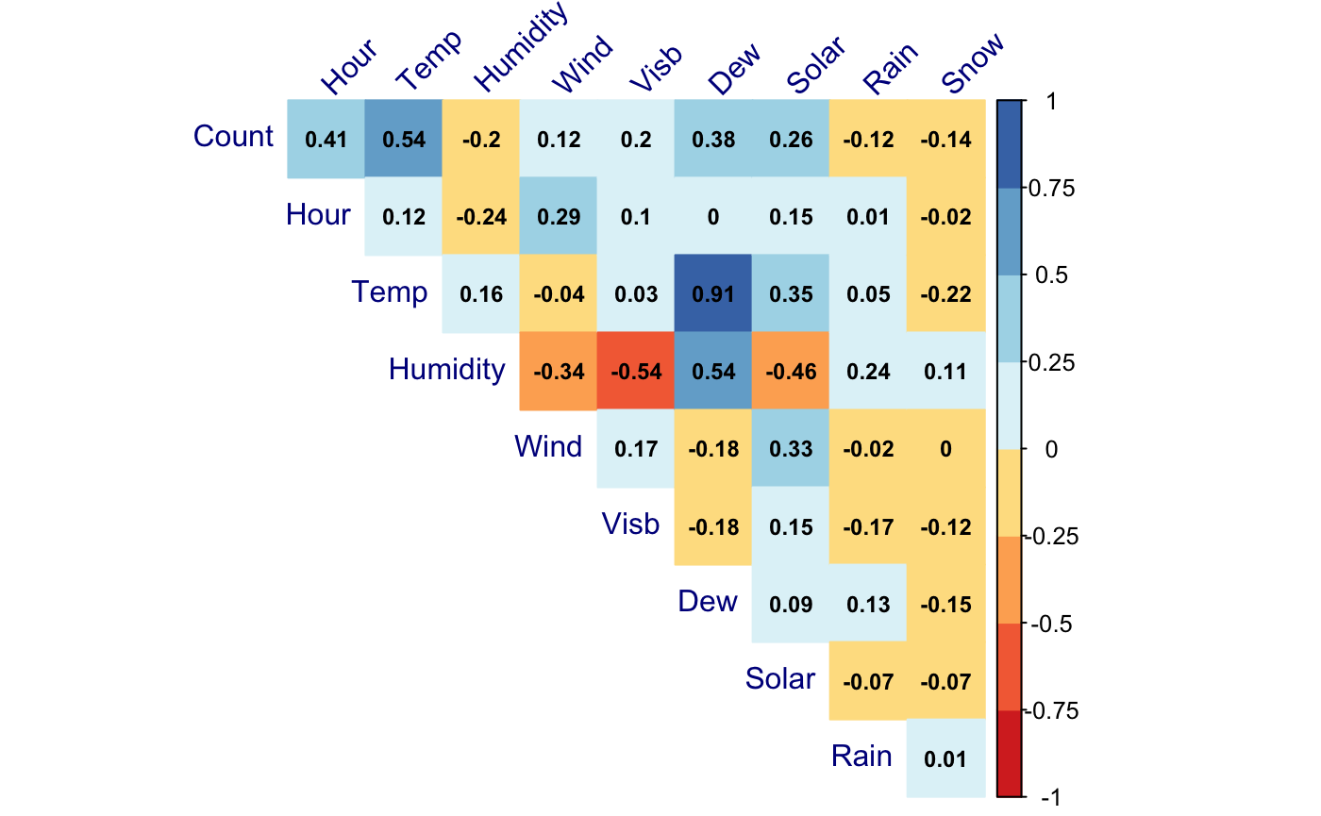
Data
Notes:
The correlation between Temperature and Dew is 0.91 which means that this two covariates have a strong relationship, and the Pearson test also confirmed that. We may want to remove one of the covariate when building the model to avoid the multicollinearity.

Slide 7
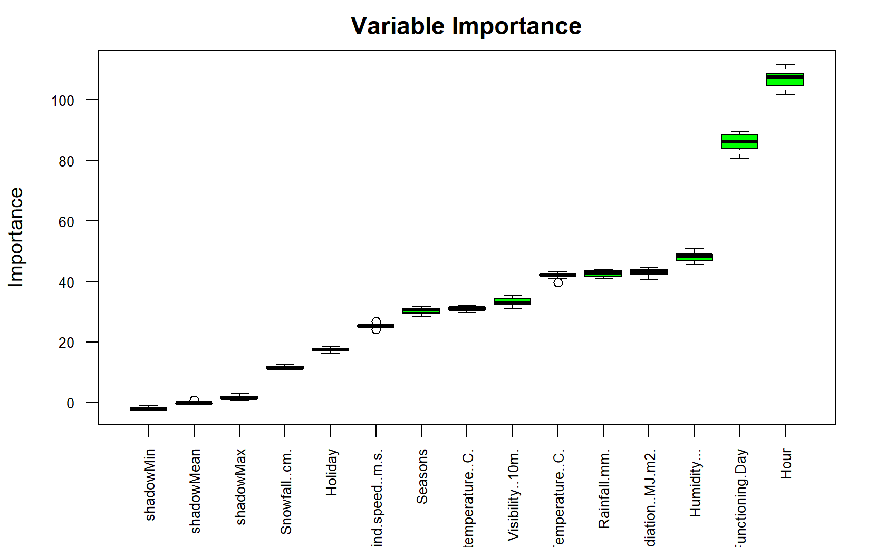
Method
Traindata: 6,132 (70%)
Testdata: 2628 (30%)
10-fold Cross Validation
Feature Selection

Slide 8
Method
LM
a linear relationship between the number of rental bikes each hour and other variables
SVM
a machine learning method that seeks hyper-plane classification of data. SVM makes a non-linear mapping of kernel function data then proceeds to linear regression in this new high- dimensional feature space.
Ridge
Estimates coefficients of multiple linear regression with the aim for lower variance, by minimizing the shrinkage penalty along with RSS.
Lasso
Similarly to Ridge but performs both shrinkage and selection.
Random Forest
a classification algorithm consisting of many decision trees, which uses bagging and feature randomness

Slide 9
Discussion
No missing data
Time dependent - independent assumption is violated in LM
Current models vs deep learning based methods
Application on other cities with bike-sharing systems

Slide 10
Thank You!

