Slide 1
Chapter 4: Designing Studies
Section 4.1
Samples and Surveys
The Practice of Statistics, 4th edition – For AP*
STARNES, YATES, MOORE

Slide 2
Chapter 4
Designing Studies
4.1 Samples and Surveys
4.2 Experiments
4.3 Using Studies Wisely

Slide 3
Section 4.1
Samples and Surveys
Learning Objectives
After this section, you should be able to…
  IDENTIFY the population and sample in a sample survey
  IDENTIFY voluntary response samples and convenience samples
  DESCRIBE how to use a table of random digits to select a simple random sample (SRS)
  DESCRIBE simple random samples, stratified random samples, and cluster samples
  EXPLAIN how undercoverage, nonresponse, and question wording can lead to bias in a sample survey

Slide 4


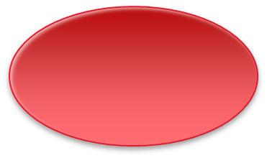

Sampling and Surveys
Population and Sample
The distinction between population and sample is basic to statistics. To make sense of any sample result, you must know what population the sample represents
Definition:
The population in a statistical study is the entire group of individuals about which we want information.
A sample is the part of the population from which we actually collect information. We use information from a sample to draw conclusions about the entire population.
Population
Collect data from a representative Sample...
Sample
Make an Inference about the Population.

Slide 5

Sampling and Surveys
The Idea of a Sample Survey
We often draw conclusions about a whole population on the basis of a sample.
Choosing a sample from a large, varied population is not that easy.
Step 1: Define the population we want to describe.
Step 2: Say exactly what we want to measure.
A “sample survey” is a study that uses an organized plan to choose a sample that represents some specific population.
Step 3: Decide how to choose a sample from the population.

Slide 6
Sampling and Surveys
How to Sample Badly
How can we choose a sample that we can trust to represent the population? There are a number of different methods to select samples.
Definition:
Choosing individuals who are easiest to reach results in a convenience sample.
Convenience samples often produce unrepresentative data…why?
Definition:
The design of a statistical study shows bias if it systematically favors certain outcomes.

Slide 7
Sampling and Surveys
How to Sample Badly
Convenience samples are almost guaranteed to show bias. So are voluntary response samples, in which people decide whether to join the sample in response to an open invitation.
Definition:
A voluntary response sample consists of people who choose themselves by responding to a general appeal. Voluntary response samples show bias because people with strong opinions (often in the same direction) are most likely to respond.

Slide 8
Sampling and Surveys
How to Sample Well: Random Sampling
The statistician’s remedy is to allow impersonal chance to choose the sample. A sample chosen by chance rules out both favoritism by the sampler and self-selection by respondents.
Random sampling, the use of chance to select a sample, is the central principle of statistical sampling.
Definition:
A simple random sample (SRS) of size n consists of n individuals from the population chosen in such a way that every set of n individuals has an equal chance to be the sample actually selected.
In practice, people use random numbers generated by a computer or calculator to choose samples. If you don’t have technology handy, you can use a table of random digits.

Slide 9
Sampling and Surveys
How to Choose an SRS
Definition:
A table of random digits is a long string of the digits 0, 1, 2, 3, 4, 5, 6, 7, 8, 9 with these properties:
  • Each entry in the table is equally likely to be any of the 10 digits 0 - 9.
  • The entries are independent of each other. That is, knowledge of one part of the table gives no information about any other part.
How to Choose an SRS Using Table D
Step 1: Label. Give each member of the population a numerical label of the same length.
Step 2: Table. Read consecutive groups of digits of the appropriate length from Table D.
Your sample contains the individuals whose labels you find.

Slide 10



Sampling and Surveys
Example: How to Choose an SRS
Problem: Use Table D at line 130 to choose an SRS of 4 hotels.
01 Aloha Kai 08 Captiva 15 Palm Tree 22 Sea Shell
02 Anchor Down 09 Casa del Mar 16 Radisson 23 Silver Beach
03 Banana Bay 10 Coconuts 17 Ramada 24 Sunset Beach
04 Banyan Tree 11 Diplomat 18 Sandpiper 25 Tradewinds
05 Beach Castle 12 Holiday Inn 19 Sea Castle 26 Tropical Breeze
06 Best Western 13 Lime Tree 20 Sea Club 27 Tropical Shores
07 Cabana 14 Outrigger 21 Sea Grape 28 Veranda
69051 64817 87174 09517 84534 06489 87201 97245
69 05 16 48 17 87 17 40 95 17 84 53 40 64 89 87 20
Our SRS of 4 hotels for the editors to contact is: 05 Beach Castle, 16 Radisson, 17 Ramada, and 20 Sea Club.

Slide 11
Sampling and Surveys
Other Sampling Methods
The basic idea of sampling is straightforward: take an SRS from the population and use your sample results to gain information about the population. Sometimes there are statistical advantages to using more complex sampling methods.
One common alternative to an SRS involves sampling important groups (called strata) within the population separately. These “sub-samples” are combined to form one stratified random sample.
Definition:
To select a stratified random sample, first classify the population into groups of similar individuals, called strata. Then choose a separate SRS in each stratum and combine these SRSs to form the full sample.

Slide 12
Sampling and Surveys
Other Sampling Methods
Although a stratified random sample can sometimes give more precise information about a population than an SRS, both sampling methods are hard to use when populations are large and spread out over a wide area.
In that situation, we’d prefer a method that selects groups of individuals that are “near” one another.
Definition:
To take a cluster sample, first divide the population into smaller groups. Ideally, these clusters should mirror the characteristics of the population. Then choose an SRS of the clusters. All individuals in the chosen clusters are included in the sample.

Slide 13
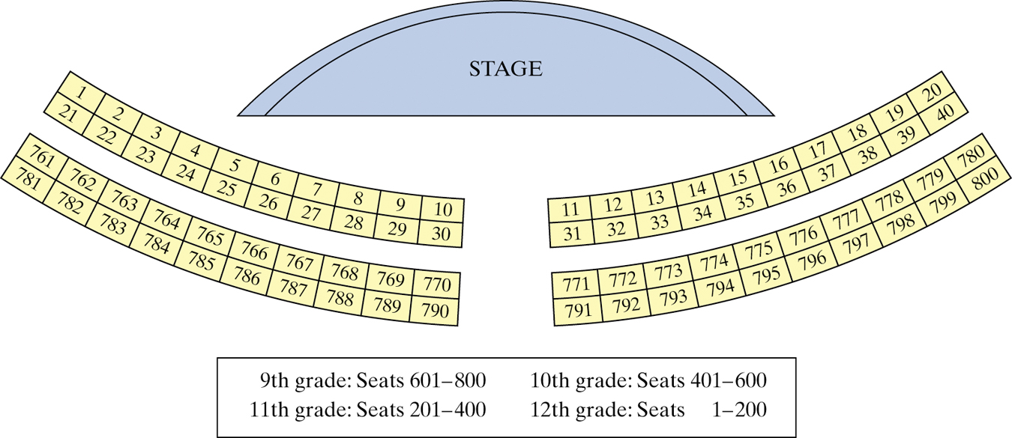
Sampling and Surveys
Example: Sampling at a School Assembly
Describe how you would use the following sampling methods to select 80 students to complete a survey.
(a) Simple Random Sample
(b) Stratified Random Sample
(c) Cluster Sample

Slide 14
Sampling and Surveys
Inference for Sampling
The purpose of a sample is to give us information about a larger population.
The process of drawing conclusions about a population on the basis of sample data is called inference.
Why should we rely on random sampling?
To eliminate bias in selecting samples from the list of available individuals.
The laws of probability allow trustworthy inference about the population
  Results from random samples come with a margin of error that sets bounds on the size of the likely error.
  Larger random samples give better information about the population than smaller samples.

Slide 15
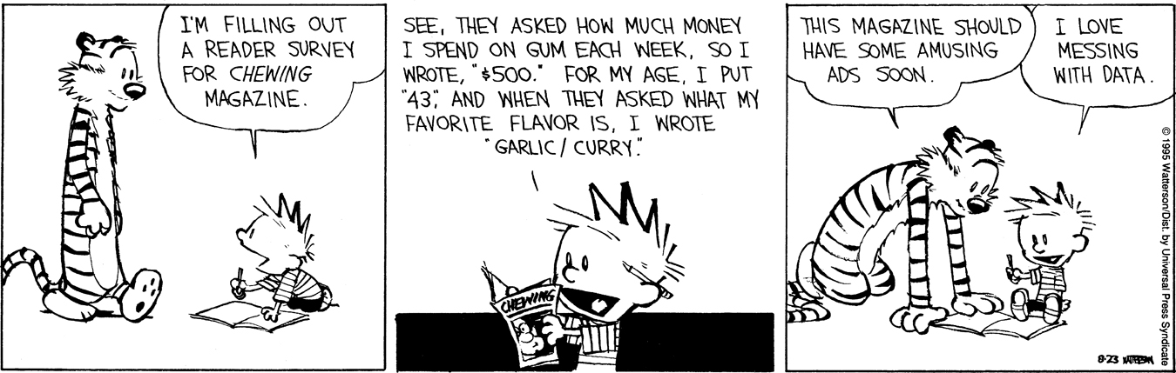
Sampling and Surveys
Sample Surveys: What Can Go Wrong?
Most sample surveys are affected by errors in addition to sampling variability.
Good sampling technique includes the art of reducing all sources of error.
Definition
Undercoverage occurs when some groups in the population are left out of the process of choosing the sample.
Nonresponse occurs when an individual chosen for the sample can’t be contacted or refuses to participate.
A systematic pattern of incorrect responses in a sample survey leads to response bias.
The wording of questions is the most important influence on the answers given to a sample survey.

Slide 16
Section 4.1
Samples and Surveys
Summary
In this section, we learned that…
  A sample survey selects a sample from the population of all individuals about which we desire information.
  Random sampling uses chance to select a sample.
  The basic random sampling method is a simple random sample (SRS).
  To choose a stratified random sample, divide the population into strata, then choose a separate SRS from each stratum.
  To choose a cluster sample, divide the population into groups, or clusters. Randomly select some of the clusters for your sample.

Slide 17
Section 4.1
Samples and Surveys
Summary, con’t
In this section, we learned that…
  Failure to use random sampling often results in bias, or systematic errors in the way the sample represents the population.
  Voluntary response samples and convenience samples are particularly prone to large bias.
  Sampling errors come from the act of choosing a sample. Random sampling error and undercoverage are common types of error.
  The most serious errors are nonsampling errors. Common types of sampling error include nonresponse, response bias, and wording of questions.

Slide 18
Looking Ahead…
In the next Section…
We’ll learn how to produce data by designing experiments.
We’ll learn about
  Observational Studies vs. Experiments
  The Language of Experiments
  Randomized Comparative Experiments
  Principles of Experimental Design
  Inference for Experiments
  Blocking
  Matched Pairs Design

