Slide 1
Chapter 4: Designing Studies
Section 4.2
Experiments
The Practice of Statistics, 4th edition – For AP*
STARNES, YATES, MOORE

Slide 2
Chapter 4
Designing Studies
4.1 Samples and Surveys
4.2 Experiments
4.3 Using Studies Wisely

Slide 3
Section 4.2
Experiments
Learning Objectives
After this section, you should be able to…
  DISTINGUISH observational studies from experiments
  DESCRIBE the language of experiments
  APPLY the three principles of experimental design
  DESIGN comparative experiments utilizing completely randomized designs and randomized block designs, including matched pairs design

Slide 4
Experiments
Observational Study versus Experiment
In contrast to observational studies, experiments don’t just observe individuals or ask them questions. They actively impose some treatment in order to measure the response.
Definition:
An observational study observes individuals and measures variables of interest but does not attempt to influence the responses.
An experiment deliberately imposes some treatment on individuals to measure their responses.
When our goal is to understand cause and effect, experiments are the only source of fully convincing data.
The distinction between observational study and experiment is one of the most important in statistics.

Slide 5
Experiments
Observational Study versus Experiment
Observational studies of the effect of one variable on another often fail because of confounding between the explanatory variable and one or more lurking variables.
Definition:
A lurking variable is a variable that is not among the explanatory or response variables in a study but that may influence the response variable.
Confounding occurs when two variables are associated in such a way that their effects on a response variable cannot be distinguished from each other.
Well-designed experiments take steps to avoid confounding.

Slide 6
Experiments
The Language of Experiments
An experiment is a statistical study in which we actually do something (a treatment) to people, animals, or objects (the experimental units) to observe the response. Here is the basic vocabulary of experiments.
Definition:
A specific condition applied to the individuals in an experiment is called a treatment. If an experiment has several explanatory variables, a treatment is a combination of specific values of these variables.
The experimental units are the smallest collection of individuals to which treatments are applied. When the units are human beings, they often are called subjects.
Sometimes, the explanatory variables in an experiment are called factors. Many experiments study the joint effects of several factors. In such an experiment, each treatment is formed by combining a specific value (often called a level) of each of the factors.

Slide 7

Experiment
How to Experiment Badly
Experiments are the preferred method for examining the effect of one variable on another. By imposing the specific treatment of interest and controlling other influences, we can pin down cause and effect. Good designs are essential for effective experiments, just as they are for sampling.
Example, page 236
A high school regularly offers a review course to prepare students for the SAT. This year, budget cuts will allow the school to offer only an online version of the course. Over the past 10 years, the average SAT score of students in the classroom course was 1620. The online group gets an average score of 1780. That’s roughly 10% higher than the long- time average for those who took the classroom review course. Is the online course more effective?
Students -> Online Course -> SAT Scores

Slide 8





Experiment
How to Experiment Badly
Many laboratory experiments use a design like the one in the online SAT course example:
Experimental Units
Treatment
Measure Response
In the lab environment, simple designs often work well.
Field experiments and experiments with animals or people deal with more variable conditions.
Outside the lab, badly designed experiments often yield worthless results because of confounding.

Slide 9
Experiments
How to Experiment Well: The Randomized Comparative Experiment
The remedy for confounding is to perform a comparative experiment in which some units receive one treatment and similar units receive another. Most well designed experiments compare two or more treatments.
Comparison alone isn’t enough, if the treatments are given to groups that differ greatly, bias will result. The solution to the problem of bias is random assignment.
Definition:
In an experiment, random assignment means that experimental units are assigned to treatments at random, that is, using some sort of chance process.

Slide 10












Experiments
The Randomized Comparative Experiment
Definition:
In a completely randomized design, the treatments are assigned to all the experimental units completely by chance.
Some experiments may include a control group that receives an inactive treatment or an existing baseline treatment.
Group 1
Treatment 1
Compare Results
Experimental Units
Random Assignment
Group 2
Treatment 2

Slide 11
Experiments
Three Principles of Experimental Design
Randomized comparative experiments are designed to give good evidence that differences in the treatments actually cause the differences we see in the response.
Principles of Experimental Design
Control for lurking variables that might affect the response: Use a comparative design and ensure that the only systematic difference between the groups is the treatment administered.
Random assignment: Use impersonal chance to assign experimental units to treatments. This helps create roughly equivalent groups of experimental units by balancing the effects of lurking variables that aren’t controlled on the treatment groups.
Replication: Use enough experimental units in each group so that any differences in the effects of the treatments can be distinguished from chance differences between the groups.

Slide 12
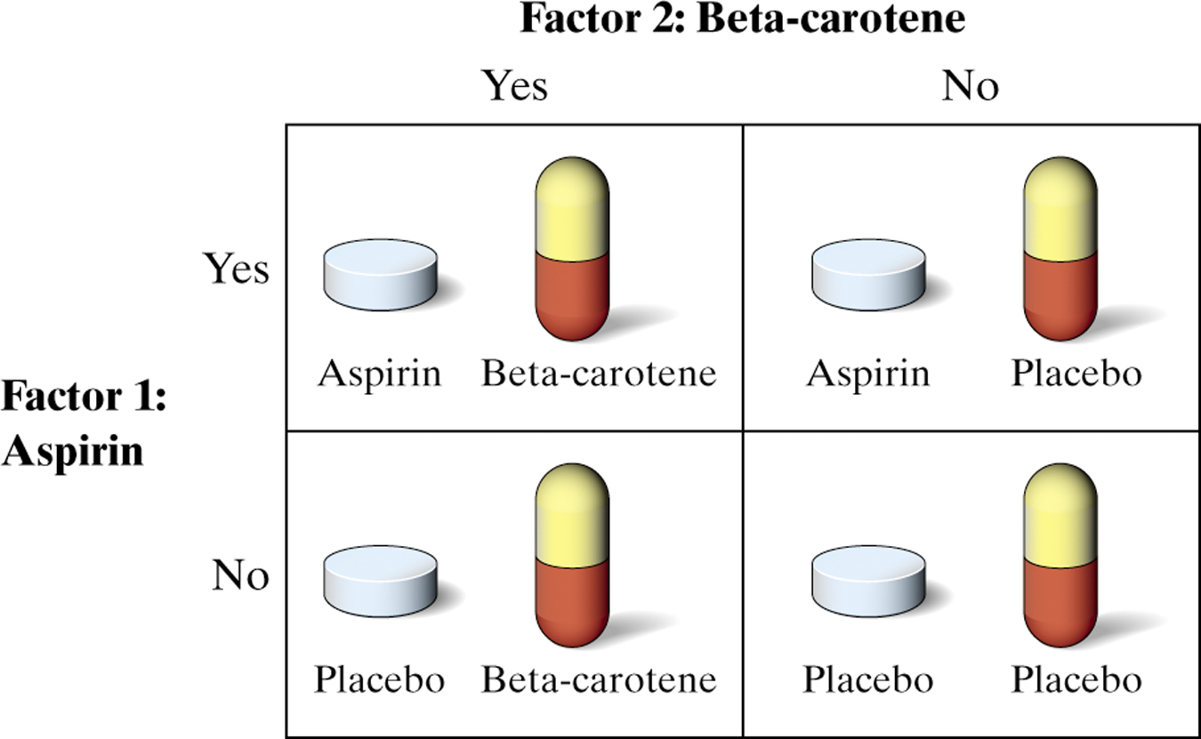

Experiments
Example: The Physicians’ Health Study
Read the description of the Physicians’ Health Study on page 241. Explain how each of the three principles of experimental design was used in the study.
A placebo is a “dummy pill” or inactive treatment that is indistinguishable from the real treatment.

Slide 13
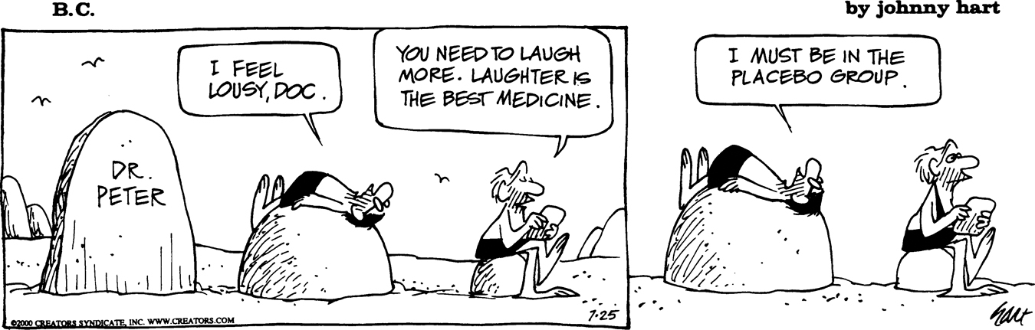
Experiments
Experiments: What Can Go Wrong?
The logic of a randomized comparative experiment depends on our ability to treat all the subjects the same in every way except for the actual treatments being compared.
Good experiments, therefore, require careful attention to details to ensure that all subjects really are treated identically.
A response to a dummy treatment is called a placebo effect. The strength of the placebo effect is a strong argument for randomized comparative experiments.
Whenever possible, experiments with human subjects should be double-blind.
Definition:
In a double-blind experiment, neither the subjects nor those who interact with them and measure the response variable know which treatment a subject received.

Slide 14
Experiments
Inference for Experiments
In an experiment, researchers usually hope to see a difference in the responses so large that it is unlikely to happen just because of chance variation.
We can use the laws of probability, which describe chance behavior, to learn whether the treatment effects are larger than we would expect to see if only chance were operating.
If they are, we call them statistically significant.
Definition:
An observed effect so large that it would rarely occur by chance is called statistically significant.
A statistically significant association in data from a well-designed experiment does imply causation.

Slide 15
Experiments
Blocking
Completely randomized designs are the simplest statistical designs for experiments. But just as with sampling, there are times when the simplest method doesn’t yield the most precise results.
Definition
A block is a group of experimental units that are known before the experiment to be similar in some way that is expected to affect the response to the treatments.
In a randomized block design, the random assignment of experimental units to treatments is carried out separately within each block.
Form blocks based on the most important unavoidable sources of variability (lurking variables) among the experimental units.
Randomization will average out the effects of the remaining lurking variables and allow an unbiased comparison of the treatments.
Control what you can, block on what you can’t control, and randomize to create comparable groups.

Slide 16
Experiments
Matched-Pairs Design
A common type of randomized block design for comparing two treatments is a matched pairs design. The idea is to create blocks by matching pairs of similar experimental units.
Definition
A matched-pairs design is a randomized blocked experiment in which each block consists of a matching pair of similar experimental units.
Chance is used to determine which unit in each pair gets each treatment.
Sometimes, a “pair” in a matched-pairs design consists of a single unit that receives both treatments. Since the order of the treatments can influence the response, chance is used to determine with treatment is applied first for each unit.

Slide 17
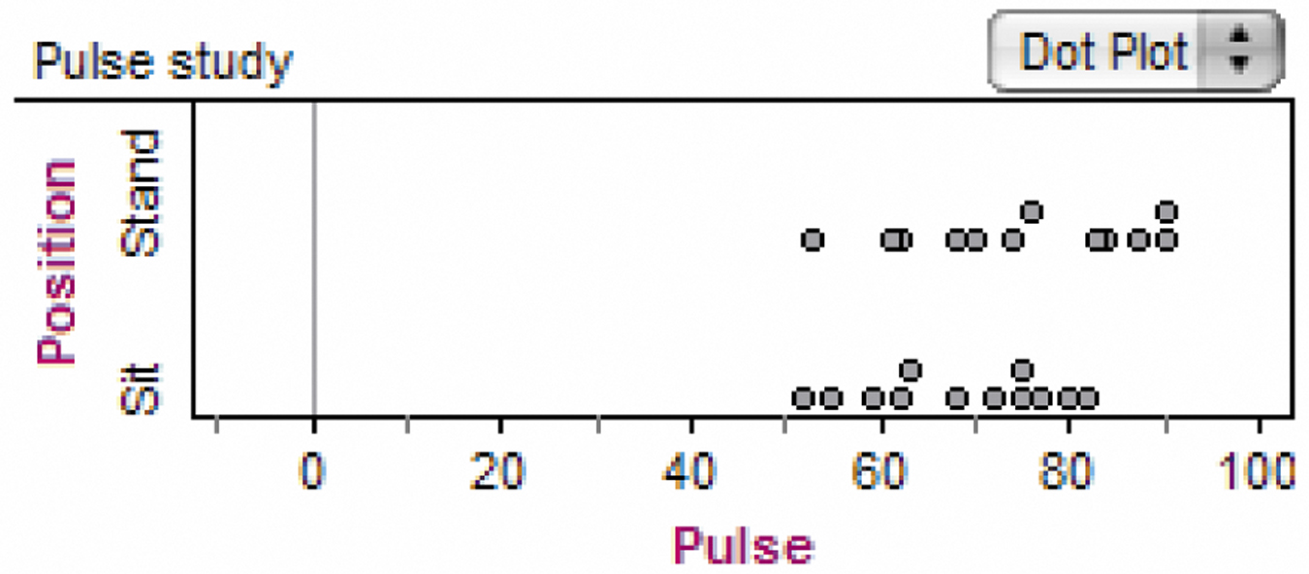
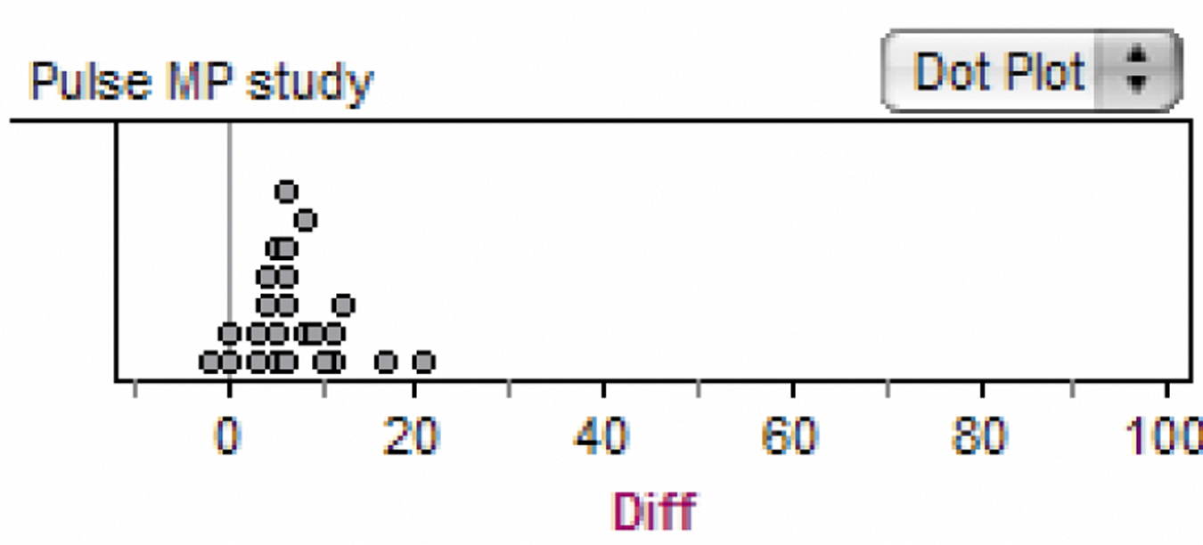
Experiments
Example: Standing and Sitting Pulse Rate
Consider the Fathom dotplots from a completely randomized design and a matched-pairs design. What do the dotplots suggest about standing vs. sitting pulse rates?

Slide 18
Section 4.2
Experiments
Summary
In this section, we learned that…
  We can produce data intended to answer specific questions by observational studies or experiments.
  In an experiment, we impose one or more treatments on a group of experimental units (sometimes called subjects if they are human).
  The design of an experiment describes the choice of treatments and the manner in which the subjects are assigned to the treatments.
  The basic principles of experimental design are control for lurking variables, random assignment of treatments, and replication (using enough experimental units).
  Many behavioral and medical experiments are double-blind.

Slide 19
Section 4.2
Experiments
Summary, con’t
In this section, we learned that…
  Some experiments give a placebo (fake treatment) to a control group that helps confounding due to the placebo-effect.
  In addition to comparison, a second form of control is to form blocks of individuals that are similar in some way that is important to the response. Randomization is carried out within each block.
  Matched pairs are a common form of blocking for comparing just two treatments. In some matched pairs designs, each subject receives both treatments in a random order.

Slide 20
Looking Ahead…
In the next Section…
We’ll learn how to use studies wisely.
We’ll learn about
  The Scope of Inference
  The Challenges of Establishing Causation
  Data Ethics

