Slide 1
Chapter 6: Random Variables
Section 6.2
Transforming and Combining Random Variables
The Practice of Statistics, 4th edition – For AP*
STARNES, YATES, MOORE

Slide 2
Chapter 6
Random Variables
6.1 Discrete and Continuous Random Variables
6.2 Transforming and Combining Random Variables
6.3 Binomial and Geometric Random Variables

Slide 3
Section 6.2
Transforming and Combining Random Variables
Learning Objectives
After this section, you should be able to…
  DESCRIBE the effect of performing a linear transformation on a random variable
  COMBINE random variables and CALCULATE the resulting mean and standard deviation
  CALCULATE and INTERPRET probabilities involving combinations of Normal random variables

Slide 4
Transforming and Combining Random Variables
Linear Transformations
In Section 6.1, we learned that the mean and standard deviation give us important information about a random variable. In this section, we’ll learn how the mean and standard deviation are affected by transformations on random variables.
In Chapter 2, we studied the effects of linear transformations on the shape, center, and spread of a distribution of data. Recall:
Adding (or subtracting) a constant, a, to each observation:
  Adds a to measures of center and location.
  Does not change the shape or measures of spread.
Multiplying (or dividing) each observation by a constant, b:
  Multiplies (divides) measures of center and location by b.
  Multiplies (divides) measures of spread by |b|.
  Does not change the shape of the distribution.

Slide 5
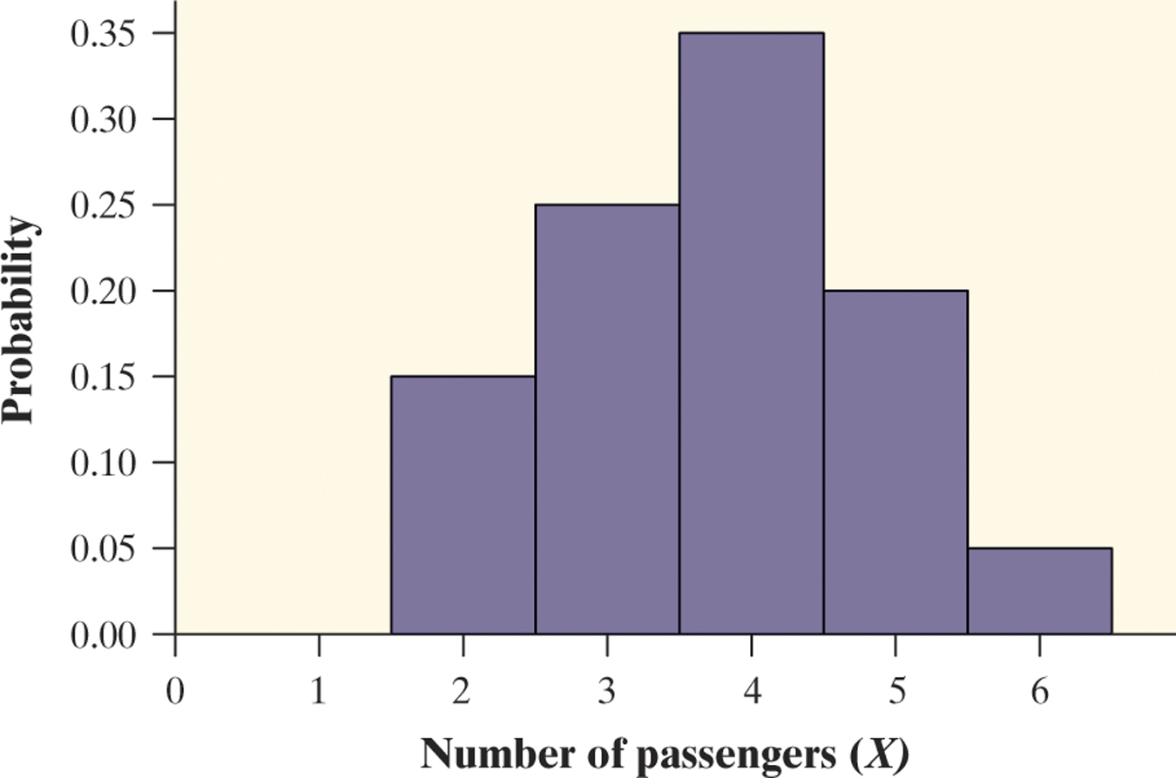
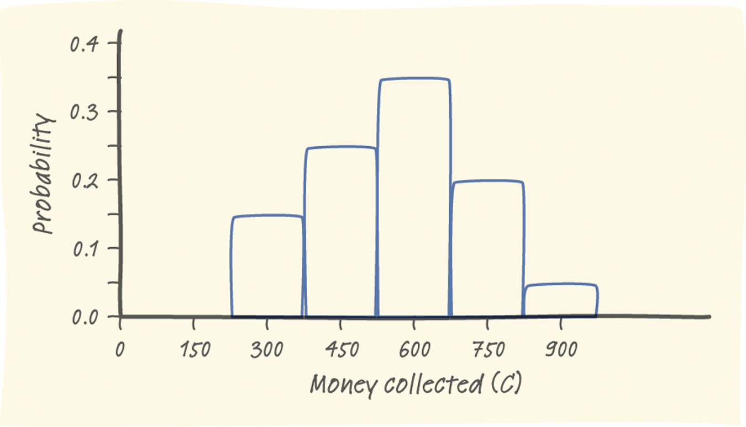
Transforming and Combining Random Variables
Linear Transformations
Pete’s Jeep Tours offers a popular half-day trip in a tourist area. There must be at least 2 passengers for the trip to run, and the vehicle will hold up to 6 passengers. Define X as the number of passengers on a randomly selected day.
Passengers x_{i} | 2 | 3 | 4 | 5 | 6
Probability p_{i} | 0.15 | 0.25 | 0.35 | 0.20 | 0.05
The mean of X is 3.75 and the standard deviation is 1.090.
Pete charges $150 per passenger. The random variable C describes the amount Pete collects on a randomly selected day.
Collected c_{i} | 300 | 450 | 600 | 750 | 900
Probability p_{i} | 0.15 | 0.25 | 0.35 | 0.20 | 0.05
The mean of C is $562.50 and the standard deviation is $163.50.
Compare the shape, center, and spread of the two probability distributions.

Slide 6
Transforming and Combining Random Variables
Linear Transformations
How does multiplying or dividing by a constant affect a random variable?
Effect on a Random Variable of Multiplying (Dividing) by a Constant
Multiplying (or dividing) each value of a random variable by a number b:
Multiplies (divides) measures of center and location (mean, median, quartiles, percentiles) by b.
Multiplies (divides) measures of spread (range, IQR, standard deviation) by |b|.
Does not change the shape of the distribution.
Note: Multiplying a random variable by a constant b multiplies the variance by b².

Slide 7
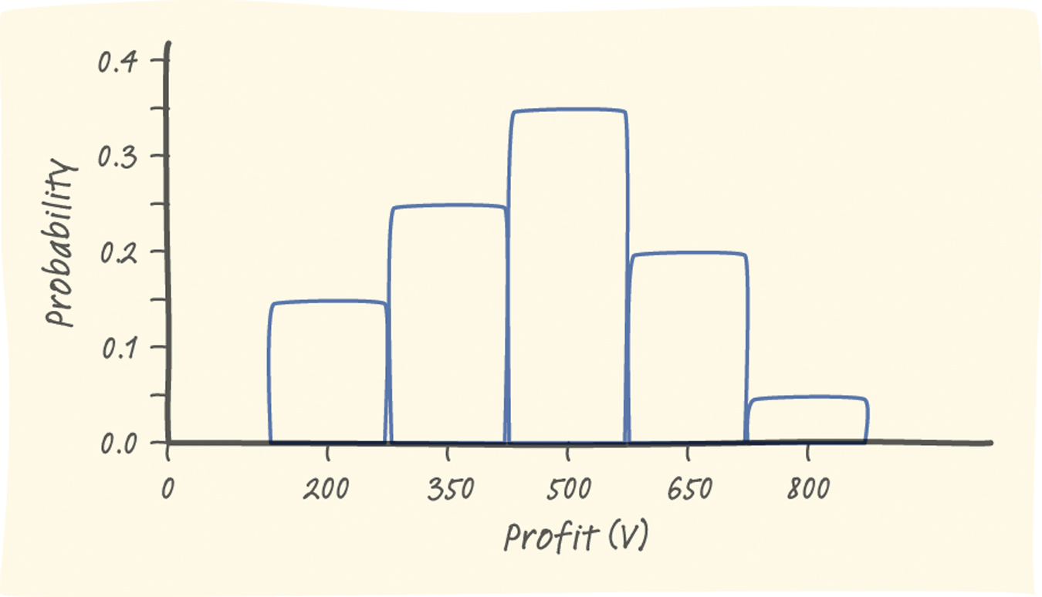
Transforming and Combining Random Variables
Linear Transformations
Consider Pete’s Jeep Tours again. We defined C as the amount of money Pete collects on a randomly selected day.
Collected c_{i} | 300 | 450 | 600 | 750 | 900
Probability p_{i} | 0.15 | 0.25 | 0.35 | 0.20 | 0.05
The mean of C is $562.50 and the standard deviation is $163.50.
It costs Pete $100 per trip to buy permits, gas, and a ferry pass. The random variable V describes the profit Pete makes on a randomly selected day.
Profit v_{i} | 200 | 350 | 500 | 650 | 800
Probability p_{i} | 0.15 | 0.25 | 0.35 | 0.20 | 0.05
The mean of V is $462.50 and the standard deviation is $163.50.
Compare the shape, center, and spread of the two probability distributions.

Slide 8
Transforming and Combining Random Variables
Linear Transformations
How does adding or subtracting a constant affect a random variable?
Effect on a Random Variable of Adding (or Subtracting) a Constant
Adding the same number a (which could be negative) to each value of a random variable:
Adds a to measures of center and location (mean, median, quartiles, percentiles).
Does not change measures of spread (range, IQR, standard deviation).
Does not change the shape of the distribution.

Slide 9
Transforming and Combining Random Variables
Linear Transformations
Whether we are dealing with data or random variables, the effects of a linear transformation are the same.
Effect on a Linear Transformation on the Mean and Standard Deviation
If Y = a + bX is a linear transformation of the random variable X, then
The probability distribution of Y has the same shape as the probability distribution of X.
µ_{Y} = a + bµ_{X}.
σ_{Y} = |b|σ_{X} (since b could be a negative number).

Slide 10
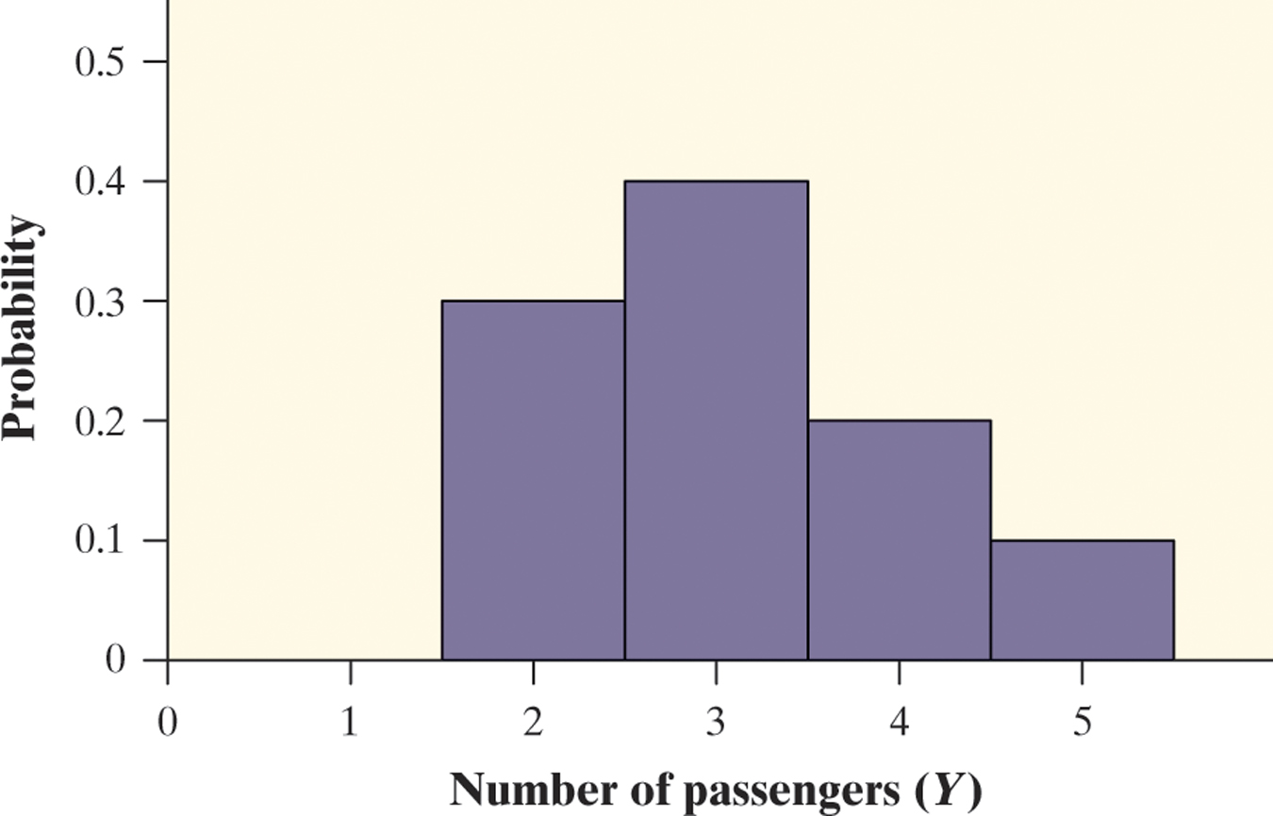
Transforming and Combining Random Variables
Combining Random Variables
So far, we have looked at settings that involve a single random variable. Many interesting statistics problems require us to examine two or more random variables.
Let’s investigate the result of adding and subtracting random variables. Let X = the number of passengers on a randomly selected trip with Pete’s Jeep Tours. Y = the number of passengers on a randomly selected trip with Erin’s Adventures. Define T = X + Y. What are the mean and variance of T?
Passengers x_{i} | 2 | 3 | 4 | 5 | 6
Probability p_{i} | 0.15 | 0.25 | 0.35 | 0.20 | 0.05
Mean µ_{X} = 3.75 Standard Deviation σ_{X} = 1.090
Passengers y_{i} | 2 | 3 | 4 | 5
Probability p_{i} | 0.3 | 0.4 | 0.2 | 0.1
Mean µ_{Y} = 3.10 Standard Deviation σ_{Y} = 0.943

Slide 11
Transforming and Combining Random Variables
Combining Random Variables
How many total passengers can Pete and Erin expect on a randomly selected day?
Since Pete expects µ_{X} = 3.75 and Erin expects µ_{Y} = 3.10 , they will average a total of 3.75 + 3.10 = 6.85 passengers per trip. We can generalize this result as follows:
Mean of the Sum of Random Variables
For any two random variables X and Y, if T = X + Y, then the expected value of T is
E(T) = µ_{T} = µ_{X} + µ_{Y}
In general, the mean of the sum of several random variables is the sum of their means.
How much variability is there in the total number of passengers who go on Pete’s and Erin’s tours on a randomly selected day? To determine this, we need to find the probability distribution of T.

Slide 12
Transforming and Combining Random Variables
Combining Random Variables
The only way to determine the probability for any value of T is if X and Y are independent random variables.
Definition:
If knowing whether any event involving X alone has occurred tells us nothing about the occurrence of any event involving Y alone, and vice versa, then X and Y are independent random variables.
Probability models often assume independence when the random variables describe outcomes that appear unrelated to each other.
You should always ask whether the assumption of independence seems reasonable.
In our investigation, it is reasonable to assume X and Y are independent since the siblings operate their tours in different parts of the country.

Slide 13
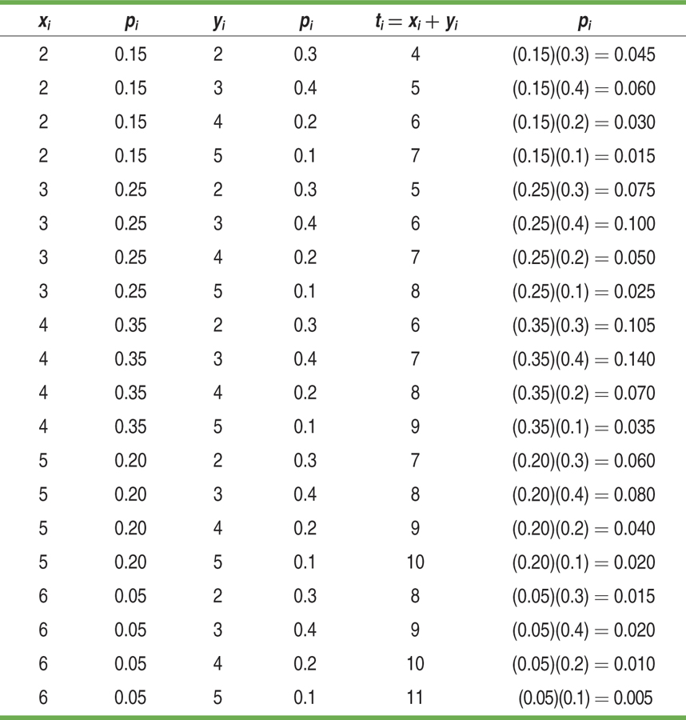
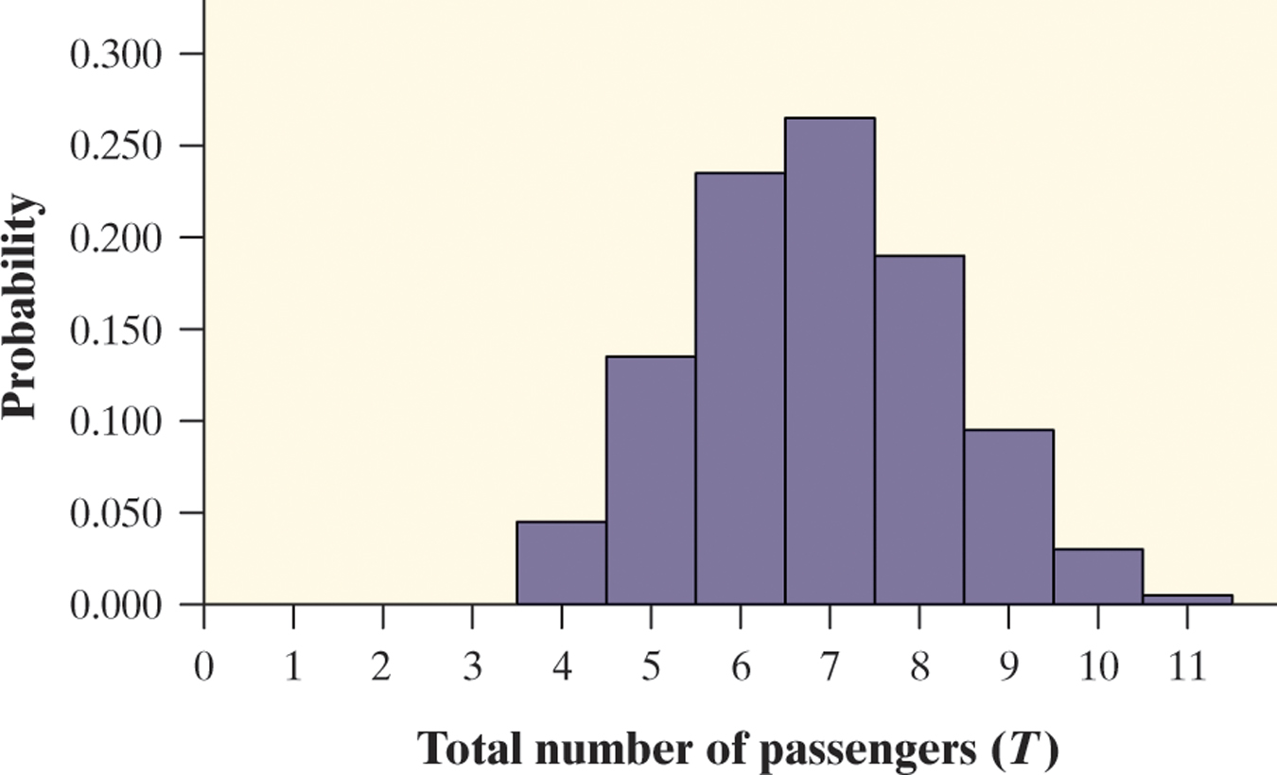
Combining Random Variables
Let T = X + Y. Consider all possible combinations of the values of X and Y.
Recall: µ_{T} = µ_{X} + µ_{Y} = 6.85
= (4 – 6.85)²(0.045) + … +
(11 – 6.85)²(0.005) = 2.0775
Note:
What do you notice about the
variance of T?

Slide 14
Transforming and Combining Random Variables
Combining Random Variables
As the preceding example illustrates, when we add two independent random variables, their variances add. Standard deviations do not add.
Variance of the Sum of Random Variables
For any two independent random variables X and Y, if T = X + Y, then the variance of T is
In general, the variance of the sum of several independent random variables is the sum of their variances.
Remember that you can add variances only if the two random variables are independent, and that you can NEVER add standard deviations!

Slide 15
Transforming and Combining Random Variables
Combining Random Variables
We can perform a similar investigation to determine what happens when we define a random variable as the difference of two random variables. In summary, we find the following:
Mean of the Difference of Random Variables
For any two random variables X and Y, if D = X - Y, then the expected value of D is
E(D) = µ_{D} = µ_{X} - µ_{Y}
In general, the mean of the difference of several random variables is the difference of their means. The order of subtraction is important!
Variance of the Difference of Random Variables
For any two independent random variables X and Y, if D = X - Y, then the variance of D is
In general, the variance of the difference of two independent random variables is the sum of their variances.

Slide 16
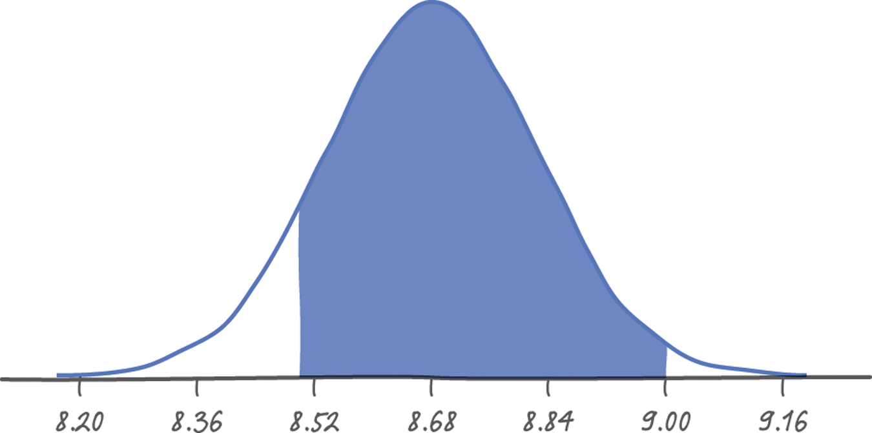

Transforming and Combining Random Variables
Combining Normal Random Variables
So far, we have concentrated on finding rules for means and variances of random variables. If a random variable is Normally distributed, we can use its mean and standard deviation to compute probabilities.
An important fact about Normal random variables is that any sum or difference of independent Normal random variables is also Normally distributed.
Example
Mr. Starnes likes between 8.5 and 9 grams of sugar in his hot tea. Suppose
the amount of sugar in a randomly selected packet follows a Normal distribution with mean 2.17 g and standard deviation 0.08 g. If Mr. Starnes selects 4 packets at random, what is the probability his tea will taste right?
Let X = the amount of sugar in a randomly selected packet.
Then, T = X₁ + X₂ + X₃ + X₄. We want to find P(8.5 ≤ T ≤ 9).
P(-1.13 ≤ Z ≤ 2.00) = 0.9772 – 0.1292 = 0.8480
There is about an 85% chance Mr. Starnes’s tea will taste right.
µ_{T} = µ_{X1} + µ_{X2} + µ_{X3} + µ_{X4} = 2.17 + 2.17 + 2.17 +2.17 = 8.68

Slide 17
Section 6.2
Transforming and Combining Random Variables
Summary
In this section, we learned that…
  Adding a constant a (which could be negative) to a random variable increases (or decreases) the mean of the random variable by a but does not affect its standard deviation or the shape of its probability distribution.
  Multiplying a random variable by a constant b (which could be negative) multiplies the mean of the random variable by b and the standard deviation by |b| but does not change the shape of its probability distribution.
  A linear transformation of a random variable involves adding a constant a, multiplying by a constant b, or both. If we write the linear transformation of X in the form Y = a + bX, the following about are true about Y:
    Shape: same as the probability distribution of X.
    Center: µ_{Y} = a + bµ_{X}
    Spread: σ_{Y} = |b|σ_{X}

Slide 18
Section 6.2
Transforming and Combining Random Variables
Summary
In this section, we learned that…
  If X and Y are any two random variables,
  If X and Y are independent random variables
  The sum or difference of independent Normal random variables follows a Normal distribution.

Slide 19
Looking Ahead…
In the next Section…
We’ll learn about two commonly occurring discrete random variables: binomial random variables and geometric random variables.
We’ll learn about
  Binomial Settings and Binomial Random Variables
  Binomial Probabilities
  Mean and Standard Deviation of a Binomial Distribution
  Binomial Distributions in Statistical Sampling
  Geometric Random Variables

