Slide 1
MOBILE APP CONTROLLED STEPPER MOTOR with JETSON NANO
SINDHUJA RAVI (015742688)
sindhuja.ravi@sjsu.edu MS CMPE
PRABHAT KUMAR (016659617)
prabhat.kumar@sjsu.edu MS CMPE
CMPE 244 EMBEDDED SOFTWARE Project- Fall 2023
Instructor: DR.HARRY LI
SJSU

Slide 2
OBJECTIVES:
"To design and implement a robust and efficient control system using the Jetson Nano platform to precisely drive a NEMA 17 stepper motor and calibrate with the lsm303 sensor for applications requiring accurate positioning and motion control, while ensuring user-friendly interfacing and real-time feedback through integrated sensors. And developing the webserver with the chat-GPT integration."
components needed
NVIDIA JETSON NANO DEVELOPMENT KIT
NEMA STEPPER MOTOR
MOTOR DRIVE A4988
LSM 303 / LSM 303AGR SENSOR
Wi-Fi
WEBSERVER
WEBSITE
CHAT-GPT
MOBILE APP

Slide 3


ARCHITECTURE LEVEL BLOCK DIAGRAM
USER
S
P
ACE
Chat-GPT
Webserver
Website
KE
RNAL
S
P
ACE
PROCESS
MGMT
MEMORY
MGMT
FILE
SYSTEM
DEVICE DRIVER
IP STACK
Hardware Abstraction Layer
GPP
SPI
I2C
PWM
USB
NVIDIA JETSON NANO
LSM303
MOTOR DRIVE
MOTOR

Slide 4
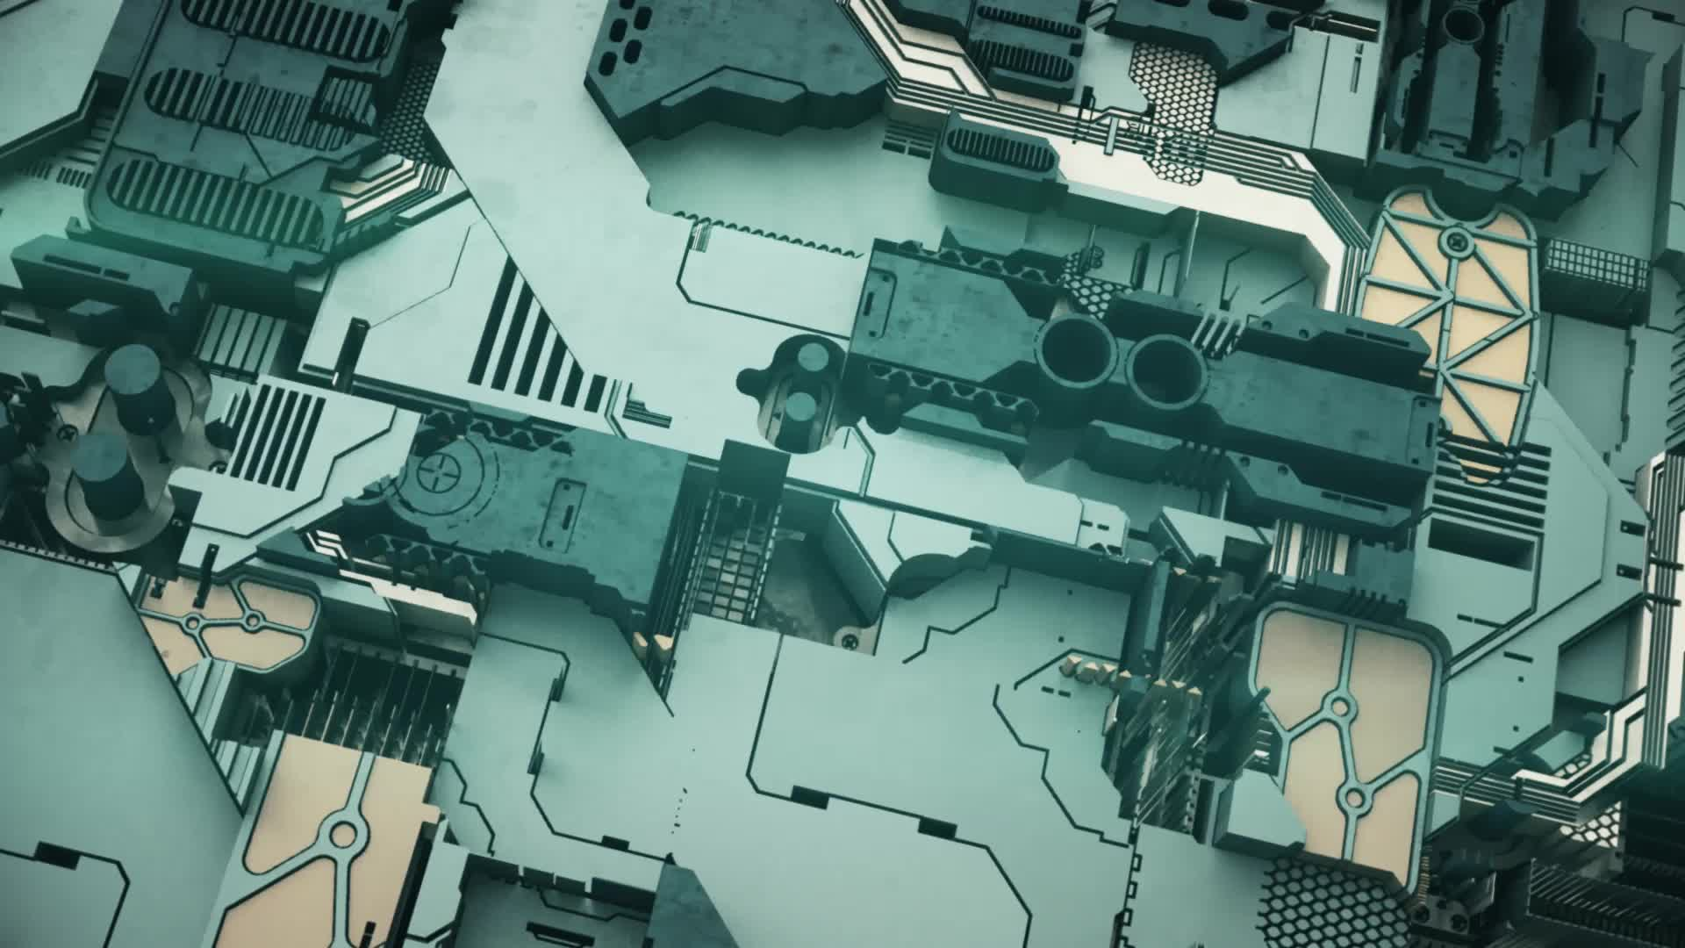
SOFTWARE TOOLS:
JetPack SDK: NVIDIA's software suite for the Jetson Nano.
Python or C++: For application development on the Jetson Nano.
Android Studio: To develop the Android app that will send commands to the Jetson Nano.
MQTT or WebSockets: Protocols that can be used for real-time communication between the Android device and the Jetson Nano over Wi-Fi.
Chat-GPT to answer all questions related to the project.
PWM Libraries: For stepper motor control.
I2C Libraries: For LSM303AGR integration
Git: For version control and collaboration.
HARDWARE PLATFORMS:
Jetson Nano: The main controller.
NEMA 17 Stepper Motor: The motor to be controlled.
Motor Driver: A4988.
LSM303AGR sensor
Power Supply: For the Jetson Nano and the stepper motor.
Wi-Fi Module: the Jetson Nano doesn't have built-in Wi-Fi, a USB Wi-Fi dongle or a Wi-Fi module like the Intel Dual Band Wireless-Ac 8265 can be used.
Breadboard and Jumper Wires: For initial setup and testing.
Heat Sinks and Fans: For thermal management.
Android Device: To send commands to the Jetson Nano.
SD Card: For the Jetson Nano's OS and software storage.

Slide 5

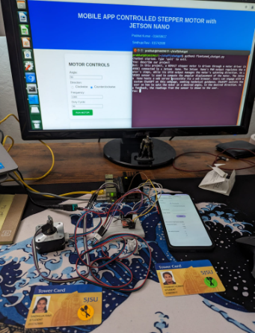
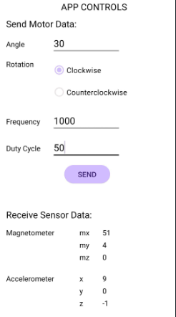
IMPLEMENTATION:
HARWARE SETUP
Android app interface

Slide 6

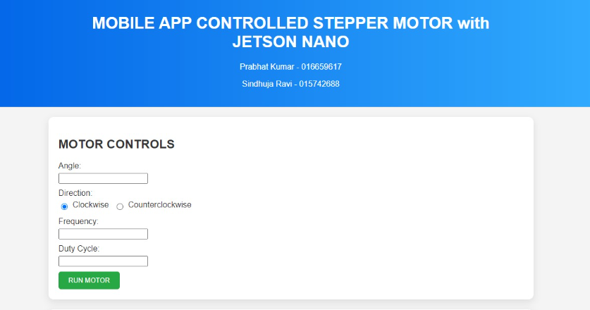
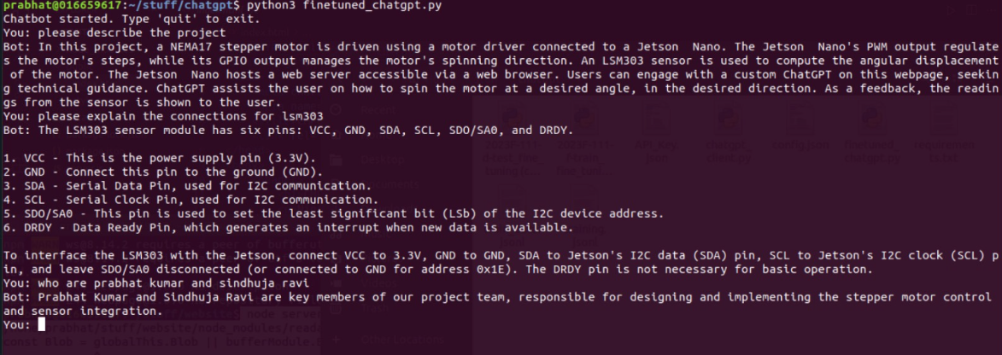
IMPLEMENTATION:
WEBSITE
CHAT-GPT

Slide 7

TECHNICAL CHALLENGES:
Hardware Integration: Ensuring that the Jetson Nano, the motor driver, and the NEMA 17 stepper motor are compatible is foundational. Misalignment in voltage, current, or communication protocols can lead to system failures or even damage to the components.
Sensor Calibration: Calibrating the sensor LSM303 to get the correct magnetometer and accelerometer readings.
Chat-GPT integration: Fine-tuning the chat-GPT with the test and trained dataset and integration with the webserver.
Android app: To send the motor data and receive back the sensor data was a challenging task.
Hardware and Software integration: The overall integration of the all above was the most challenging part of the entire project.

Slide 8
♡Thank You!

