Slide 1
Hardware/Software Co-Design and Verification
Dr. Kaputa

Slide 2

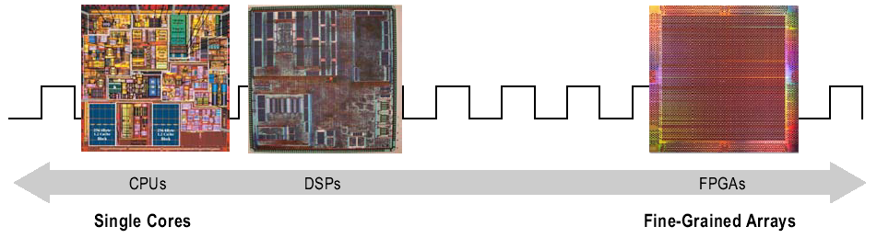



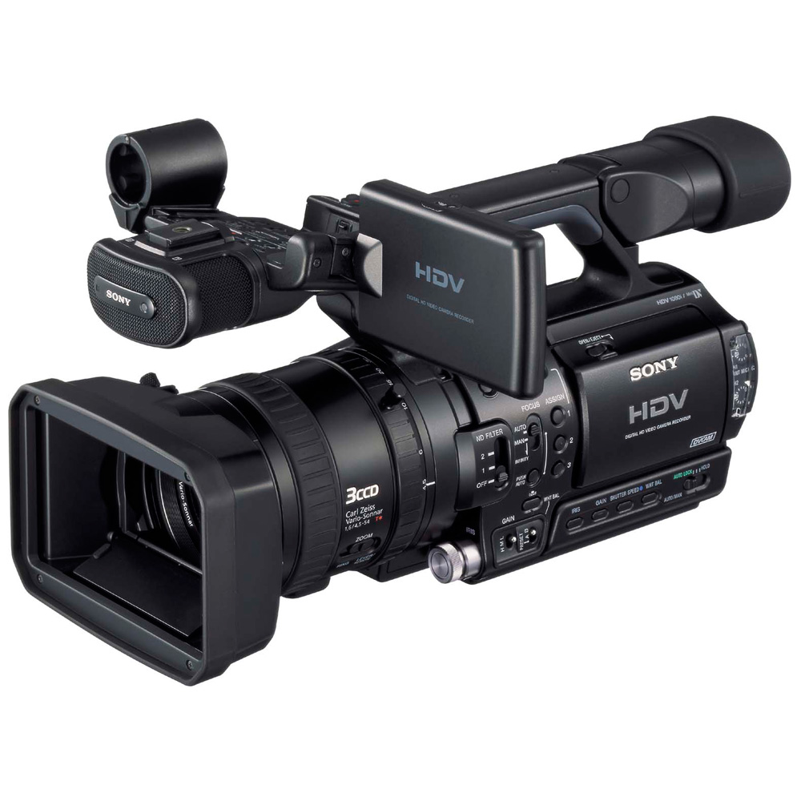
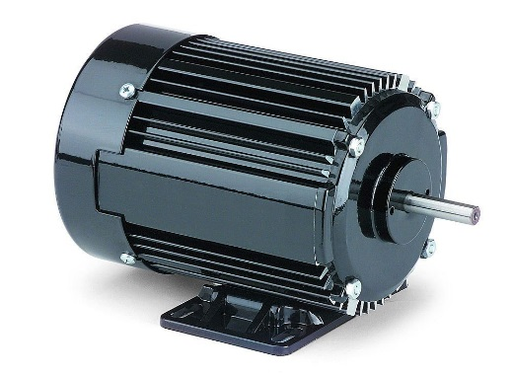

SoC FPGA?
SoC = CPU + FPGA

Slide 3
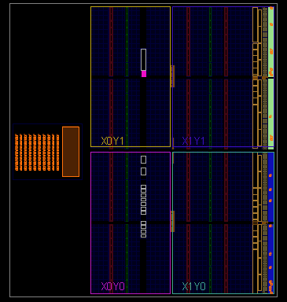
SoC FPGA Architectures
What is an SoC FPGA?
Fully Featured ARM Processor
Programmable Logic Fabric
Why SoC?
Reduce Board Space and Development Time
Increased System Flexibility
Configurable FPGA/CPU Interconnect
Integrated Development Tool Flow
Open Source Software Ecosystem
Xilinx Zynq-7000
1 GHz Dualcore ARM® Cortex™-A9
Altera SoC
1 GHz Dualcore ARM® Cortex™-A9
Microsemi Smart Fusion 2
166 megahertz (MHz) ARM ® CortexTM-M3 processor

Slide 4
Advanced eXtensible Interface [AXI]
CPU
Background
Advanced Microcontroller Bus Architecture [AMBA]
AXI is Third Generation of AMBA
Introduced by ARM in 1996
Xilinx Zynq SoC FPGA/CPU Interconnect
AXI4 – Address Followed by up to 256 Data Words
AXI-Lite – Single Address, Single Word
AXI-Stream – Unlimited Burst Transfers [non-memory mapped]
Communicating Between FPGA and CPU
CPU
Bare Metal => FPGA registers accessible via global memory map
Linux => FPGA registers accessible via /dev/mem
FPGA
Processor values accessible via registers
AXI
FPGA
Reg 1 0x400000000
Reg 2 0x400000004
Reg N 0x400001000

Slide 5
Xilinx Zynq SoC FPGAs
 | Zynq UltraScale + MPSoC | Zynq - 7000
Process Node | 16 nm FinFET | 28 nm
Application Core | Quadcore ARM® Cortex™-A53 MPCore™ up to 1.3GHz | Dualcore ARM® Cortex™-A9 MPCore™ up to 1GHz
Real-Time Core | Dual ARM® Cortex™-R5 MPCore™ up to 600MHz | -
GPU | Mali™-400MP up to 466MHz | -
High Speed Connectivity | 2x USB 3.0, SATA 3.0, DisplayPort, 4x Tri-mode Gigabit Ethernet, PCIe Gen2x4 | -
Logic Cells (K) | 920 [~13.6 M] | 444 [~6.6 M]
Block Ram | 4.4 MB | 3 MB
DSP Slices | 3528 | 2020
UltraRAM | 16 MB | -

Slide 6
Algorithm Partitioning
Solution | Execution Speed | Determinism | Design Method
ARM Processor | High | Moderate | C
Soft Processor | Moderate | Moderate/High | C
HDL State-Machine | Very High | Very High | HDL
Compile Time
Floating/Fixed Point Implementation
Algorithm Sizing
Verification Methods
Expandability
Several Companies Offer IP for SoC FPGAs
C
HDL
kHz Loops -> CPU, MHz Loops -> FPGA

Slide 7
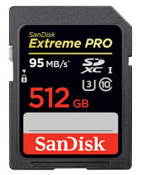
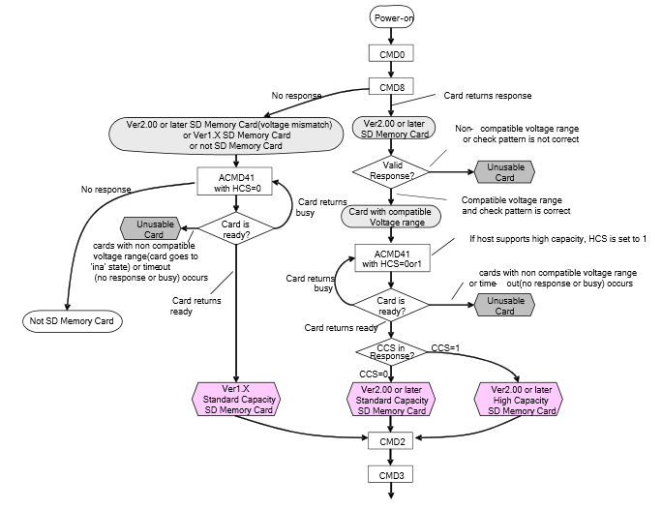
Use Case: SD Data Logging
Requirements
10 MB/Sec
Deterministic
SD Interface Algorithm
Configuration Phase
Very Complex
Many Scenarios
Non-Deterministic
Data Transfer Phase
Deterministic
Relatively Simple
High Bandwidth
How Does One Architect a Solution?

Slide 8

Hardware/Software Co-Design
SD Configuration Phase [Control Path]
Implement in Software via C, Python, Java
Reasoning:
Design Method
Compile Time
SD Data Transfer Phase [Data Path]
Implement in HDL
Reasoning:
Execution Speed
Determinism
Expandability
Your Decision Does not have to be Final!

Slide 9
Finite State Machine with a Datapath [FSMD]
CONTROL PATH
Next-State Logic
State Register
Output Logic
Command
External Status
Internal Status
Control Signals
Data Input
Routing
Network
Functional Units
Routing Network
Data Registers
Data Output
DATA PATH
Key Parameters for Partitioning
Execution Speed, Determinism, Design Method, Compile Time, Floating/Fixed Point Implementation, Algorithm Sizing, Verification Methods, Expandability, Several Companies Offer IP for SoC FPGAs
How Does One Perform Verification?

Slide 10
Traditional HDL Verification
Functional Simulation
Mentor Modelsim
Altera QSim
Xilinx Isim
Verification Via Test Benches
Pros
Can Test Corner Cases and Fault Conditions
Can Visualize any Signal in Design
Cons
Difficult to Interface with Control Path [CPU Algorithm]
Bus Functional Model may not be Available
Can Take a Long Time to Run
Test Bench
Unit
Under
Test
Bus Functional Model

Slide 11

Hardware/Software Cross-Triggering
The Problem
Application Software has been Debugged
HDL has been Simulated
The System Does not Work
The Solution
Embedded Co-Debug with Hardware/Software Cross-Triggering
Hardware/Software Breakpoints
Pros
Allows for Inter-Domain synchronization. Ex. Stop CPU and FPGA Simultaneously
Design is not Simulated, it Runs Real Time
No Bus Functional Model is Required
Can Test out HDL and C code as well as External Hardware
Cons
Must Compile the HDL
Can be Hard to Test out Corner Cases
Can only Look at Top Level Signals
Limited Trace Duration

Slide 12
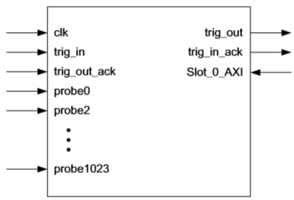
Integrated Logic Analyzer [ILA]
User Selectable Probe Count and Probe Width
Boolean Trigger Equations
Enabled FPGA/CPU Cross-Triggering
Up to 1024 Probes each of width from 1 to 4096 bits.
Data Capture Depth of up to 131,072 Points
C
Under
Test
Hardware
ILA
HDL
Under
Test
Hardware

Slide 13
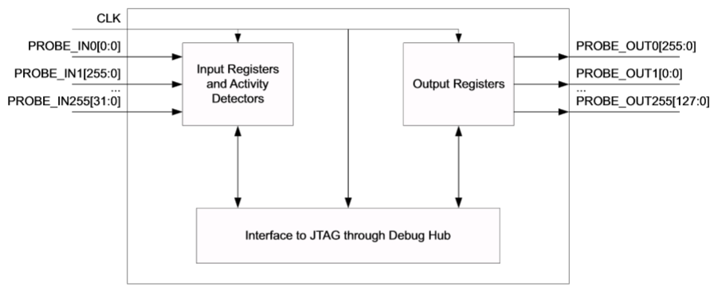
Virtual IO [VIO]
Peek and Poke data through JTAG Port
Designed to Replace or Augment Board level I/O and Status Indicators
LEDs, Push Buttons
Max Frequency: 250 MHz
Custom Output Initialization

