Slide 1
DESIGN PATTERNS
Adrian Zburatura
Mihai Sandu, Deloitte Digital

Slide 2
Design patterns
A design pattern is an established general solution to a commonly occurring software development problem.
Gives developers a common vocabulary in which they can discuss common problems and solutions.
Object Oriented Design Patterns are divided into three categories:
Creational Patterns
Structural Patterns
Behavioral Patterns

Slide 3
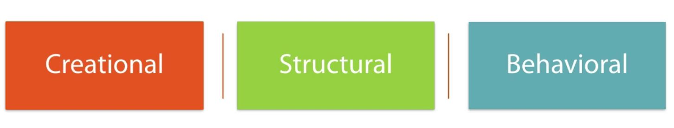
Creational patterns
Creational patterns are a type of software design pattern that manages the creation of objects within an application.
The creational patterns simply apply a level of indirection to object creation by creating the object in some other class, rather than creating the object directly in your application.
Level of indirection is a general term for solving a software design problem by conceptually separating the task into multiple levels.

Slide 4
Creational patterns
Singleton Pattern
Immutable Object Pattern
Builder Pattern
Factory Pattern
Abstract Factory Pattern
Prototype Pattern

Slide 5
Singleton pattern
Problem: How do we create an object in memory only once in an application and have it shared by multiple classes?
Solution: The singleton pattern is a creational pattern focused on creating only one instance of an object in memory within an application, sharable by all classes and threads within the application. The globally available object created by the singleton pattern is referred to as a singleton.

Slide 6
Singleton pattern
Rules:
Singletons in Java are created as private static variables within the class, often with the name instance.
They are accessed via a single public static method, often named getInstance(), which returns the reference to the singleton object.
All constructors in a singleton class are marked private, which ensures that no other class is capable of instantiating another version of the class.
- By marking the constructors private, we have implicitly marked the class final

Slide 7
Singleton pattern
Eager Instantiation
Static Block Instantiation
Lazy Instantiation
Thread Safe Singleton
Using Reflection to break Singleton
Enum Singleton

Slide 8
Immutable object pattern
Problem: How do we create read‐only objects that can be shared and used by multiple classes?
Solution: The immutable object pattern is a creational pattern based on the idea of creating objects whose state does not change after they are created and can be easily shared across multiple classes. Immutable objects go hand and hand with encapsulation, except that no setter methods exist that modify the object. Since the state of an immutable object never changes, they are inherently thread‐safe.

Slide 9
Immutable object pattern
Rules:
1. Use a constructor to set all properties of the object.
2. Mark all of the instance variables private and final.
3. Don’t define any setter methods.
4. Don’t allow referenced mutable objects to be modified or accessed directly.
5. Prevent methods from being overridden.

Slide 10
BUILDER PATTERN
Problem: How do we create an object that requires numerous values to be set at the time
the object is instantiated?
Motivation: As the data objects grow in size, the constructor may grow to contain many attributes. Users who reference our object would also be required to update their constructor calls each time the object was modified, resulting in a class that would be difficult to use and maintain.
Anti-Patterns
The problem of a constructor growing too large is called the telescoping constructor anti-pattern.
Anti-pattern is a common solution to a reoccurring problem that tends to lead to unmanageable or difficult-to-use code.
Solution The builder pattern is a creational pattern in which parameters are passed to a builder object, often through method chaining, and an object is generated with a final build call.
Notes:
Users who reference our object would have to update their constructor calls each time the object is modified
Add a new constructor each time we add a parameter, making it difficult to manage.
Use setter methods instead of a constructor – but this doesn’t work for immutable objects.

Slide 11
Factory pattern
Problem: How do we write code that creates objects in which the precise type of the object may not be known until runtime?
Motivation: We’d like some way of encapsulating object creation to deal with the complexity of object creation, including selecting which subclass to use, as well as loosely coupling the underlying creation implementation.
Solution The factory pattern (factory method pattern), is a creational pattern based on the idea of using a factory class to produce instances of objects based on a set of input parameters. It is similar to the builder pattern, although it is focused on supporting class polymorphism.

Slide 12
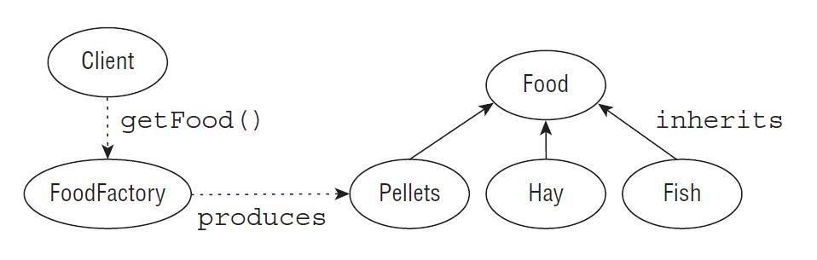
Factory pattern

Slide 13
Prototype pattern
Prototype pattern is used when the Object creation is a costly affair and requires a lot of time and resources and there is a similar object already existing.
Benefits and Necessity:
It’s used to get a unique instance of the same object.
Used when trying to avoid costly creation.
Avoid subclassing.
They implement the Clone/ Cloneable method and interface, enabling us to avoid using the “new” keyword.
The original object is created and then kept in our registry. When another object is needed we create a clone of that object from the registry.
You can chose if you want to do a shallow or a deep copy.
Shallow copy just copies the immediate properties
Deep copy will copy any of its object references as well

Slide 14
Structural patterns
Structural patterns are a type of software design pattern that focuses on how classes and objects can be composed, to form larger structures.
The structural design patterns simplifies the structure by identifying the relationships.
These patterns focus on how the classes inherit from each other and how they are composed from other classes.

Slide 15
adapter pattern
Adapter pattern is used when we want to create a bridge between to incompatible interfaces so that they can work together. The object that joins these unrelated interfaces is called an Adapter.
Advantages of using Adapter Pattern:
It allows two or more previously incompatible objects to interact.
It allows reusability of existing functionality.

Slide 16
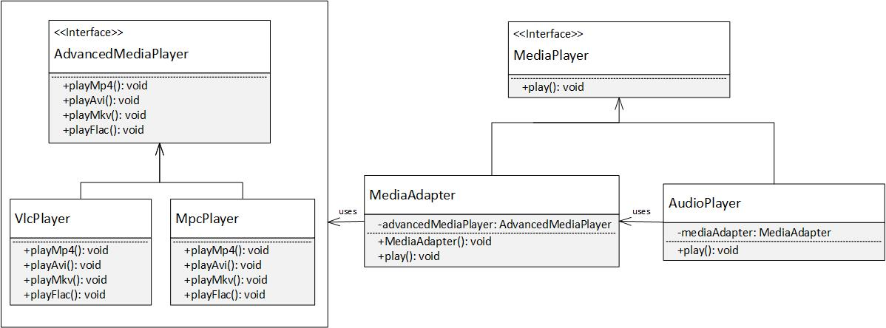
adapter pattern

Slide 17
Proxy pattern
Proxy pattern provides a surrogate or a placeholder for another object to control access to it.
Types of proxy:
Protective proxy – to control access right to an object. It acts as an authorization layer.
Virtual proxy – handles the case where an object might be expensive to create. It creates the objects only on demand.
Remote proxy – provides a local representation for an object in a different address location.
Smart proxy – performs additional actions when the object is called
Notes:
This pattern is recommended when either of the following scenarios occur in your application: - The object being represented is external to the system. - Objects need to be created on demand. - Access control for the original object is required. - Added functionality is required when an object is accessed.

Slide 18
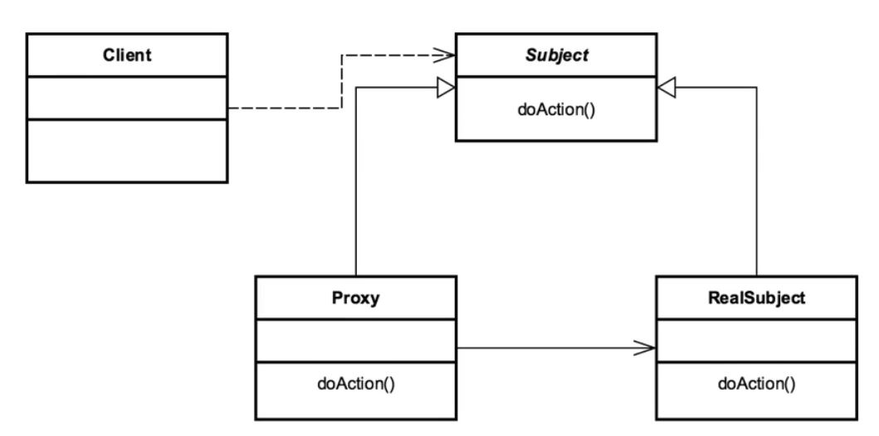
Proxy pattern
Notes:
Client class will make a reference call to the Subject
Instead of retrieving the real subject it will be intercepted with the Proxy.
The subject will be an interface to whatever the implementation class is that we want to retrieve.
The Proxy using the InvocationHandler and the Proxy class in Java, intercepts that call and makes the call to the RealSubject, or if it’s a case like security would deny it or do something different.

Slide 19
Decorator pattern
Decorator Pattern also known as Wrapper, allows behaviour to be added to an individual object, either statically or dynamically, without affecting the behaviour of other objects from the same class.
Often used to adhere to the Single Responsibility Principle, allows functionality to be divided between classes with unique areas of concern.

Slide 20
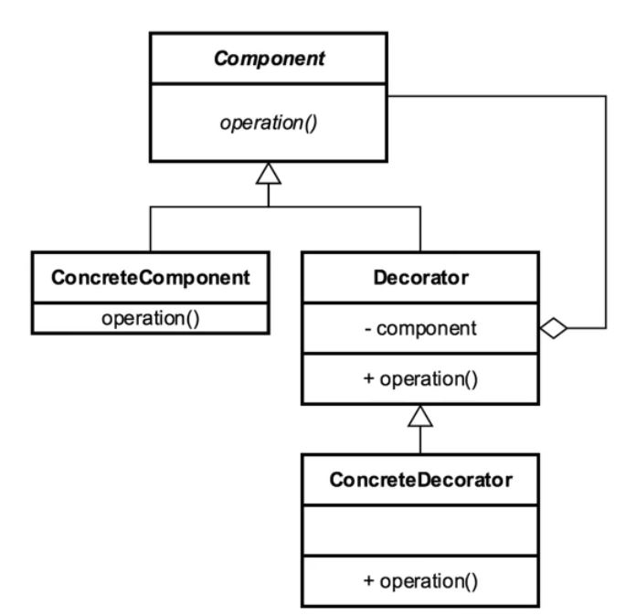
Decorator pattern
Notes:
Component – usually an interface that has a concrete instance
Concrete Component – will eventually be decorated
Decorator – base wrapper that we will extend and create other decorators from
Both Concrete Component and Decorator extend the Component so that they can be treated the same.
Create multiple concrete decorator to decorate the object and provide functionality

Slide 21
Flyweight pattern
Flyweight pattern facilitates the reuse of many fine grained objects, making the utilization of large numbers of objects more efficient.
It is a pattern of patterns. It utilizes other patterns inside of it.
It uses a factory pattern to retrieve flyweight objects after they’ve been created.
Necessity:
Used when you need to make a more efficient use of memory.
When you need an Optimization pattern.
Typically used when you have a large number of similar objects, especially for objects that are stateless or immutable in nature.
Caching is generally a hint that you are or could be using a flyweight.

Slide 22
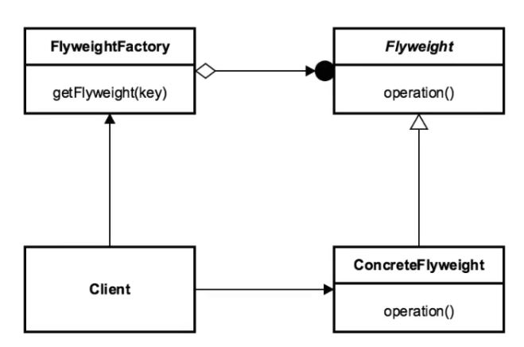
Flyweight pattern
Notes:
Client – requests the Flyweight object
Client requests the object from the Flyweight Factory.
The factory returns the cached object or it creates a new instance of the flyweight.
ConcreteFlyweight is in the end what gets returned to the client.

Slide 23
composite pattern
Composite design pattern allows you to have a tree structure and ask each node in the tree structure to perform a task. You can take real life example of a organization. It have general managers and under general managers, there can be managers and under managers there can be developers. Now you can set a tree structure and ask each node to perform common operation like getSalary().
Necessity:
you want to represent part-whole hierarchies of objects.
you want client to be able to ignore difference between compositions of objects and individual objects. Clients will treat all objects in the composite structure uniformly.

Slide 24
BEHAVIORAL patterns
Behavioral patterns are a type of software design pattern that are focused on how objects interact with one another.
Help reduce code complexity
Help reduce code duplication
Promotion of loose coupling
Increase flexibility of object communication

Slide 25
observer pattern
Observer pattern defines a one-to-many dependency between objects so that when one object changes state, all of its dependents are notified and updated automatically.
The object which is being watched is called the subject. The objects which are watching the state changes are called observers or listeners.
Necessity:
A one-to-many dependency between objects should be defined without making the objects tightly coupled.
It should be ensured that when one object changes state an open-ended number of dependent objects are updated automatically.
Notes:
Try catch blocks

Slide 26
VISITOR pattern
The visitor pattern is used to simplify operations on groupings of related objects. These operations are performed by the visitor rather than by placing this code in the classes being visited. Since the operations are performed by the visitor rather than by the classes being visited, the operation code gets centralized in the visitor rather than being spread out across the grouping of objects, thus leading to code maintainability. The visitor pattern also avoids the use of the instanceof operator in order to perform calculations on similar classes.
In the visitor pattern, we have a Visitor interface that declares visit() methods for the various types of elements that can be visited. Concrete Visitors implement the Visitor interface's visit() methods. The visit() methods are the operations that should be performed by the visitor on an element being visited.
Necessity:
The pattern should be used when you have distinct and unrelated operations to perform across a structure of objects. This avoids adding in code throughout your object structure that is better kept separated, so it encourages cleaner code.
Notes:
Try catch blocks

Slide 27
Chain of responsibility pattern
Chain of responsibility pattern is used to achieve loose coupling in software design where a request from the client class is passed to a chain of objects to process it.
The objects in the chain will decide themselves who will be processing the request and if the request is required to be sent to the next object in the chain or not.
Necessity:
Used when more than one object can handle a request and the handler is unknown.
When the group of objects that can handle the request must be specified in a dynamic way.
Notes:
Try catch blocks

Slide 28
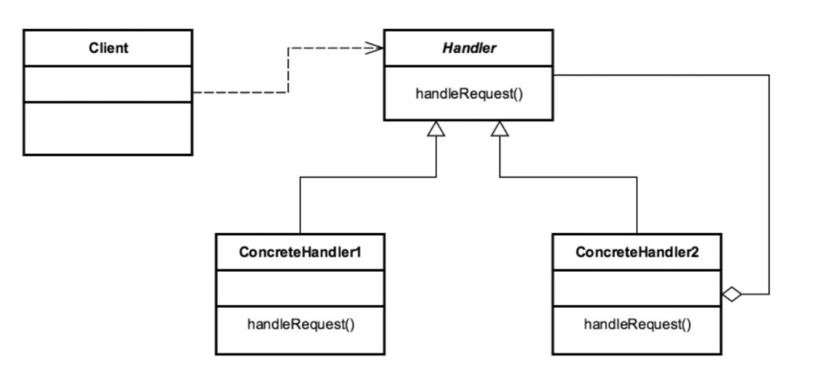
Chain of responsibility pattern
Notes:
Client makes calls to a Handler class
Handler is a common interface or contract for all of the concrete handlers
Multiple concrete handlers for each link in the chain
The successor – specifies the next link in the chain.

Slide 29
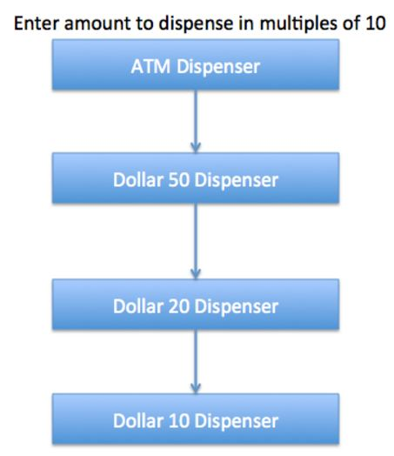
Chain of responsibility pattern

Slide 30
Strategy pattern
Strategy pattern is used when we have multiple algorithms for a specific task and the client decides the actual implementation to be used at runtime.
Provides a way to define a family of algorithms, encapsulate each one as an object, and make them interchangeable.
Necessity:
Eliminates conditional statements
Behavior encapsulated in classes – One Strategy per Class
The client is aware about the different Strategies
Notes:
Good use of the Strategy pattern: saving files in different formats, file compression.

Slide 31
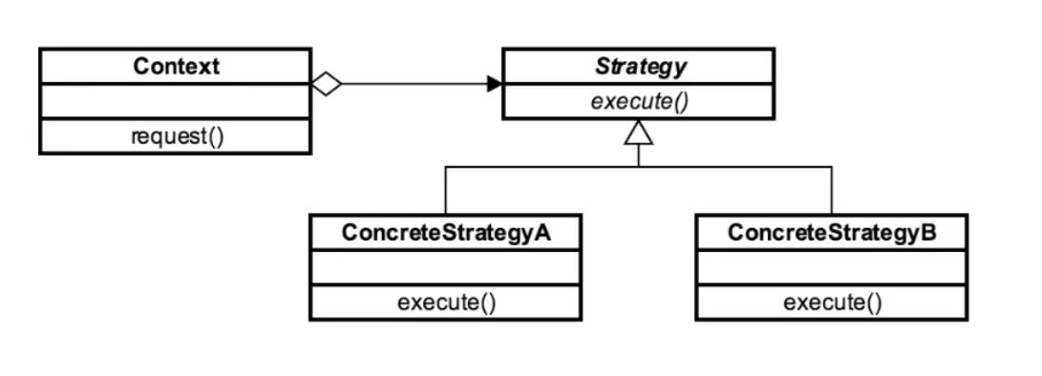
Strategy pattern
Notes:
Strategy interface - defining an action
Concrete strategy classes implementing the Strategy interface.
Context class: receives a request and decides what strategy to use.

Slide 32
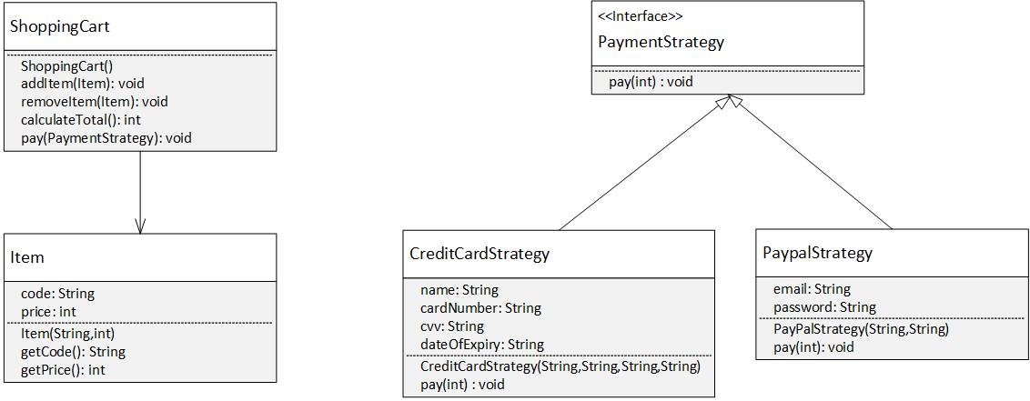
Strategy pattern

Slide 33
template pattern
Template pattern is used to create a method stub and deferring some of the steps of implementation to the subclasses.
Template method defines the steps to execute an algorithm and it can provide default implementation that might be common for all or some of the subclasses.
Template method should consists of certain steps whose order is fixed and for some of the methods, implementation differs from base class to subclass. Template method should be final.
Most of the times, subclasses calls methods from super class but in template pattern, superclass template method calls methods from subclasses.
Methods in base class with default implementation are referred as Hooks and they are intended to be overridden by subclasses, if you want some of the methods to be not overridden, you can make them final.

Slide 34
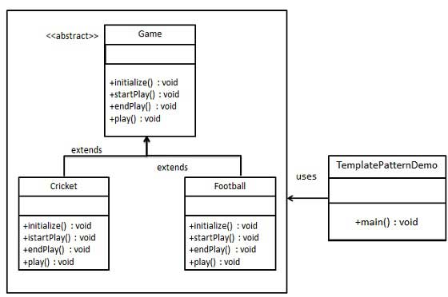
template pattern

Slide 35

Question & Answer

Slide 36

Feedback

