Slide 1
Population dynamics of ligase ribozymes during in vitro selection
Code re-run
https://github.com/zweiss22/proj-population_dynamics_ligase/tree/main

Slide 2
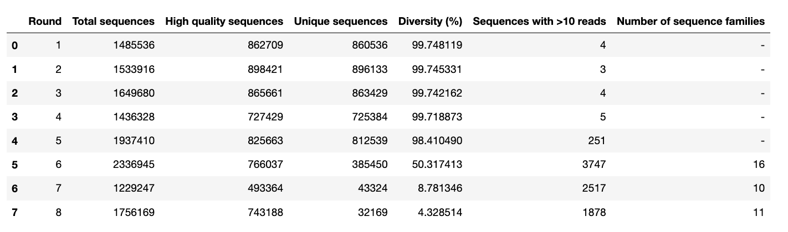
Table 1 Data: https://github.com/zweiss22/proj-population_dynamics_ligase/blob/main/data/qc_statistics_table.csv Code: https://github.com/zweiss22/proj-population_dynamics_ligase/blob/main/scripts/010-qc_cluster/0030_mk_qc_table.py

Slide 3
Assigned clusters – use Ranked_Cluster
/Users/zoeweiss/Desktop/evolution_manuscript/proj-population_dynamics_ligase/data/clusters_round6.csv
/Users/zoeweiss/Desktop/evolution_manuscript/proj-population_dynamics_ligase/data/clusters_round7.csv
/Users/zoeweiss/Desktop/evolution_manuscript/proj-population_dynamics_ligase/data/clusters_round8.csv

Slide 4
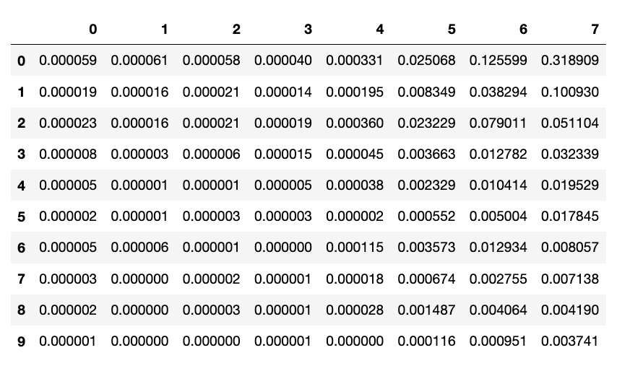
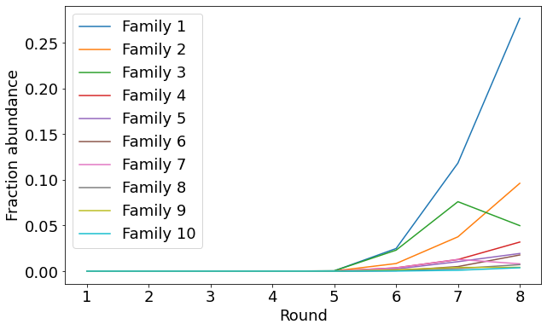
Figure 1B Data: https://github.com/zweiss22/proj-population_dynamics_ligase/blob/main/data/peak_enrichment_fraction.csv Code: https://github.com/zweiss22/proj-population_dynamics_ligase/blob/main/scripts/020_enrichment/plot_family_enrichment.py

Slide 5
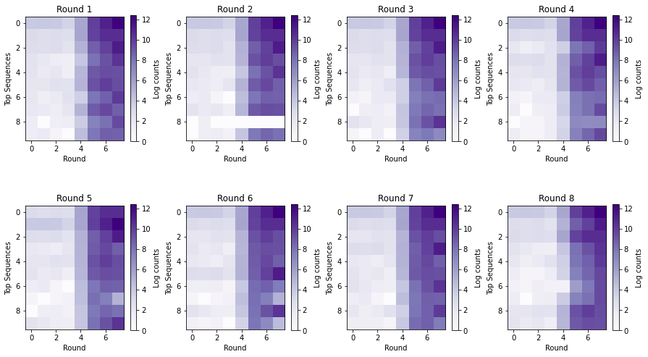
Figure 3 (log counts – don’t love this metric) Code: https://github.com/zweiss22/proj-population_dynamics_ligase/blob/main/scripts/020_enrichment/plot_round_enrichment.py

Slide 6
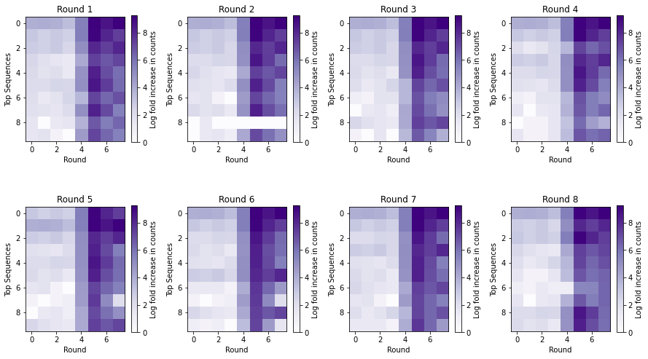
Figure 3 (log(counts/mean(counts))) Code: https://github.com/zweiss22/proj-population_dynamics_ligase/blob/main/scripts/020_enrichment/plot_round_enrichment.py

Slide 7
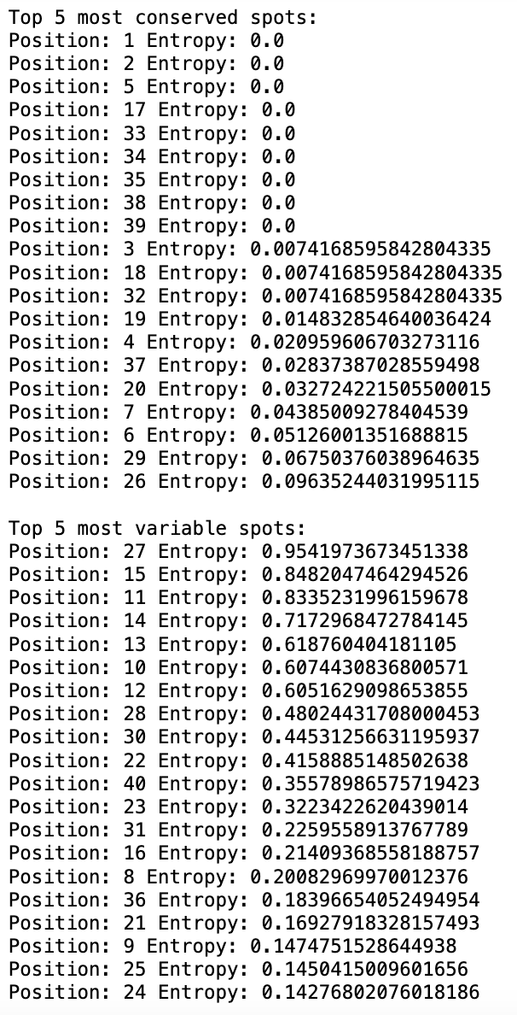
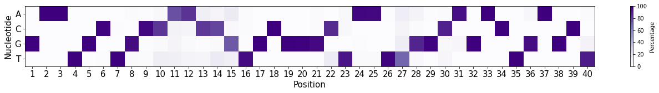
Figure 4 Data: Code: https://github.com/zweiss22/proj-population_dynamics_ligase/blob/main/scripts/030_nucleotide_variants/variable_conserved_cluster1.py sequences used = 90% similar to RS1 + more than 10 reads (robust for 80%)
Conserved old: 2,13,19,20,35
Variable old: 4,5,6,7,8,10,16,37
Tested: 2,13 (still ligated),19, 20, 35

Slide 8
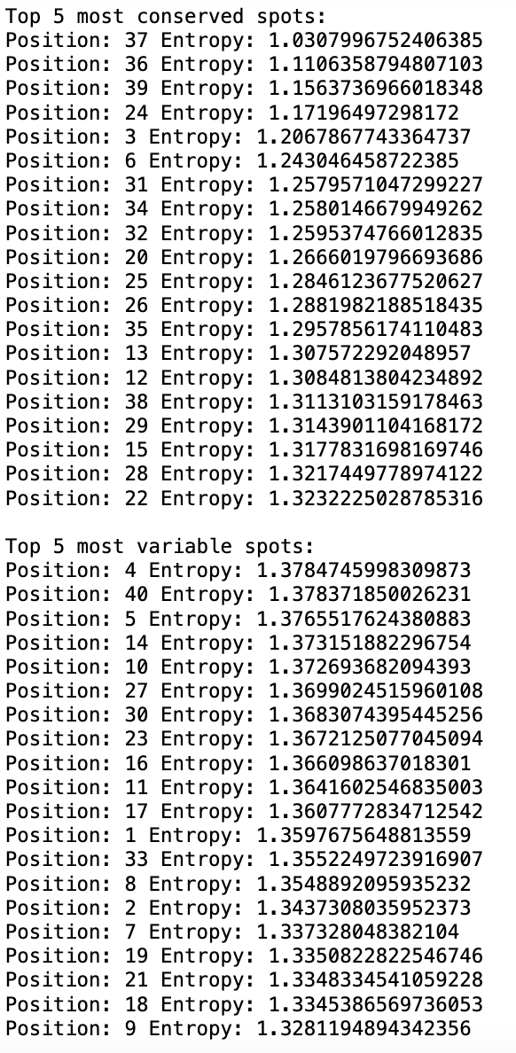
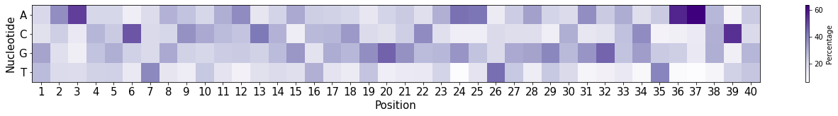
Figure 4 Data: Code: https://github.com/zweiss22/proj-population_dynamics_ligase/blob/main/scripts/030_nucleotide_variants/variable_conserved_cluster1.py sequences used = Cluster 1
Conserved old: 2,13,19,20,35
Variable old: 4,5,6,7,8,10,16,37
Tested: 2,13 (still ligated),19, 20, 35

Slide 9
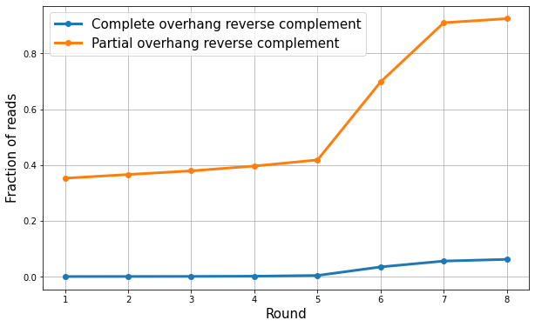
Figure 5 Data: https://github.com/zweiss22/proj-population_dynamics_ligase/blob/main/scripts/040_overhang/overhang_fractions.csv Code: https://github.com/zweiss22/proj-population_dynamics_ligase/blob/main/scripts/040_overhang/overhang_track.py

Slide 10
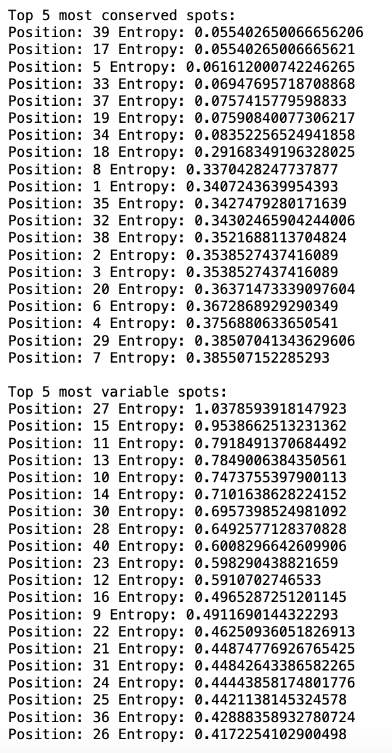
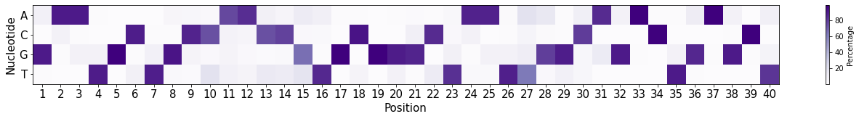
Figure 6 Data: Code: https://github.com/zweiss22/proj-population_dynamics_ligase/blob/main/scripts/050-doped_selection/002_conservation_doped_slxn.py seqs: r3 doped selection, greater than 10 reads

Slide 11
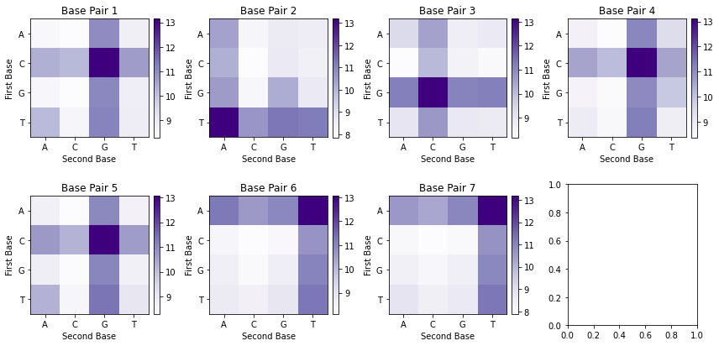
Code: https://github.com/zweiss22/proj-population_dynamics_ligase/blob/main/scripts/050-doped_selection/003_alternative_bps.py

Slide 12
??s
Added required filtering for constant region…decreased # unique seqs and changed some results
Is clustal omega ok bc its doing alignment…
Dont love figure 3 bc counts are inaccurate
7a - structure is wrong? Not GAA
Doped – analyze r3?

