Slide 1
Population dynamics of ligase ribozymes during in vitro selection
Code re-run

Slide 2
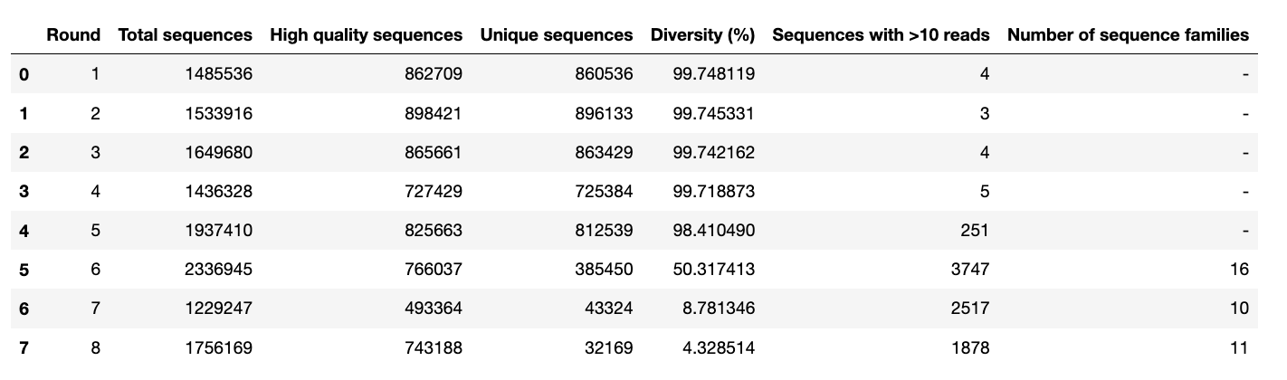
Table 1 Data: https://github.com/zweiss22/proj-population_dynamics_ligase/blob/main/data/qc_statistics_table.csv Code: https://github.com/zweiss22/proj-population_dynamics_ligase/blob/main/scripts/010-qc_cluster/0030_mk_qc_table.py

Slide 3
Assigned clusters – use Ranked_Cluster
/Users/zoeweiss/Desktop/evolution_manuscript/proj-population_dynamics_ligase/data/clusters_round6.csv
/Users/zoeweiss/Desktop/evolution_manuscript/proj-population_dynamics_ligase/data/clusters_round7.csv
/Users/zoeweiss/Desktop/evolution_manuscript/proj-population_dynamics_ligase/data/clusters_round8.csv

Slide 4
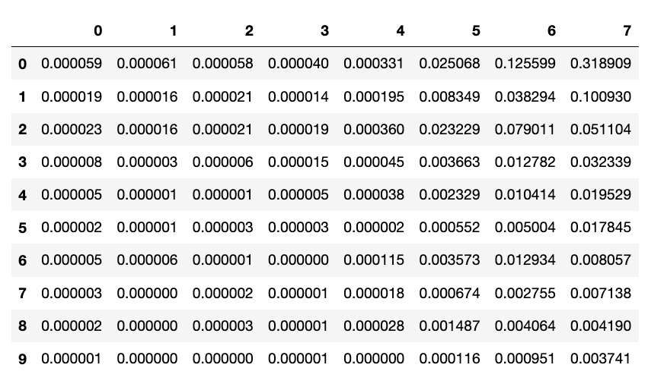
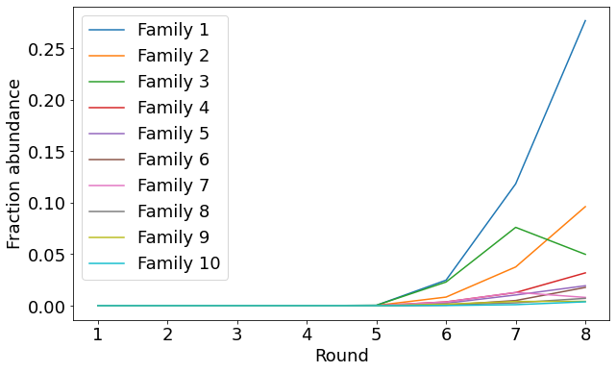
Figure 1B Data: https://github.com/zweiss22/proj-population_dynamics_ligase/blob/main/data/peak_enrichment_fraction.csv Code: https://github.com/zweiss22/proj-population_dynamics_ligase/blob/main/scripts/020_enrichment/plot_family_enrichment.py

Slide 5
Figure 3 Data: Code:

Slide 6
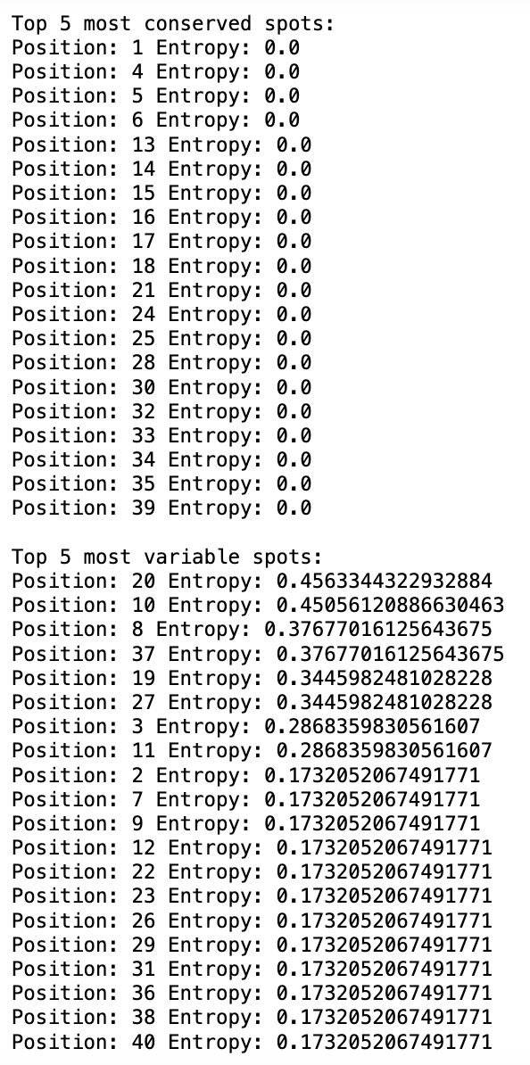
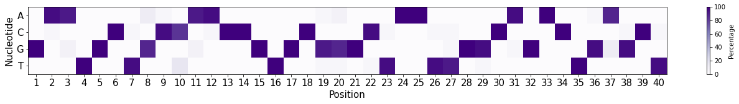
Figure 4 Data: Code: https://github.com/zweiss22/proj-population_dynamics_ligase/blob/main/scripts/030_nucleotide_variants/variable_conserved_cluster1.py sequences used = Cluster 1

Slide 7
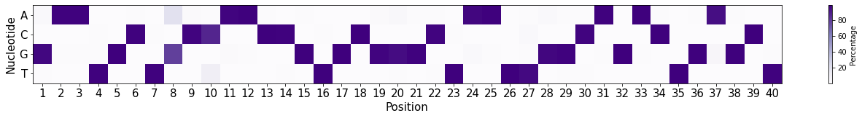
Figure 4 Data: Code: https://github.com/zweiss22/proj-population_dynamics_ligase/blob/main/scripts/030_nucleotide_variants/variable_conserved_cluster1.py sequences used = 90% similar to RS1 + more than 10 reads (robust for 80%)
Top 5 most conserved spots:
Position: 5 Entropy: 0.09765065407844606
Position: 17 Entropy: 0.09765065407844606
Position: 18 Entropy: 0.09765065407844606
Position: 32 Entropy: 0.09765065407844606
Position: 39 Entropy: 0.09765065407844606
Top 5 most variable spots:
Position: 8 Entropy: 0.5674528743292931
Position: 10 Entropy: 0.4664081652201073
Position: 37 Entropy: 0.2691720173914361
Position: 20 Entropy: 0.26871844198347955
Position: 27 Entropy: 0.23585087070283198

Slide 8
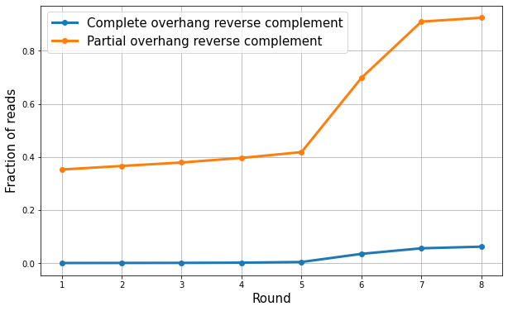
Figure 5 Data: https://github.com/zweiss22/proj-population_dynamics_ligase/blob/main/scripts/040_overhang/overhang_fractions.csv Code: https://github.com/zweiss22/proj-population_dynamics_ligase/blob/main/scripts/040_overhang/overhang_track.py

Slide 9
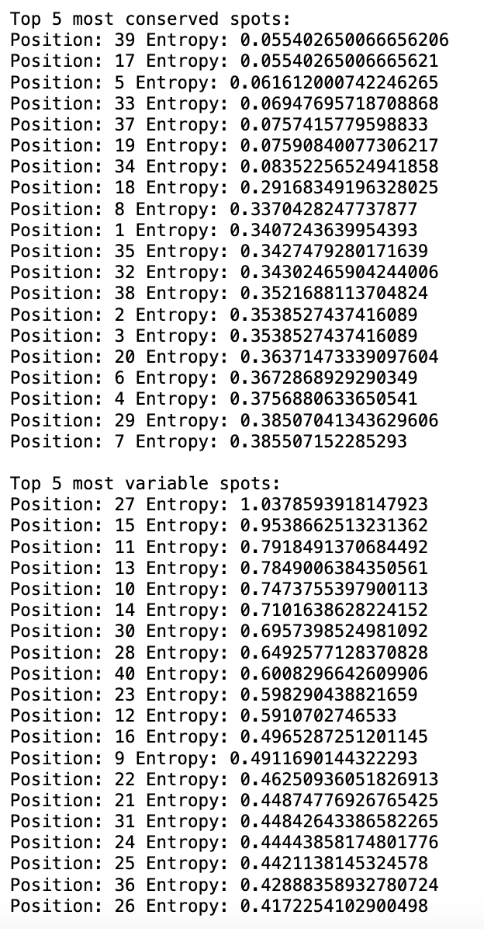
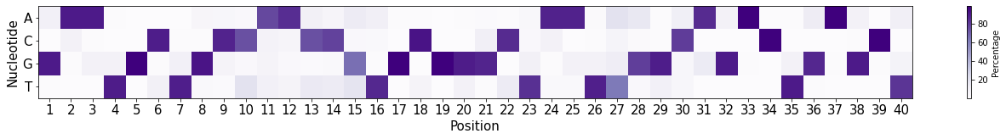
Figure 6 Data: Code: seqs: r3 doped selection, greater than 10 reads

Slide 10
??s
Added required filtering for constant region…decreased # unique seqs
Is clustal omega ok bc its doing alignment…
Dont love figure 3 bc counts are inaccurate
Fig 4a - g10, 90% from RS1
7a - structure is wrong? Not GAA
Doped – analyst r3?

