Slide 1

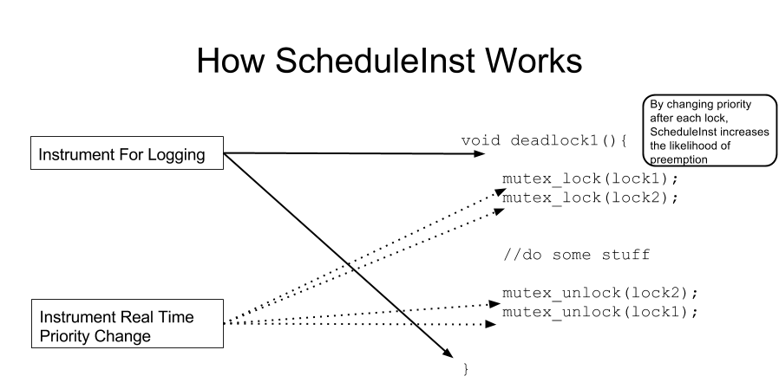
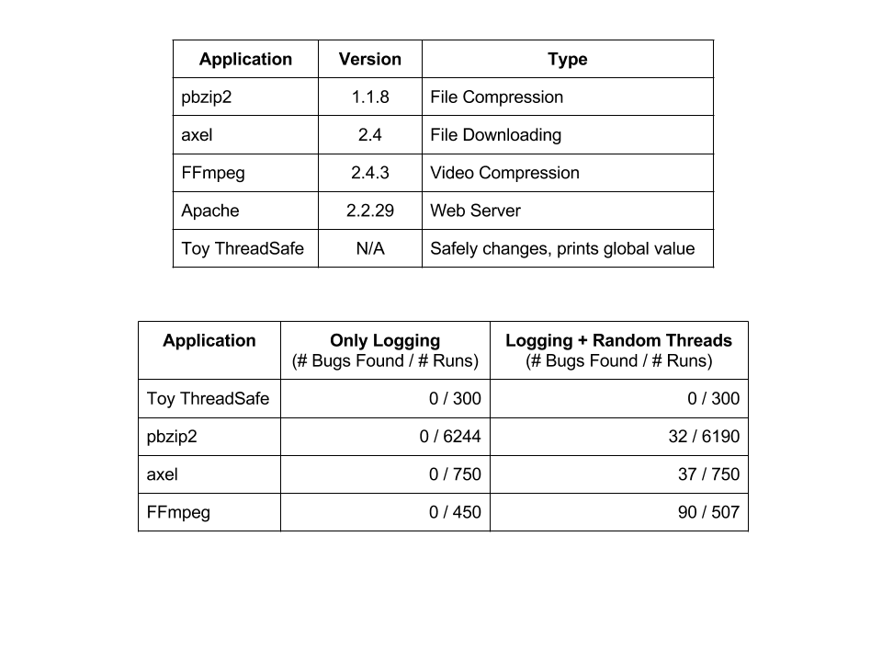
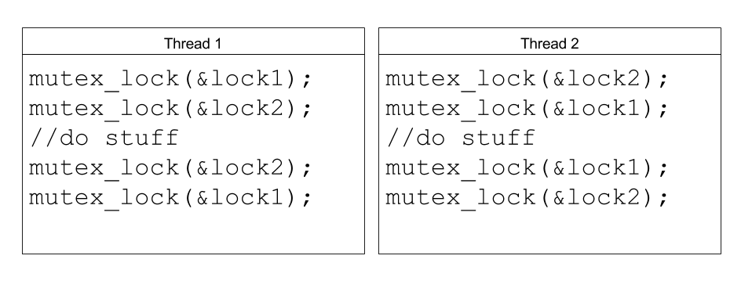
Robert Wespetal
Zach Welch
ScheduleInst: Using Dyninst to Fuzz Test Multithreaded Program Schedules
INTRODUCTION
METHODS
RESULTS
Concurrency bugs are hard to find
Most Concurrency Bugs live in Low Probability Interleavings
By Encouraging Unusual Thread Schedules, we hope to find bugs
Default Linux Scheduler uses Multilevel Feedback Queue with time slices; no control of individual threads
Using real time threads, we can explicitly state thread priority and have some control over scheduling.
Bugs found by running many tests with new random seeds.
Test to see if real time threads increase the rate at which bugs are found
ScheduleInst found bugs in Apache, pbzip2, FFmpeg, axel
No bugs found in control runs.
Results show ScheduleInst finds deadlocks at useful rate
A DEADLOCK
Similar to Fuzz Random Testing
Fuzzing: Testing the reliability of Applications by passing randomly generated command line input
Uses Dyninst, a Dynamic Instrumentation API, to insert code and use real time threads
Change threads to real time, instrument synchronization points to randomly alter thread priority
Add logging to provide an idea of where bugs occur when they occur
INSERT THING HERE

