Slide 1

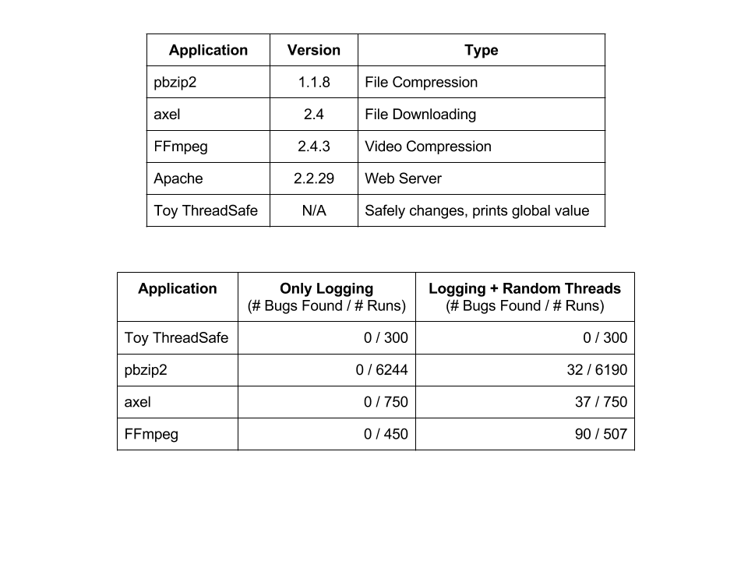
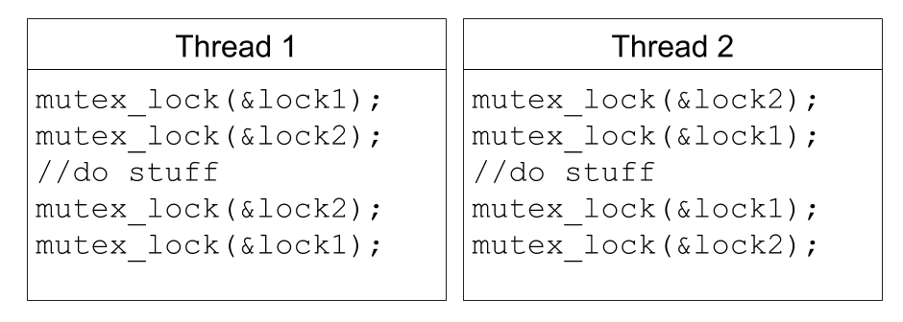
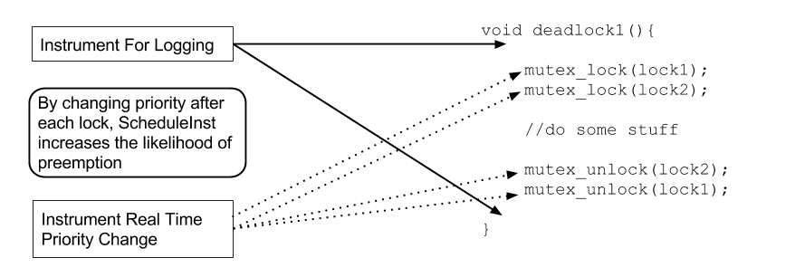
Robert Wespetal
Zach Welch
ScheduleInst: Using Dyninst to Fuzz Test Multithreaded Program Schedules
INTRODUCTION
METHODS
RESULTS
Multithreaded Programming Is Challenging
Scheduling of multithreaded programs is non-deterministic: the next instruction to run could be from any thread.
Threads need to interact with each other despite partitioned work
Low probability concurrency bugs could exist, what if we run programs with atypical scheduling patterns?
Extend Fuzz Random Testing to Thread Scheduling
Fuzzing: applications should be able to handle any input, a crash or hang is a bug
Randomly schedule threads in a process: test for a crash or hang
Process and Thread Scheduling in Linux
Default Linux Scheduler: Multilevel Feedback Queue with time slices where scheduler has control over priority
Real-time scheduling for some control over scheduling
Round-robin or First in first out
Able to assign priorities, threads of higher priority will always run until block or completion
Binary Instrumentation using Dyninst
Able to insert code and wrap functions to change scheduler algorithm and priority
Randomly change priority at thread creation and synchronization points
Log function entry and exit to provide an idea of where bugs occur when they occur
Testing Multithreaded Programs
pbzip2 (compression), axel (file download),
FFMpeg (video compression), Apache (web server)
Enabled Pthreads and tested with a typical use case
Ran applications multiple times with new random seeds
Control and test case: both are instrumented using ScheduleInst but control case uses normal scheduler
Test to see if real time threads increase rate at which bugs are found
Found Bugs in Applications Tested
Results show ScheduleInst finds bugs at a useful rate, it found bugs in all of the applications we tested
All bugs found were deadlocks
No bugs were found in the control tests
Example: Deadlock Bugs in Apache
Surprisingly, we were able to get Apache to deadlock consistently under randomly scheduled threads
One thread would consume most of the CPU, shortly after the server stopped logging functions and was not responsive
Apache with ScheduleInst Only Logging functioned normally at decreased performance
Bugs were near code to accept new connections, main network filtering code, process management of threads
Found bug reports that were similar to bugs found in our tests
Example of Deadlock
Instrumentation of Test Programs

Slide 2
