Slide 1

Waaneiza Worldwide Corporate Companies
The Waaneiza Organization
The Holistic Investment Organization
The Entrepreneurship 5.0 Education: The New Entrepreneurs Welcoming
Presentation & Discussion: U Zin Aung, Executive Chairman
01 August 2022, ZOOM Discussion, New Entrepreneurs, Nationwide, Myanmar

Slide 2

Waaneiza Organization __
The Holistic Investment Organization
A Big Business Organization

Slide 3
What Business is ?
Values Sharing
Value: Discovering, Developing, Donating
Value: Creation, Communication, Delivering

Slide 4
What Business is ?
ArrZiWa
Surviving a Life
Business = Life

Slide 5
The Values in ArrZiWa __
The Wealth
The Health
The PyinNyar
The Holistic Values needed for ArrZiWa.

Slide 6

THE HOLISTIC VALUES in INVESTMENT
Financial Value
2%
Tangible Value
3%
Intangible Value
95%
Tangible 5% ←
→ Intangible 95%
#4
#3
#1
knowledge
#2
pyinnyar
ROI
ROE
ROV
The Return of Holistic Values.

Slide 7
The Universal Truth, AhNatTa ThitSa __
Sharing is Receiving
BarWarNar (DarNa Taw, BawGa War)
Value: Discovering, Developing, Donating
Value: Creation, Communication, Delivering
The Value Sharing Concept.

Slide 8
THE HOLISTIC PYINNYAR in 4Qs
PQ
IQ
EQ
SQ
Physical ←
→ Mental
#4
#3
#1
knowledge
#2
pyinnyar
4Qs Holistic PyinNyar.

Slide 9
The Value __
PyinNyar
ThiLa
The Value = The PyinNyar
ThiLa is derived from the PyinNyar.

Slide 10
The Value Concept __
Benefits
Value =
Costs
Functional Benefit + Emotional Benefit + Spiritual Benefit
Value =
Money Cost + Time Cost + Energy Cost + Psychic Cost
Tangible Benefit + Intangible Benefit
Value =
Tangible Costs + Intangible Costs
The Most Important Concept in the Commercial World.
The Value is The Most Important Word on our Planet Earth.

Slide 11
The Action __
The Action = The PyinNyar
The Action = The Value
ThiLa is Action Guidelines for the Value.

Slide 12
The Values Sharing Actions in ArrZiWa __
The Wealth Sharing Actions ??
The Health Sharing Action ??
The PyinNyar Sharing Action ??
The Holistic Values sharing Action Plan for ArrZiWa.

Slide 13
The Commercial Plan Development __
Commercial Plan Development
Commercialization

Slide 14
The Commercial Plan Development __
Ideas Creation
Contents Creation
Programs Creation
Commercialization
The Enablers: System & People.
The System: Commercial Structure & Operating Structure.

Slide 15
How Business work ?
Value
Seller/
Buyer
Buyer/
Seller
Products Exchanging
Values Sharing

Slide 16
Business works simply __
Value
Seller/
Buyer
Buyer/
Seller
2 Sides, 2 Products
But 1 Value

Slide 17
When Business works __
Value
Seller/
Buyer
Buyer/
Seller
Sale
Trade
Waaneiza =
Commerce

Slide 18
When Business works __
Sales
Seller/
Buyer
Buyer/
Seller
Market
Product
Business

Slide 19
The Classes of Business __
E
S
B
I
Employee
People work for Money
Small Business, Self Employed, Specialists
You Own a Job, You work
Systematic Big Business
You Own the System that works for You
Sophisticated Investor
Money works for You

Slide 20
The Investment Innovation __
The Market Innovation
The Product Innovation
The Business Innovation
The 3 ENMN & THZT.

Slide 21
Business/ArrZiWa Operating needs __
Academic PyinNyar/Education
Professional PyinNyar/Education
Investment PyinNyar/Education
Investment needs Sophisticated PyinNyar.

Slide 22
Our Valued Class of Business __
E
S
B
I
H
Employee
People work for Money
MSM Business
You Own a Job, You Work
Systematic Big Business
You Own the System that works for You
Sophisticated Investor
Money works for You
Holistic Investor
Investor works for the People

Slide 23
The Holistic Business Operating needs __
Academic Education
Professional Education
Investment Education
The Holistic Education
The Holistic Education gives the Holistic PyinNyar/Values.

Slide 24
The Holistic Education needs just ThaMaDi __
Focus
Repeating Spirit
ArrTheyWarNa Action
The Buddha’s Education, the Holistic Education needs just FRA.

Slide 25
THE PYINNYAR+EDUCATION (APPLICATION IN BUSINESS)
THE AHNATTA THITSA
THE MAGGA THITSA
knowledge
#1
#4
#3
#2
transcending
The PyinNyar.
The Education. FRA

Slide 26
THE PYINNYAR+EDUCATION (APPLICATION IN BUSINESS)
THE AHNATTA THITSA
THE MAGGA THITSA
knowledge
#1
#4
#3
#2
transcending
The Health.
The Healthcare. FRA

Slide 27
THE PYINNYAR+EDUCATION (APPLICATION IN BUSINESS)
THE AHNATTA THITSA
THE MAGGA THITSA
knowledge
#1
#4
#3
#2
transcending
The Wealth.
The Investment. FRA

Slide 28
ENMN ArrZiWa 3 Values Strategy __
Holistic Investment Strategy
Holistic Education Strategy
Holistic Healthcare Strategy
The Holistic Values Sharing for Holistic ArrZiWa needs.

Slide 29
THE HOLISTIC VALUES in HOLISTIC INVESTMENT
Financial Value
2%
Tangible Value
3%
Intangible Value
95%
Tangible 5% ←
→ Intangible 95%
#4
#3
#1
knowledge
#2
pyinnyar
People ←
→ People + System
To Share Holistic Values.

Slide 30
ENMN Holistic Investment Strategy __
Waaneiza Holistic Investment
Waaneiza Holistic Education
Waaneiza Holistic Healthcare
To the Vision of Holistic Investment Organization.

Slide 31
Waaneiza seeks Entrepreneurs all the time.
Why ?

Slide 32
Spiritual Capital
Relational Capital
Intellectual Capital (IP)
Niche Professional Ideas
The Capitals ENMN Investment Teamwork
System Capital
Human Capital
Spiritual Capital
Tangible Capitals
New Entrepreneur
Organization
Financial Capital

Slide 33
The Corporate Executive Summary __
The Vision is The Holistic Investment Organization, OHI
The Mission is to Create Holistic Values amongst All Stakeholders
The Value is $94.5 Million Equity by Deloitte Valuation Report in 2014.
Currently 36 Operating Companies in 4 Strategic Nations.
Operate in Servicing, Trading, Manufacturing, Project Engineering & System Engineering All sectors.
All Operating Companies are progressing in Digital Transformation.
The Strategy is to make ENMN Development on Holistic Investment,
Holistic Healthcare & Holistic Education.
The AhBiDhamMa:
The Concept is to make Teamwork Sharing Holistic Values to Everybody.

Slide 34
An Entrepreneur Organization needs Entrepreneurs always.

Slide 35
VIRTUOUS DISCUSSION, Q&A !
Please discuss with your valuable ideas . . .

Slide 36
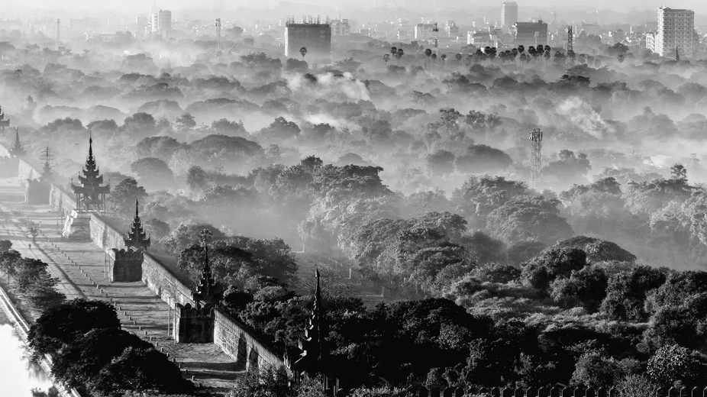
THANK YOU ALL
Waaneiza Worldwide Corporate Companies
The Holistic Investment Organization
Presentation Version 12.4, 01 August 2022
U Zin Aung, Executive Chairman
Mobile: 09-513 0 654, 09-977 103 000
Email: zinaung@waaneiza.com, zin.shweyihq@gmail.com

