Slide 1


Odoo Hosting in AWS lightsail Ko htet min thu, ko ahkar shwe baw zwe linn htet

Slide 2
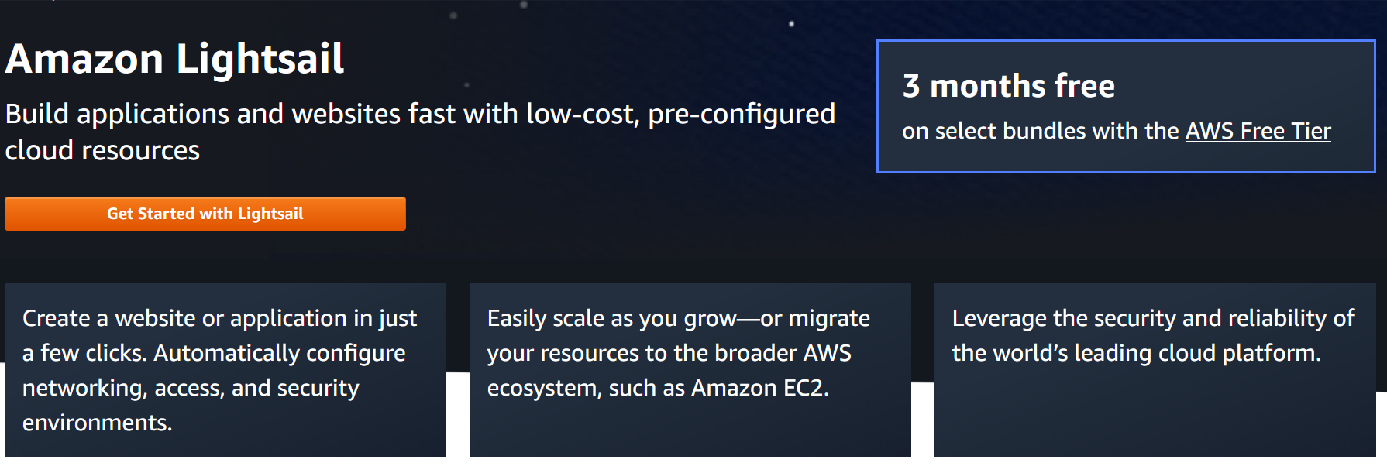
What is AWS Lightsail?

Slide 3
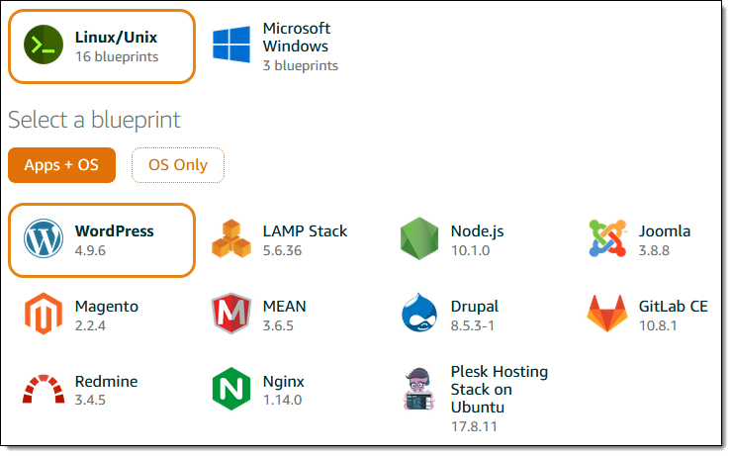

Slide 4
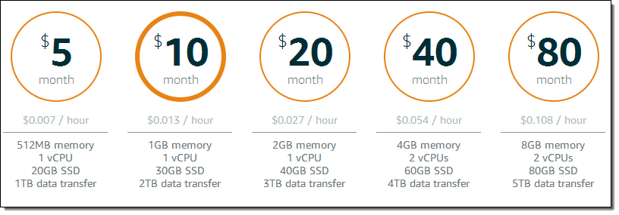
AWS pricing

Slide 5
2 ways upload feature
One Script Install with Version Control
Manual Setup (not included)

Slide 6
Early lightsail setup
Create AWS Account
Choose Light Sail Plan
Fetch With IP
Machine Setup

Slide 7
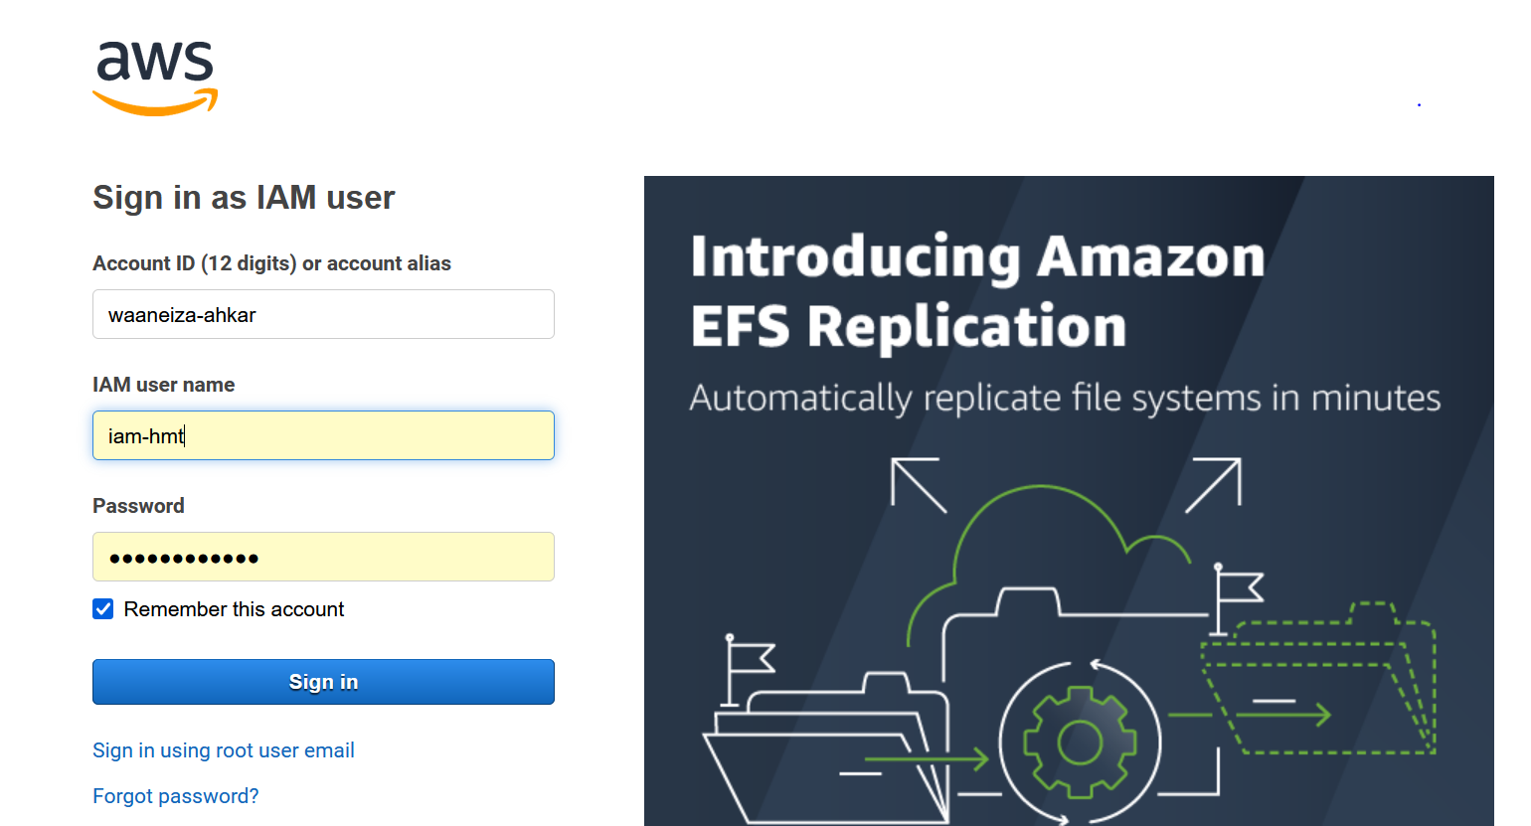
Create aws account and login

Slide 8
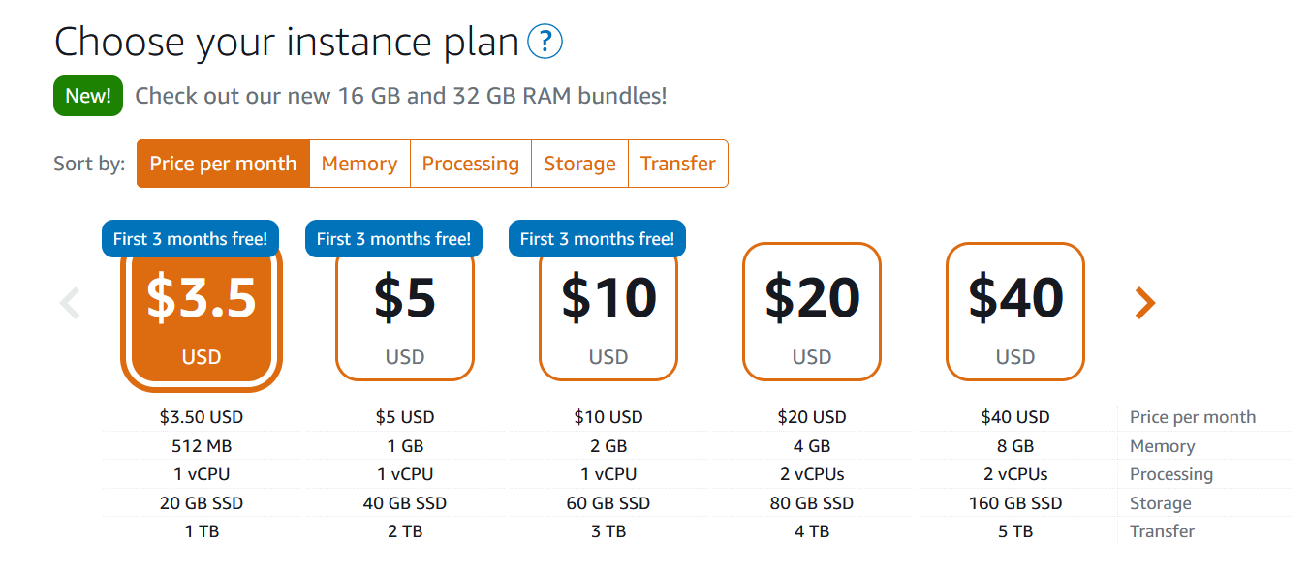
Choosing light sail plan

Slide 9
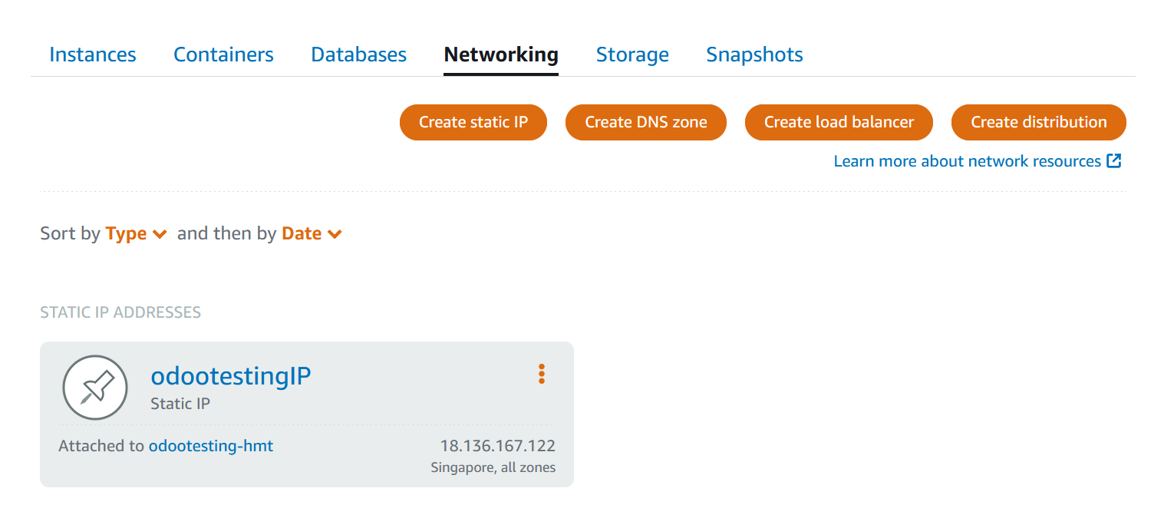
Fetch with Ip

Slide 10
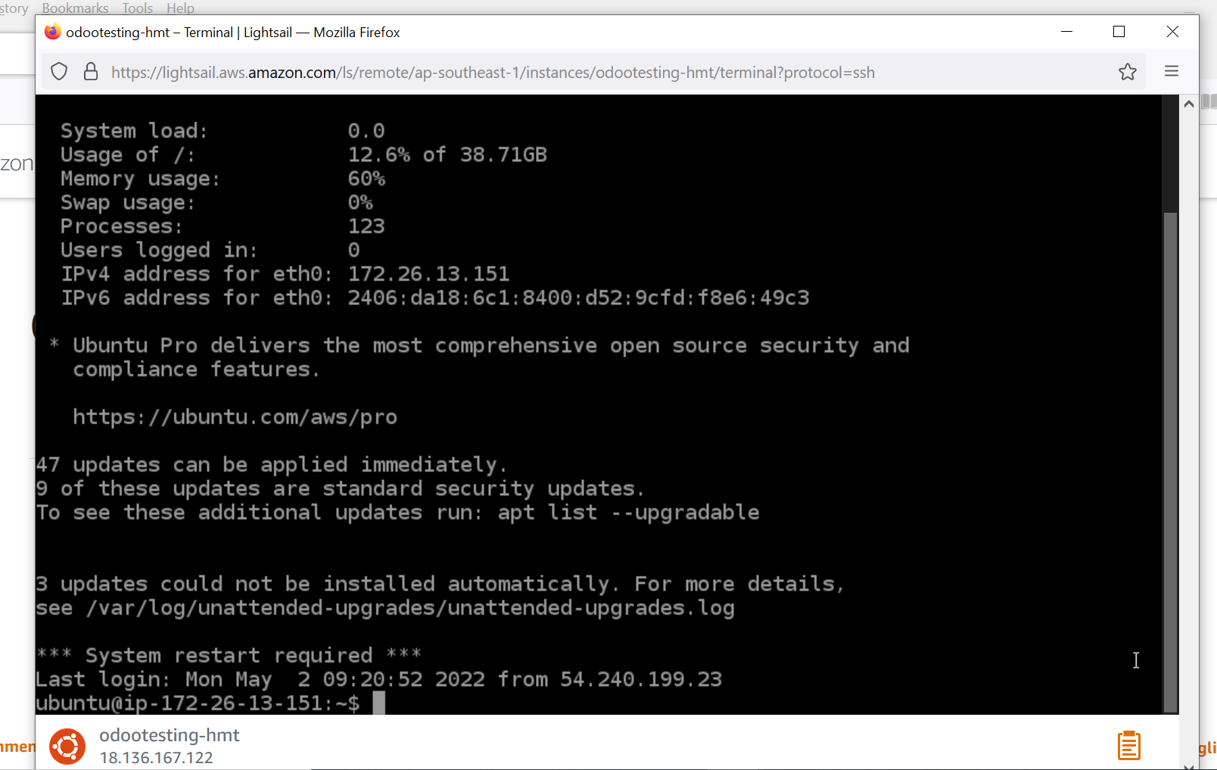
Machine setup

Slide 11
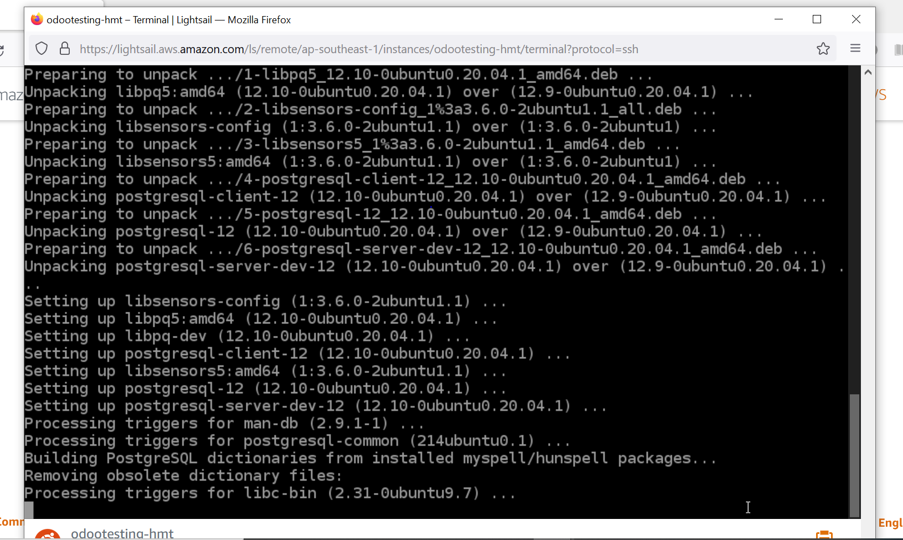
Update and Upgrade Machine on Start up sudo apt-get update && sudo apt-get upgrade && sudo apt-get dist-upgrade

Slide 12
Setup for odoo with one script
Install script file
Configuration
Run and start odoo

Slide 13
Install script file
Type “ git clone https://github.com/Yenthe666/InstallScript.git “
Type “cd InstallScript”
Type “sudo chmod +x odoo_install.sh ”
Type “sudo vi odoo_install.sh ”

Slide 14
configuration
Type “ sudo vi odoo_install.sh “
Type “i” to make changes to script
INSTALL_NGINX = True
WEBSITE_NAME = ‘wwsodootesting’
ADMIN_EMAIL = ‘htetminthu@waaneiza.com’
Type “Esc” and “:wq” to update changes to script
Type “sudo ./odoo_install.sh”
Wait before things getting ready!!

Slide 15
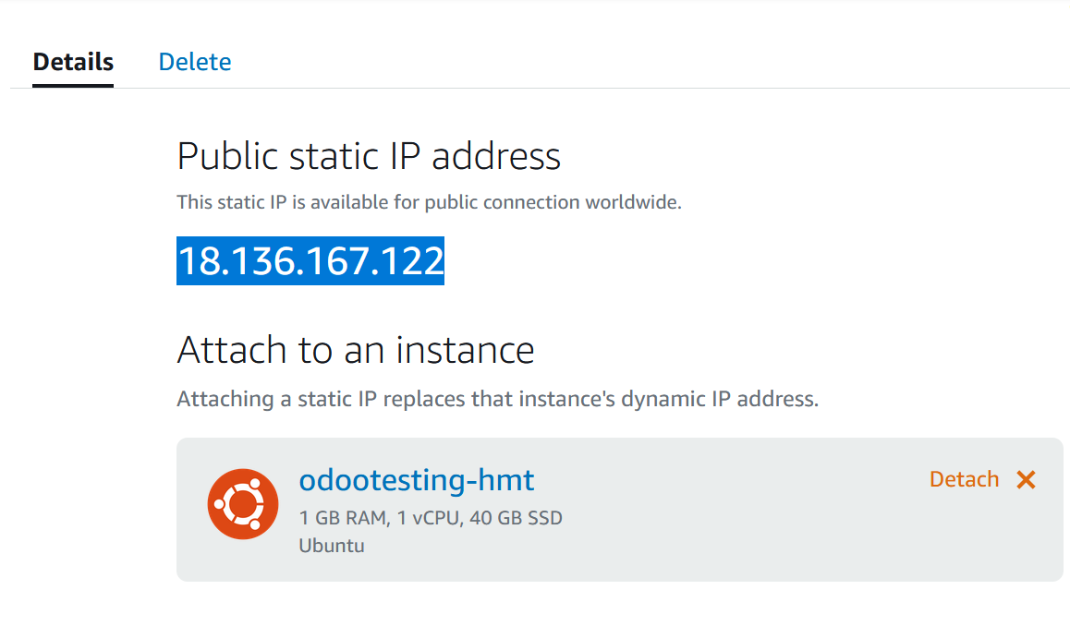
RUN odoo : 18.136.167.122:8069

