Slide 1
IT ASSETS MANAGEMENT · LARAVEL 11
Infra Ninja
PCs · Devices · Subscriptions · Licenses & Contracts
One place. One workflow. Renewals that don't slip through the cracks.
01 / 22

Slide 2
02 · OVERVIEW
What is Infra Ninja?
A unified web app for tracking every renewable IT asset in your organization.
● Single source of truth for PCs, peripherals, subscriptions and licenses
● Granular permissions per-module View / Edit on top of admin / user roles
● Proactive renewals live expiring badge, staggered email digests, mark-as-read
● Audit-ready every change is logged — who, when, what
● Self-service users update their own profile and password
● Modern UI Bootstrap 5 + glass-card auth + dark mode
INFRA NINJA · ITAMS

Slide 3
03 · OVERVIEW
Team
The people who built and maintain this system.
TZ
ZM
NW
Thiha Zin Ko
Zwe Myat Thurain Phyo
Nyein Wai Khant
Team member
Team member
Team member
INFRA NINJA · ITAMS

Slide 4
04 · OVERVIEW
Tech stack
Boring, stable, well-supported. No exotic dependencies.
Backend
● PHP 8.2+
● Laravel 11.31
● Eloquent ORM
Frontend
● Blade templates
● Bootstrap 5
● Bootstrap Icons
● Vite + Tailwind
Database
● MySQL / MariaDB
● JSON columns
● Encrypted fields
● 11 tables
Integrations
● SMTP mail
● Excel I/O
● Chart.js
● Windows Task Scheduler
INFRA NINJA · ITAMS

Slide 5
05 · OVERVIEW
High-level architecture
Classic Laravel MVC — session cookies, server-rendered Blade, no SPA.
Browser · Blade UI
Laravel 11 · Routes / Controllers
MySQL · Eloquent
Cross-cutting concerns
● Middleware: admin · module:<name>,<view|edit>
● AppServiceProvider applies DB-driven mail config at boot
● ActivityLogger captures every state change
Scheduled work
● app:check-expirations runs once daily
● Marks overdue Subscriptions
● Sends staggered reminder digests (per day-mark)
INFRA NINJA · ITAMS

Slide 6
01
CHAPTER 01
Modules
The four asset categories your team manages — end-to-end CRUD with audit log and bulk operations.
INFRA NINJA · ITAMS

Slide 7
07 · MODULES
Four asset modules
Each has full CRUD, search, filter, Excel import / export, and bulk delete.
PC Master
● Workstations, employees, status, encrypted credentials.
● Route prefix: /pc-assets
Device Master
● Peripherals, inventory qty, serial, warranty.
● Route prefix: /devices
Subscriptions
● Domain, SSL, hosting, cloud, renewal cadence.
● Route prefix: /subscriptions
License & Contract
● Software licenses & vendor contracts.
● Route prefix: /licenses-contracts
INFRA NINJA · ITAMS

Slide 8
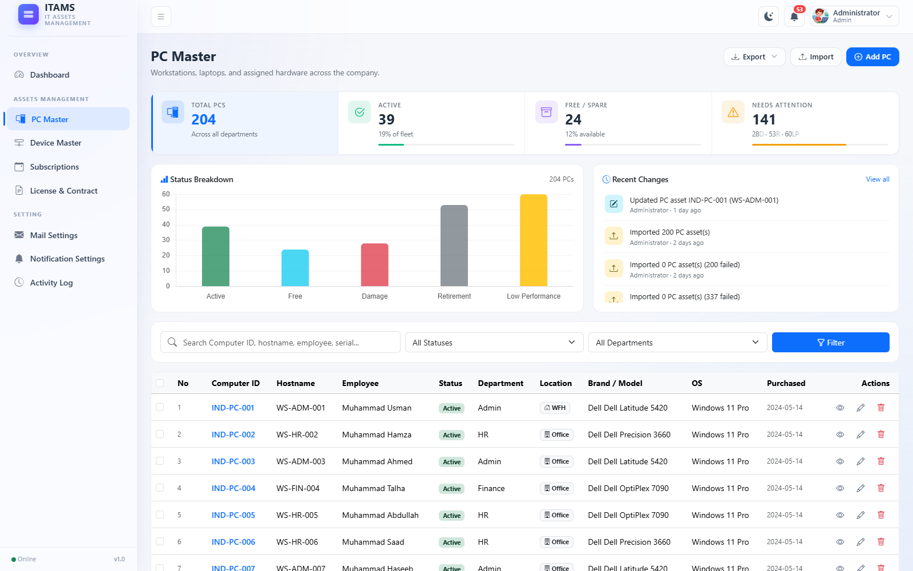
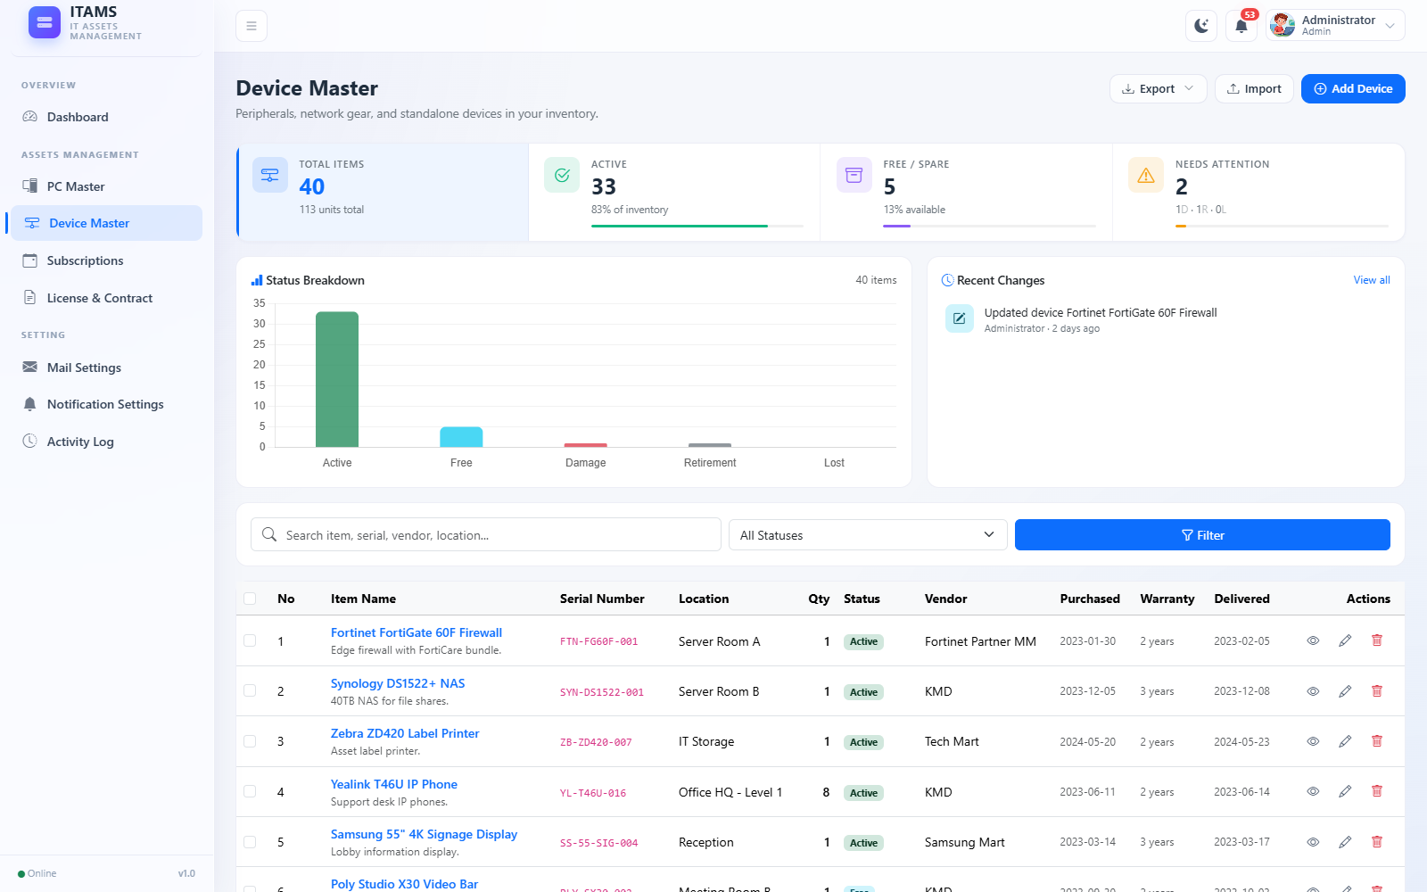
08 · MODULES
PC Master & Device Master
Hardware inventory — who has what, where it lives, when it was bought.
PC Master — workstation list with status, OS, warranty
Device Master — peripherals with qty, vendor, delivery date
INFRA NINJA · ITAMS

Slide 9
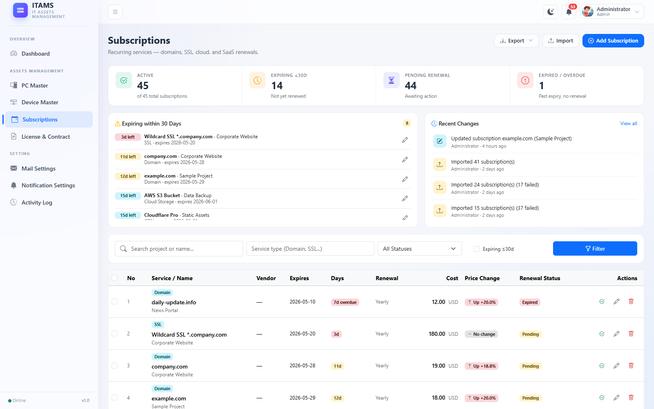
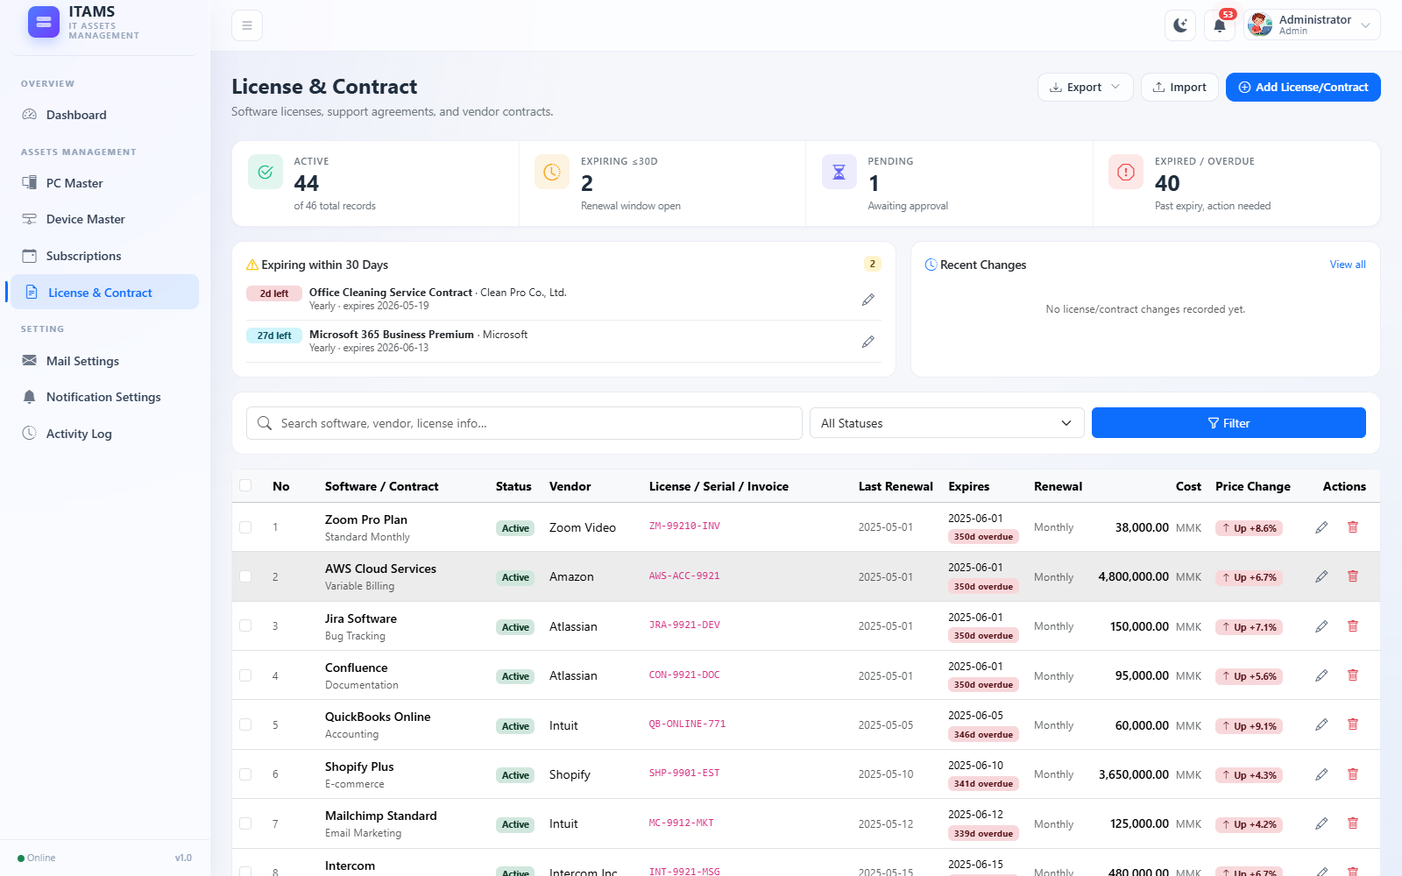
09 · MODULES
Subscriptions & License / Contract
Recurring expenses that need renewing — the heart of the reminder system.
Subscriptions — domains, SSL, hosting, cloud
License & Contract — software licenses & vendor contracts
INFRA NINJA · ITAMS

Slide 10
02
CHAPTER 02
Users & Auth
Two roles, granular per-module permissions, and a modern login / reset flow.
INFRA NINJA · ITAMS

Slide 11
11 · USERS & AUTH
Users & permissions
Two roles + 8 granular flags = no shared admin password, no all-or-nothing.
ADMIN · full access
USER · granted per module
● Per-module View see index, show, export, template
● Per-module Edit additionally allowed to create / update / delete / import
● Edit implies View enforced in form, controller, and model
● Admin bypass canView() / canEdit() short-circuit for admins
● Route middleware module:<name>,<view|edit> wraps every module endpoint
● User management admin-only at /users
INFRA NINJA · ITAMS

Slide 12
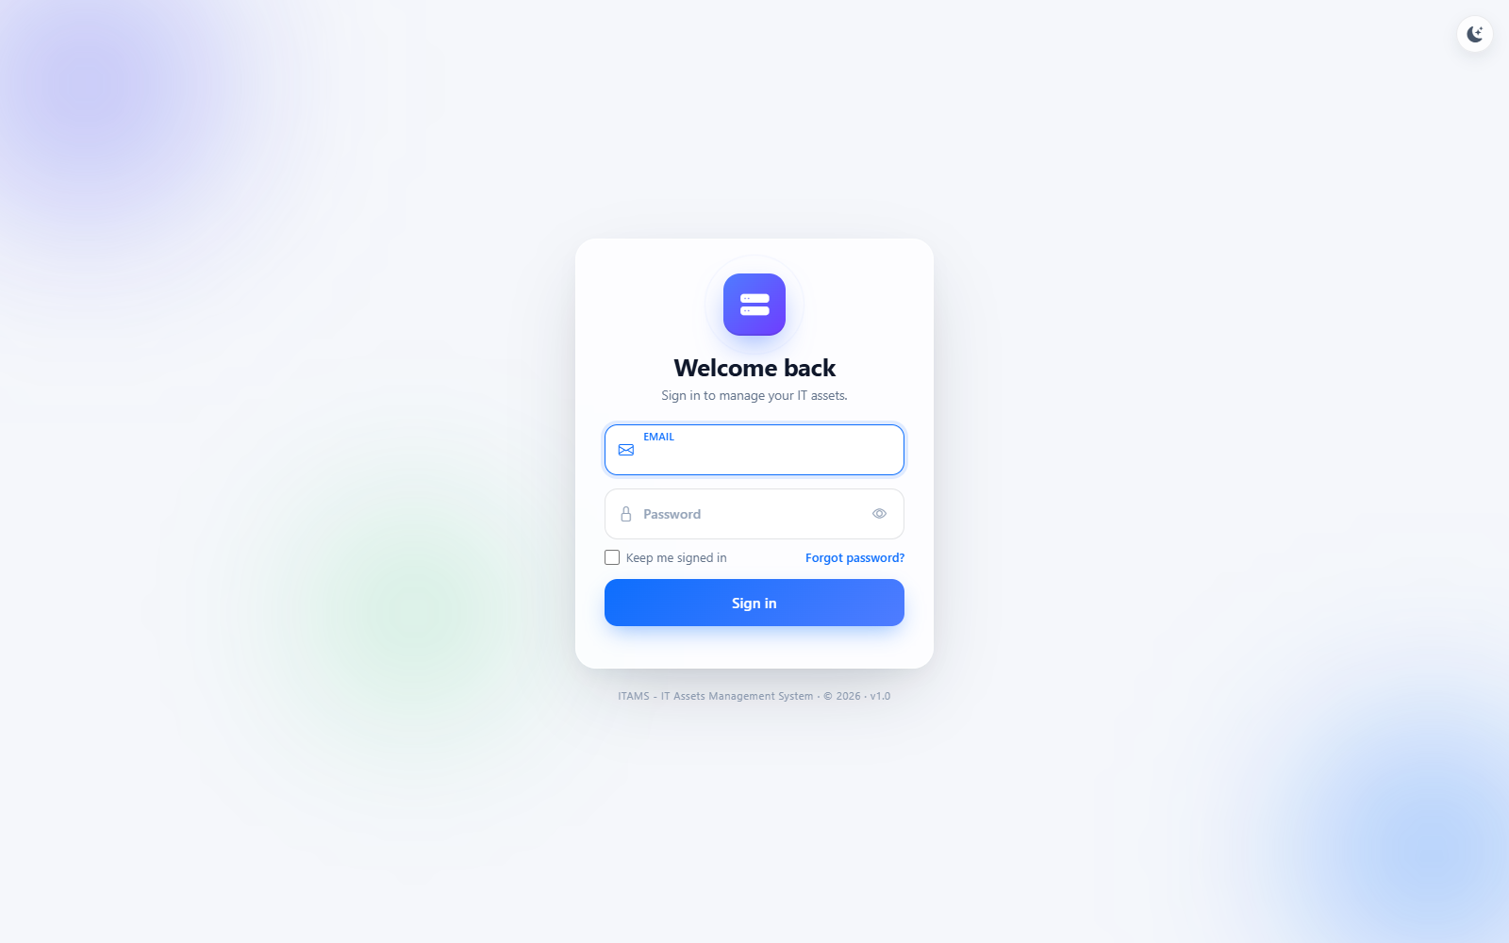
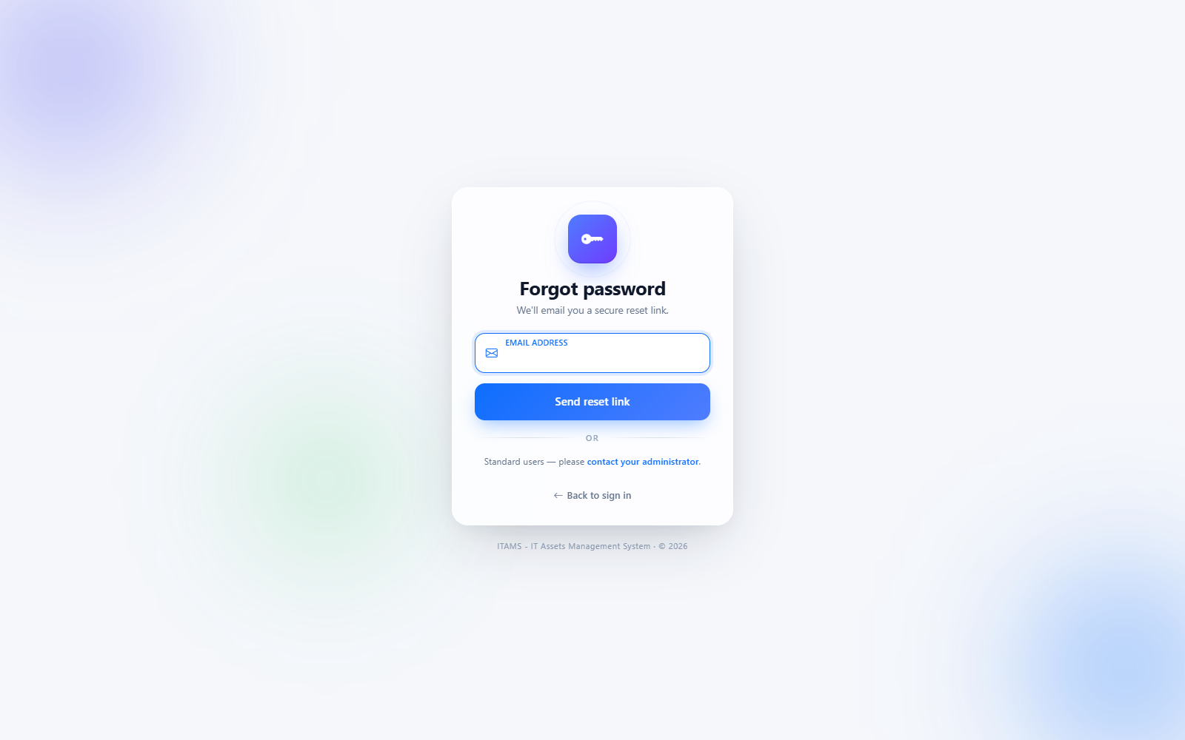
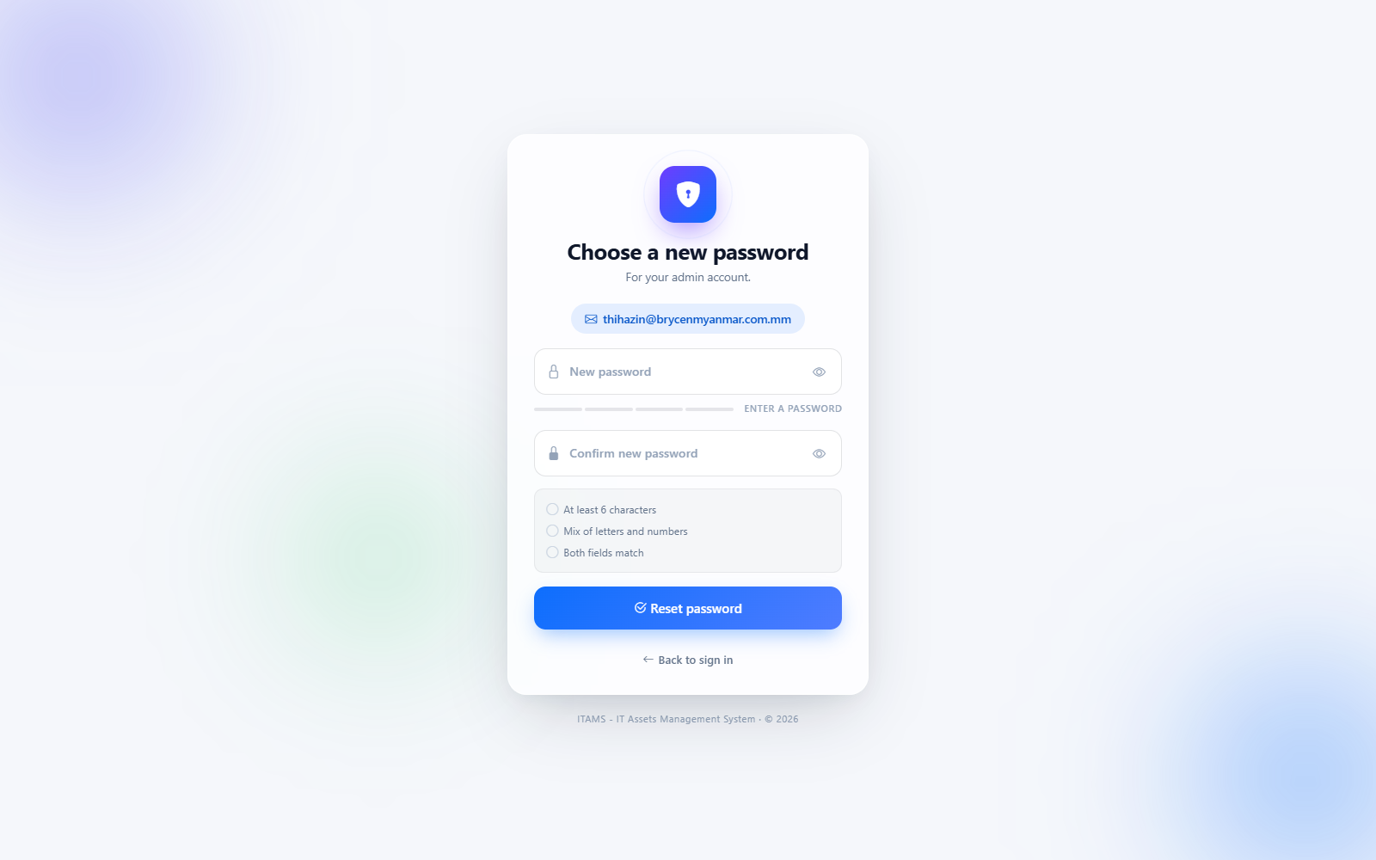
12 · USERS & AUTH
Authentication flow
Login + admin-only password reset by email + role-aware contact-admin branch.
1 · Sign in
2 · Forgot password
3 · Reset password
● Email + password, remember-me
● Modern glass-card shell
● Logs: login / login_failed
● Admin → reset link (60 min)
● Non-admin → contact-admin panel
● Same response → no email leak
● Strength meter + match indicator
● Requirements checklist
● Re-checks role on submit
INFRA NINJA · ITAMS

Slide 13
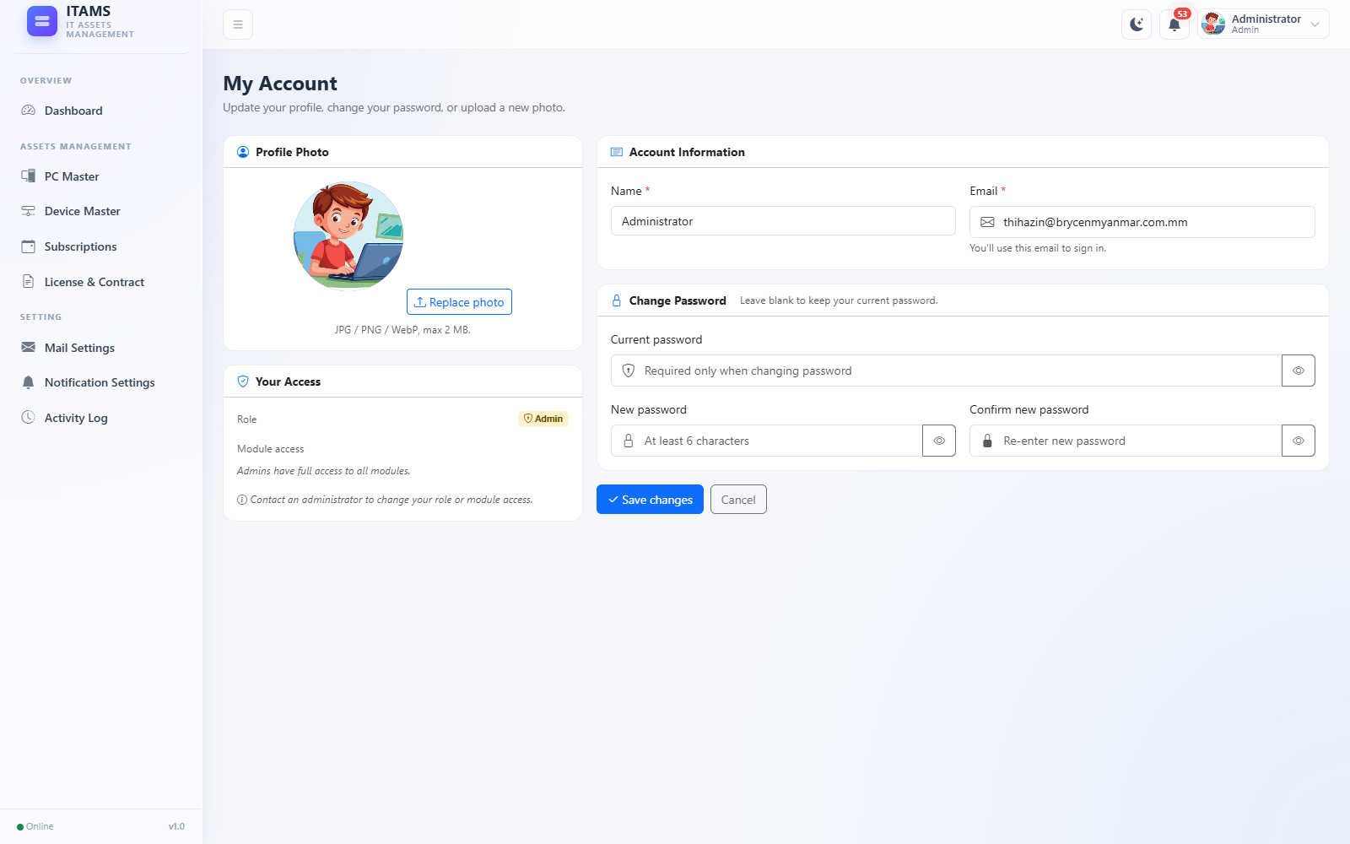
13 · USERS & AUTH
Self-service profile · My Account
Every authenticated user updates their own basics — no admin needed.
● Name & Email instant update, unique enforced
● Avatar upload JPG / PNG / WebP up to 2 MB
● Change Password requires current_password
● Role / Module Access shown read-only
● Activity log profile_updated with changed_fields
Role & permissions → admin only
/profile — My Account page
INFRA NINJA · ITAMS

Slide 14
03
CHAPTER 03
Insights
What the system shows at a glance — dashboard, notifications, live counts.
INFRA NINJA · ITAMS

Slide 15
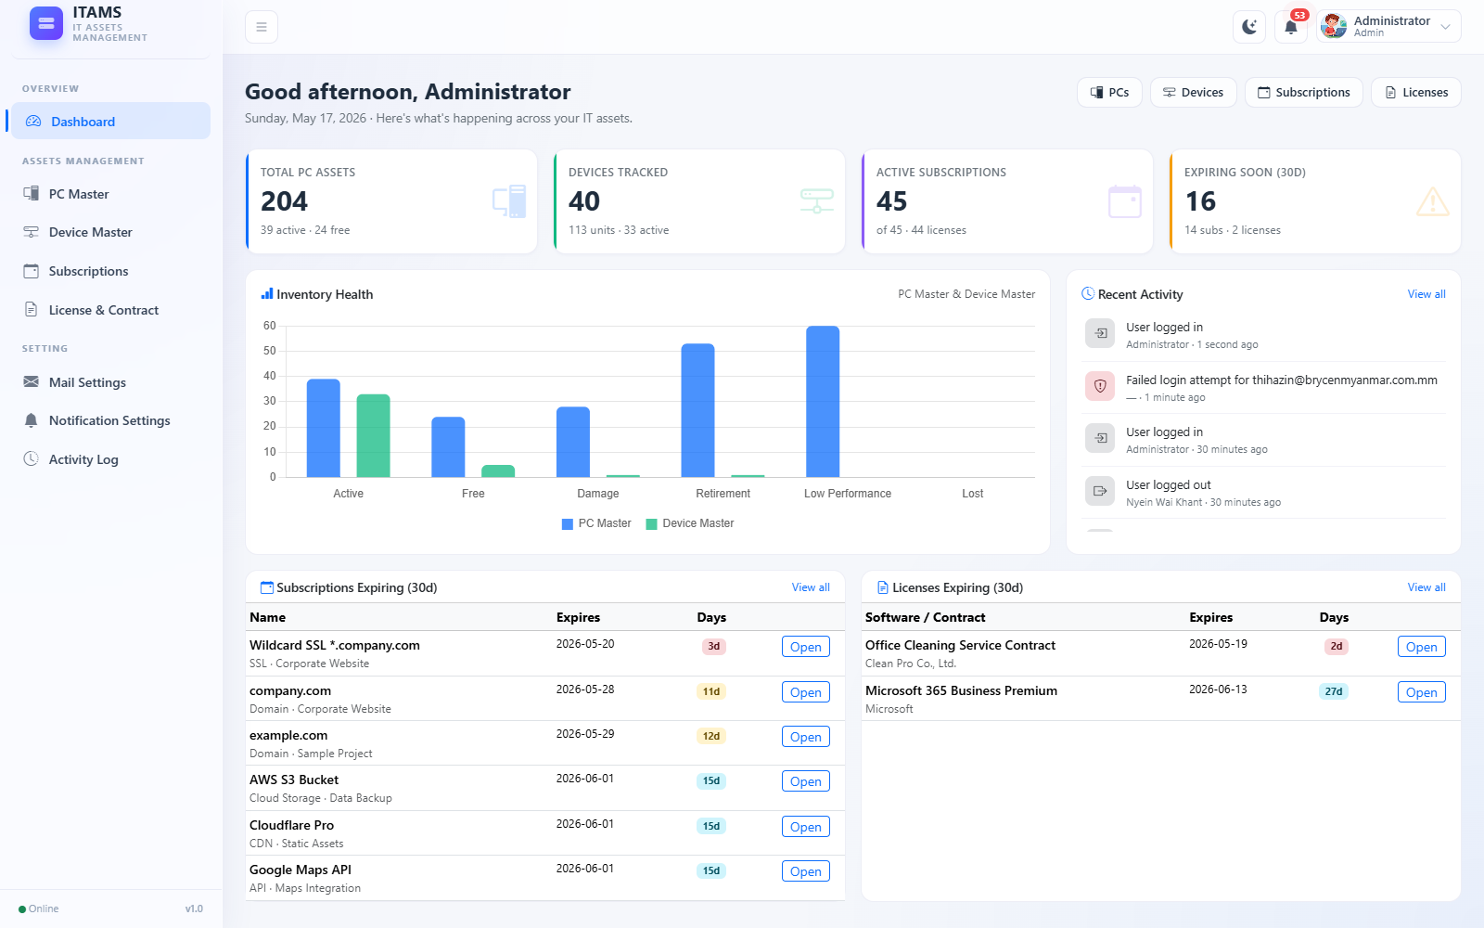
15 · INSIGHTS
Dashboard
Visual digest of the whole estate, refreshed on every load.
● 4 KPI cards PCs · Devices · Subs · Expiring
● Inventory chart Chart.js — PC vs Device by status
● Recent activity last 8 audit-log entries
● Expiring tables subs and licenses in next 30 days
● Quick actions header buttons jump to each module
INFRA NINJA · ITAMS
/dashboard — KPIs, inventory chart, recent activity, expiring lists

Slide 16
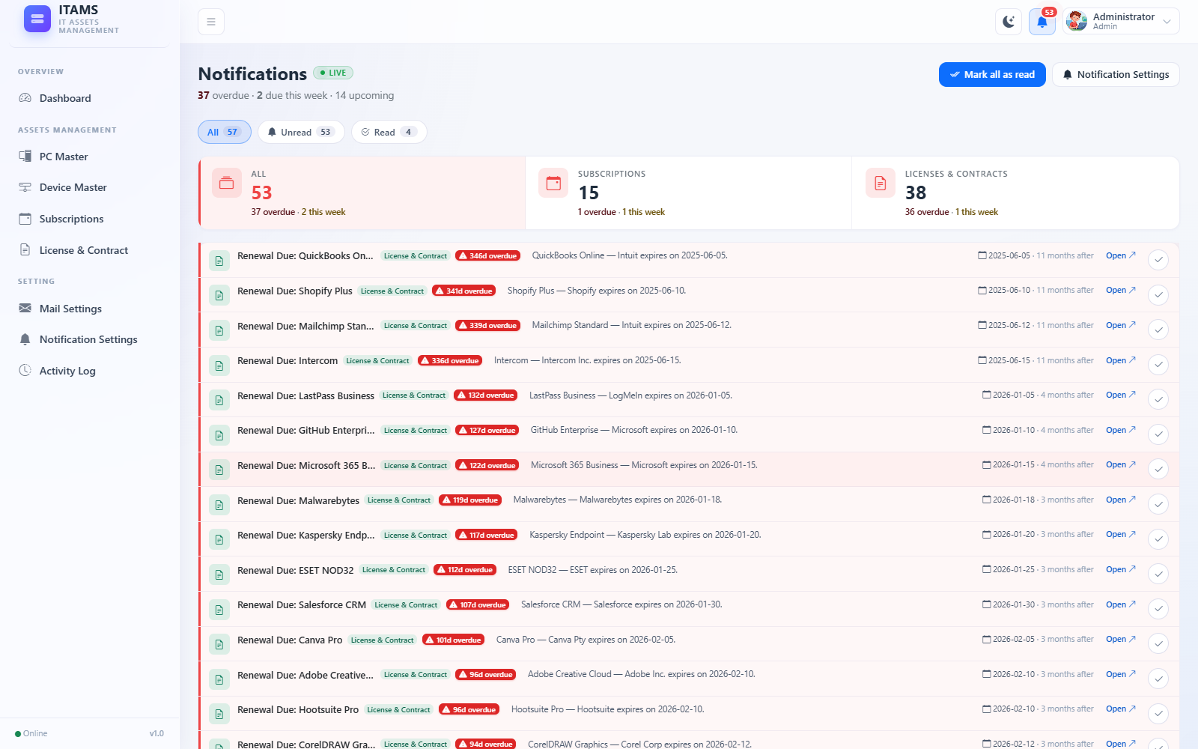
16 · INSIGHTS
Notifications system
Live count · per-user read state · auto-unread on signature drift.
● Topbar bell live count per user, urgency tone
● Filter chips All · Unread · Read
● Per-module filter subs · L&C
● Mark as read single item or all
● Auto-unread on renewal or bucket transition
INFRA NINJA · ITAMS
/notifications — live items with module colors and per-row actions

Slide 17
04
CHAPTER 04
Operations
The plumbing keeping it running — mail, reminders, and the audit trail.
INFRA NINJA · ITAMS

Slide 18
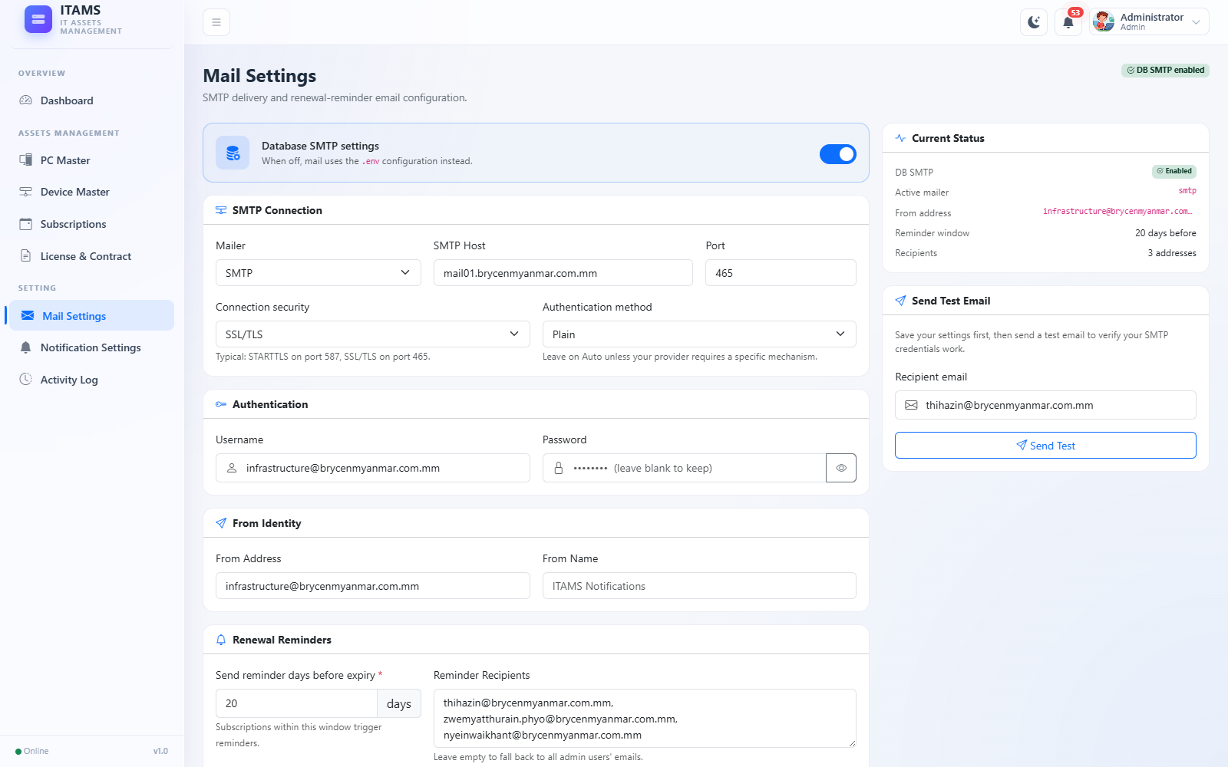
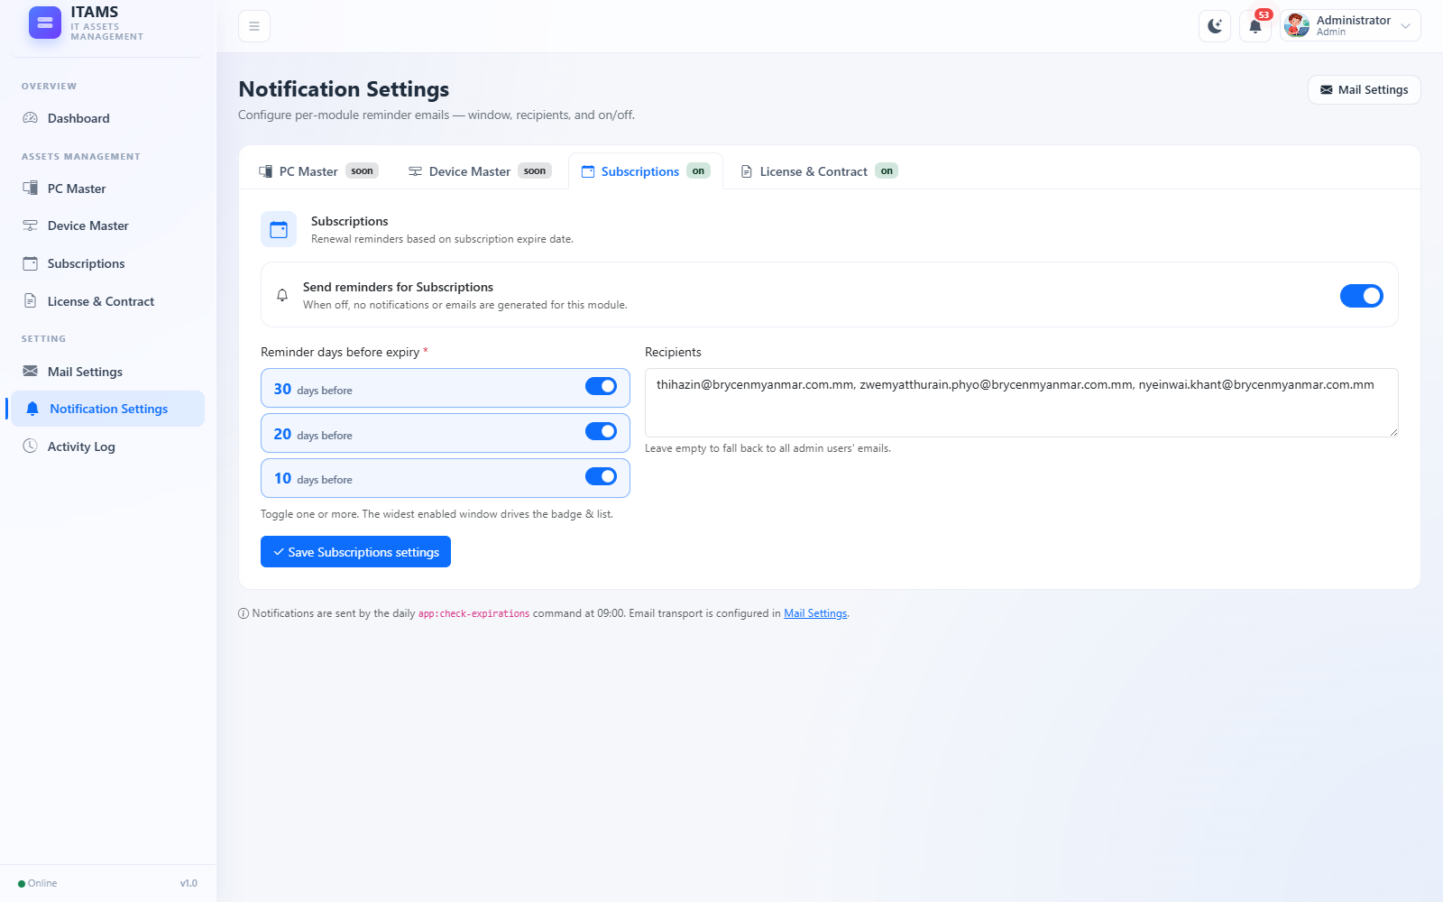
18 · OPERATIONS
Mail & staggered reminders
DB-overridable SMTP plus one digest per (module × selected day-mark).
/mail-settings — SMTP, auth, from identity, test send
/notification-settings — per-module enable + 30/20/10 day-mark toggles
INFRA NINJA · ITAMS

Slide 19
19 · OPERATIONS
Activity log · audit trail
Every meaningful action recorded via App\Support\ActivityLogger::log(...).
● CRUD on every module created · updated · deleted · imported
● Subscriptions renewed
● Auth login · logout · login_failed · password_reset_*
● User & profile profile_updated · mail_sent · mail_test
● Settings Mail / Notification updates
● Captured fields subject_type/id · user_id/name/email · properties · ip · user_agent
● Visible at /activity-logs (admin-only, paginated)
INFRA NINJA · ITAMS

Slide 20
05
CHAPTER 05
Wrap-up
Setup, where it could go next, and the team behind it.
INFRA NINJA · ITAMS

Slide 21
21 · WRAP-UP
Setup & next steps
How to get it running, and where it could go next.
Get it running
● composer install
● cp .env.example .env → set APP_*, DB_*, MAIL_*
● php artisan key:generate
● php artisan migrate
● php artisan storage:link
● npm install && npm run build (optional)
● Schedule: php artisan schedule:run (every minute)
Possible next iterations
● Warranty-expiry tracking for PCs & Devices
● Two-factor authentication for admins
● Weekly overdue digest
● Per-user notification preferences
● PDF export for contracts
● API surface for integrations
● Soft-delete + restore on critical tables
INFRA NINJA · ITAMS

Slide 22
Thank you
Questions · Discussion
Infra Ninja · IT Assets Management System

