Slide 1
RNA alternative splicing analysis
experience sharing
Group 8
2019.11.4

Slide 2
Content
MISO
rMATS
comparison

Slide 3
Content
MISO
rMATS
comparison

Slide 4
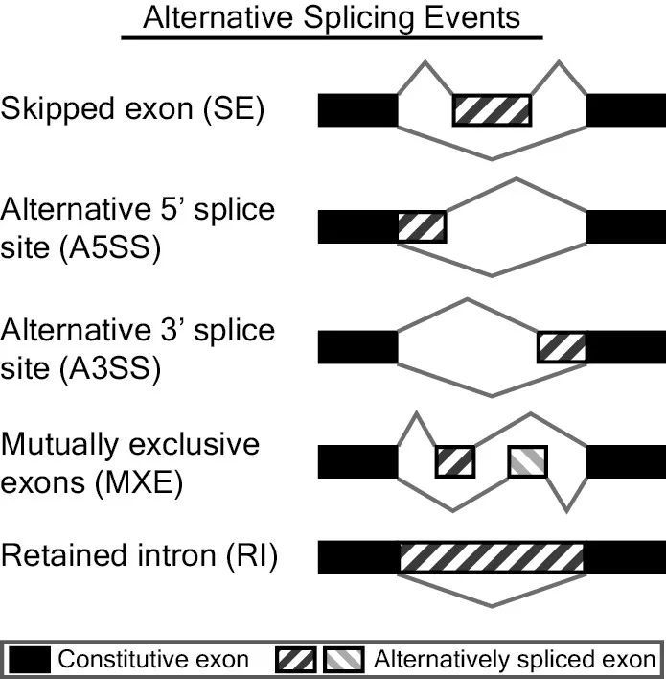
RNA alternative splicing
http://rnaseq-mats.sourceforge.net/

Slide 5
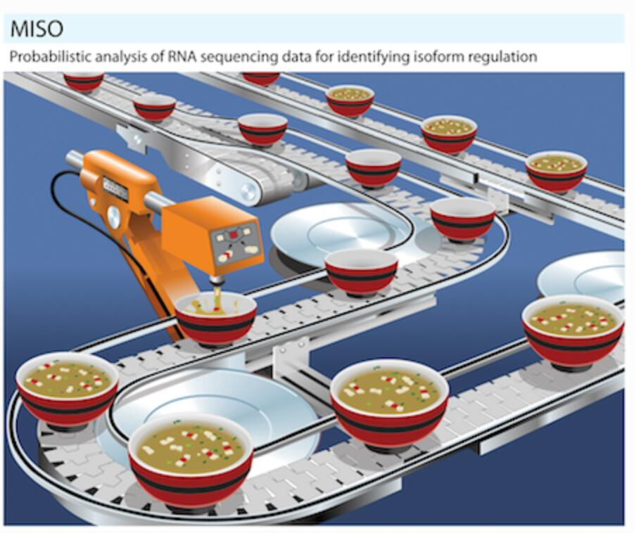
MISO (Mixture-of-Isoforms)
WHAT
MISO (Mixture-of-Isoforms) is a probabilistic framework that quantitates the expression level of alternatively spliced genes from RNA-Seq data, and identifies differentially regulated isoforms or exons across samples. By modeling the generative process by which reads are produced from isoforms in RNA-Seq, the MISO model uses Bayesian inference to compute the probability that a read originated from a particular isoform.
HOW
MISO treats the expression level of a set of isoforms as a random variable and estimates a distribution over the values of this variable. The estimation algorithm is based on sampling, and falls in the family of techniques known as Markov Chain Monte Carlo (“MCMC”).
Nature Methods (2010)

Slide 6
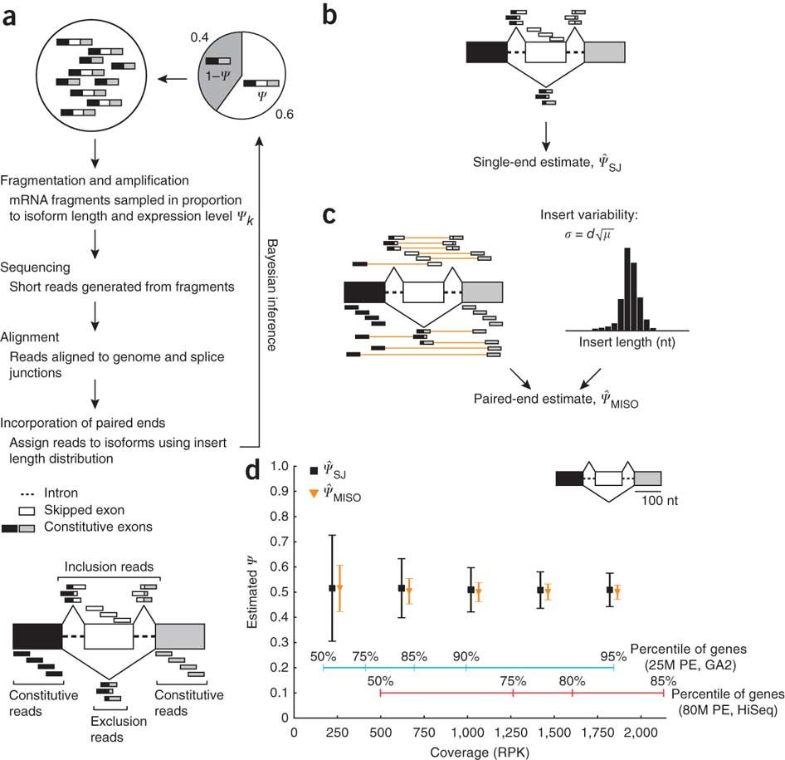
MISO
Nature Methods (2010)

Slide 7
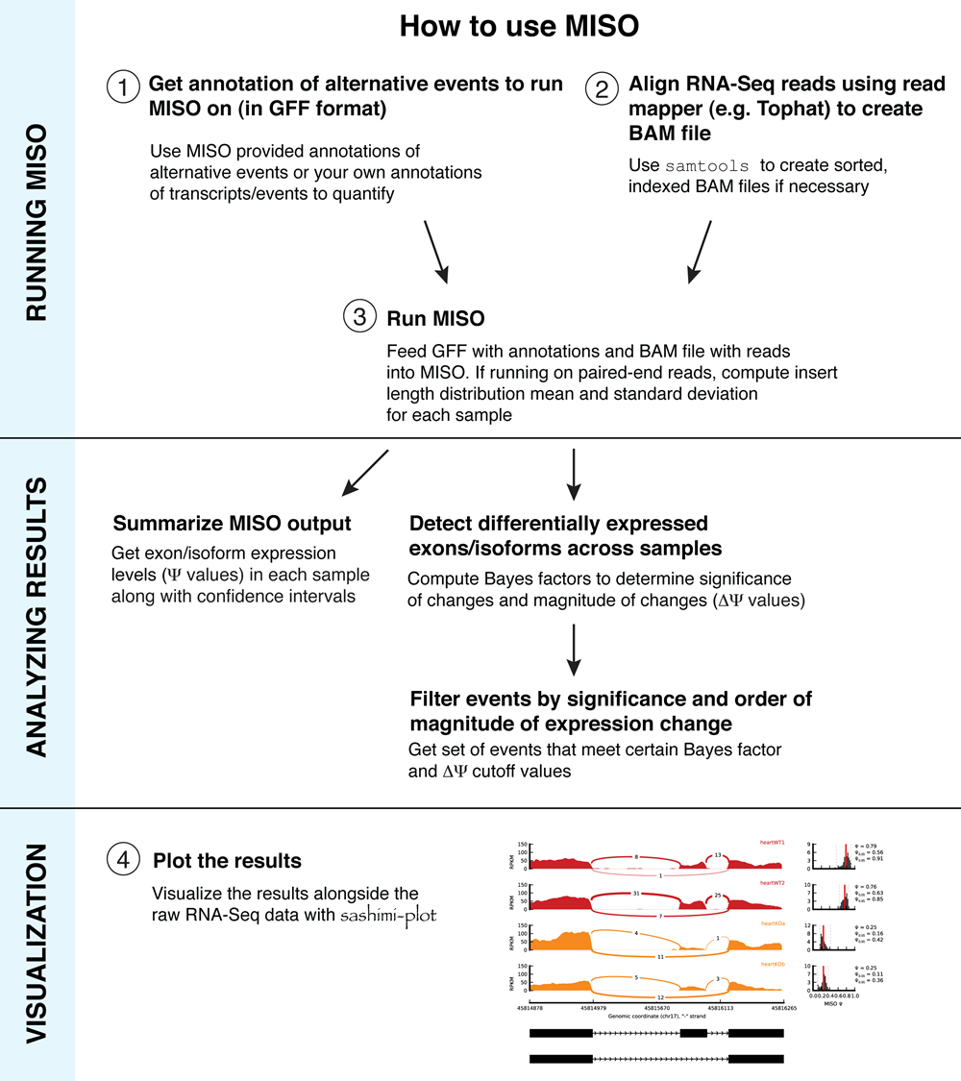
How to use MISO

Slide 8
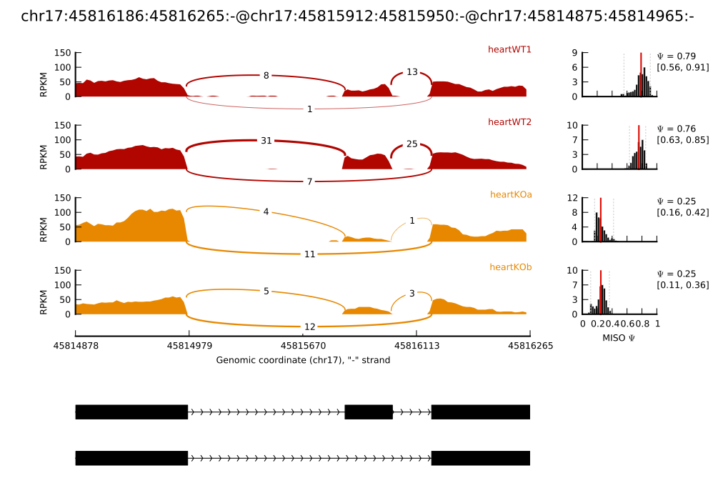
sashimiplot
https://miso.readthedocs.io/en/fastmiso/sashimi.html

Slide 9
Content
MISO
rMATS
comparison

Slide 10
rMATS
MISO: two-sample comparison, do not handle replicates
rMATS: better account for uncertainty and variation
specific model for paried duplicates
hypothesis testing(p-value)
read depth conductive to increase true positive rate

Slide 11
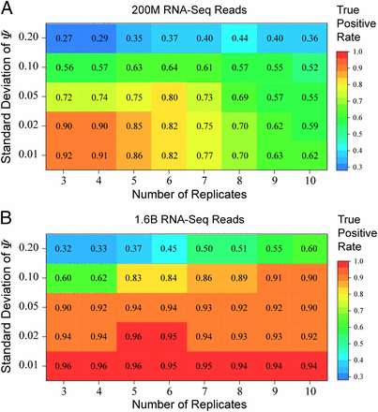
rMATS
PNAS (2014)

Slide 12
How to use rMATS
Obtain .bam and .gtf file
Run rMATS -> As_Event.MATS.JC/JCEC.txt, fromGTF.As_Event.txt, JC/JCEC.raw.input.As_Event.txt
Use rMATS-STAT to evaluate different alternative splicing events
Use rmats2sashimiplot to visualize

Slide 13
Content
MISO
rMATS
comparison

Slide 14
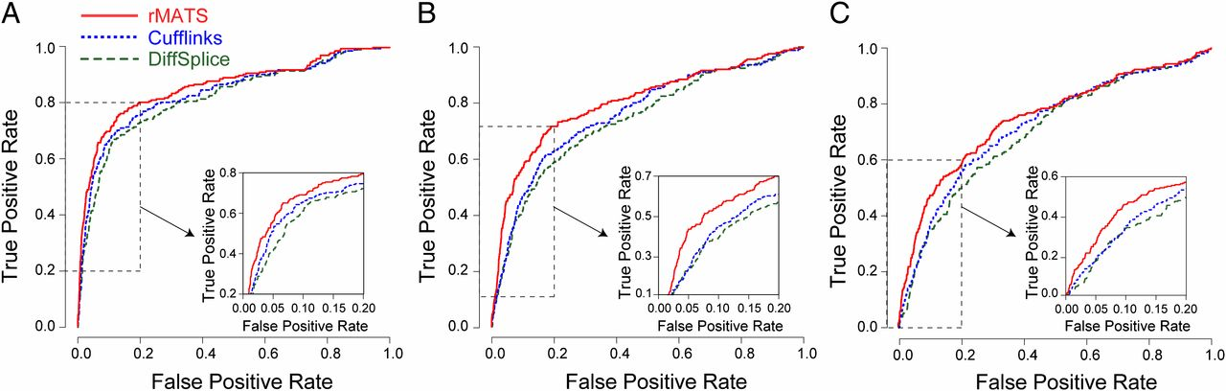
Comparison offered in rMATS article
PNAS (2014)

Slide 15
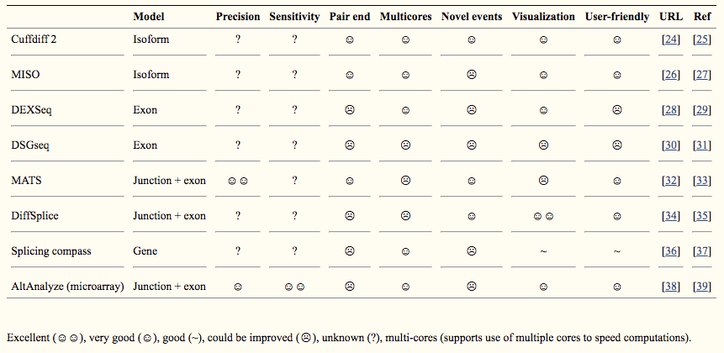
Comparison of different software for alternative splicing analysis
Hum Genomics. 2014; 8(1): 3.

Slide 16
Thank you!
第八组分工：
洪赟，杨友琦——搜集资料
黄嘉欣，陈泊文——整理github
赵伟豪*——制作PPT，展示
（带*为选课同学）

