Slide 1
Peer Review Assignment 4
Group DAFOT

Slide 2
Task 4.2: Ticket Reservation with PHP
Used XAMPP (MySQL)

Slide 3
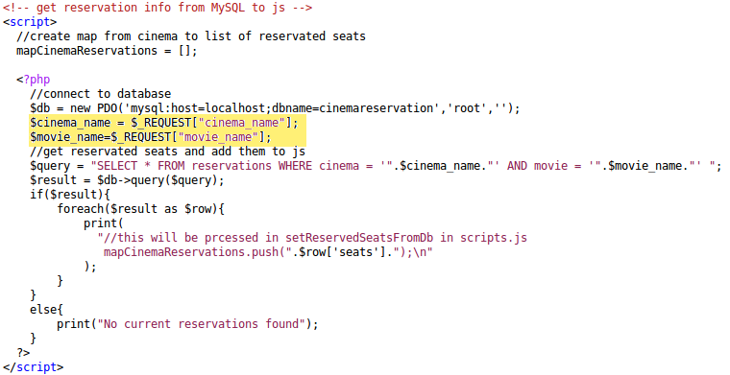
Task 4.2: Ticket Reservation with PHP
Used XAMPP (MySQL)
Display Reservations:
- Open reservation.php?cinema_name=cin&movie_name=mov

Slide 4
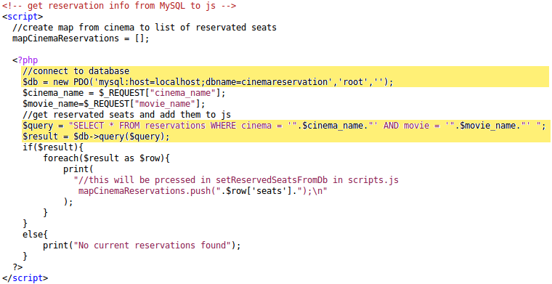
Task 4.2: Ticket Reservation with PHP
Used XAMPP (MySQL)
Display Reservations:
- Open reservation.php?cinema_name=cin&movie_name=mov
- Connect to MySQL and send query

Slide 5
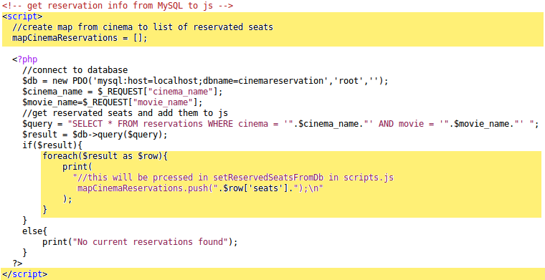
Task 4.2: Ticket Reservation with PHP
Used XAMPP (MySQL)
Display Reservations:
- Open reservation.php?cinema_name=cin&movie_name=mov
- Connect to MySQL and send query
- Insert into JavaScript

Slide 6
Task 4.2: Ticket Reservation with PHP
Used XAMPP (MySQL)
Display Reservations:
- Open reservation.php?cinema_name=cin&movie_name=mov
- Connect to MySQL and send query
- Insert into JavaScript (seats entry is a JSON.stringify list)
- Process in JavaScript as in Assignment 2

Slide 7
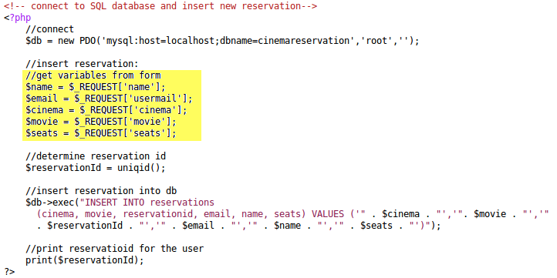
Task 4.2: Ticket Reservation with PHP
Insert New Reservations:
- Read data submitted by the user

Slide 8
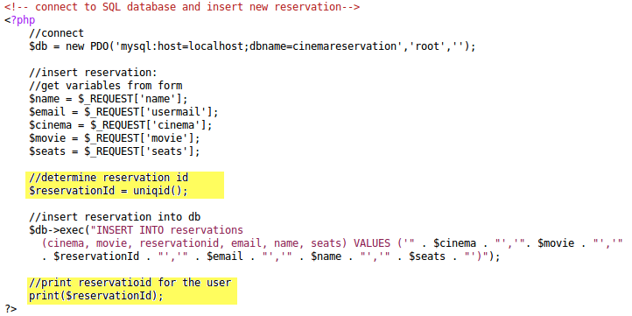
Task 4.2: Ticket Reservation with PHP
Insert New Reservations:
- Read data submitted by the user
- Generate and show Reservation ID

Slide 9
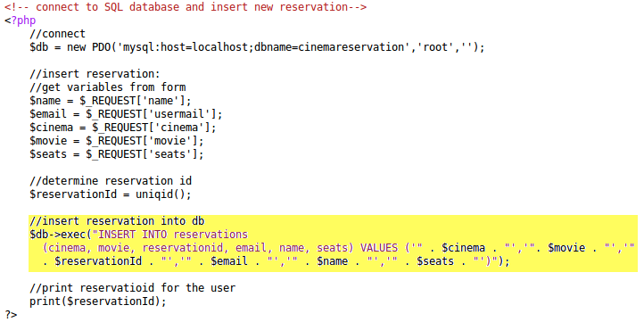
Task 4.2: Ticket Reservation with PHP
Insert New Reservations:
- Read data submitted by the user
- Generate and show Reservation ID
- Insert reservation into database

