Slide 1
Architecture
Analyser
Convert libvirt’s XML to YAML
1
6
Convertor
Convert kubernetes’s YAML to XML
3
4
2
5
Controller
Scheduler
Client
Request
Executor
Multiple
Queues
Collector
VM
Container

Slide 2
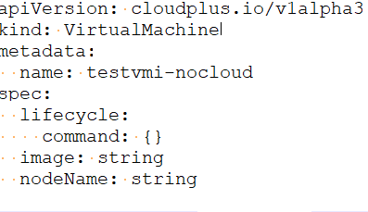
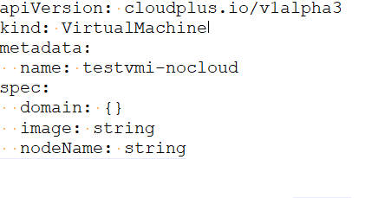
Architecture
submit
Kube-apiserver
watch
update
virtctl
invoke and
callback
libvirt

Slide 3
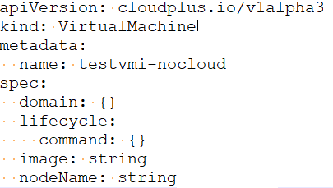
Architecture
update
Kube-apiserver
watch
update
virtctl
invoke and
callback
libvirt

Slide 4
Architecture
Client
Request

