Slide 1
Architecture
Analyser
Convert libvirt’s XML to YAML
1
6
Convertor
Convert kubernetes’s YAML to XML
3
4
2
5
Controller
Scheduler
Client
Request
Executor
Multiple
Queues
Collector
VM
Container

Slide 2
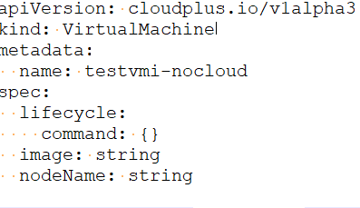
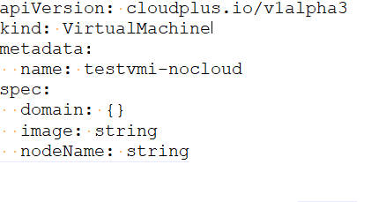
Architecture
submit
Kube-apiserver
watch
update
virtctl
invoke and
callback
libvirt

Slide 3
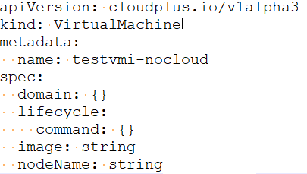
Architecture
update
Kube-apiserver
watch
update
virtctl
invoke and
callback
libvirt

Slide 4
Architecture
Client
Request

Slide 5

Architecture
创建
Virtual
Machine
Disk
导入或者安装OS
挂载/卸载硬盘
Virtual
Machine
当虚拟机处于关机状态时且有OS，可转化为镜像
为虚拟机做快照
为硬盘做快照
基于快照生成硬盘
Virtual
Machine
Image
基于镜像创建虚拟机
基于快照回滚/创建虚拟机
Virtual
Machine
Snapshot

