Slide 1
ECE220 Lab1

Slide 2
Introduction
TA: Matt Potok (Poe tock)
Email: potok2@illinois.edu
Office Hours:
Monday – 6:00 PM to 8:00 PM
Thursday – 6:00 PM to 8:00 PM
Course websites:
Course Wiki: https://wiki.illinois.edu/wiki/display/ece220su2/ECE+220+SU18+Home+Page
Course Github: https://github-dev.cs.illinois.edu/ECE220SU18/_release
Piazza: https://piazza.com/class/jexl8le0xnb3zz

Slide 3
Class Overview
Machine Problems:
Available on Monday before the lab
Due next Monday 10:00 PM CST
Labs
Weekly on Mondays 3:00 PM to 4:00 PM CST
Optional lab assignment
10 extra points per assignment
Available on Monday before the lab
Due next Monday 10:00 PM CST
Quizzes
Weekly on Thursday 8:00 PM to 9:00 PM CST
Git/Github
Version control system
Retrieve and submit assignments

Slide 4
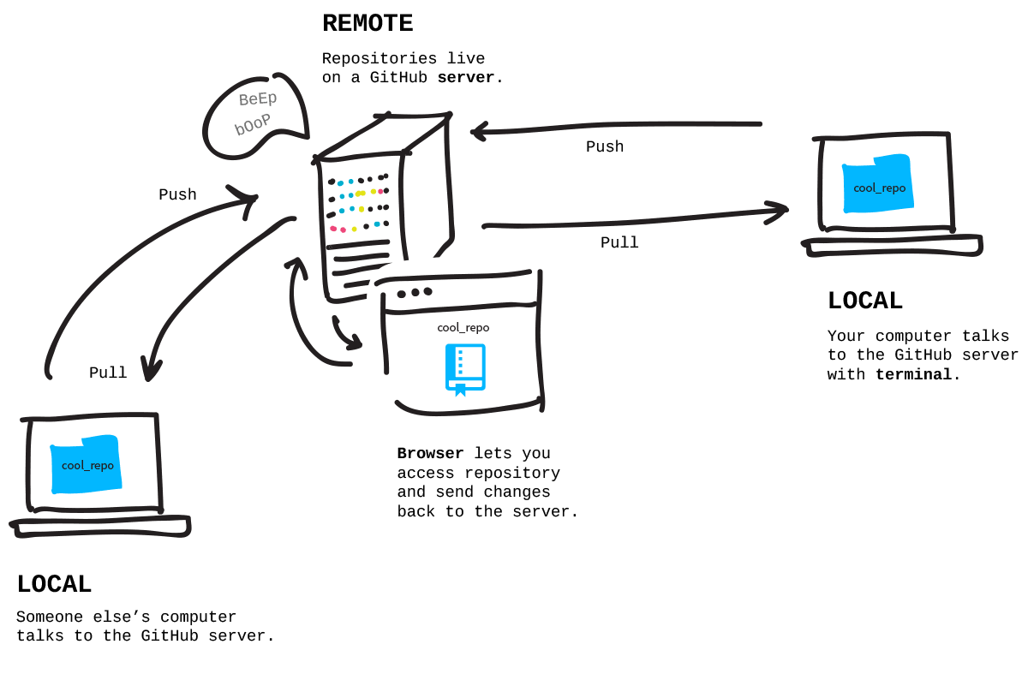
Git Overview

Slide 5
Setting up Git and Lab1
Login at https://github-dev.cs.illinois.edu/
Follow instructions at https://github-dev.cs.illinois.edu/ECE220SU18/_release

Slide 6
Lab1a – Hello World!
Two assignments:
lab1a – Hello World!
lab1b – Printing a hexadecimal number
More information about the lab at https://wiki.illinois.edu/wiki/display/ece220su2/Lab1
Complete lab1a and see ‘Hello <your name>!’ printed to the console
Commit changes to your local repository.
Push changes to the remote repository.

Slide 7
Working Remotely
Personal computer
Install LC3 tools: https://wiki.illinois.edu/wiki/display/ece220su2/Installing+LC-3+tools+on+your+machine
EWS machines
SSH/X-forwarding
Remote desktop environment with FastX
Load LC3 tools with module load lc3tools
Instructions at https://wiki.illinois.edu/wiki/display/ece220su2/Working+Remotely
SSH Keys:
Follow instructions at https://wiki.illinois.edu/wiki/display/ece220su2/Setting+up+SSH+Keys

Slide 8
Git Review
NetID
Lab1
file1.txt
file2.txt
file4.txt
_release
Lab1
file1.txt
file2.txt
NetID
git status @ 3)
unmodified tracked
lab1/file1.txt
lab1/file2.txt
Remote Repository
2) remote add
git status @ 4)
unmodified tracked
lab1/file2.txt
modified tracked
lab1/file1.txt
untracked
lab1/file3.txt
lab1/file4.txt
git status @ 4.5)
unmodified tracked
lab1/file2.txt
untracked
lab1/file3.txt
changes to commit
lab1/file1.txt
lab1/file4.txt
1) clone
6) push
3) merge release/lab1
NetID
Lab1
file1.txt
file2.txt
file4.txt
NetID
Lab1
file1.txt
file2.txt
Local Repository
4) changes
5) commit
git status @ 5)
unmodified tracked
lab1/file1.txt
lab1/file2.txt
lab1/file4.txt
untracked
lab1/file3.txt
NetID
Lab1
file1.txt
file2.txt
file3.txt
file4.txt
Workspace

Slide 9
MP1 and Lab1b – Printing a hexadecimal number
This is a test of the counting frequency code. AbCd...WxYz.
@ 000F
A 0002
B 0001
…
Y 0002
Z 0001
MP1
Given a histogram of letters and symbols, print it out to the console.
More information at https://wiki.illinois.edu/wiki/display/ece220su2/MP1+-+Printing+a+Histogram

Slide 10
Lab1b – Printing a hexadecimal number
What LC3 ASM instruction can we use for printing?
LC3 ASM instruction OUT – write character from R0[7:0] to console
Suppose given R3 with xCA75 (x1100 1010 0111 0101)
What order do we want to print hexadecimal characters to the console?
C, A, 7, 5 (left to right)
How to move each hexadecimal character into R0? x1100 1010 0111 0101 -> x0000 0000 0000 1100
Check MSB of R3 to see if a 1 or 0 where 1 indicates R3 is negative and 0 indicates R3 is either zero or positive
Add 1 to R0 if R3 is negative
Left shift R3 and R0 by 1

Slide 11
Lab1b – Printing a hexadecimal number
Whole process from previous slide
Initially have R3 with x1100 1010 0111 0101 and R0 with x0000 0000 0000 0000
x1001 0100 1110 1010 and x0000 0000 0000 0001
x0010 1001 1101 0100 and x0000 0000 0000 0011
x0101 0011 1010 1000 and x0000 0000 0000 0110
x1010 0111 0101 0000 and x0000 0000 0000 1100
Are we done yet?

Slide 12
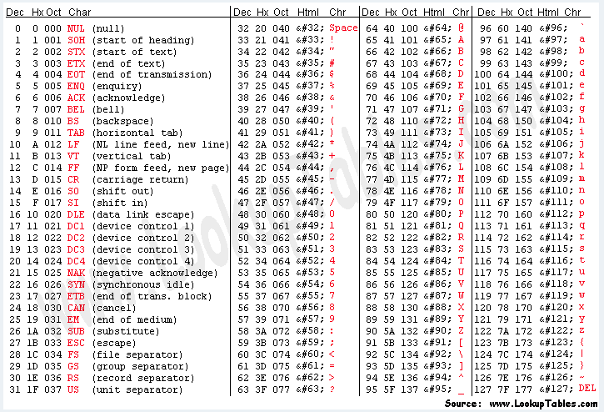
Lab1b – Printing a hexadecimal number
Now have R0 with x0000 0000 0000 1100
What happens if we call OUT now?
Tries to print xC to the console which is the character for a new page.
How can we correctly print ‘C’ to the console given x1100?
Need to convert x1100 to ASCII letter ‘C’ which is x43 (x0100 0011)
Do we need to check the number in R0 before adding any offsets?
Yes!
Which offsets do we need to add?
x30 for 0 – 9 and x41 for A – F

Slide 13
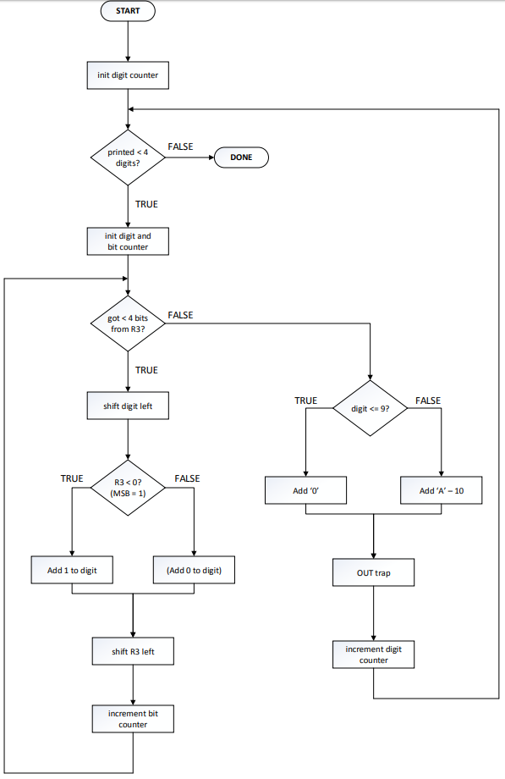
Lab1b Flowchart

