Slide 1
ECE220 Lab4

Slide 2
Brain Teaser – Swapping Data
Version 1
void swap(int *x, int *y) {
int temp = *x;
*x = *y;
*y = temp;
}
Version 2
void swap(int *x, int *y) {
*x ^= *y;
*y ^= *x;
*x ^= *y;
}

Slide 3
Brain Teaser – Fun with Pointers
Multi-line vs one-line initialization
int a = 1; int b = 2;
int a = 1, b = 2;
int* a_p = &a; int* b_p = &b;
int *a_p = &a, *b_p = &b;
Double pointers
int a = 1, b = 2;
int *a_p = &a, *b_p = &b;
int **a_p_p = &a_p, **b_p_p = &b_p;
*a_p_p = &b; //What changes?
a
1
2
b
a_p
b_p
a_p_p
b_p_p

Slide 4
Function Pointers
Add function
int add(int x, int y) {
return x + y;
}
Main function
int main() {
int (*add_ptr)(int, int) = &add;
int sum = (*add_ptr)(2, 3);
}
Passing as parameter
int add2to3(int (*add_ptr)(int, int)) {
return (*add_ptr)(2, 3)
}
Return value
int (*much_confusion(int x))(int, int) {
printf(“%Got parameter %d\n”, x);
int (*add_ptr)(int, int) = &add;
return add_ptr
}

Slide 5
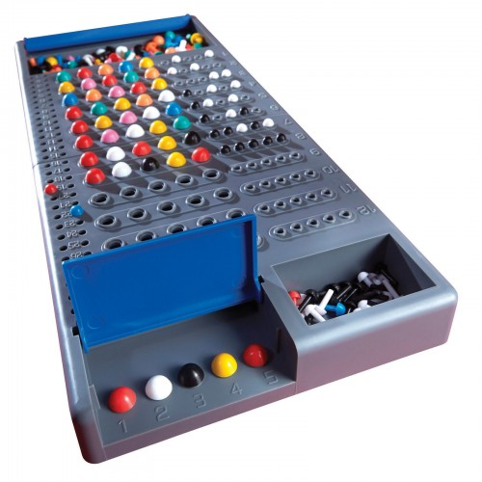

MP4 - Codebreaker
Implement game of Mastermind
only elements things to guess
elements $∈\left[1, 8\right]$ rather than colors
Feedback
perfect or misplaced matches
Example:
Actual: 1357, guess: 9753
Perfect: 5
Misplaced 7, 3
Implement using pointers or arrays

Slide 6
MP4 User input
Program only takes a single number as input:
1234
123abc, abc123, 3 5
sscanf(const char * s, const char * format) – reads data from s and parses input like scanf
char *sentence = “I am a 1337 h4x0r”
int x;
sscanf(sentence, “%d”, &x);
MP4 usage:
int x; char post[2];
sscanf(input, “%d1s”, &x, post);
String | X | Post | retval
“ca75” | N/A | N/A | 0
“1015” | 1015 | N/A | 1
“5afe” | 5 | “afe” | 2

Slide 7
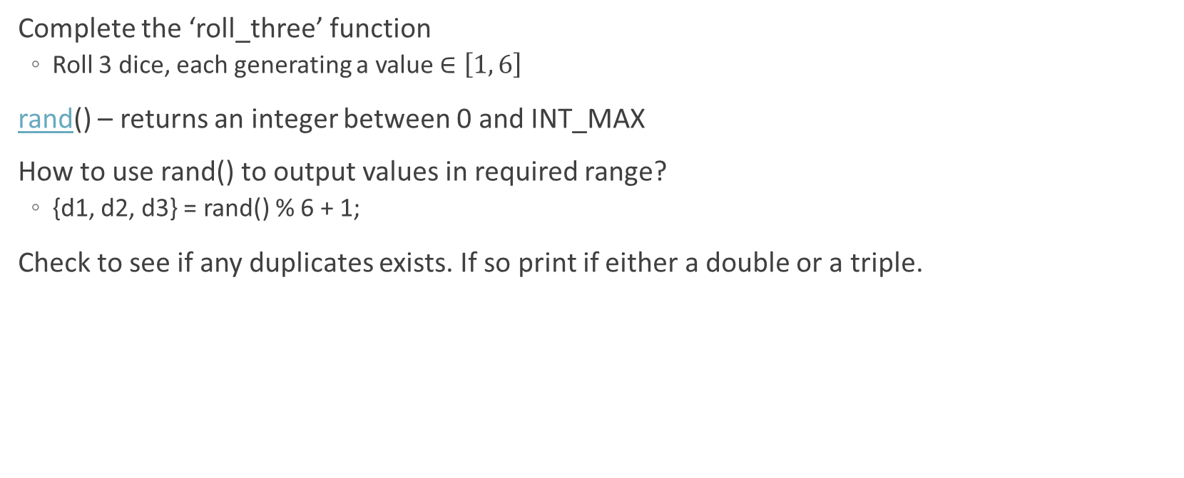
Lab4 – Rolling Dice
Complete the ‘roll_three’ function
Roll 3 dice, each generating a value $∈\left[1, 6\right]$
rand() – returns an integer between 0 and INT_MAX
How to use rand() to output values in required range?
{d1, d2, d3} = rand() % 6 + 1;
Check to see if any duplicates exists. If so print if either a double or a triple.

