Slide 1
ECE220 Lab7

Slide 2
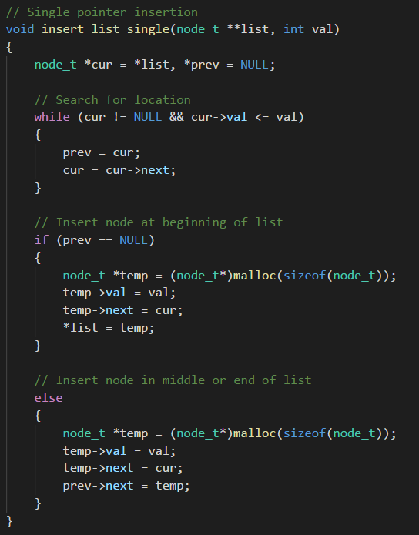

Brain Teaser – Linked List In-order insertion
Design an algorithm to insert elements into a linked list in-order. For example, given the list and element 8, an in-order insertion would look like:
Before: $1→3→9$
After: $1→3→8→9$
Solution
Use two pointers, prev and cur, to keep track of the previous node and the current node.
Iterate cur until it reaches the end of the list or find place to insert
Insert element into the list but handle case where insertion happens at the very beginning.

Slide 3
Brain Teaser – Single Pointer Insertion
Inserting 8
Inserting 0
1
3
9
1
3
9
prev
cur
prev
cur
1
3
9
0
1
3
9
prev
cur
prev
cur
1
3
9
prev
cur
1
3
8
9
prev
cur

Slide 4
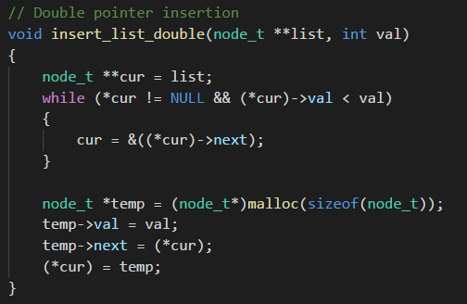
Brain Teaser – Linked List In-Order Insertion with Double Pointers
Use a double pointer to do insertion rather than single pointer
Advantages
Only needs a single ‘pointer’
Less logic and can handle any insertion point in the list
Disadvantages
Traversing and accessing list requires more thought

Slide 5
Brain Teaser – Single Pointer Insertion
Inserting 8
Inserting 0
head
1
3
9
head
1
3
9
cur
head
1
3
9
cur
head
head
cur
0
1
3
9
1
3
9
cur
head
cur
1
3
8
9
cur

Slide 6
List insertion – Side by Side Comparison

Slide 7
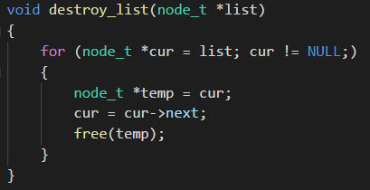
Brain Teaser – Freeing a list
How to completely free a list?
Solution
Iterate through each node in list
Free each node individually but need to watch out when freeing so that can still access later elements

Slide 8
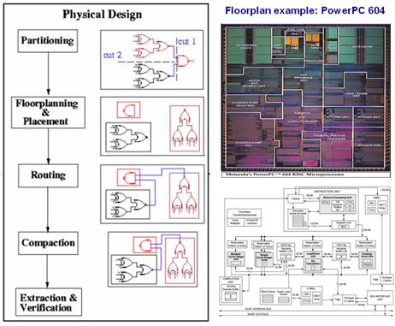
MP7 – Optimizing Floorplans
Floorplanning is the process of assembling partitioned circuit modules in an optimal fashion to maximize some metric.
Implement a floorplanner to layout module and optimize packing area.

Slide 9
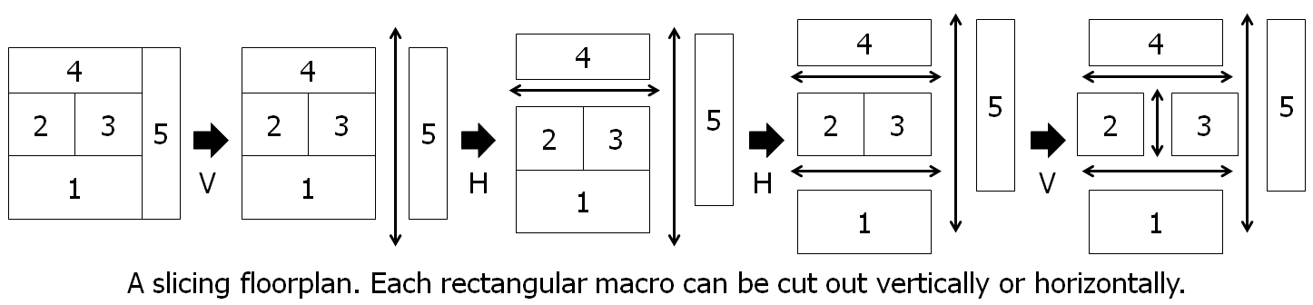
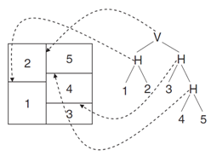

MP7 – Floorplan Models
Modules in a floor plan can be cut horizontally or vertically.
Floorplans can be represented as trees and have a corresponding postfix expression
Postfix expression for lower image is
$12H345HHV$

Slide 10
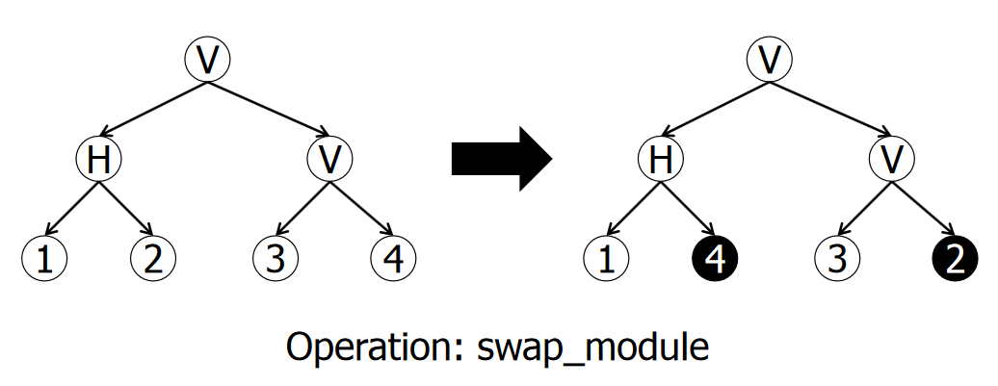
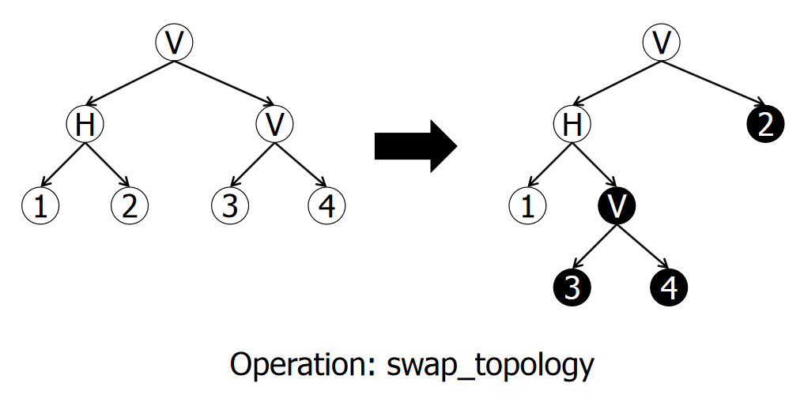
MP7 – Floorplan Functions
Functions to implement
init_slicing_tree – generate an initial slicing tree
get_expression – perform a postfix traversal on the slicing tree and extract expression
recut – change the cutline of an internal node
rotate – swap the height and width of a module
swap_module – swap two modules from two leave nodes (do this by swapping pointer values rather than actual pointers)
swap_topology – swap two subtrees rooted at two given node pointers by modifying the node links appropriately

Slide 11
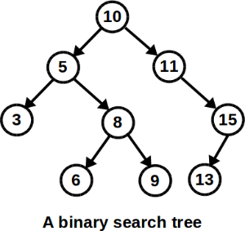
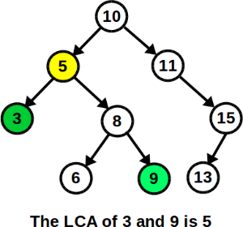
Lab7 – Lowest Common Ancestor
Given a binary search tree (BST), find the lowest common ancestor of two nodes.
Hint: use the special property of a (BST) to figure out what the lowest common ancestor is. If this was a general tree, then you would have to do a recursive search to find the lowest common ancestor.

Slide 12

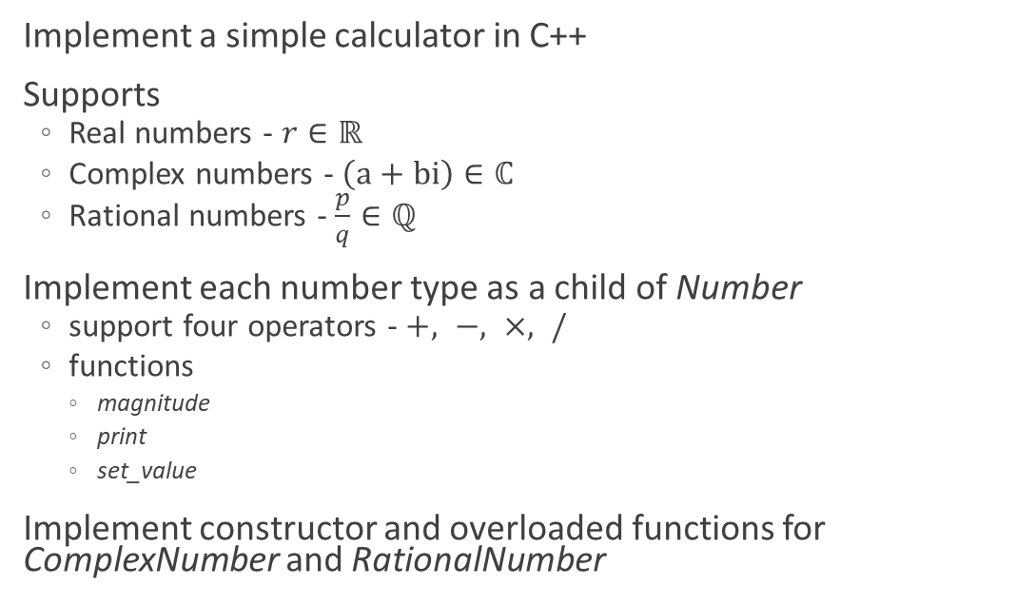
MP8 – C++ Calculator
Implement a simple calculator in C++
Supports
Real numbers - $r∈ℝ$
Complex numbers - $\left(a+bi\right)∈ℂ$
Rational numbers - $\frac{p}{q}∈ℚ$
Implement each number type as a child of Number
support four operators - $+, −, ×, /$
functions
magnitude
print
set_value
Implement constructor and overloaded functions for ComplexNumber and RationalNumber

Slide 13
Lab8 – C++ Classes
Familiarize with various C++ concepts and implement them
Constructor (and destructor)
Setter and getter functions
Operational overloads
Implement methods of Rectangle class
Utilize implementation previous implementation to perform computations on a list of Rectangles.

