Slide 1
ECE220 Lab5

Slide 2
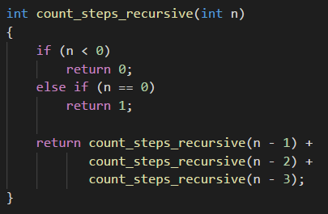
Brain Teaser - Recursion
Design a recursive algorithm
A child going up a staircase with n steps, can hop up 1, 2, or 3 steps at a time. How many ways can the child reach the top?
Solution
Recursively call count_steps_recursive with decremented count.

Slide 3
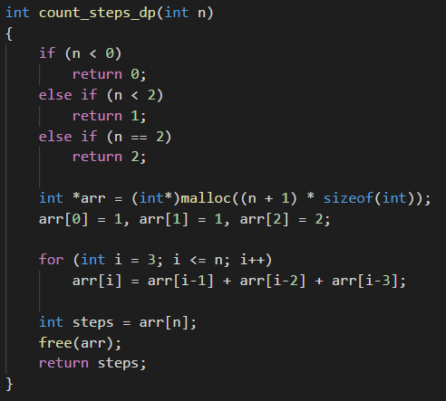
Brain Teaser – Dynamic Programming
Can we improve algorithm using concepts learned two weeks ago?
Hint: pointers, arrays
Solution
Create an array to store counts for each step.
Dynamic vs static memory allocation
Dynamic
malloc: int *arr = (*int)malloc(size_t size);
Static
VLAs: int arr[size];
alloca: int *arr = (*int)malloc(size_t size);

Slide 4
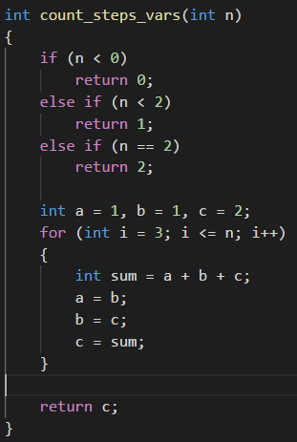

Brain Teaser – Further improvements
Can we further improve algorithm?
Solution:
Replace array with variables.
Array will be stored in cache/RAM
Variables will be stored in registers
Computer Memory Hierarchy (2012)
Registers: 1 clock cycle
L1 cache: 0.5 ns
L2 cache: 7 ns
RAM: 100 ns
SSD: 150 $μ$s

Slide 5
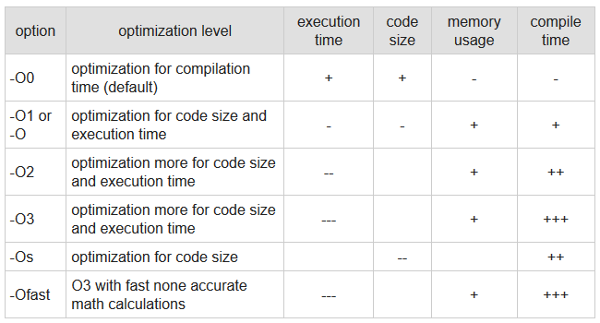

Brain Teaser – Measuring Performance
Compilation:
gcc –Ox main.c
Elapsed times for –O0 and $n=35$:
count_steps_recursive: 10.23 s
count_steps_dynamic: 2e-6 s
count_steps_vars: 1e-6 s
Elapsed times for -0fast and $n=35$:
count_steps_recursive: 8.02 s
count_steps_dynamic: 3e-6 s
count_steps_vars: 1e-6 s

Slide 6
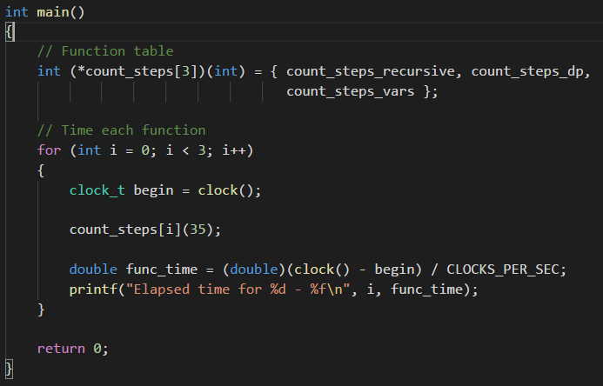
Measuring Execution Time

Slide 7
Solving Sudoku
 | 4 | 9 |  |  | 3 |  | 7
 | 2 |  | 5 | 4 |  | 3
 |  |  | 8 | 9 |  |  | 4
9 |  | 5 |  | 2 |  |  | 8 | 1
4 | 7 |  |  | 8 |  | 9 |  | 6
 | 8 |  |  | 7 | 2
 |  | 6 |  | 5 | 8 |  | 1
 | 5 |  | 1 |  |  | 8 | 6
1 | 4 | 9 | 2 | 3 | 3 |  | 7
 | 2 |  | 5 | 4 |  | 3
 |  |  | 8 | 9 |  |  | 4
9 |  | 5 |  | 2 |  |  | 8 | 1
4 | 7 |  |  | 8 |  | 9 |  | 6
 | 8 |  |  | 7 | 2
 |  | 6 |  | 5 | 8 |  | 1
 | 5 |  | 1 |  |  | 8 | 6
1 | 4 | 9 | 2 | 6 | 3 | 5 | 7 | _
 | 2 |  | 5 | 4 |  | 3
 |  |  | 8 | 9 |  |  | 4
9 |  | 5 |  | 2 |  |  | 8 | 1
4 | 7 |  |  | 8 |  | 9 |  | 6
 | 8 |  |  | 7 | 2
 |  | 6 |  | 5 | 8 |  | 1
 | 5 |  | 1 |  |  | 8 | 6

Slide 8
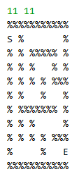
MP6 – Mazes
Solving mazes
Start at S and end at E
Ideas on how to solve?
Recursion
Depth first search algorithm
At each cell, check which surrounding four cells are available
Blue circle has one path
Green circle has three paths
Mark cells to prevent infinite recursion
Basic algorithm on the wiki

Slide 9
Lab6 – Vector Data Structure
Arrays
Statically allocated in sense that size is fixed
Vectors
Dynamically allocated data structure (at least in higher-level languages)
Methods:
vector_t *createVector(int initialSize);
void destroyVector(vector_t *vector);
void resize(vector_t *vector);
void push_back(vector_t *vector, int element);
int pop_back(vector_t *vector);
int access(vector_t *vector, int index);
Valgrind
Memory debugging, memory leak, detection, and profiling tool.
Check if you have any memory leaks.

