Slide 1
ECE220 Lab5

Slide 2
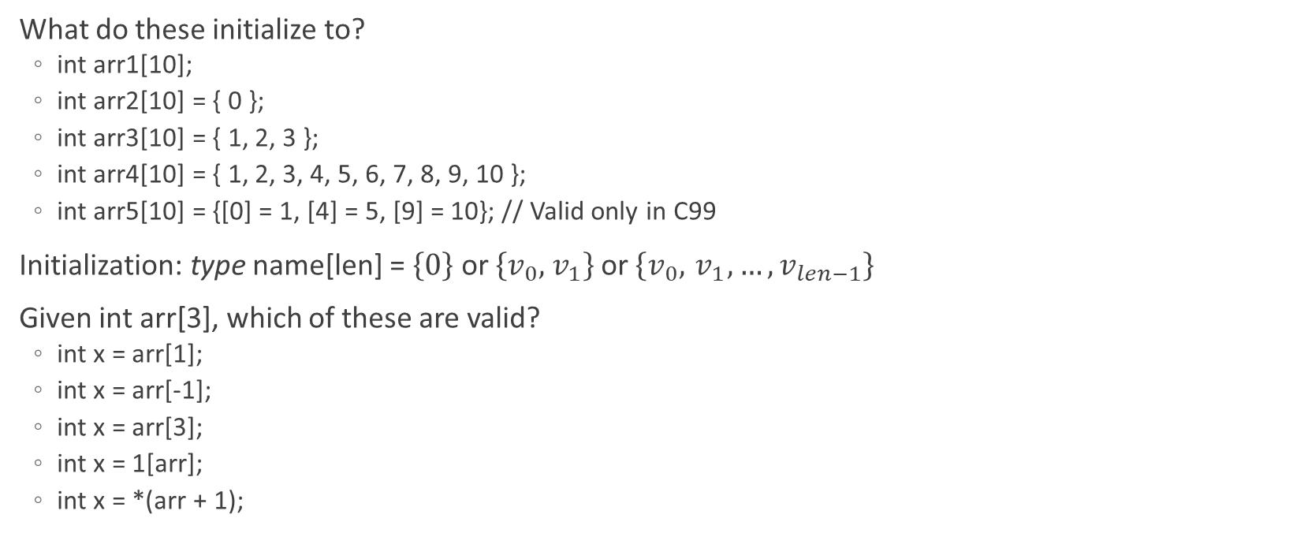
Brain Teaser - Array Initialization
What do these initialize to?
int arr1[10];
int arr2[10] = { 0 };
int arr3[10] = { 1, 2, 3 };
int arr4[10] = { 1, 2, 3, 4, 5, 6, 7, 8, 9, 10 };
int arr5[10] = {[0] = 1, [4] = 5, [9] = 10}; // Valid only in C99
Initialization: type name[len] = $\left\{0\right\}$ or $\left\{v_{0},{ v}_{1}\right\}$ or $\left\{v_{0},{ v}_{1}, …,v_{len−1}\right\}$
Given int arr[3], which of these are valid?
int x = arr[1];
int x = arr[-1];
int x = arr[3];
int x = 1[arr];
int x = *(arr + 1);

Slide 3
sizeof() Operator
sizeof() – returns the size of a variables in bytes
Examples
sizeof(char) = 1
sizeof(int) = 2 or 4 depending on system
sizeof(long) = 4
sizeof(float) = 4
sizeof(double) = 8
sizeof(char[10]) = 10
Computing size of an array
int arr = {1, 2, 3, … }
size_t n = sizeof(arr) / sizeof(arr[0]);

Slide 4
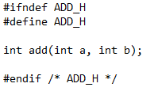
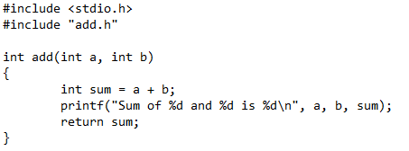
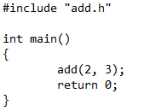
Structure of C Files
File types:
header file (*.h) – contains function declarations to be shared between source files
source files (*.c) – defines functions declared in header files and uses them
Example
add.h
add.c
main.c

Slide 5
Header and Source Files
Header files
Header guards
If constant ADD_H not defined, then define it
Prevents a header file from being included multiple times
Function declarations
Start of a function but ends in with a semicolon
Tells source files that functions exist, in this case the ‘add’ function
Source files
Includes the header file
Defines function included in the header file with actual code
Corresponding names
<filename>.c and <filename>.h convention

Slide 6
Compiling C Programs
Includes
#include <filename> - searches for system wide header files
#include “” – searches for local (same directory) header files
#include literally copies contents of filename.h into location
Compilation
Object compilation
Every *.c file is individually compiled into a separate object files *.o
Source files know included functions exist but don’t know where
Linking
Looks at indexes of object files and tries to solve dependencies between them
Generates a single executable program

Slide 7
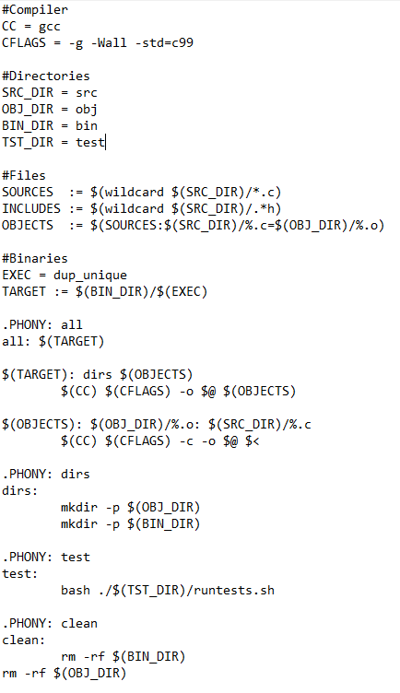
Lab Makefile
Compilation
Object compilation at $(OBJECTS)
Linking at $(TARGET)
Make commands
all (Default) – creates required directories and compiles code
dirs – creates obj and bin directories
test – runs tests to test your program
clean – removes files generated by all

Slide 8
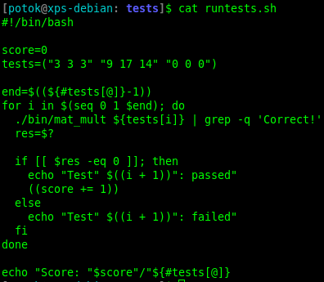
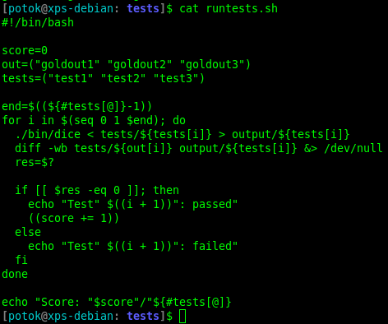
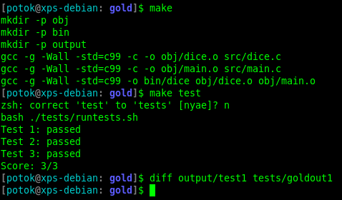
Lab Testing
Lab 4
Lab 5

Slide 9
MP5 – Conway’s Game of Life
Conway’s Game of Life
Cellular automaton whose evolution is determined by its initial state
Cell states
Alive – black
Dead – white
Neighborhood
Adjacent 8 cells around the central cell
Rules
Any live cell with 2 or less neighbors dies (under population)
Any live cell with 2 or 3 neighbors lives
Any live cell with 3 or more neighbors dies (over population)
Any dead cell with 3 live neighbors is reborn (reproduction)
This Photo by Unknown Author is licensed under CC BY-SA

Slide 10

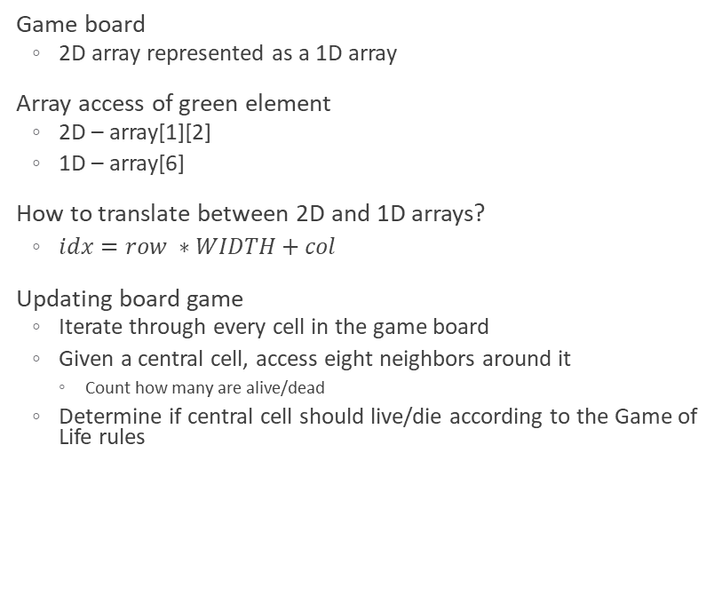
MP5 – Game Board
Game board
2D array represented as a 1D array
Array access of green element
2D – array[1][2]
1D – array[6]
How to translate between 2D and 1D arrays?
$idx=row ∗WIDTH+col$
Updating board game
Iterate through every cell in the game board
Given a central cell, access eight neighbors around it
Count how many are alive/dead
Determine if central cell should live/die according to the Game of Life rules
2D array
$\left[\begin{matrix}0 & 0 & 0 & 1 \\ 0 & 0 & 1 & 0 \\ 0 & 0 & 1 & 1 \\ 0 & 1 & 0 & 0\end{matrix}\right]$
1D array
$\left[\begin{matrix}0 & 0 & 0 & 1 & 0 & 0 & 1 & 0 & 0 & 0 & 1 & 1 & 0 & 1 & 0 & 0\end{matrix}\right]$
Neighborhood
$\left[\begin{matrix}N & N & N \\ N & C & N \\ N & N & N\end{matrix}\right]$

Slide 11
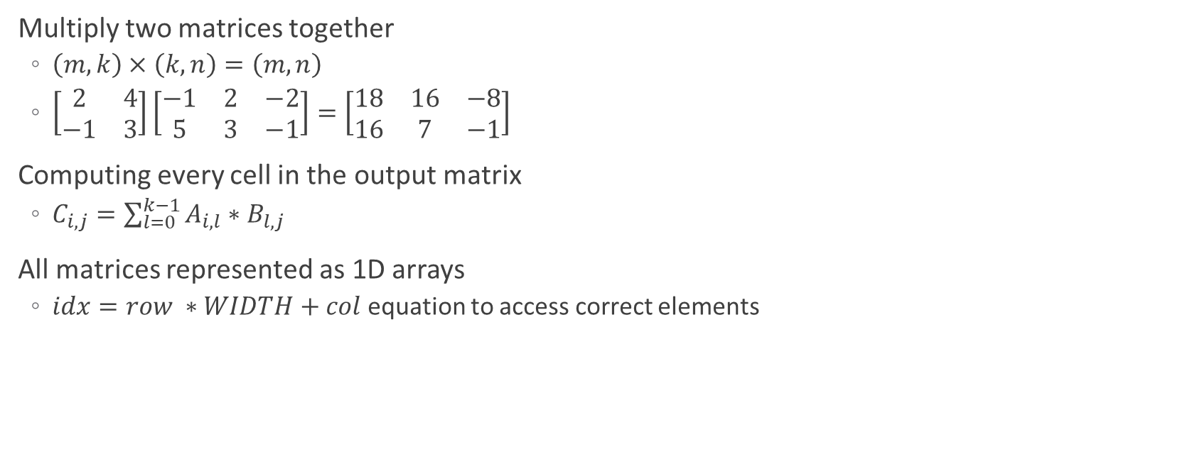
Lab5 – Matrix Multiplication
Multiply two matrices together
$\left(m, k\right)×\left(k, n\right)=\left(m, n\right)$
$\left[\begin{matrix}2 & 4 \\ −1 & 3\end{matrix}\right]\left[\begin{matrix}−1 & 2 & −2 \\ 5 & 3 & −1\end{matrix}\right]=\left[\begin{matrix}18 & 16 & −8 \\ 16 & 7 & −1\end{matrix}\right]$
Computing every cell in the output matrix
$C_{i,j}=\sum_{l=0}^{k−1}{A_{i, l}∗B_{l,j}}$
All matrices represented as 1D arrays
$idx=row ∗WIDTH+col$ equation to access correct elements

