Slide 1
ECE220 Lab3

Slide 2

Brain Teaser – Printing Decimal
Printing in hexadecimal
Shift 4 bits from MSB into the LSB
Convert into ASCII
Repeat 4 times
Printing in decimal
x24 $→$ 36
?!?!
Two Solutions

Slide 3

Brain Teaser – Printing Decimal Solution 1
Printing in decimal
x24 $→$ 36
Hint: how to extract digits from a string?
Solution
Divide hex number by 10
x0024 / x000A = x0003 R x0006
x0003 / x000A = x0000 R x0003
Store computed results: 6 3
Print in reverse order
How is division implemented in LC3?
Subtract dividend by divisor
Increment subtraction count
Loop while dividend $≥$ 0
Is there another method of converting?

Slide 4

Brain Teaser – Printing Decimal Solution 2
Printing in decimal
x24 $→$ 36
Solution
Store powers of 10
Powers of 10 in hex …, x03E8, x0064, x000A, x0001
Subtract each power of 10 from hex number
100:
x0024 – x0064 = x0000 R x0024; count = 0
10
x0024 – x000A = x001A R x0000; count = 0
x001A – x000A = x0010 R x0000; count = 1
x0010 – x000A = x0006 R x0000; count = 2
x0006 – x000A = x0000 R x0006; count = 3
1
x0006 – x0001 = …; count = 6
Print numbers an compute: 0, 3, 6
Which solution is faster, 1 or 2?
Both use similar amounts of memory
Solution 2 performs less subtractions

Slide 5
Endianness
What is endianness?
Sequential order in which byes are stored in memory
Given a value of xS010
Big Endian
Least significant bits stored in highest memory address
Examples: Internet protocols
Little Endian
Least significant bits stored in lowest memory address
Examples: LC3, x64
0 | 1 | 2 | 3
S | 0 | 1 | 0
0 | 1 | 2 | 3
0 | 1 | 0 | S

Slide 6
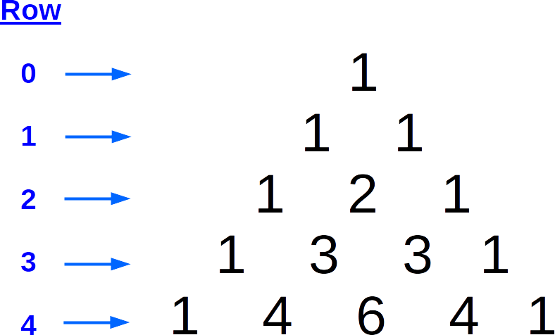

MP3 – Pascal’s Triangle
Pascal’s triangle
Array of binomial coefficients of ${\left(x+y\right)}^{n}$
${\left(x+y\right)}^{2}=x^{2}+2xy+y^{2}$
Combinations $\left(\begin{matrix}n \\ k\end{matrix}\right)=\frac{\left(n!\right)}{k!\left(n−k\right)!}$
$\left(\begin{matrix}3 \\ 0\end{matrix}\right)=1,\left(\begin{matrix}3 \\ 1\end{matrix}\right)=3,\left(\begin{matrix}3 \\ 2\end{matrix}\right)=3,\left(\begin{matrix}3 \\ 3\end{matrix}\right)=1$
Problem
Compute the $nth$ row of the triangle
Algorithm
For a given $n$, compute each of the $\left(\begin{matrix}n \\ k\end{matrix}\right)$ terms

Slide 7
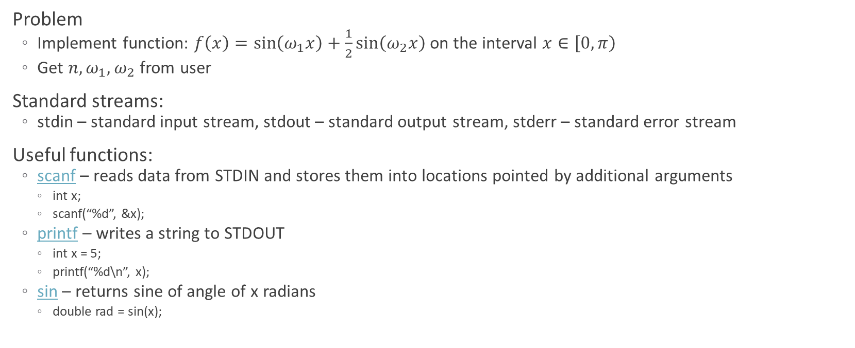
Lab 3 – Computing a math function
Problem
Implement function: $f\left(x\right)=\sin\left(ω_{1}x\right)+\frac{1}{2}\sin\left(ω_{2}x\right)$ on the interval $x∈\left[0, π\right)$
Get $n, ω_{1}, ω_{2}$ from user
Standard streams:
stdin – standard input stream, stdout – standard output stream, stderr – standard error stream
Useful functions:
scanf – reads data from STDIN and stores them into locations pointed by additional arguments
int x;
scanf(“%d”, &x);
printf – writes a string to STDOUT
int x = 5;
printf(“%d\n”, x);
sin – returns sine of angle of x radians
double rad = sin(x);

